Slide 1
Miłosz Nasierowski (429632)
Masaryk University
Spring 2014
What is Post-traumatic Stress Disorder (PTSD)?

Slide 2

What is post-traumatic stress disorder, or PTSD?
It is an anxiety disorder that some people get after seeing or living through dangerous, traumatic events such as sexual assault, war, violence, natural catastrophies, car accidents, plane crashes etc..
http://youtu.be/cIXEkLY5D5U

Slide 3
Some facts about PTSD:
every third person have some traumatic experience in their life. 10-20% from it change into PTSD.
3-6% of human population have PTSD.
60-80% of people with ptsd are drug/alcohol abusers.

Slide 4
History of PTSD
First observations were made in American Civil War and I World War. (Charcot) connection between trauma and histeria.
Next observation was in II World War by Mc Farlane.
Soldiers with bad „personality” were not accepted (25%),but that didnt change situation.
Next research on people from concetration camps, then on Korean war veterans and Vietnam war veterans.

Slide 5
M.j.Horowitz concept
catastrophic events provide large amounts of information coming from the outside, from which most can not stay adjusted to the individual cognitive schemas due to the fact the they are outside the range of normal experience. In consequence there is an information overload. Unprocessed information does not remain separated from consciousness, staying in untreated, active, raw form. Their maintenance beyond consciousness is sustained by denial and numbness.
1980 - DSM III – disorder after traumatic experience
1992 - in ICD 10

Slide 6
Traumatic events that can lead to PTSD include:
War.
Natural disasters.
Car or plane crashes.
Terrorist attacks.
Sudden death of a loved one.
Rape.
Kidnapping.
Assault.
Sexual or physical abuse.
Childhood neglect.
And more...

Slide 7
Symptoms of PTSD
1. Re-experiencing symptoms:
• Flashbacks—reliving the trauma over and over, including physical symptoms like a racing heart or sweating.
• Bad dreams.
• Frightening thoughts.

Slide 8
Avoidance symptoms:
• Staying away from places, events, or objects that are reminders of the experience.
• Feeling emotionally numb.
• Feeling strong guilt, depression or worry.
• Losing interest in activities that were enjoyable in the past.
• Having trouble remembering the dangerous event.

Slide 9
Hyperarousal symptoms:
• Being easily startled.
• Feeling tense or “on edge”.
• Having difficulty in sleeping, and/or having angry outbursts.

Slide 10
Children and teens can have extreme reactions to trauma, but their symptoms may not be the same as adults. In very young children, these symptoms can include:
• Bedwetting, when they’d learned how to use the toilet.
• Forgetting how or being unable to talk.
• Acting out the scary event during playtime.
• Being unusually clingy with a parent or other adult.

Slide 11
To be diagnosed with PTSD, a person must have all of the following for at least 1 month after at least 1 month:
• At least one re-experiencing symptom.
• At least three avoidance symptoms.
• At least two hyperarousal symptoms.
• Symptoms that make it hard to go about daily life, go to school or work, be with friends, and take care of important tasks.

Slide 12

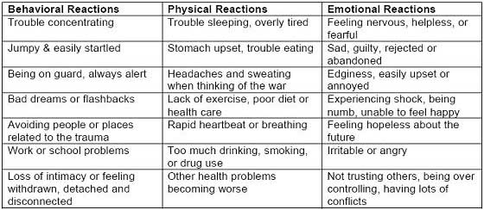

Slide 13
Treatment for PTSD
Cognitive behavioral therapy (CBT). There are several parts to CBT, including:
• Exposure therapy. This therapy helps people face and control their fear. It exposes them to the trauma they experienced in a safe way. It uses mental imagery, writing, or visits to the place where the event happened. The therapist uses these tools to help people with PTSD cope with their feelings.
• Cognitive restructuring. This therapy helps people make sense of the bad memories. Sometimes people remember the event differently than how it happened. They may feel guilt or shame about what is not their fault. The therapist helps people with PTSD look at what happened in a realistic way.
• Stress inoculation training. This therapy tries to reduce PTSD symptoms by teaching a person how to reduce anxiety. Like cognitive restructuring, this treatment helps people look at their memories in a healthy way.

Slide 14
Dynamic psychotherapy
This includes the development phase, in which there is injury, reactivates hidden injuries from earlier phases of development and takes into account the social context of existing during and after trauma.
Hipnotheraphy
Not very popular and has smaller efficiency than CBT. But sometimes used as an addition to CBT.
EMDR (Eye Movement Desensitization and Reprocessing) (F.Shapiro)
http://youtu.be/OlfQIRJEsYk
When a traumatic or distressing experience occurs, it may overwhelm normal cognitive and neurological coping mechanisms. The memory and associated stimuli are inadequately processed and stored in an isolated memory network. The goal of EMDR therapy is to process these distressing memories, reducing their lingering effects and allowing clients to develop more adaptive coping mechanisms.

Slide 15
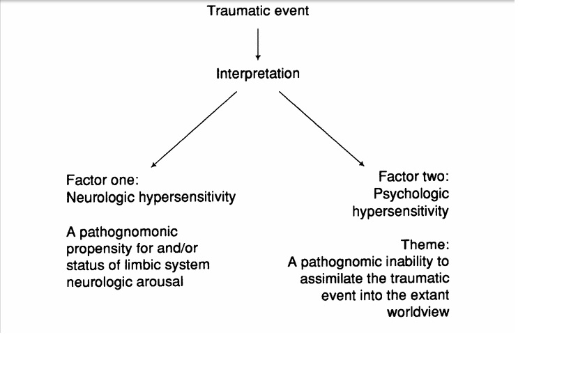
Neurocognitive therapy (G.S. Everly)
4 categories of intervention:
withdrawal of the person from the stressful, overly stimulating conditions.
Encourage to catharsis experience.
behavioral interventions that cause relaxation response and the use of psychotropic drugs.

Slide 16
Group Therapy
Its based on group support for victims. Work in groups reduces feeling of loneliness and isolation and increase feeling of acceptance and belonging to the group and society.

Slide 17
To all types of therapy, it is common to use some types of strategy:
Supporting adaptive behaviours (reducing external expectations, resting, relaxation, vizualization, talking to yourself, pharmacology).
Normalization of some behaviours which can be seen as disorder.
reducing avoidance; by avoiding the processing of traumatic experience, it remains toxic.
change attribution on the meaning of the trauma.

Slide 18
Bibliography
Holiczer, Gałuszko, Cubała, (2007); Post-traumatic stress disorder. Evolution of the concept and therapeutic approaches. Via Medica.
National Institute of Mental Health ,U.S. Department of Health and Human Services; Post-Traumatic Stress Dissorder (PTSD)
http://www.google.cz/books?hl=pl&lr=&id=2_WiYestq0cC&oi=fnd&pg=PA241&dq=EMDR+(Eye+Movement+Desensitization+and+Reprocessing)&ots=ib7RHzq_pA&sig=NXuaZ0dYzzyj8Iqak8uuPzJ0Wko&redir_esc=y#v=onepage&q=EMDR%20(Eye%20Movement%20Desensitization%20and%20Reprocessing)&f=false
http://www.nimh.nih.gov/health/topics/post-traumatic-stress-disorder-ptsd/index.shtml
http://www.helpguide.org/mental/post_traumatic_stress_disorder_symptoms_treatment.htm
http://www.ncbi.nlm.nih.gov/pmc/articles/PMC3083990/

