Slide 1
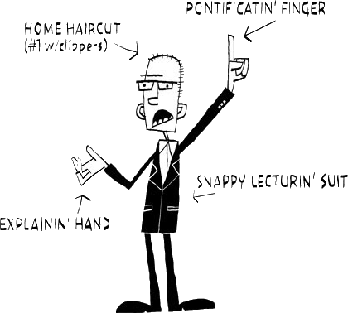
Presentation Skills
Compiled by A.Krittaya
Notes:
Identifying personal strengths and areas for development
Expressing yourself– verbally and in presentation format
Non-verbal behaviour (e.g. eye contact and posture)
on “Effective Communication Skills” e.g. how to address an audience; using Ppt etc.

Slide 2
Outline:
  Introductions
  Self-Assessment
Planning Presentations
Preparing Presentations
Practicing Presentations
Delivering Presentations
Dealing with Questions

Slide 3

Outline :
Miscellaneous Tips
Wrap up

Slide 4
Introduction: Read this for 1 min.
You are going to learn how to make an effective presentation. Presentations skills are important in general: during your study, and also later in your career. Presentations can have different objectives: to inform, to sell something, to persuade someone, or to train people.
Academic presentations are mainly meant for informing and training.

Slide 5

What is irritating during presentations?
The speaker…?
the speaker is nervous
is disorganised
never looks at the audience
is monotonous
his/her speech is confusing; what he/she is trying
to tell the audience.
his/her clothing is bad
the visuals are bad

Slide 6
Self Assessment
Assess yourself:
Speaking too quickly
Going off-point
Supplying too many details
What are you good at?
What skills would you like to develop?

Slide 7
What is a good presenter?
It is said…
“A presenter should be like a mini skirt:
Long enough to cover the vital parts,
and short enough to attract attention.”

Slide 8

Steps in Giving Presentation
Plan
  2. Prepare
  3. Practice
  4. Present
Notes:
Importance of the 4 processing steps

Slide 9

1. Planning

Slide 10
Questions?
Who is your audience?
Why are they there?
What is your goal?
How long will it be?
Where will it take place?
Notes:
Remember, the audience could always just read your handout if information transfer were the only purpose of the presentation.

Slide 11
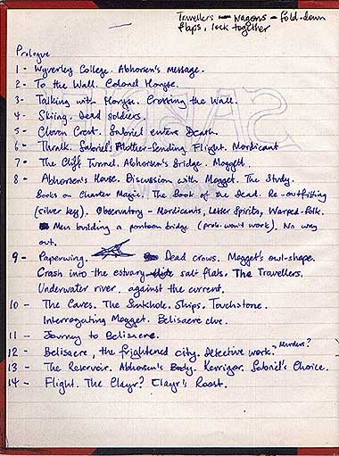
Start Your Outline
Pen & Paper
Key points
Order your thoughts
Notes:
What are the key points?
Logical Flow

Slide 12

Structure
Presentation structure is paramount, so
have CLEAR structure

Slide 13
The basic structure of a talk:
Introduction
Main part (body)
Conclusion
Question & Answer session

Slide 14
Structure
Introduction
Get Attention
Main theme
Content
Summary/
Conclusions
Key message
Notes:
Facts in logical order
Re-state your main points
People remember the last thing that they are told. So the ending of the presentation is key.

Slide 15



Presentation Slide

Slide 16

2. Preparation

Slide 17
3 friends
1. Personal Notes
2. Visuals
3. Handouts
Notes:
Personal Notes: used as a reminder of the topics and key points. Words should be spontaneous to the audience.
Illustrative Slides: illustrations should be relevant. Data, graphs, photographs , etc. are helpful.
Handouts: the references, the data, the appendices and detailed info. are in there so that the reader can use later on to remember the points of the talk and to further study and analysis.

Slide 18
Things to avoid….

Slide 19
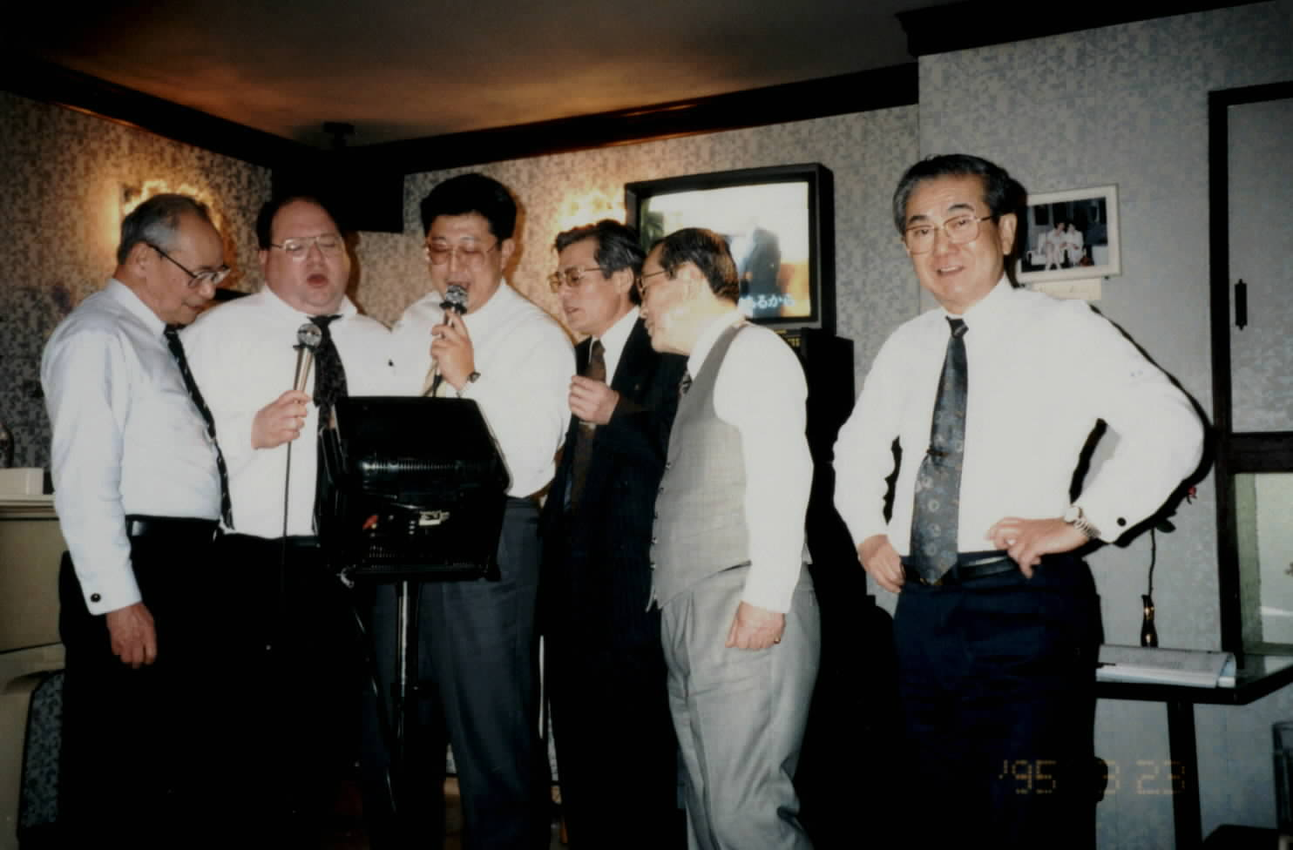
Ppt. Karaoke

Slide 20
Poor Ppt.
The evils of Ppt include:
    Too much text
    Too small to read
    a-million-time-seen clip art & slide templates
    too many bullets– it makes the info. dull for the audience.
    Spinning animations
Notes:
- Use a consistent visual theme throughout your presentation. - Avoid using ubiquitous Ppt Design Template.
- Shy away from too much text otherwise why you are there. People read quicker than you can talk, so they’ll have finished reading your slide and be waiting for the next one.
- Lure your audience to focus more on you not your presentation—deliver an equally interesting presentation.

Slide 21
A few guidelines

Slide 22
10-20-30 rule
“10 slides, no more than 20 minutes, and font≥ 30 points.”
Notes:
10 slides in a Ppt presentation (a human being cannot comprehend more than 10 concepts in a meeting)
20 minutes for 10 slides, and the rest for discussion
30 More text is more convincing. Use big font: it helps you find salient points and to know where you are.

Slide 23
More info.
Font Types & Size
Never use sentences
Notes:
Use the same font set throughout your presentation, and no more than 2 fonts (There are 2 main font sets: a Serif font (e.g., Times New Roman used for lots of texts) and a Sans-Serif font (Helvetica or Arial used for screen presentations ). Gill Sans and Trebuchet in between and friendly. Make sure the text can be read from the back of the room.

Slide 24
Colour
Use colour well
Notes:
Pick 3 colours and stick to them. Color evokes feelings & emotions. The right color can help persuade and motivate.
-a dark background with white text.
-a white background with black or dark text

Slide 25

High quality images
Use images to support your point
Use a consistent theme
Notes:
Free Stock Photos Commercial Stock Photos
http://www.sxc.hu/ www.istockphoto.com

Slide 26
Compare these!

Slide 27
Attending College
“Overall, our findings provide a combined retention rate of 92.40 % for students who attended TCD. This is very close to the previous year’s rate of 92.45%. It should be noted that these results should be interpreted on a tentative basis as it is clear that a number of other outside factors impact on a student’s ability to sustain and progress in their chosen area of study at third level.”
15,000 students come to Trinity every year
There are 3 Faculties
Morgan 2001 A study of non-completion in undergraduate University courses
The average non-completion rate across Irish Universities is 16.8%
Improve all students chances of achieving their maximum potential
Connect with students – building relationships, departmental receptions
51% of college students leave college because of lack of effective supports

Slide 28


Slide 29
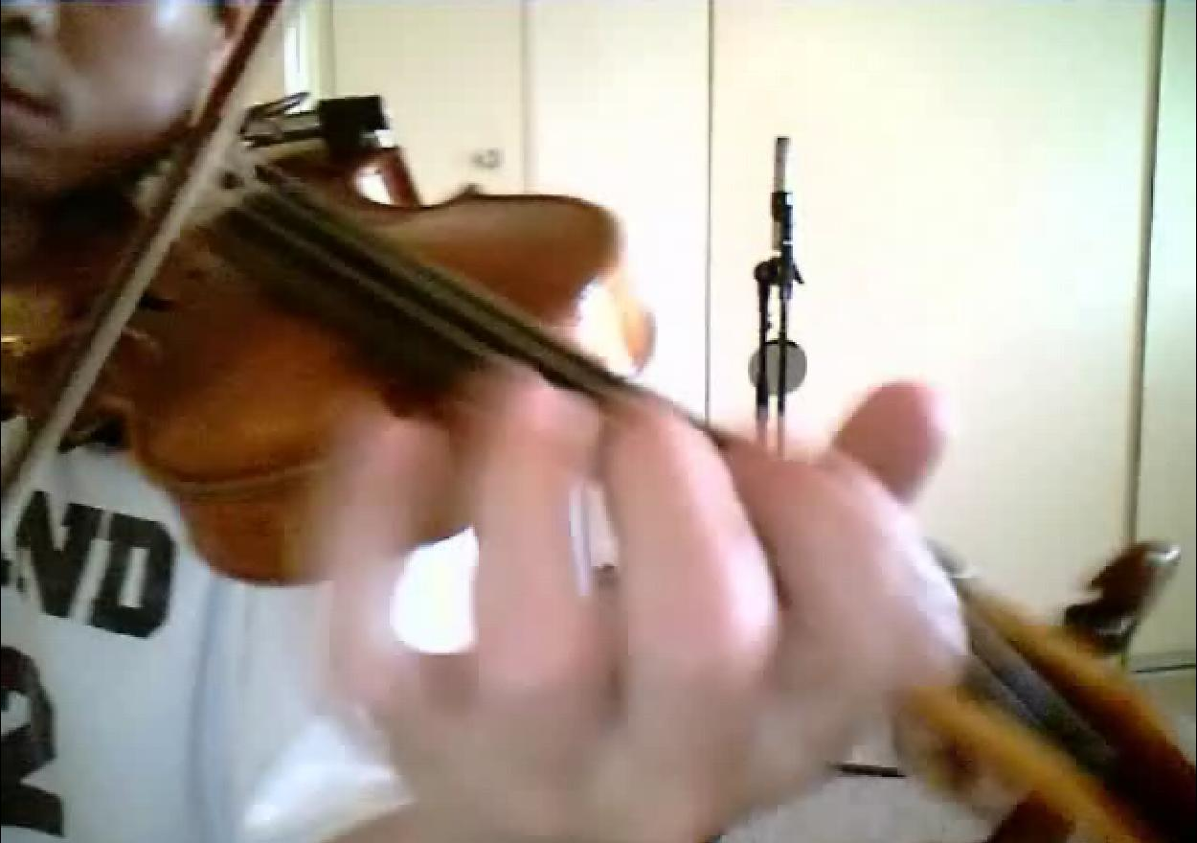
3. Practice
Notes:
According to most studies, people's number one fear is public speaking. Number two is death.

Slide 30

Nervous?
Lack of experience
Lack of preparation
Lack of enthusiasm
Negative self-talk: I can’t do it well. I lack a talent of presentation skills.

Slide 31

Fight with Fear:
Slow to develop
Quick to disappear
The more you practice:
the better you feel!
the more you become a good speaker!

Slide 32

Presenting Fitness
Practice
Room
Everything
Technology
Notes:
Rehearse in actual room – full simulation
Set everything Check technology readiness Test your slides

Slide 33
Becoming Confident
Be over-prepared
Rehearse and practice
Know your target group
Be positive +++
Avoid stress
Notes:
Organise visual aids, notes and handouts
Prepare for & Ask audience questions
Always be conscious

Slide 34

4. Presenting
Notes:
Introduce: What you’re going to tell them? Why you’re telling them? & Why it’s important?
Body language & Eye Contact
Disruptions – an effective way is to look at the person talking.

Slide 35

The most powerful aids:
            words
            voice
            body language
Notes:
Control: words / body language / intonation
Natural & look comfortable Make it interactive – engaging. Pace & pause

Slide 36

Turn yourself on
more energetic/ interactive

Slide 37

Make a strong start
First impressions
Notes:
First impressions are the most important. Engage your audience in the first 2-3 minutes
Do not ramble on too long about superfluous introduction or your personal/professional history.

Slide 38
Warm-up!
Helps
you to relax
you to be heard
you to sound more confident.

Slide 39
How?
Take a deep breath, counting 1 to 10
warm up audience by using some activities like doing tongue twisters or famous jokes.

Slide 40

Miscellaneous tips

Slide 41

Notes:
Get closer to your audience by moving away from the podium. This will help you build rapport and make a connection.
However, don’t talk & move + don’t talk over a video

Slide 42
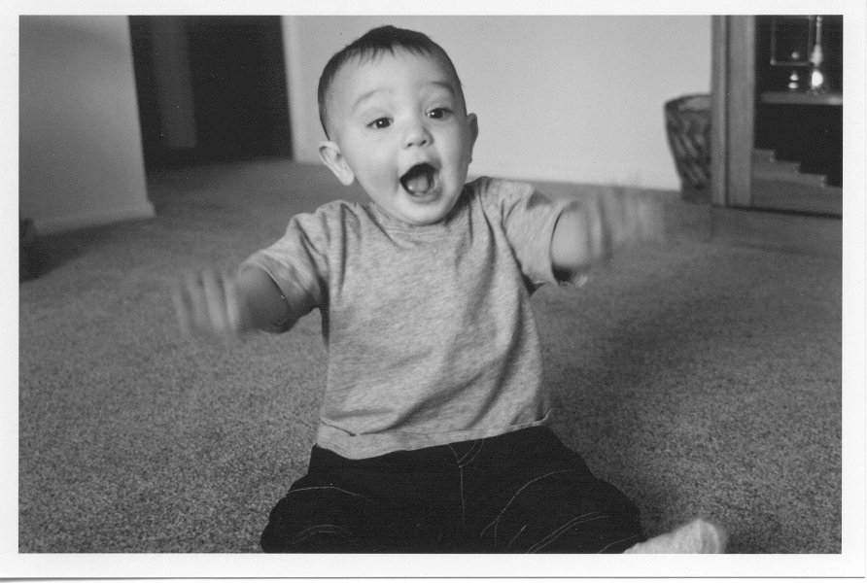
Eye contact
  Make eye contact
  Don’t look at group
  Pick out some in the audience as anchors
Notes:
Look at the audience‘s eyes to gain their attention, to judge their level of interest,
and to see how well they understand the messages being delivered.

Slide 43

Smile
Notes:
While you're maintaining eye contact, don't forget to smile. Unless (Though) your topic is very serious, a smile can be a very powerful thing.
And while using a computer, never look back at the screen— just glance down at the screen briefly.

Slide 44

Dealing with Questions
Questions show if people are listening!
Allow time to tackle them
Decide when to answer them
Try and anticipate
It’s ok to stop and think

Slide 45
Strategic Steps (TRACT)
Thank the questioner
Repeat the question
Answer the question
Check with the questioner if they are satisfied
Thank them again
Notes:
Once finishing your presentation, instead of asking ‘Does anyone have questions?’, ask a specific question related to your presentation
like ‘Do you agree with (part of your presentation)’.

Slide 46
What if I don’t know the answer?
Throw it to the floor
Take details and answer later
Repeat the question back if you don’t understand it
E.g. That’s a good question. Give me a moment to think about it.

Slide 47
Steps in Giving Presentation
Plan
  2. Prepare
  3. Practice
  4. Present
Notes:
Importance of a process (4 steps)

Slide 48

Your turn!
  Mind your pace and pauses
  Intonation
  Be clear

