Slide 1

ENGLISH AUTONOMOUSLY
Eva Trumpešová – Rudolfová
Lenka Zouhar Ludvíková
Notes:
introduction

Slide 2
ENGLISH AUTONOMOUSLY
– 2nd session
last week summary, your HW
multiple intelligences
think outside the box
logs
contract
module selection, counselling reservation

Slide 3
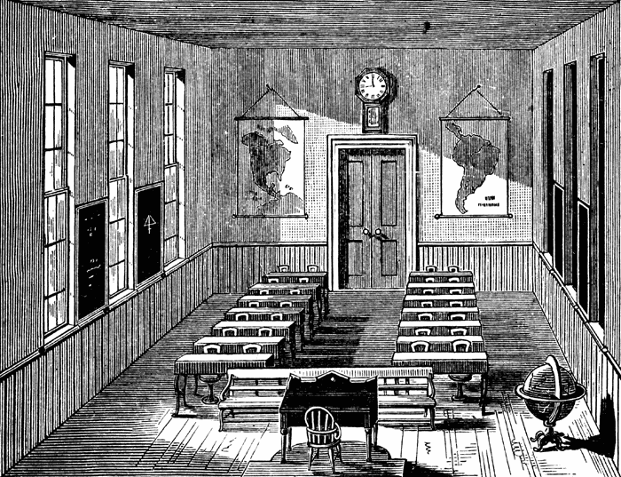
ENGLISH AUTONOMOUSLY
- focus on the language
teacher centred class
student centred class
learning centred class
Notes:
What kind of learner are you? – questionnaire – 5mins max!!!

Slide 4
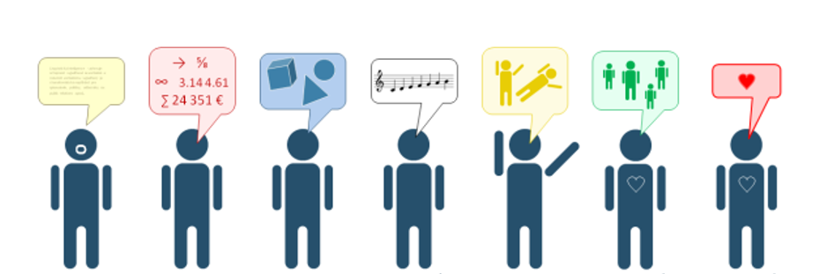
ENGLISH AUTONOMOUSLY
- multiple intelligences
Notes:
aktivitka

Slide 5
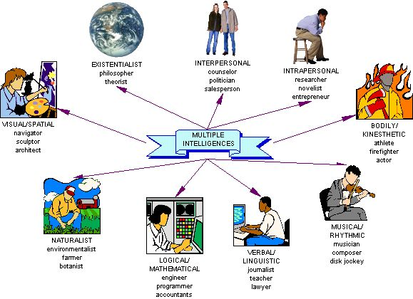
ENGLISH AUTONOMOUSLY
- multiple intelligences
Notes:
aktivitka

Slide 6
ENGLISH AUTONOMOUSLY
- think out of the box
http://www.theguardian.com/education/2015/mar/04/why-students-should-volunteer-while-at-university

Slide 7
ENGLISH AUTONOMOUSLY
- log writing
black book log
video log (Maroš)
electronic log (Sylvie)
Notes:
examples???

Slide 8
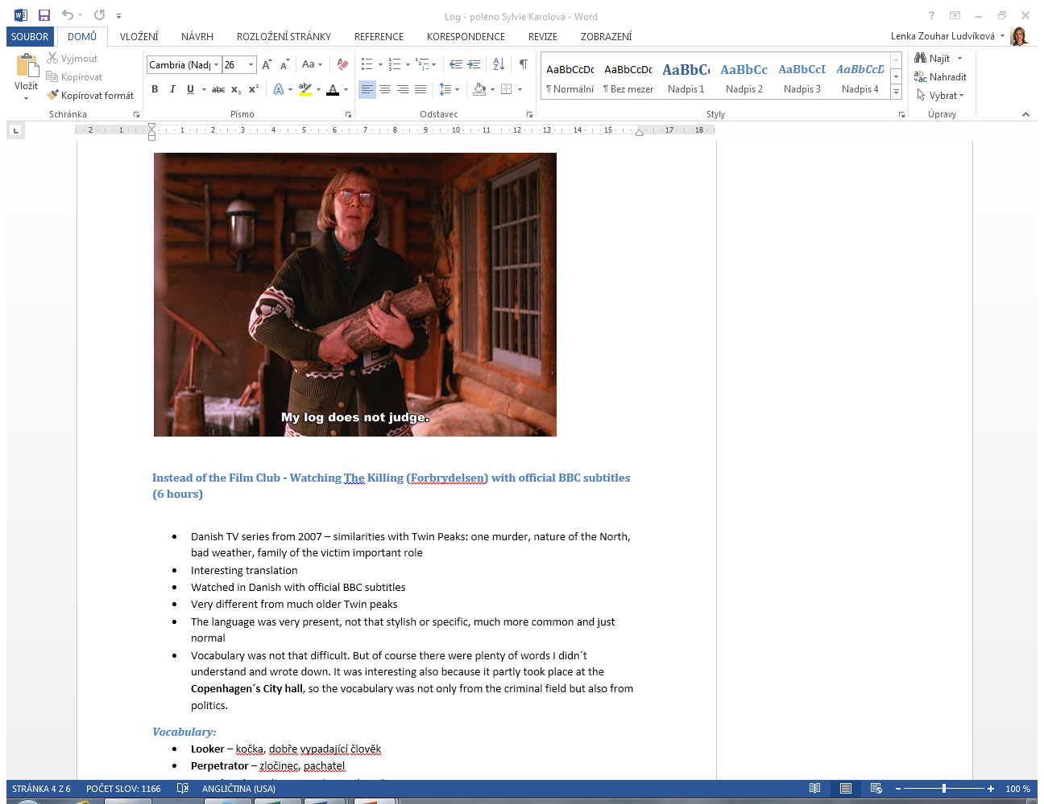
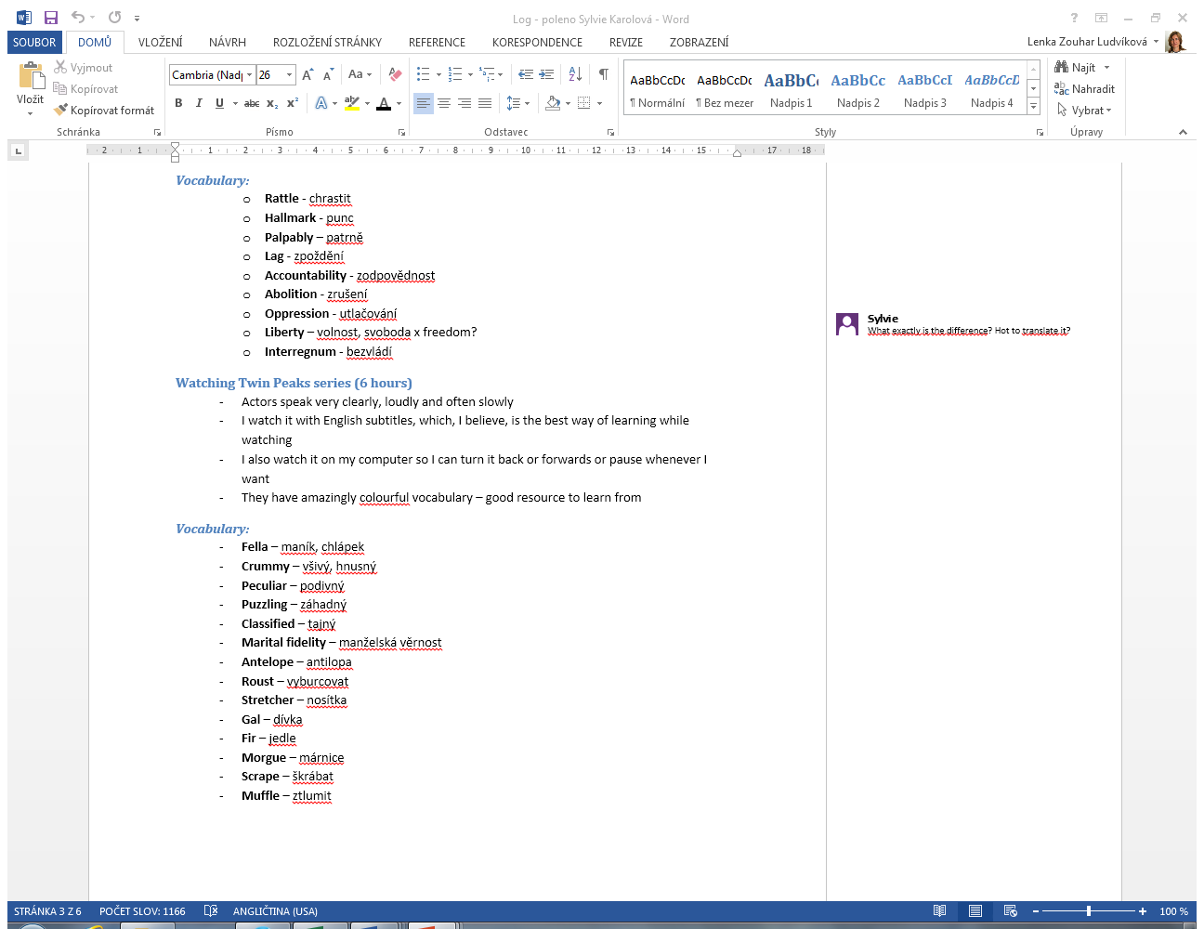

Slide 9
ENGLISH AUTONOMOUSLY
- log writing
regular, frequent, English learning focused
- what, why, when, where…
objective, goal, reflection, actual gain…
Language learning history to start with
online log, video log, audio log, hand-written log, portfolio, book...

Slide 10
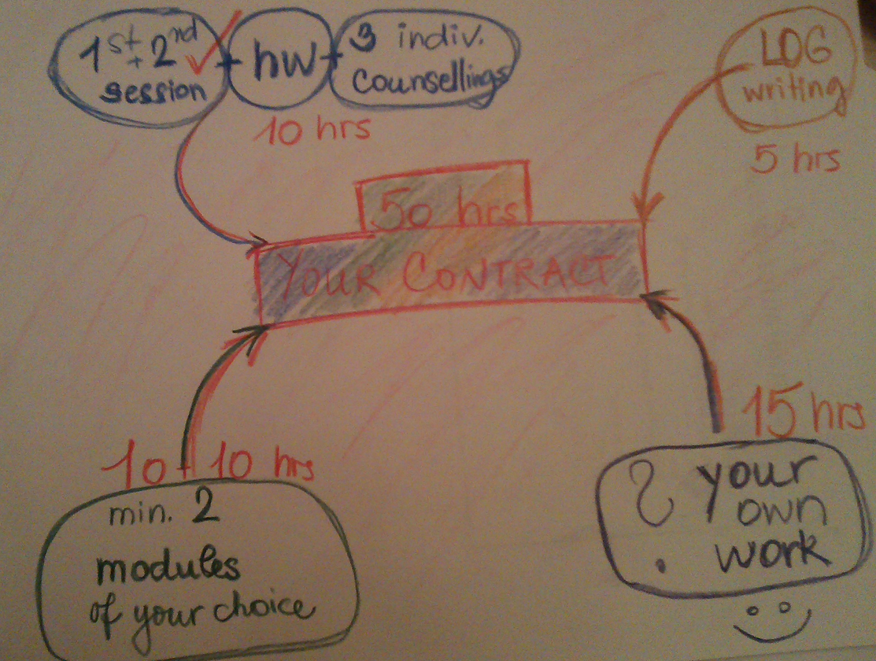
ENGLISH AUTONOMOUSLY
- contract / plan
Notes:
Odkazy na videopozvánky?

Slide 11
ENGLISH AUTONOMOUSLY
- contract / plan
 | hours
1st and 2nd session + HW + 3 ind.counsellings | 10
min. 2 modules of your choice | 10 + 10
log writing | 5
??? (more modules, showers, your own work…) | 15
TOTAL | 50
Notes:
Odkazy na videopozvánky?

Slide 12
ENGLISH AUTONOMOUSLY
HW for your first counselling session:
Language learning history starting your log
SWOT
SILL
Metacognition Awareness Inventory
CEFR
Needs analysis
contract

Slide 13
ENGLISH AUTONOMOUSLY
- booking
1st counsellings
2 modules of your choice
shower?
Thank you for the second session:).
Notes:
You shou
TODAY – book the modules and showers
- book the first counselling

