Slide 1
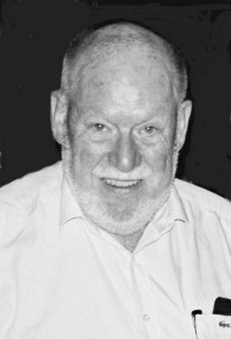
John Sinclar (1933–2007)

Slide 2
John McHardy Sinclair
Narozen 14. června 1933, zemřel 13. března 2007 ve Florencii.
3 děti, druhá žena Elena Tognini-Bonelli
1965 stěhování ze Skotska do Birminghamu
Do roku 2000 profesorem na univerzitě v Birminghemu.
1980 založen COBUILD, 1987 první slovník

Slide 3
John McHardy Sinclair
Korpusový lingvista, lexikograf, textový lingvista
Zakladatel Tuscan Word Centre, asociace podporující studium jazyka
Práce:
  Towards an Analysis of Discourse: The English Used by Teachers and Pupils. Oxford: Oxford University Press.1975.
  Corpus, Concordance, Collocation, Oxford, Oxford University Press, 1991,
  Reading Concordances, 2003,
  Trust the Text: Language Corpus and Discourse, 2004

Slide 4
COBUILD
Collins Birmingham University International Language Database
Elektronická verze v roce 1980
Publikován v roce 1987, reálná angličtina
Od roku 1990 gramatika angličtiny, metafory, slova ve větě
http://www.collinsdictionary.com/dictionary/english-cobuild-learners
http://www.collins.co.uk/category/English+Language+Teaching/COBUILD+Reference

Slide 5
Although the British National Corpus may not have been exactly the kind of corpus John wanted it to be, it is safe to say that the BNC would never have existed without John's work. Almost everyone who ever worked on the project has to a greater or lesser extent been influenced by his thinking and, in many cases, worked directly with him. It is a cruel irony that his death should have occurred on the same day as we finalised a new edition of the corpus which includes for the first time a change in its internal tagging made on his recommendation. We dedicate that new edition to his memory

Slide 6
Zdroje
http://en.wikipedia.org/wiki/COBUILD
http://en.wikipedia.org/wiki/John_McHardy_Sinclair
http://www.natcorp.ox.ac.uk/jmchs.xml
http://www.ello.uos.de/field.php/TheoryModelMethod/JohnSinclair
http://www.collinsdictionary.com/dictionary/english-cobuild-learners
http://www.collins.co.uk/category/English+Language+Teaching/COBUILD+Reference
http://www.lexically.net/downloads/corpus_linguistics/Sinclair_obituary.pdf
https://scholar.google.com/citations?user=RUxm1iEAAAAJ&hl=cs

