Slide 1
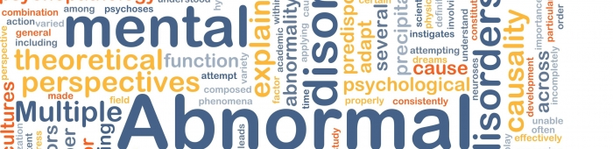
Lecture 5
Culture specific mental disorders
Cross-cultural psychology
Petra Chvojkova
2.4. 2015

Slide 2
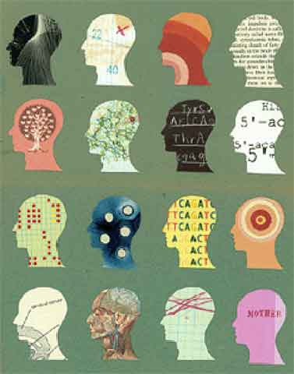
Content
Classification of mental diseases
Psychopathologies across culture
Culture-bound syndromes
Culture specific psychotherapy

Slide 3
An example…

Slide 4

Classification of mental diseases

Slide 5
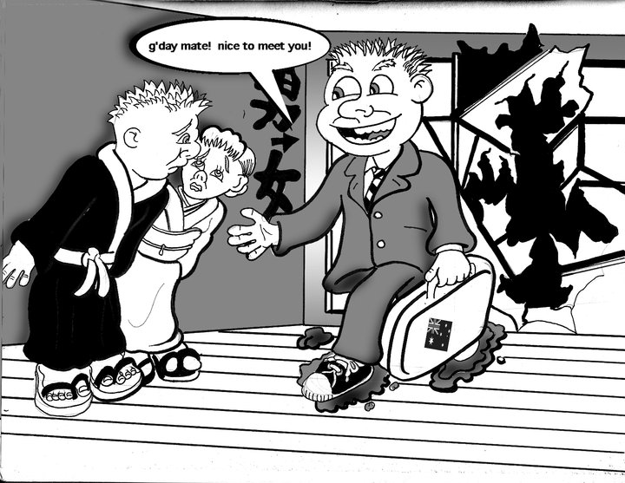
MENTAL DISORDER = “a clinically significant behavioral or psychological syndrome or pattern that occurs in an individual [which] is associated with present distress…or disability…or with a significant increased risk of suffering.”
Psychopathological symptom x culture norm
Diagnostic and Statistical Manual of Mental Disorders DSM-V (by American Psychiatric Association)
  Today DSM V has become the main system of classification of psychological disorders
International Classification of Diseases ICD 10 (by World Health Organization)
Psychopathological symptom
Culture norm

Slide 7
Biases in the classification system of mental disorders
The goal - Reliable and valid classification system
  Experience of mental disorder highly subjective -> highly subejctive its expression
  Depends on The manner, in which the behavioural aspect expressed are acceptable or not in the society
  Changes in professional knowledge
Example of homosexuality
  removed from the category of psychopathology in 1973 in western world
  X
  abnormal behaviour + criminal offence in other countries (Uganda)
== universal classification system difficult to achieve

Slide 8
The link between culture and psychopathology

Slide 9

Health = „a state of complete physical, mental and social well-being, and not just the absence of disease or infirmity“ (WHO, 1948)
Concept of health differs across cultures
Culture
Mental illness
MENTAL DISEASE
Peripheral symptoms – culture specific
Central symproms – culture universal

Slide 10
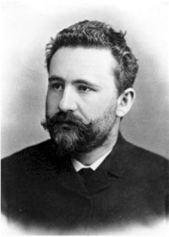
E. Kraepelin
start of 20th century
Comparative Psychiatry
  = sub discipline in psychiatry to study cultural differences in psychopathology.

Slide 11
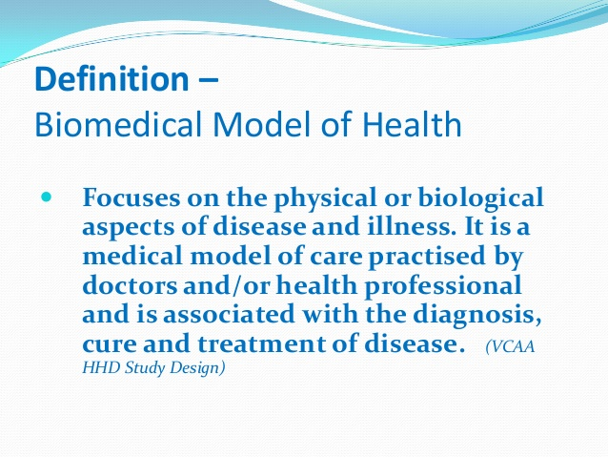
Western illness perspective - Biomedical model of mental illness
  „psychopathology essentially homogenous, with only superficial variation presentation across people“
  –>> position of extreme universalism

Slide 12
Universalism of psychopathology
Extreme universals
Psychopathological phenomena invariant across cultures in their origin and expression
Moderate universals
Psychopathology presents in some form in all cultures,
but subject to cultural influence on factors such as the onset and expression
Culturally relative
Psychopathology unique to some cultures and understandable only in terms of that culture

Slide 13
Prevalence of some mental health disorders across countries
Study Goldberg and Lecrubier, 1995, Ustun and Sartorius, 1995)
  Prevalence rate for Current Depression – 29,5% in Santiago, 2,3% in Nagasaki, 11,6% in Ankara.
  Prevalence rate for Generalize Anxiety 0,9% in Ankara and 2,6% in Rio de Janierio
  = psychopathology present in all societies + qualification what pathological and expression differ from society to society
  Kleinman – category fellacy -
    impute the illness categories of their culture to other culture

Slide 14
Psychopathologies across cultures

Slide 15
Schizophrenia
Aprrox. 1% of the worlds population today is affected by schizophrenia
cultural practice may affect the apparent prevalence
  In US black have relatively higher rates of schizophrenia than whites
  Acute and catatonic cases more prevalent in developing counties (compared developed )
The contents of delusions varied
  Religious delusions and delusional guilt are primarily found in Christian traditions
=>Schizophrenia as moderate universal disorder recognizably present in all cultures, but respond to different cultural experience in prevalence rates and modes of expression, and prognosis

Slide 16
DEPRESSION
  Huge differences in prevalence and incidence rates across societies
    Prevalence rate from 1,0% in Nigeria to 10,3% in the US
    Explanation: research artefacts, differential use of diagnosis, variations in pathways to care, health care, attitudes towards physicians, different terminology in language for being depressed
  Descriptions found in text of ancient civilizations as Egypt, China, in Ramayana
  „depressed“ has no language equivalent among American Indians , some South Asian groups

Slide 17
DEPRESSION
Core symptoms
  Dysphoria, anxiety, tension, lack of energy, ideas of insufficiency
Peripheral
  Headaches in Latino, Mediterranean
  Weakness, imbalance, tidiness in China and Asia
  Problem of the „heart“ in middle Eastern

Slide 18
DEPRESSION
Fear of stigmatization in some countries – other (somatic) diagnosis instead of depression
emotional disturbance not taken as mental illness , explained by situational factors (Zimbabwe )
Some (affective and cognitive) symptoms underreported – more refer somatic complains
Non Western people tend to somatise their distress x Western cultures to psychologize
  Physical (somatic) symptoms such as headache more often in non-western countries
  Disapproval of strong expression of negative emotions – directing emotional feelings into bodily –complaints is more legitimate
  In China neurasthenia (somatoform disorder x depression)

Slide 19
Trauma
Traumatic events (terrorism, captivity, torture) produce similar behavioural responses in individuals of different national, cultural and religious backgrounds
  ->posttraumatic stress disorder

Slide 20
Culture and suicide
US:India (suicide rate) = 2:1
Low suicide rate: Syria, Egypt, Jordan and Kuwait
High rate: Japan, Singapore, Scandinavian, Central , East Europe
Causes such as alcoholism, group pressure, depressive disorder,…
Significant relationship between societal complexity and frequency of suicide (Durkheim hypothesis)
  Some religious beliefs may prevent from considering self-killing
  Come cultural norms increase the social supportiveness among people

Slide 21
Substance abuse
Wide cultural variations in attitudes toward substance consumption, patterns of substance use, accessibility of substance and prevalence of disorder related to substance
Highest consumption : Argentina, Australia, Northern Hemisphere
Low consumption level : Africa, southern Asia, Indian Ocean
Europeans consumes 50% alcohol on Earth

Slide 22
Culture-bound syndroms

Slide 23
= recurrent, locality-specific patterns of aberrant behaviour, and troubling experience (that may or may not be linked to a particular DSM-V diagnostic category)
Are found only in a particular cultural group
A collection of signs and symptoms which are restricted to a limited number of cultures primarily by reason of certain psychosocial features
Culturally unique or local expressions of some universal disorders
All cultures have separate categories for normal and abnormal bahavior
Found in the appendix of the DSM-IV, but not in the ICD-10

Slide 27
Psychotherapy across cultures

Slide 28
Psychotherapy
= alleviating the patients suffering due to a psychological problem or disorder
= special practice involving a designated healer (or therapist) and an identified client (or patient) with the particular purpose of solving a problem for which the client suffering or promoting the client's mental health. The practice may take various forms, and the fundamental orientation may be supernatural, natural, biomedical, sociophilosophical or psychological (Tseng, 2001)
Cultural beliefs and practices usually enter into psychotherapeutic process
  – part of the therapist's and patient's understandings of the problem

Slide 29
Psychotherapy
Indigenous
Cross-cultural
Multicultural

Slide 30
Indigenous psychotherapies
Shared common culture
Indigenous healing practices produce psychotherapeutic effects – „folk psychotherapy“
Seen as religious ceremonies or healing exercises related to supernatural or natural powers
The mobilization of ones own resources through medico-religious practices that one believes in
Indigenous healers
  More accessible
  Accept patient's description of problems
  Empathetic and charismatic – effective healing relationship
  Placebo effect

Slide 31
Indigenous psychotherapies
Examples: religious healing practice, healing ceremony, shamanism, divination, fortune-telling, voodoo
  Morita therapy and Naikan therapy in japan
    http://en.wikipedia.org/wiki/Naikan
    https://www.youtube.com/watch?v=StSqWdJfX8g

Slide 32
Cross-cultural psychotherapy
across international borders
western-based theory and method used to examine persons of other cultures
Common core to psychotherapeutic practices but with different historical and cultural roots and highly varied cultural expressions
Can medical beliefs and practices from one culture be effective in the healing process in another culture?
Griner, Smith (2006) meta-analysis culturally adapted psychological intervention X traditional intervention
  Overall positive effect of cult. Adapted therapy (d=0,3-0,6)

Slide 33
Multicultural psychotherapy
culturally sensitive and appropriate psychotherapeutic methods taking into consideration the cultural and ethnic backgrounds of the therapist and client and the acculturating context
=> incorporation of culture-relevant and culture-sensitive information into practice of psychotherapy with diverse clients
Cultural adaptation of psychotherapeutic methods that have been proven scientifically to be effective
Therapist need to be aware of his own ethnic views and biases and how it may interact

Slide 34
Resources
Shiraev, E., Levy D. (2014). Cross-Cultural Psychology. Pearson.
Berry, J. W., Poortinga, Y. H., et al. (2011). Cross-cultural Psychology: Research and aplication. Third Edition. Cambridge university press.

Slide 35
Thank You

