Slide 1

Acculturation
Cross-cultural psychology
Petra Chvojkova
5.3. 2015

Slide 2
Acculturation – what is it
explains the process of cultural change and psychological change that results following meeting between cultures
the process of adopting the cultural traits or social patterns of another group
„Those phenomena which result when groups of individuals having different cultures come into continuous firs-hand contact, with subsequent changes in the original cultural patterns of either or both groups…under this definition acculturation is to be distinguished from…assimilation, which is at times a phase of acculturation“. (Redfield, Linton, 1936)

Slide 3


History
The earliest recorded thoughts towards acculturation in Sumerian inscriptions and Plato manuscripts
1880 J.W. Powell
studied scientifically since 1918 - Thomas, Znaniecki Polish Peasant in Europe - The first psychological theory of acculturation
  Bohemian (adopting the host culture and abandoning their culture of origin)
  Philistine (preserving their culture of origin but failing to adopt the host culture)
  creative type (able to adapt to the host culture while preserving their culture of origin).
50.l. 20.st. Kim + Gudykunst
60.l. 20.st. Gordon
Contemporary research has primarily focused on different strategies of acculturation and how variations in acculturation affect how well individuals adapt in their society

Slide 4
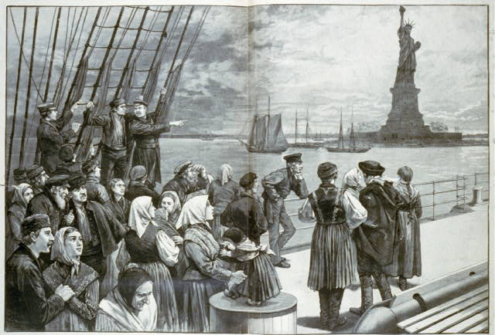
Acculturation
Group (sociology) x individual (psychology) level
Unidimenzional x bidimenzional process
One way – two way proces
immigrants, sojourners, refugees and asylum seekers, indigenous people.

Slide 5
Theories of acculturation
50.l. 20.st. Kim + Gudykunst
  unilinear proces, the sojourner must conform to the majority group culture in order to be “communicatively competent
Kramer – Cultural Fusion Theory
  identity depends on difference
  If everyone assimilates into a monoculture that would mean that identity, meaning, and communication would cease to be
Berry – Fourfold model – acculturation preferencies
  retention or rejection of an individual’s minority or native culture
  adoption or rejection of the dominant group or host culture.
Benet – Martinez
  Biculturalism and bicultural identity integration (BII)

Slide 6
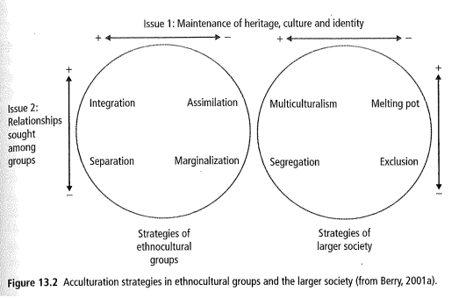
Berry´s acculturative strategies
Assimilation
Separation
Integration
Marginalization
Dimension od maintenance x refusion of original culture
Dimension adoption x refusion of new culture

Slide 7

Assimilation
Separation
individuals reject the dominant culture in favour of preserving their culture of origin
Separation is often facilitated by immigration to ethnic enclaves
individuals adopt the cultural norms of a dominant or host culture, over their original culture

Slide 8
Integration
Marginalization
individuals are able to adopt the cultural norms of the dominant or host culture while maintaining their culture of origin
Integration leads to, and is often synonymous with biculturalism.
the most preferred option (Berry, 1997)
most positive individual and group acculturations strategy
individuals reject both their culture of origin and the dominant host culture.

Slide 9
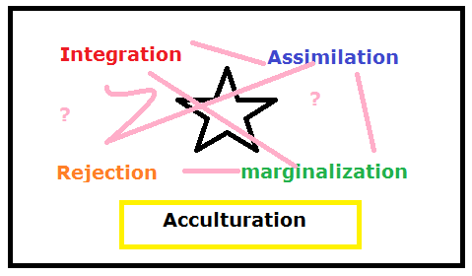
Berry´s acculturative strategies
Individuals’ acculturation strategy can differ between their private and public live spheres
Prefered strategy (attitude) x real strategy (behavior)
Strategy prefered by minority x prefered by majority
Depends on
  Cultural distance
  Age, gender, education
  Personal factors
  …

Slide 10
ABCs model of acculturation
Affective perspective (emocional aspects of acculturation process)
  Acculturative stress
Cognitive perspective
  Social identity theory. Tajfel
  Ethnic identity, steretypes
Bahaviour perspective
  Cultural learning aproach
  Learning culture specific competencies
  Cultural training – cultural assimilator
Notes:
Ukázka kulturního asimilátoru

Slide 11

Acculturative stress
„Acculturative stress refers to the psychological, somatic, and social difficulties that may accompany acculturation processes, often manifesting in anxiety, depression and other forms of mental and physical maladaptation.“ (Berry, 1970)
a response by people to life events that are rooted in intercultural contact
a reduction in health status (including psychological, somatic, and social aspects) of individuals who are undergoing acculturation
Symptoms: heightened levels of depression (linked to the experience of cultural loss) and of anxiety (linked to uncertainty about how one should live in new society).
negative predictor of well-being
Measurement of acculturative stres – Riverside acculturation scale (RASI, Benet-Martinez, 2005)

Slide 12

The measurement of acculturation
To measure
  Acculturative outcomes x accul. conditions
  Accu. Strategies x preferencies
  Acculturation attitudes
  Accu. Behavior
Uni- x bi-diensionals scales
  bipolar, single dimension scales x bidemensional scales x four scales with statements capturing favourable attitudes toward every strategy
Specific scales (for example mexican americans)

Slide 13
The measurement of acculturation
  Examples:
  General ethnicity questionaire (GEQ, Tsai et al, 2000)
  Stephenson multigroup acculturation scale (SMAS, Stephenson, 2000)
  Vancouver index of acculturation (VIA, Ryder, 2000)
  Multicultural Personality Questionnaire (MPQ, Van der Zee, Van Oudenhovenven, 2000)
  Riverside Acculturation Stress Inventory (RASI; Benet-Martınez, Haritatos, 2005)

Slide 14
Acculturation outcomes
Refer to consequences of the acculturation process which can be psychological (internal adjustment, well-being) and behavioral (external adjustment, doing well).
Depends on acculturation strategy, personality,..
Immigrant paradox
  First x second generation od immigrants

Slide 15

Practical aplications
unprecedented increase in worldwide migration and globalization
Education
  successful and unsuccessful schooling trajectories for immigrant children
  educational strategies that may benefit them
immigrants in the labor market
  salaries of immigrants
immigration policy

Slide 16

Practical aplications II
intercultural training
  how immigrants and sojourners can learn to deal successfully with cross-cultural transitions using intercultural training
health system
intercultural relations in plural societas
  relationship between the larger society and ethno cultural groups
  how to improve their relationship and thereby increase the chance of positive acculturation

Slide 17
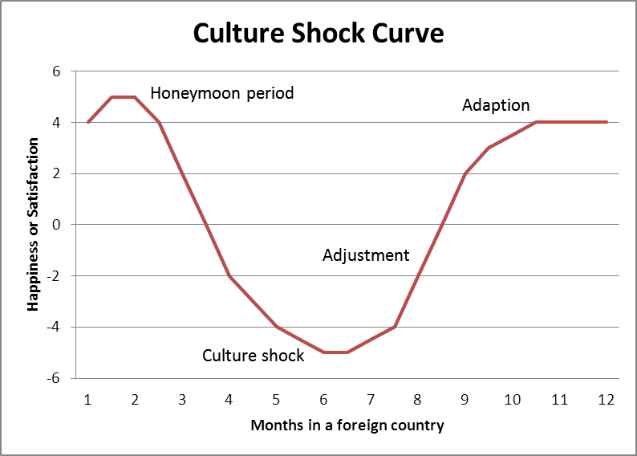
Culture shock
a state of bewilderment and distress experienced by an individual who is suddenly exposed to a new, strange, or foreign social and cultural environment (dictionary.com)
Phases
  Honeymoon phase
  Frustration phase
  Adjustment phase
  Mastery phase
  Return

Slide 18
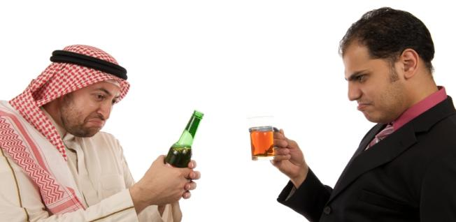
Culture shock II
Symptoms : information overload, language barrier, technology gap, skill interdependence, formulation dependency, homesickness, boredom (job dependency), response ability (cultural skill set).
Depends on: age, gender, purpose of visit, lenght of visit, cultural distance

Slide 19
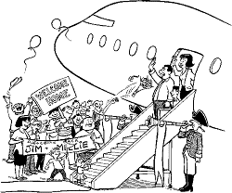
Reverse culture shock
results from the psychosomatic and psychological consequences of the readjustment process to the primary culture
more surprising and difficult to deal with than the original culture shock

Slide 20

Bicultural identity Integration (BII)
Correspond to integration strategy
Author Veronica Benet-Martinez
captures (explains) variations among bicultural individuals in the degree to which they “perceive their mainstream and ethnic cultural identities as compatible and integrated versus oppositional and difficult to integrate”.
focuses on bicultural individuals¨ subjective perceptions of managing dual cultural identities
perception of distance (versus overlap) and perception of conflict (versus harmony)
Dimensions harmony x conflict, blendedness vs. compartment

Slide 21
BII
High BIII
Low BII
cultural identities as generally compatible
to view themselves as part of a combined or third emerging culture
find it relatively easy to integrate both cultures into their everyday lives
difficulty in incorporating both cultures into a cohesive sense of identity
perceive the two cultures as highly distinct and oppositional
describe feeling as if they should just choose one culture over the other
sensitive to specific tension between the two cultural orientations

