Slide 1
Key studies
Developmental psychology
PhDr.Kateřina Bartošová, Ph.D.

Slide 2
Developmental psychology

Slide 3
It always starts with Freud…

Slide 4
Stages

Slide 5
Jean Piaget cognitive development

Slide 6
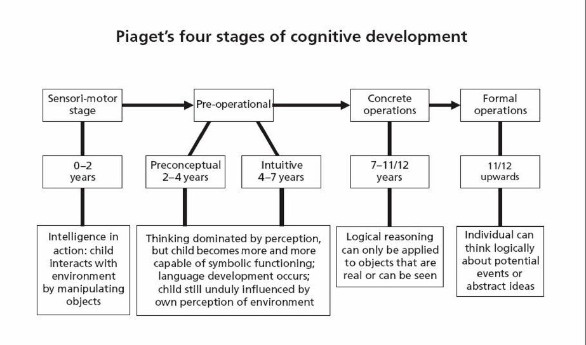
https://www.youtube.com/watch?v=TRF27F2bn-A

Slide 7
Vygotsky’s Sociocultural Theory

Slide 9
Albert Bandura – social lerning

Slide 10
The bobo doll experiment https://www.youtube.com/watch?v=eqNaLerMNOE

Slide 11
Thank you for your attention

