Slide 1

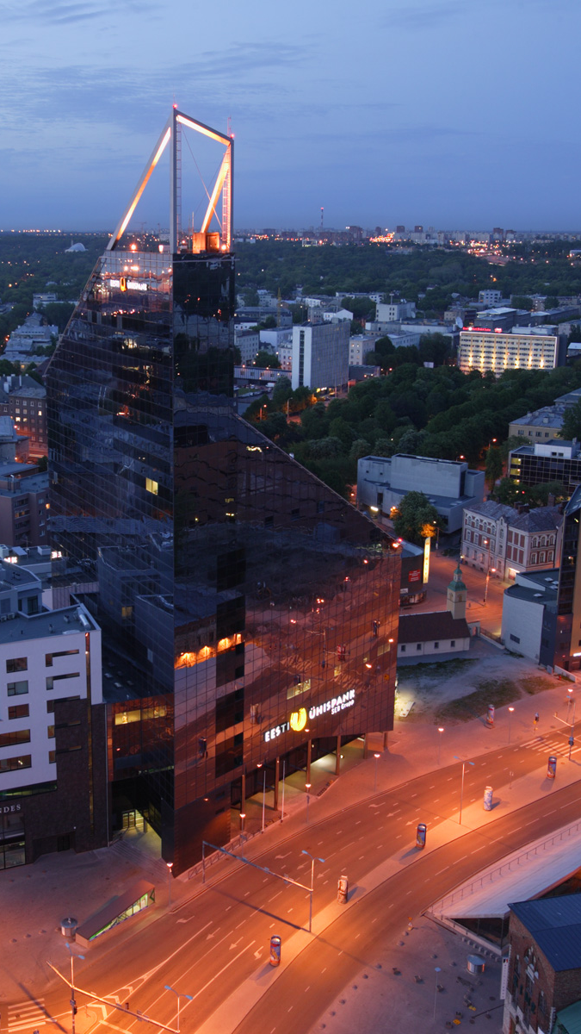

The innovative Estonia: from top science to e-government
Arko Olesk
Tallinn University/Postimees
Guest Lecture Course in
Masaryk University
March 21-24, 2016

Slide 2
Outline of the course
History of Science in Estonia
Current Cutting-Edge Estonian Science
E-stonia: Pioneering Public e-Services
Not just Skype: the Sweet Fruits of Estonian Start-Up Culture
Science and Innovation Communication and Education in Estonia

Slide 3
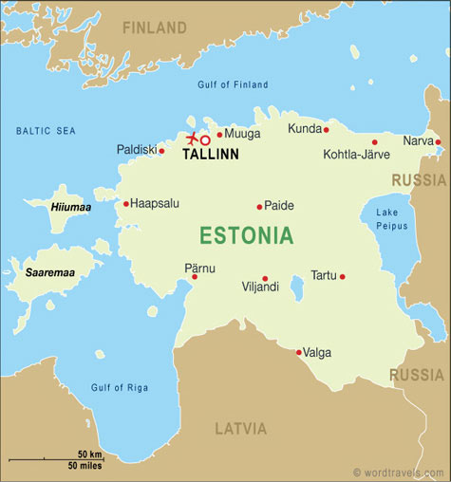
ESTONIA
Area: 45 339 sq.km
Population: 1 311 800
Capital: Tallinn

Slide 4
Extremely short Estonian history
First traces of settlement approx. 9000 BC
Independent tribes until 13th Century
The Estonian Crusade 1208-1227
-> Danish, Swedish, German, Polish, Russian control
Independence in 1918 (February 24)
Occupied between 1940-1991
Notes:
https://www.youtube.com/watch?v=IcFDrA8topY

Slide 5
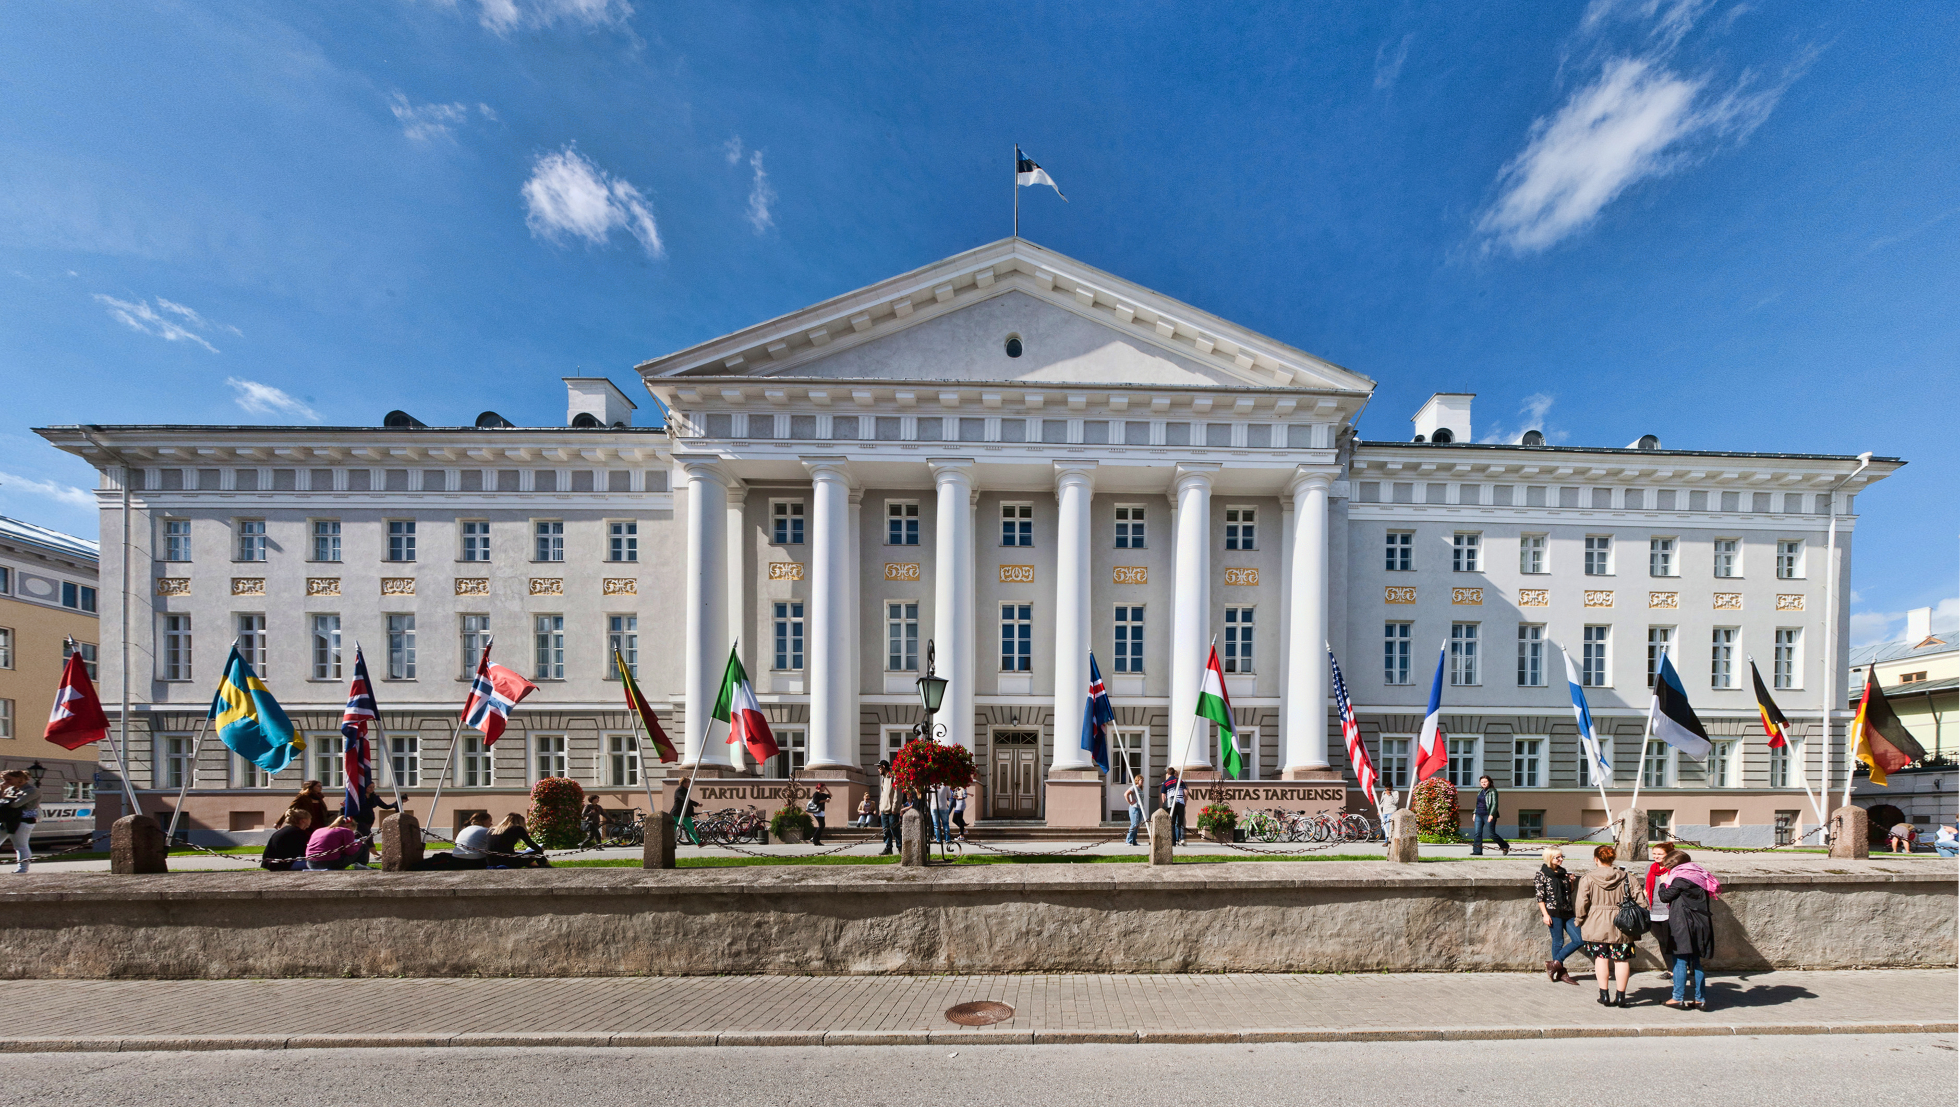
University of Tartu
1632 – Academia Gustaviana
1802 – Universität Dorpat
1919 – University of Tartu

Slide 6
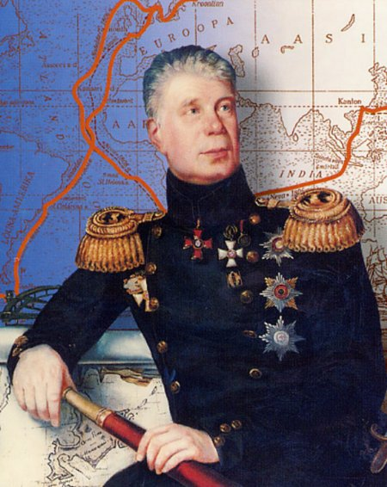
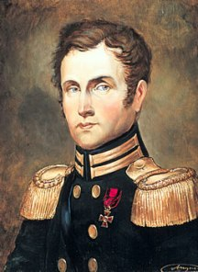
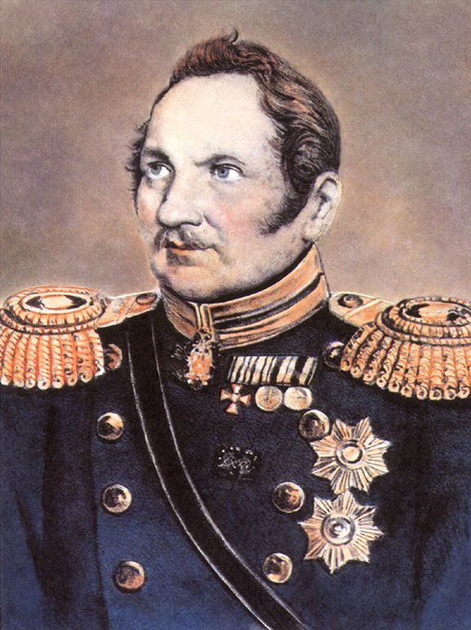
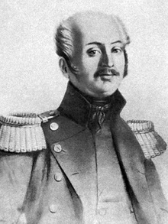
Explorers
Johann Adam von Krusenstern
- First Russian circumnavigation (1803-06)
- „South Sea Atlas“
Otto von Kotzebue
- Two circum-navigations (1815-18, 1823-26)
- Oceanographic study of the Pacific
Fabian Gottlieb von Bellingshausen - Antarctic expe-dition in 1819-21
Ferdinand von Wrangel
- Arctic Sea travels 1820-24

Slide 7
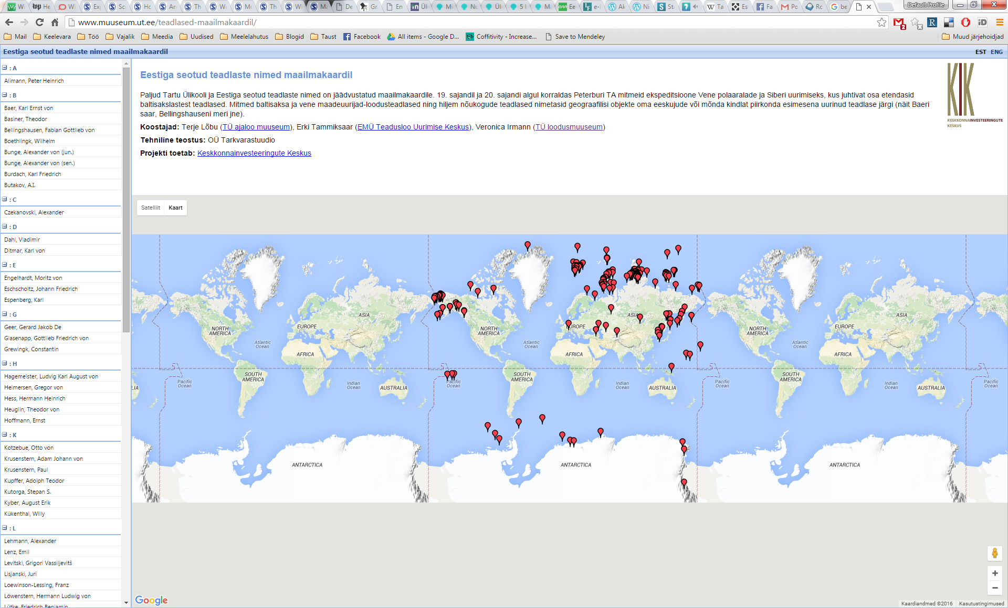
http://www.muuseum.ut.ee/teadlased-maailmakaardil/

Slide 8

Georg Wilhelm Richmann (1711-1753)
Proved that thunder clouds contain electric charge.

Slide 9
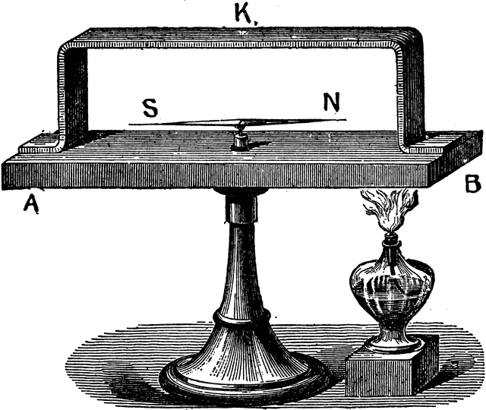
Thomas Johann Seebeck (1770-1831)
discoverer of the thermoelectric effect
described the action of the spectrum of light on the chloride of silver

Slide 10
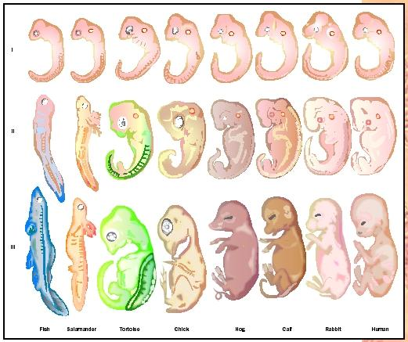
Karl Ernst von Baer (1792-1876)
Discoverer of the mammalian ovum
Founder of embryology

Slide 11
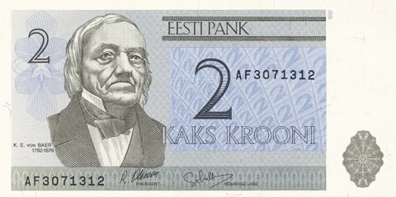
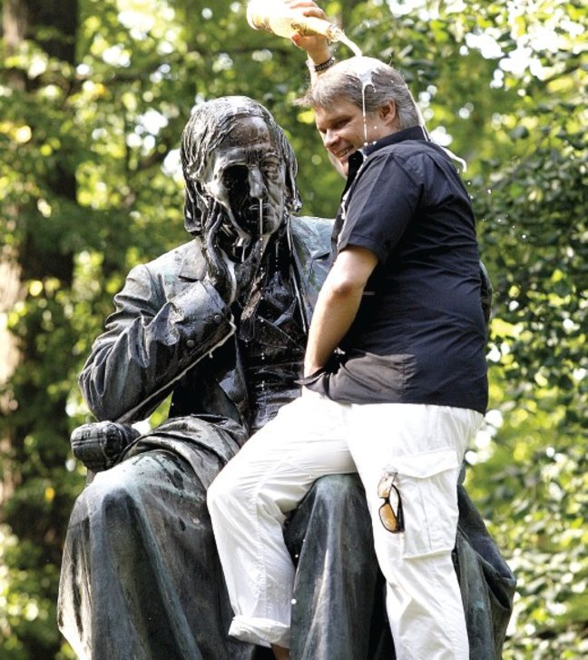
Karl Ernst von Baer
Erosion of river banks
founder of the Russian Geographical Society
pioneer in studying biological time
„On Estonians' Endemic Diseases“

Slide 12
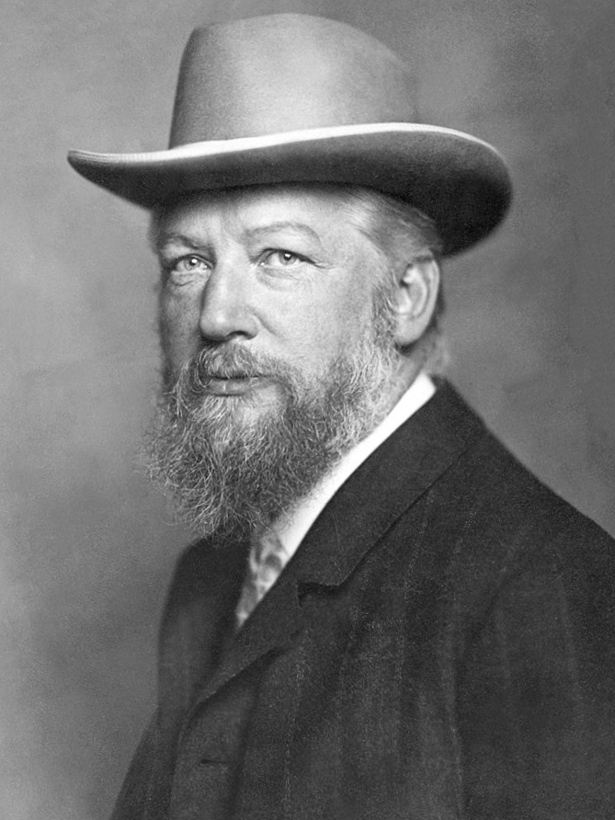
Wilhelm Ostwald (1853-1932)
Nobel Prize in Chemistry 1909
work on catalysis, chemical equilibria and reaction velocities
Ostwald process (patent 1902) for the manufacture of nitric acid

Slide 13
Other Tartu professors
Alexander Schmidt - foundation for the creation of anti-coagulation systems and towards the development of blood transfusion
Emil Kraepelin - founder of modern scientific psychiatry; diagnosed skizophrenia
Moritz Jacobi - study of magnetic motors, discoverer of galvanoplastics
Ivan Kondakov - invented synthetic rubber

Slide 14
Other Estonian-born scientists
Heinrich Lenz – Lenz’s law „If an induced current flows, its direction is always such that it will oppose the change which produced it.“
Jakob Johann von Uexküll – zoosemiotics, „umwelt“

Slide 15
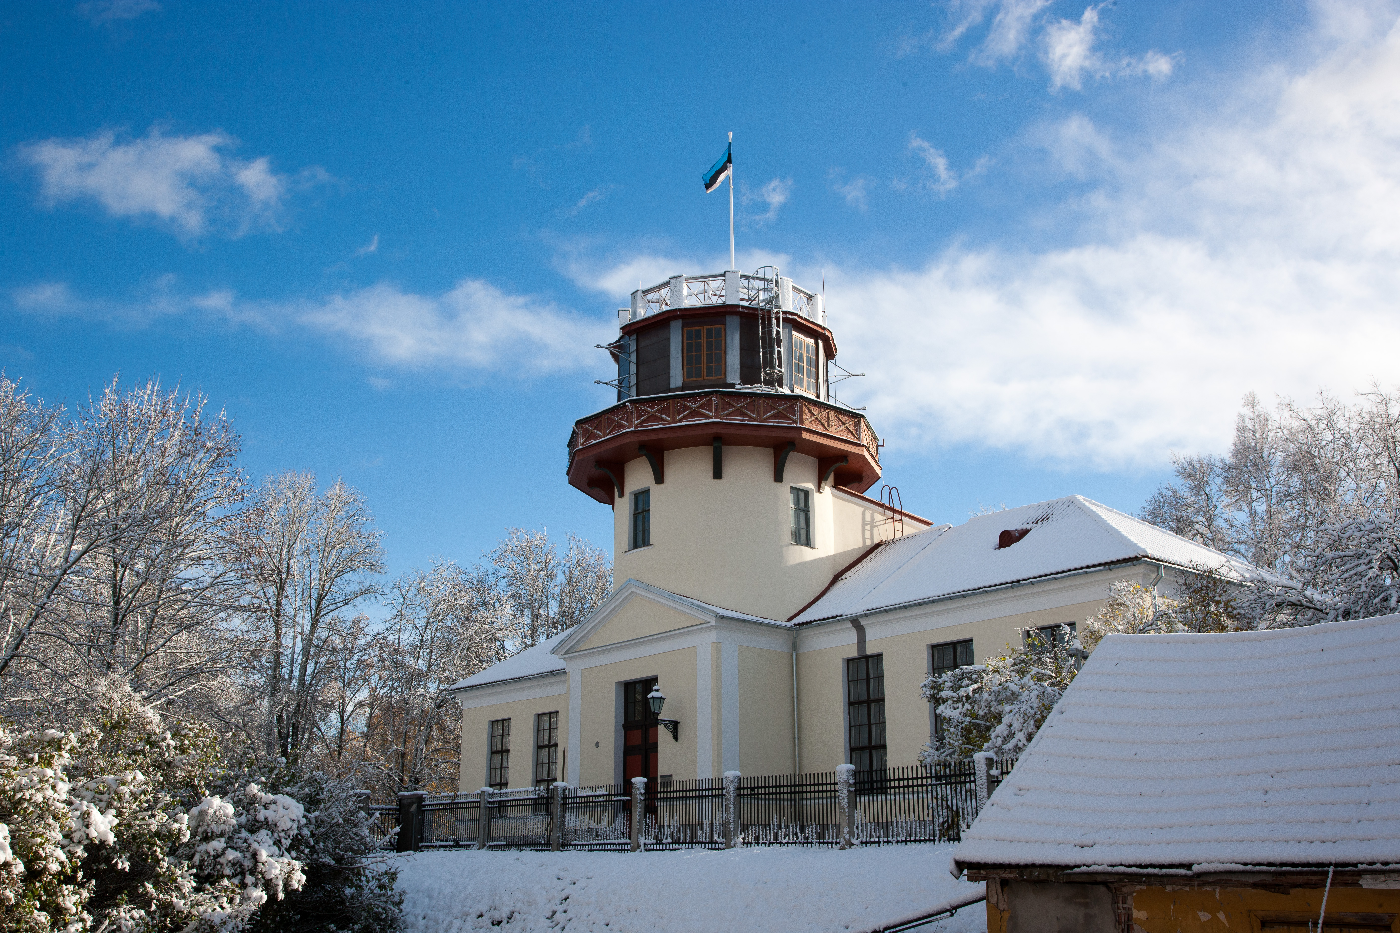
Astronomy tradition in Estonia

Slide 16
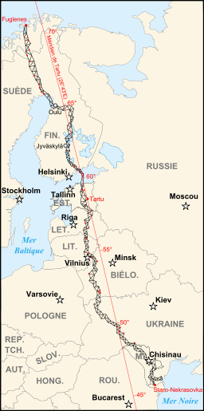
Astronomy tradition
Friedrich Georg Wilhelm Struve (1793–1864)
Geodetic arc - the first accurate measuring of a long segment of a meridian (UNESCO World Heritage object)

Slide 17
Astronomy tradition
First measurement of star’s distance – Vega (1837)
First observed supernova from outside our Galaxy (1885)

Slide 18
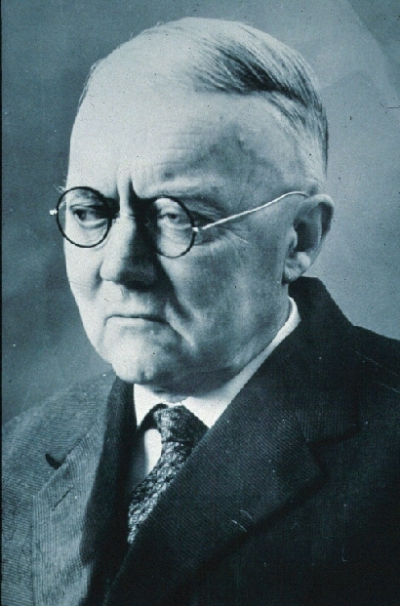
Ernst Öpik (1893-1985)
distance to Andromeda galaxy
density of white dwarfs
predicted the frequency of craters on Mars
thermonuclear reactions as stellar energy source
Öpik-Oort cloud – origin of comets

Slide 19
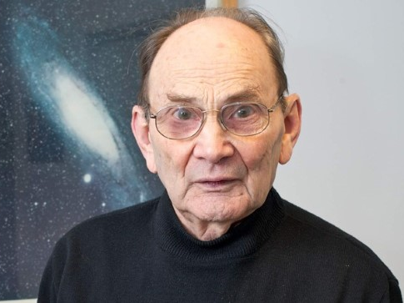
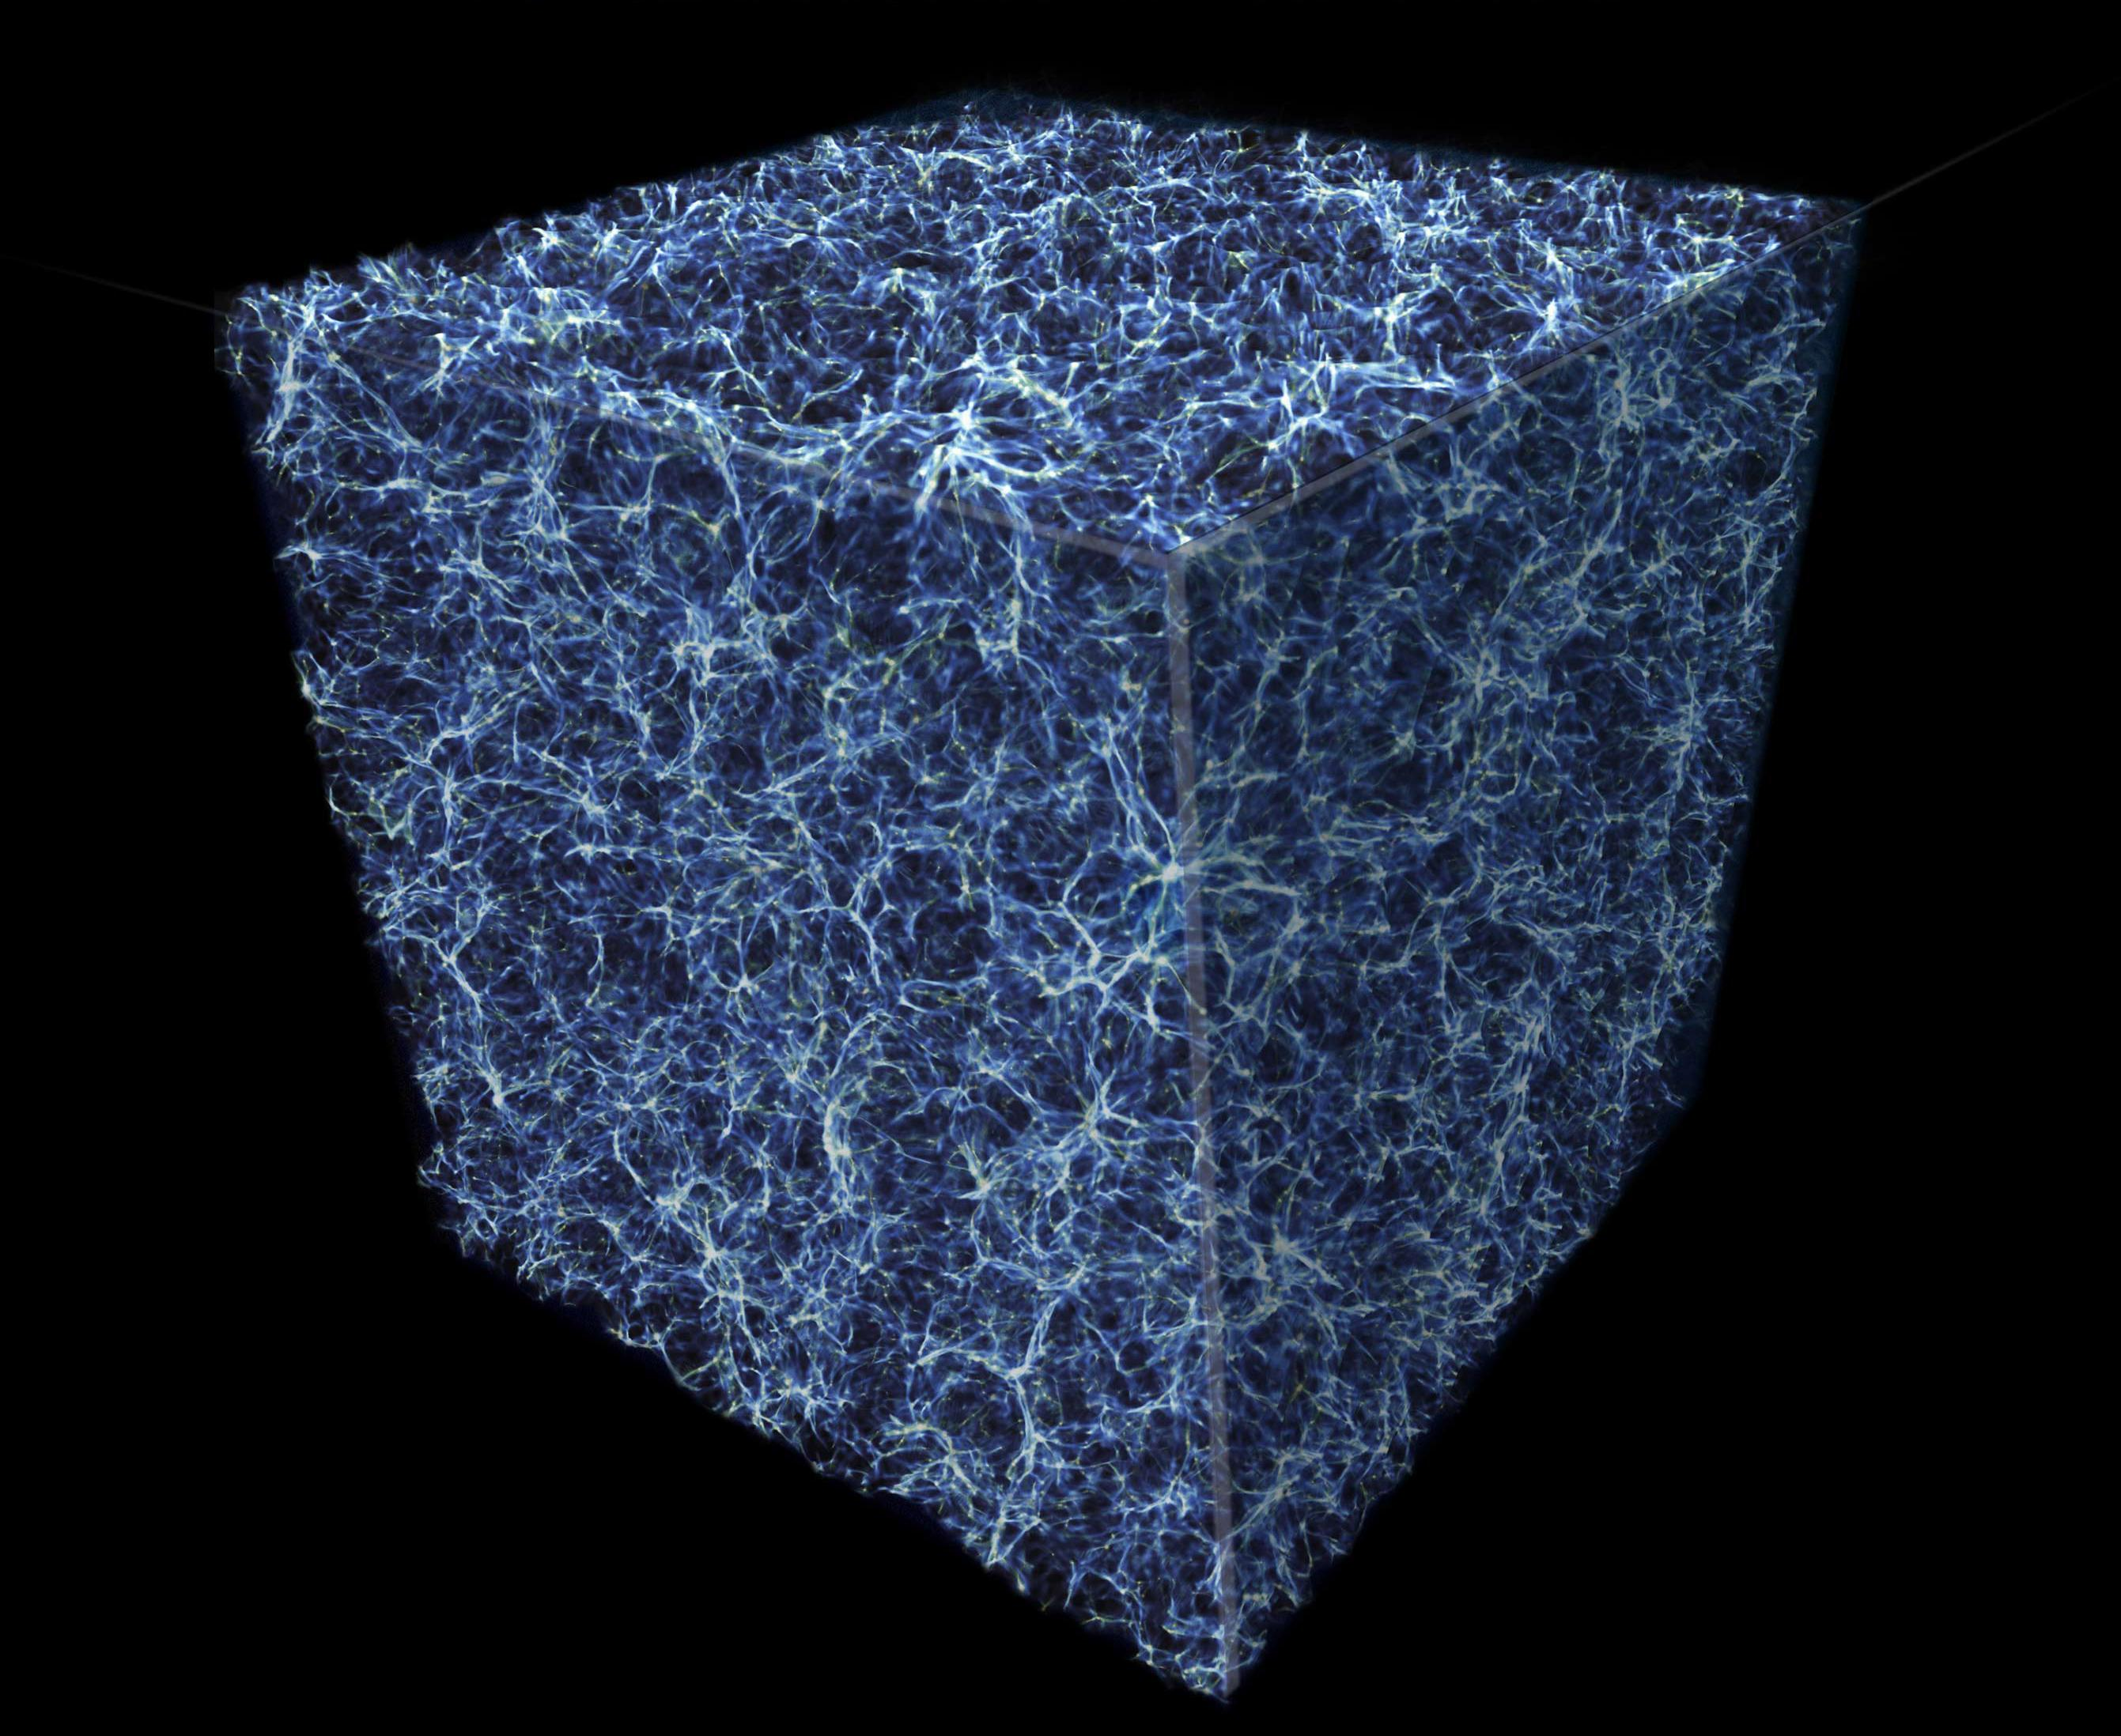
Jaan Einasto (b. 1929)
Large-scale structure of the Universe
Dark matter

Slide 20
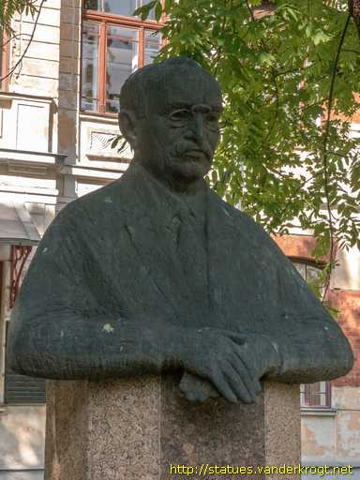
Science in Independent Estonia
Focus on national sciences
Ludvig Puusepp – world's first professor of neurosurgery
Aleksander Paldrok – treatments of leprosy

Slide 21
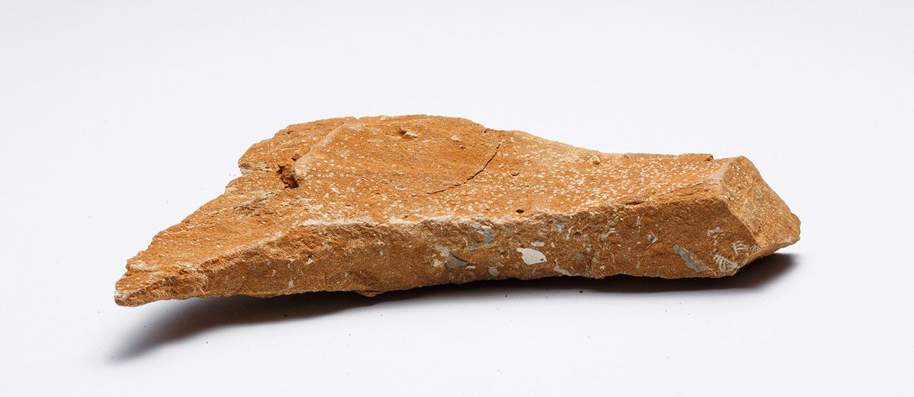
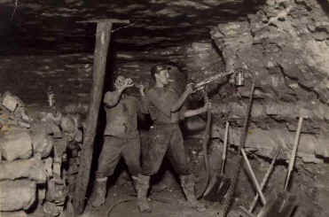
Oil shale
1838 – first studies
1916 – first mines
1918 – start of chemical industry
1959 – large-scale electricity production

Slide 22
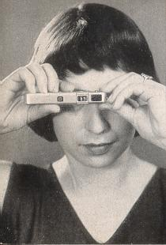
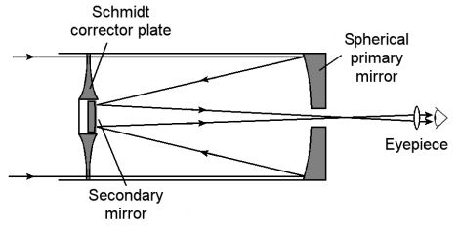
Inventors
Bernhard Schmidt
Walter Zapp – Minox camera

Slide 23
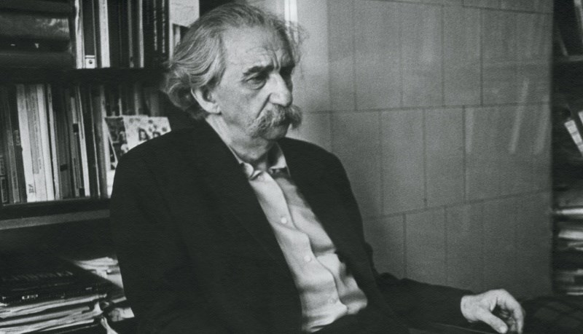
Tartu-Moscow Semiotic School
Juri Lotman
The language of art, cultural rules, religion etc. are secondary modelling systems, or more complex languages built upon natural language.
semiosphere

Slide 24
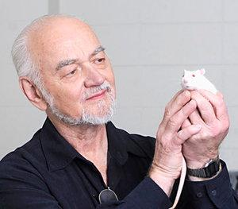
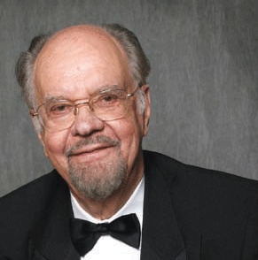
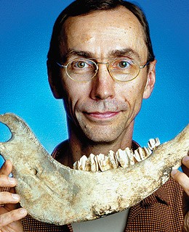
Estonian science in exile
Jaak Panksepp
neural mechanisms of emotion, functions of play
Endel Tulving distinction of episodic and semantic memory
Svante Pääbo Neanderthal genome
Notes:
Jaak Panksepp: https://www.youtube.com/watch?v=65e2qScV_K8

Slide 25


