Slide 1
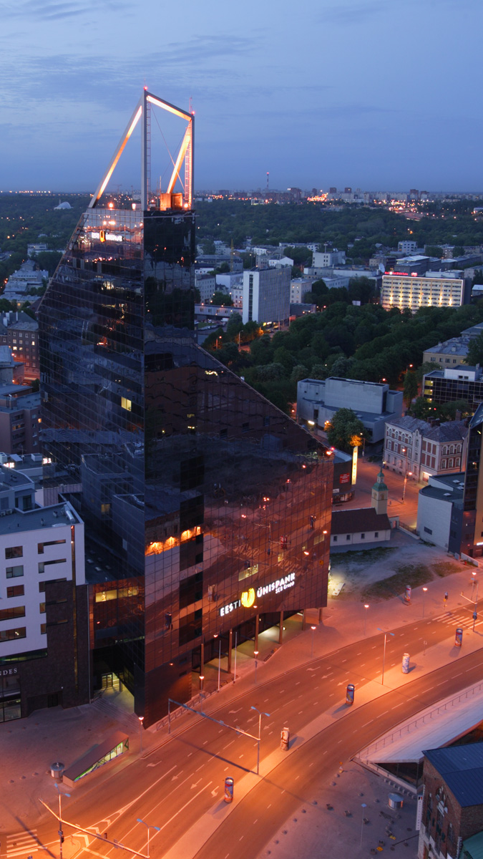
E-stonia: Pioneering Public e-Services
Lecture 3 of course ‘The innovative Estonia’
Arko Olesk
Tallinn University/Postimees

Slide 2
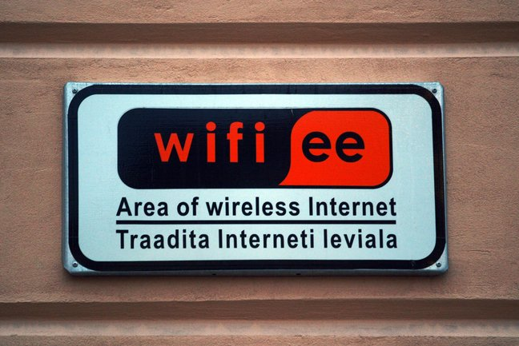
The beginnings
Clean sheet in 1991
Widespread adoption of ICT – schools, public access points
Internet access as a social right

Slide 3
Indicators
Entire country is covered with a broadband
99,8 % of bank transfers are performed electronically
98% of income tax declarations made via the e-Tax Board
Over 30% of votes were cast over the internet in 2015
98% of medications is bought with a digital prescription
Notes:
https://www.youtube.com/watch?v=xBQQ1dQ_2Ow

Slide 4
Some achievements
2000: Launch of e-Tax Board
2000: Launch of m-Parking
2003: Launch of ID bus ticket
2005: i-Voting was introduced
2007: Launch of e-Police system
2008: Launch of e-Health system
2010: Launch of e-Prescription
2013: X-Road Europe introduced
2013: Online Border-Crossing System
2014: e-Residency

Slide 5
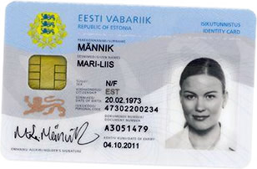
National ID Card
Digital name:
38101222744
Introduction in 2002
Compulsory
Contains certificates

Slide 6
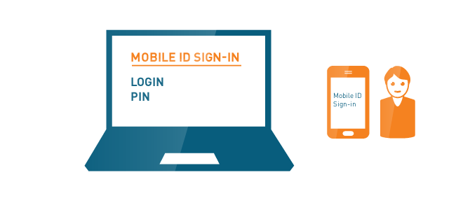
National ID card application
Secure log-in / prove identity (PIN1)
Digital signatures (PIN2)
Mobile ID
NFC chip

Slide 7
Services
E-services portal: eesti.ee
E-tax
Setting up a business
National databases
E-health (health record, prescriptions)
E-school
etc...

Slide 8
Internet based voting
Since 2005
30% of votes in 2015
Not allowed on election day

Slide 9
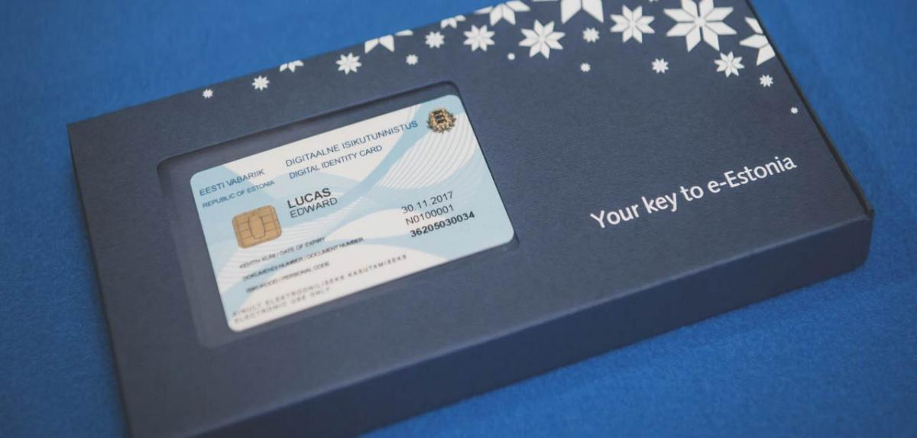
E-residency
Since 2014
More than 9000 e-residents
10 million by 2025?
Development of services - ‘app-store’

Slide 10
E-residents can
• Digitally sign documents and contracts
• Verify the authenticity of signed documents
• Encrypt and transmit documents securely.
• Establish an Estonian company online within a day.
• Administer the company from anywhere in the world.
• Conduct e-banking and remote money transfers.
• Access online payment service providers
• Declare Estonian taxes online
Notes:
https://app.cyfe.com/dashboards/195223/5587fe4e52036102283711615553

Slide 11
The future
Cross-border services
EU standard
Invisible government
Data embassies
Open data

Slide 12
X-road

Slide 13
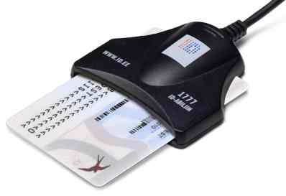
Security
Encryption
Transparency
Trust

Slide 14
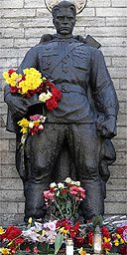
Cyber security
Bronze night in 2007
NATO Cooperative Cyber Defence Centre of Excellence

