Slide 1
Not just Skype: Estonia as a Start-Up Country
Lecture 4 of course ‘The innovative Estonia’
Arko Olesk
Tallinn University/Postimees

Slide 2
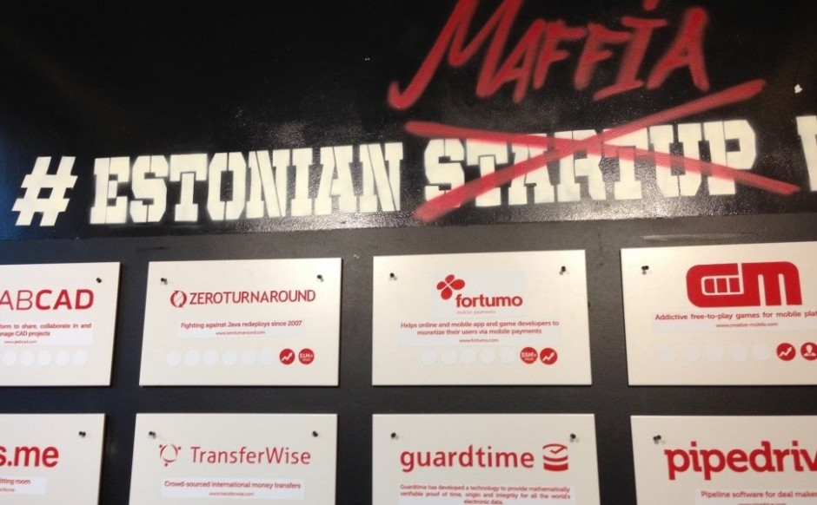
Most start-ups per capita (?)
$65 million of investments in first six months of 2015

Slide 3
Skype – the ‘Estonian Nokia’
A team of Estonian coders
Kazaa – P2P file sharing
Skype – 2003
Sold to eBay in 2005 ($2.6 bn)
Acquired by Microsoft in 2011 for $8.5 bn

Slide 4
TransferWise
money transfer service
2011
Unicorn

Slide 5
Successful exits
Modesat
FitsMe - Virtual Fitting Room
GrabCad – collaborative working tool for engineers, ca $100 M

Slide 6
Projects
Fortumo – mobile payments
Pocopay – mobile banking
GuardTime – cyber-security provider
Signwise – eSignature and authentication
ZeroTurnaround – Java development tools
Erply – online point-of-sale and retail software system
Notes:
http://hub.garage48.org/estonian-startups

Slide 7
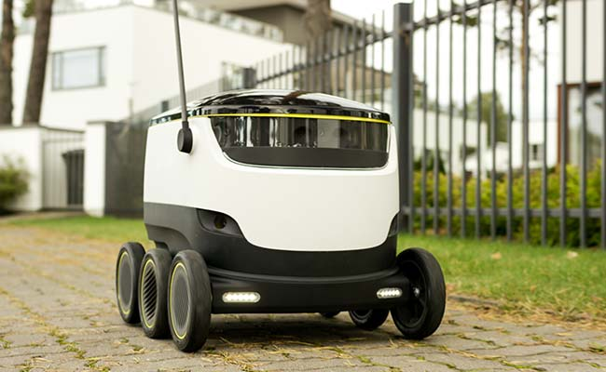
More projects
Click & Grow
Starship – local delivery robot

Slide 8
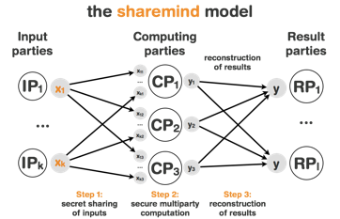
Sharemind
Allows computing encrypted data
Notes:
https://vimeo.com/63275377

Slide 9
Even more projects
Lingvist – language learning
Tsolutions – bus tickets
Jobbatical - connecting talent to employers for short term gigs
Fleep – business messenger
VitalFields – farm management software
Planet OS – big data managements
Skeleton - supercapacitors
Taxify – taxi sevice
Notes:
http://www.eu-startups.com/2016/03/10-estonian-startups-to-look-out-for-in-2016/#more-14475

Slide 10
Support structure
Incubators and startup accelerators
Angel investors
Garage48 – startup hackathlon
MSQRD (€100 M Facebook deal)
Ajujaht – prime-time TV show, competition of business ideas

