Slide 1
Migration in Central Europe

Slide 2
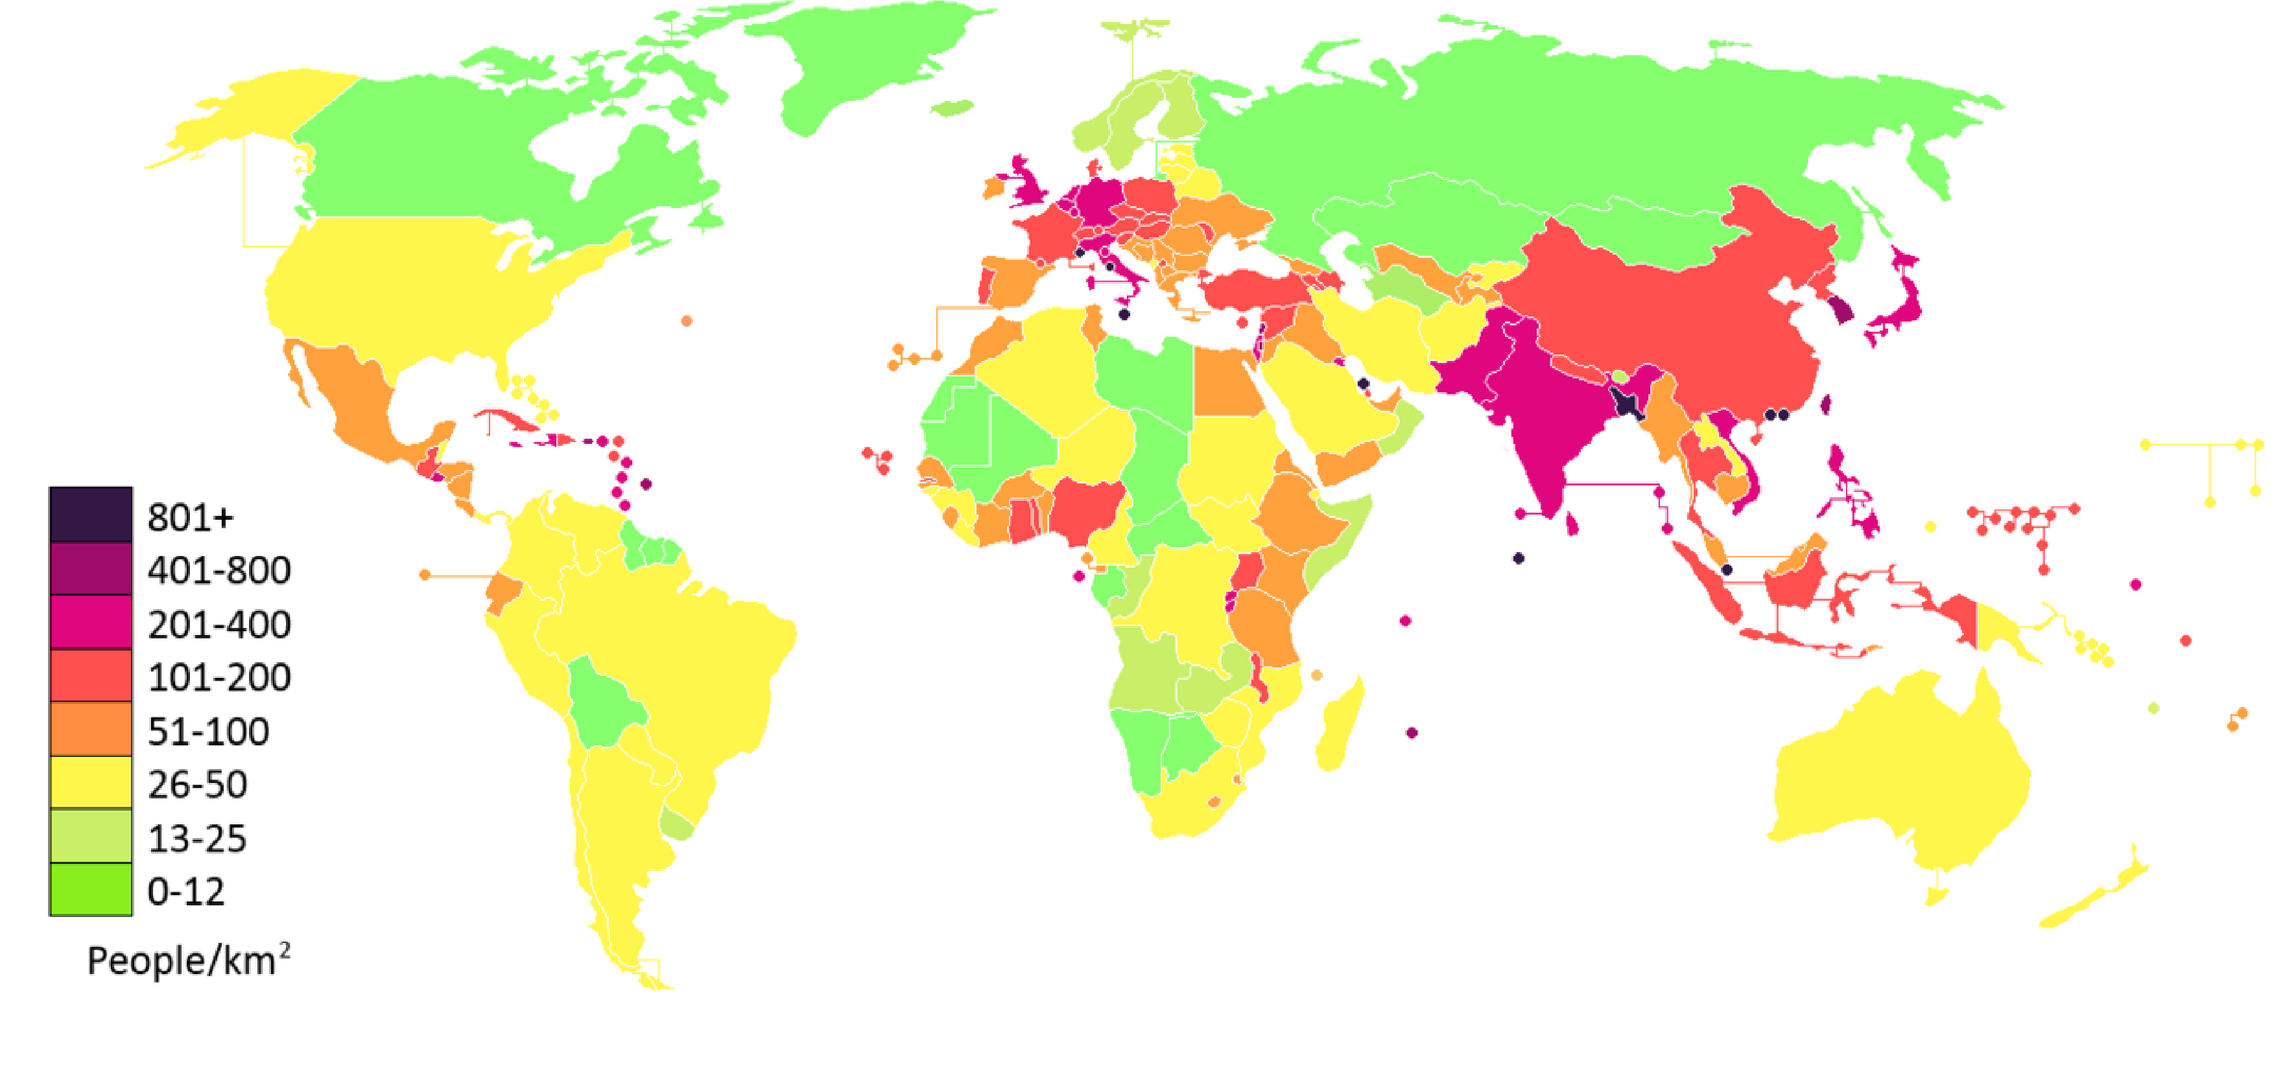
Population Density

Slide 3
Demographic Revolution - Transition
originally high birth/death rate gradually decreasing
(natality vs. mortality)
reduced infant mortality
increased life expectancy

Slide 4
Population Growth in Time
0 – 300 mil
1000 – 310 mil
1500 – 500 mil
1750 – 800 mil – European expansion
1804 – 1 bn
1927 – 2 bn
1960 – 3 bn
1974 – 4 bn
1987 – 5 bn
1999 – 6 bn
2011 – 7 bn – October
2050 – 9.5 bn

Slide 5
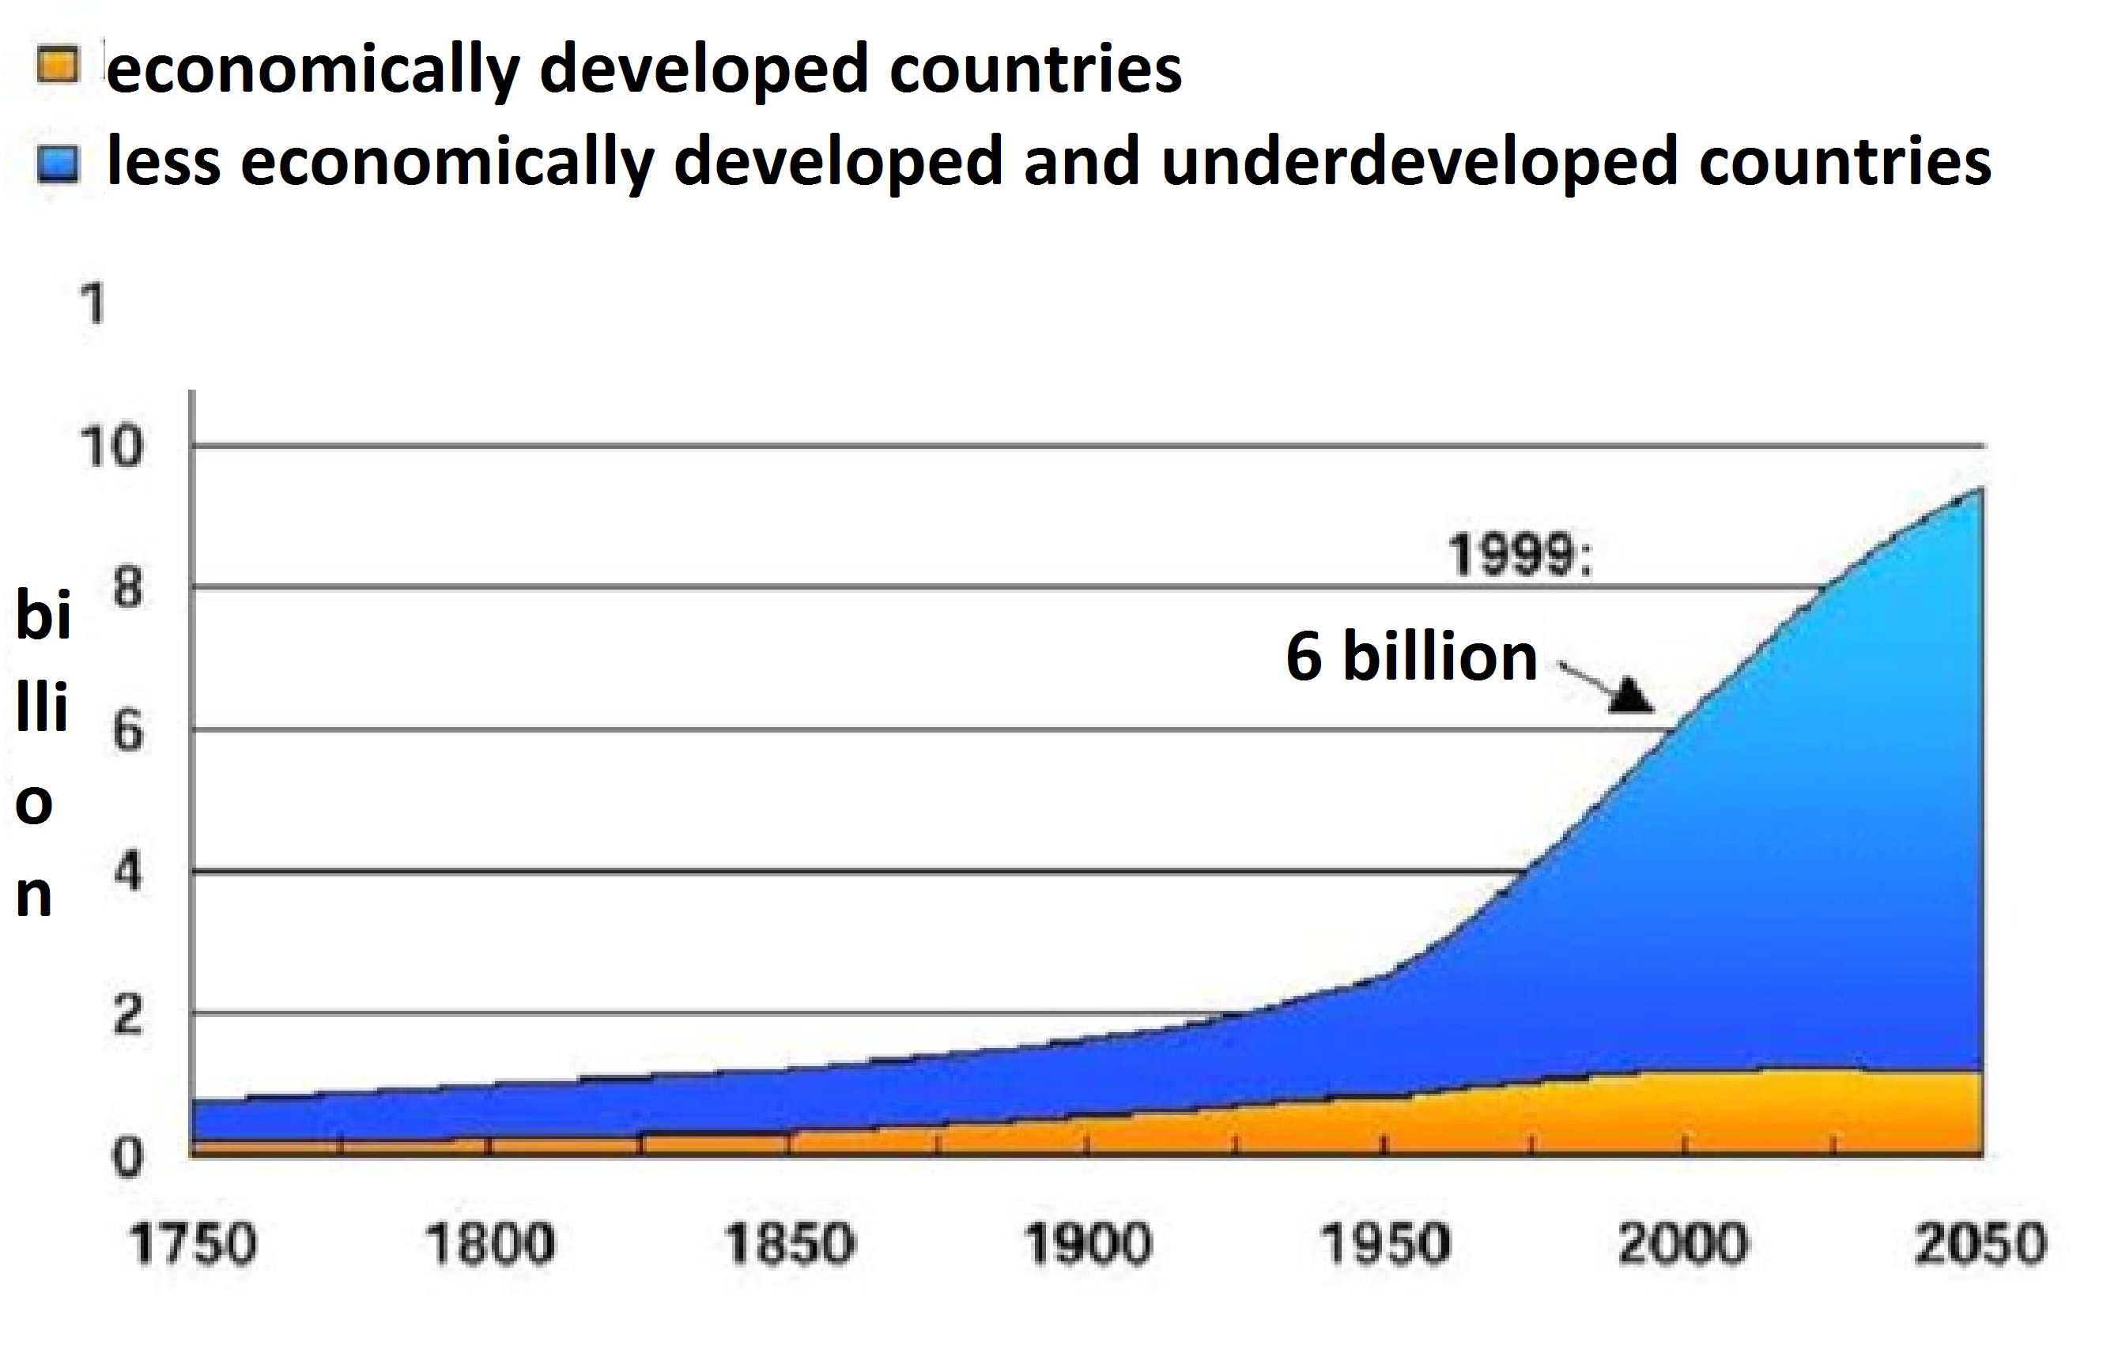

Slide 6
‘Age of Migration’ a period during which international migration has accelerated, globalised, feminised, diversified and become increasingly politicised.
(Castles and Miller 1993, 2009: 10-12).

Slide 7
Migration Theories
internal vs. international
temporary vs. permanent
regular vs. irregular migration
voluntary and forced migration
‘economic’ migrants vs. refugees
transnationalism
diaspora

Slide 8
Push Factors
Not enough jobs
Few opportunities
Primitive conditions
Desertification
Famine or drought
Political fear or persecution
Poor medical care
Natural disasters
Death threats
Pollution
Poor housing
Landlord/tenant issues
Discrimination
Poor chances of marrying
Pull Factors
Job opportunities
Better living conditions
Political and/or religious freedom
Enjoyment
Education
Better medical care
Security
Family links
Industry
Better chances of marrying

Slide 9
Migration Theories
Migration occurs because individuals search for food, sex and security outside their usual habitation.(Idyorough, 2008)
Zipf's Inverse Distance Law (1956)
Gravity Model of Migration and the Friction of Distance
Buffer Theory
Stouffer's Theory of Intervening Opportunities (1940)
Zelinsky's Mobility Transition Model (1971)
Bauder's Regulation of Labor Markets (2006) suggests that the international migration of workers is necessary for the survival of industrialized economies.

Slide 10
Modern Migrations
Industrialization encouraged migration wherever it appeared.
Forced migration = the movements of refugees and internally displaced people (conflicts, natural or environmental disasters, chemical or nuclear disasters, famine, or development projects)
(http://www.forcedmigration.org/about/whatisfm)
Worldwide
Europe

Slide 11
Modern Migrations
Until 1925
From 1933 to 1948
Migrations during and after the Cold War
New expulsions

Slide 12
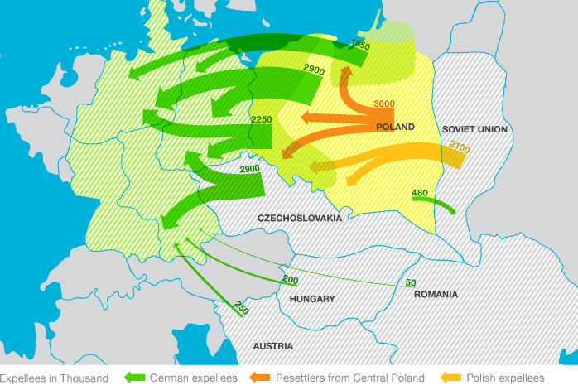

Slide 13
EUROPEAN MIGRATION AND ASYLUM POLICY: DEVELOPMENT AND KEY POLICY AREAS
Phase 1: 1957–1990
Phase 2: 1990–1999
Phase 3: since 1999

Slide 14
Common European Asylum System (CEAS)
Dublin Convenction
Schengen System

Slide 15
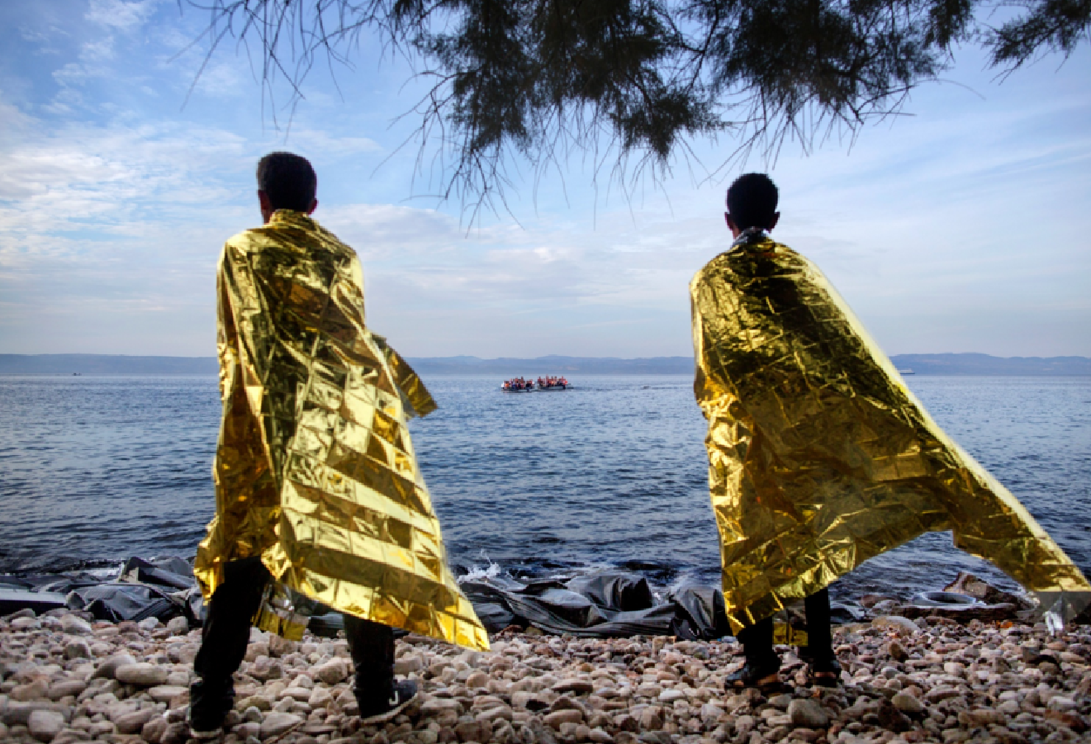
Integration of Third-Country Nationals Living in the EU

Slide 16
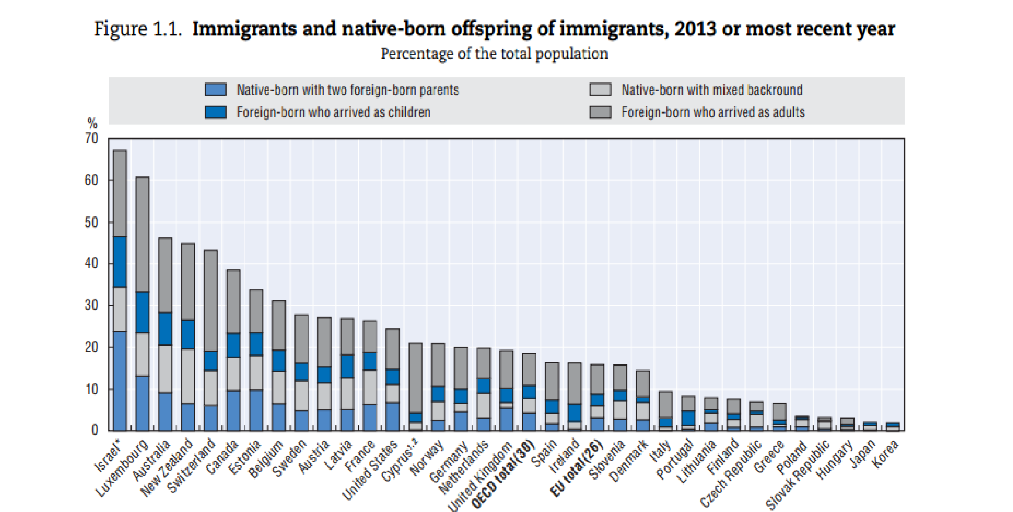
Structure of immigrants

