Slide 1
Migration in Central Europe
http://www.worldometers.info/

Slide 2
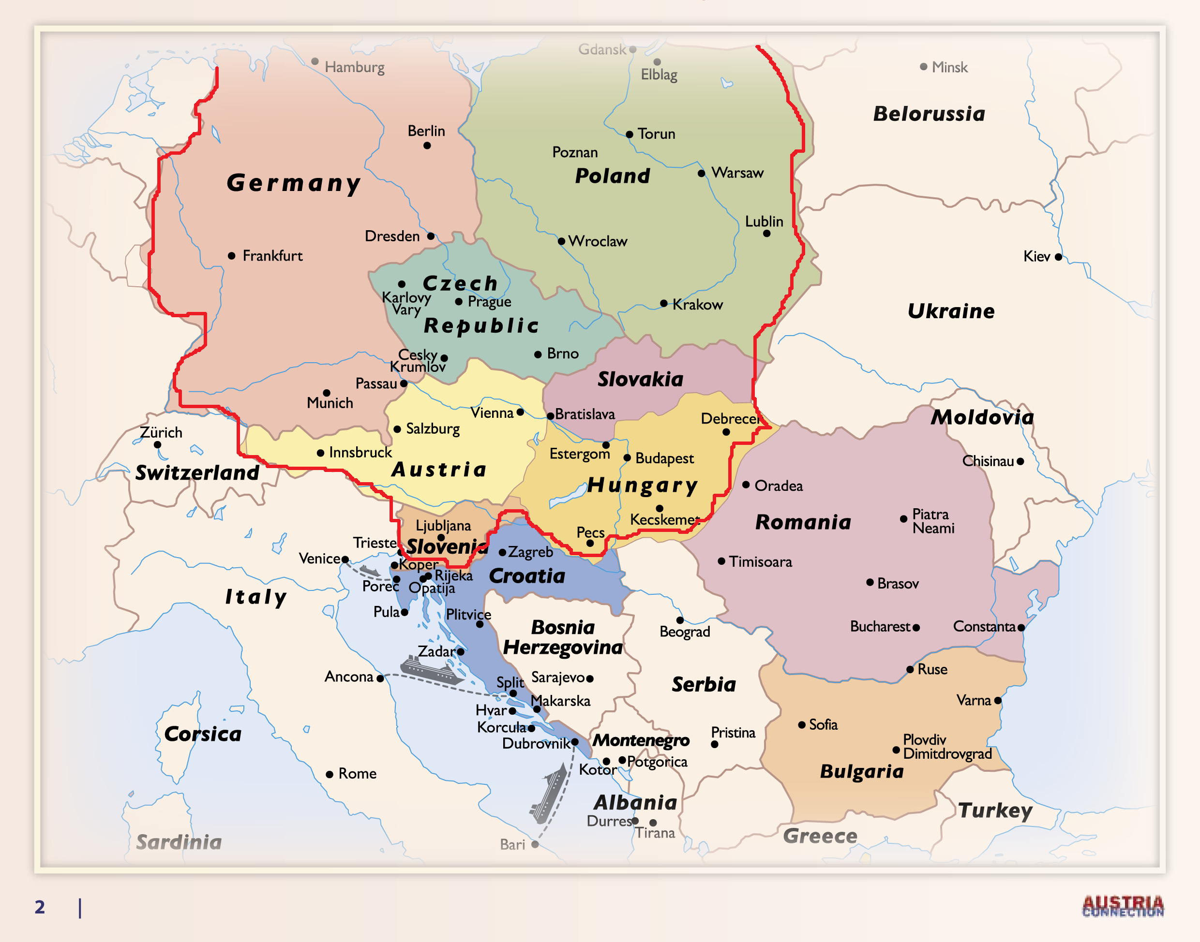
Central Europe

Slide 3
3% of World´s Population
=
140 – 170,000,000
=
international migrants

Slide 4
At the End of 2014
=
59.5 milion refugees
=
½ children

Slide 5
1951 United Nations - Status of Refugees
"A person who owing to well-founded fear of being persecuted for reasons of race, religion, nationality, membership of a particular social group or political opinion, is outside the country of his nationality and is unable or, owing to such fear, is unwilling to avail himself of the protection of that country; or who, not having a nationality and being outside the country of his former habitual residence as a result of such events, is unable or, owing to such fear, is unwilling to return to it."

Slide 6
The Main Source of Refugees
=
armed conflicts
15 in last 5 years
(8 Africa, 3 Middle East, 3 Asia, 1 Europe)

Slide 7
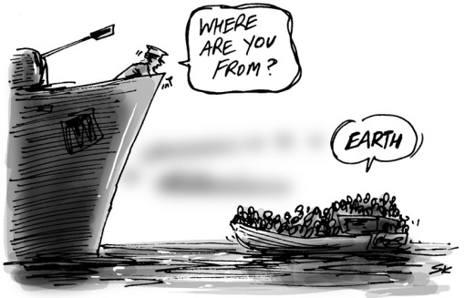
Media
Instruments Used For Communication

Slide 8
Social Media
Social Instrument of Communication

Slide 9
Function of Mass Media
guidance and information
interpretive
public control of power through media
socialization
relaxing and fun

Slide 10
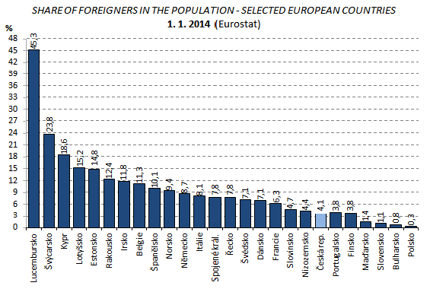

Slide 11
Hungary
2011 – 200,000 less then 2% foreigners
ethnic Hungarians from Romania, Ukraine, Serbia
Germans, Chinese
Hungary does not allow undocumented migrants to access the full education system.

Slide 12
The Czech Republic
2015 – 467,562 foreigners = 4.1%
Ukraine, Slovakia, Vietnam, Germany, Poland,
Bulgaria, China, Belarus, Moldova, Mongolia
The long-term trend observed in connection with the foreign population has been an interest
of a permanent residence in the Czech Republic.

Slide 13
Poland
2014 –0.3% foreigners of Polish population
97,000 legally; 50-70,000 illegally
Ukraine, Belarus, Russia, Moldova, Armenia,
China, Vietnam

Slide 14
Slovakia
2011 – 71,000 = 1.3%
Czech Republic, Hungary and Romania
The immigration to Slovakia has been gradually rising since the country’s accession to the EU.

Slide 15
Slovenia
2011 – 4% foreigners
Slovenia is mainly an immigration country with high migration flows from the former Yugoslavian countries.

Slide 16
Austria
2012 – 970,000 = 12.4% foreigners
Germany, Serbia, Montenegro, Kosovo and Turkey more than half of all immigrants are from EU
2010–2012 the number of immigrants increased by 40%.

Slide 17
Germany
2014 – 8.7% foreigners
Turkey, Italy, Poland, Serbia and Greece
more than a third of immigrants are EU citizens
2010–2012, the number of immigrants increased by 20%.

Slide 18
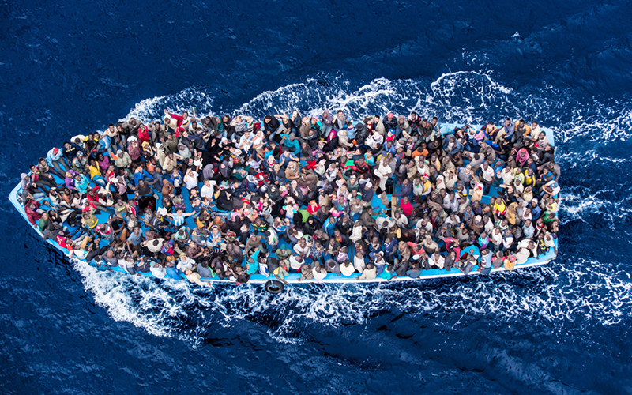
Asylum Seekers

Slide 19
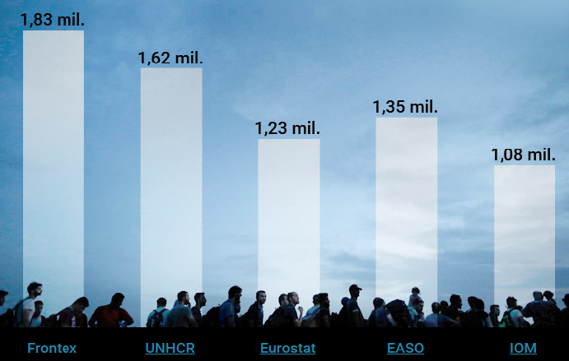
How Many Migrants Had Arrived in 2015 (according to different sources)

Slide 20
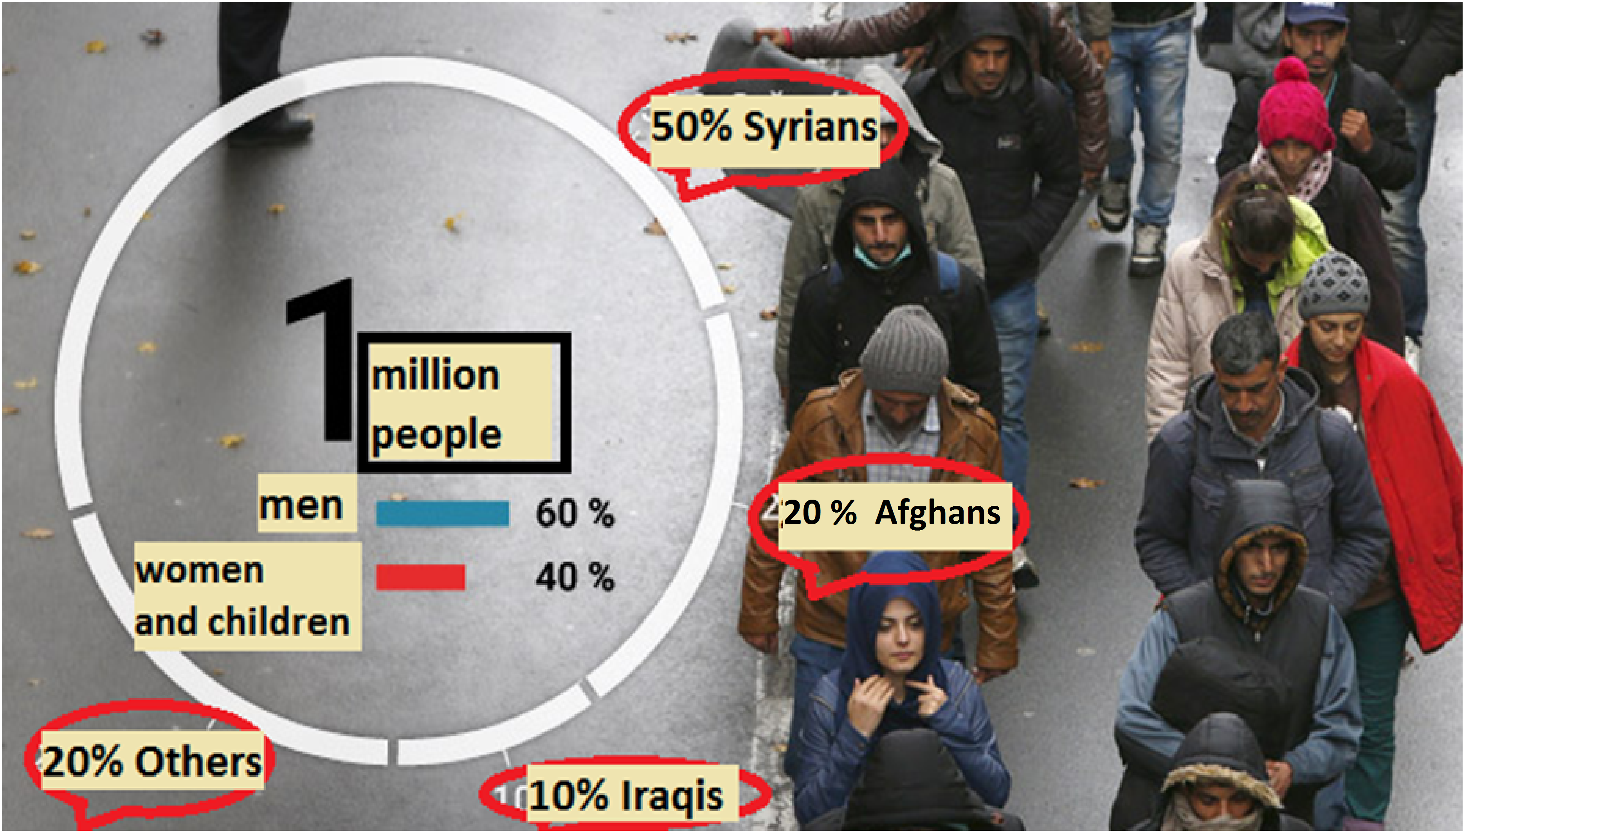
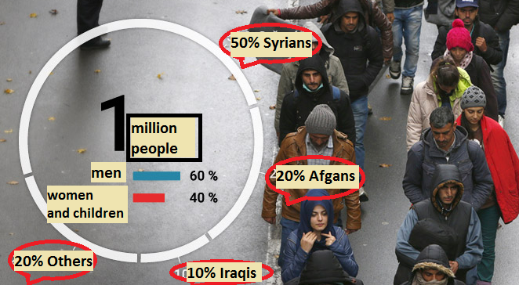

Slide 22
Access to Employment
Slovenia Czech Republic Poland
Hungary
Germany
Slovakia
Austria

