Slide 1
Refugees

Slide 2
Terminology
Asylum seeker
Migrant
Refugee

Slide 3
Reasons
Military intervention?
Instability not because of the intervention?
Islam?

Slide 4
Why now?
the ongoing violence
the worsening of conditions
the continued lack of opportunities
geopolitical changes

Slide 5
Why This Crisis Is So Difficult to Tackle
focusing on the “care and maintenance” of refugee populations and with little focus on long-term, sustainable solutions
no sharing with hosting countries in conflict regions
territorially based national asylum systems

Slide 6
Main Routes
Central Mediterranean Route (Italy and Malta)
Eastern Mediterranean Route (Greece/Aegean Sea)
Western Balkans (Hungary)

Slide 7
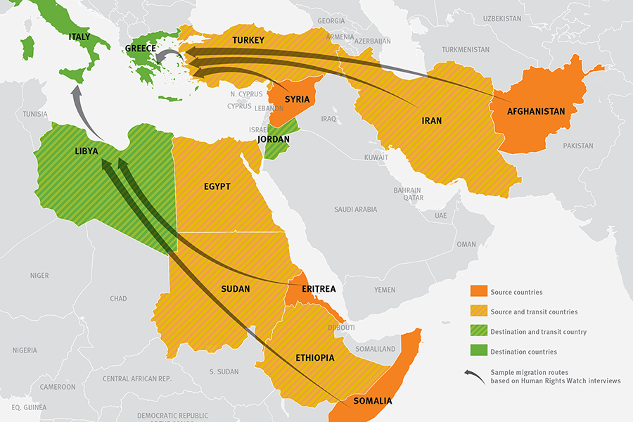
Main Migratory Routes
http://www.businessinsider.com/animated-map-migrant-refugee-crisis-syria-2015-9

Slide 8
European migrant crisis or European refugee crisis
The Schengen Agreement = internal Schengen borders are abolished.
Dublin regulation – who is responsible to examine an assylum application?

Slide 9
Germany
Sweden 2/3 of EU´s Syria
= asylum applications = Afghanistan > half of total
Hungary Iraq
Austria
3,771 people were registred as having died at sea - 2015

Slide 10
Domino Effect of Border Closures
2012 Greek fence with Turkey
2013 Bulgarian fence with Turkey
20/8 2015 FYROM (Former Yugoslavian Republic of Macedonia) closed border with Greece
16/9 2015 Hungary – closed borders with Serbia – closed borders with Croatia
11/11 2015 Slovenian fence with Croatia
18/11 2015 Slovenia, Croatia, Serbia and FYROM – allow nationals from Syria, Afghanistan and Iraq

Slide 11
Media
http://blisty.cz/art/79011.html
Role of media in society:
flow of information
interpreter of information
watchdog fiction

Slide 12
To mark International Migrants Day on Friday 18 December the Ethical Journalism Network has published a report on media and the global migration and refugee crisis.
The report, Moving Stories, reviews media coverage of migration in the European Union and in 14 countries across the globe and finds that journalists often fail to tell the full story and routinely fall into propaganda traps laid by politicians.
http://ethicaljournalismnetwork.org/assets/docs/127/166/e9f107f-311f4a6.pdf

Slide 13
Vocabulary…
http://www.migrationobservatory.ox.ac.uk/reports/migration-news
https://www.online.muni.cz/veda-a-vyzkum/6912-media-odlidstuji-migranty-tvrdi-odbornici
Migrants in the newspapers: An influx of illegal, failed economic terrorists?

Slide 14
Social Media
Arab Spring
Migrants use social media to plan, warn and prepare
Journalist use images, text and video to depict the plight of migrants
The public use digital to galvanise support from citizens across Europe

Slide 15
http://www.aljazeera.com/news/2016/02/macedonia-greek-border-faces-humanitarian-challenge-160228135807844.html
http://www.unhcr.org/pages/4ac9fdae6.html - Camps http://www.unhcr.org/pages/4ac9fdae6-page2.html
https://www.youtube.com/watch?v=pfyaOAZ4pNI 24 min

