Slide 1
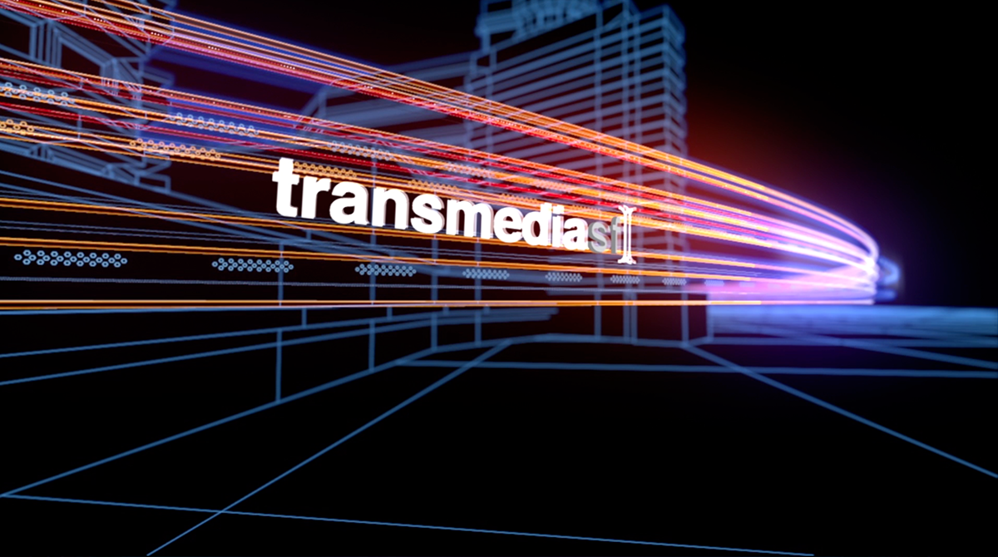
TRANSMEDIA ENTERTAINMENT
Dr Matthew Freeman
Senior Lecturer in Media Communications
Bath Spa University, UK

Slide 2



About me…
Dr Matthew Freeman
Senior Lecturer in Media Communications
Director of the Media Futures Research Centre
Bath Spa University, UK

Slide 3
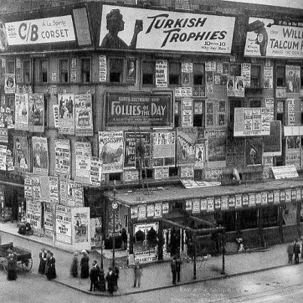
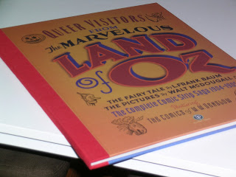

My Research…
International media industry studies
Production cultures across media, time, and countries
  Transmedia storytelling/production
  Media branding/commodification
  Media and cultural history

Slide 4
Course Context
Throughout the world people now engage with stories across multiple media, following the adventures of Doctor Who television to the Web, exploring the Batman universe across cinema, television, comics, and more. This phenomenon, branded ‘transmedia storytelling’ by Henry Jenkins in 2003, has since gained both significant academic and industry presence over the last decade or so. The media industries have since developed sophisticated tools for allowing entertainment to play out seamlessly across media platforms.

Slide 5
Course Rationale
The proliferation of entertainment across multiple media platforms is indeed now so commonplace that it is important to fully understand its workings and implications. Across this course we will analyse and explore different concepts, practices and models of transmedia storytelling, providing you with expansive examples of the role of transmedia entertainment in today’s media culture and industries. We will consider the underlying characteristics of all transmedia stories, before exploring its potential histories as well as a number of key themes of transmedia – including branding, promotion, technology, participation, and globalism. The course will be structured around explorations of transmedia’s past, its present, and its future, altogether providing you with an understanding of the forms, roles and impacts of our contemporary transmedia culture on everything from technology to storytelling, from industry to audiences.

Slide 6
Learning Outcomes
By the end of this course, you should be able to:
Explain the concept and characteristics of transmedia storytelling.
Describe the values and roles of transmedia as a contemporary practice of the media industries.
Analyse the forms of transmedia entertainment across different genres, assessing the textual, economic, cultural and audience implications.

Slide 7
Monday
Lecture 1: Transmedia Introductions: Industry, Technology, Narrative
  Reading: Jenkins, H. (2006) ‘Searching for Origami Unicorn: The Matrix and Transmedia Storytelling’, Convergence Culture: Where Old and New Media Collide. New York: New York University Press, pp.93-130.

Slide 8
Tuesday
Lecture 2: Transmedia Conceptions: World, Character, Author - Promotion, Brand, Continuity
  Reading: NO READING.
Lecture 3: Transmedia Histories Part I: Early 20th Century: Industrialised Consumerism
  Reading: Freeman, M. (2014) ‘Advertising the Yellow Brick Road: Historicizing the Industrial Emergence of Transmedia Storytelling’, International Journal of Communication 8, pp.2362-2381.

Slide 9
Wednesday
Lecture 4: Transmedia Histories Part II: Late 20th Century: Brand Hollywood
  Reading: Grainge, P. (2007) ‘Media Branding and the Entertainment Complex’, Brand Hollywood: Selling Entertainment in a Global Media Age. London: Routledge, pp.44-66.
Screening: The Greatest Movie Ever Sold (2011)

Slide 10
Thursday
Lecture 5: Transmedia Futures Part I: Digital Participation
  Reading: Tepper, A. (2015) ‘Lizzie in Real Life: Social and Narrative Immersion Through Transmedia in The Lizzie Bennett Diaries’, Film Matters (Spring), pp.45-51.
Lecture 6: Transmedia Futures Part II: Transnational and Global Perspectives
  Reading: NO READING.

Slide 11
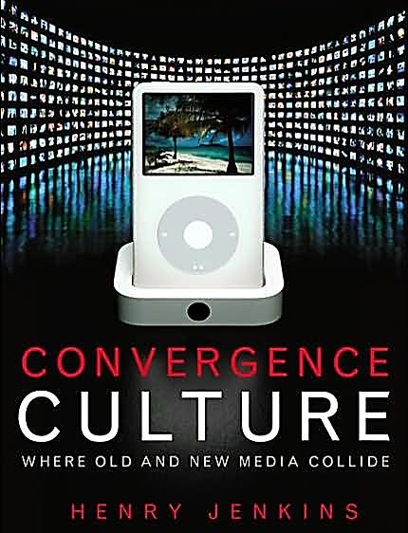
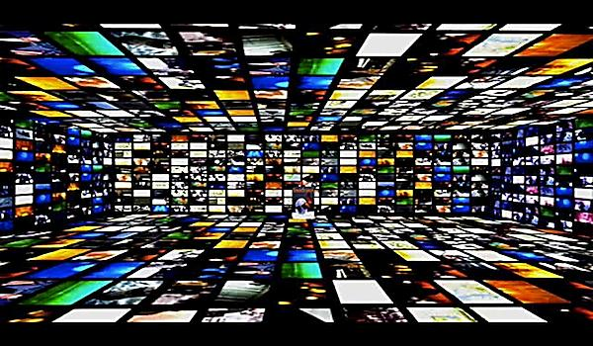
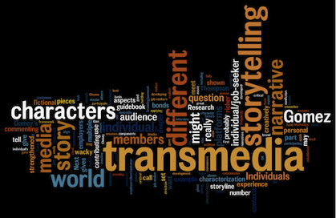
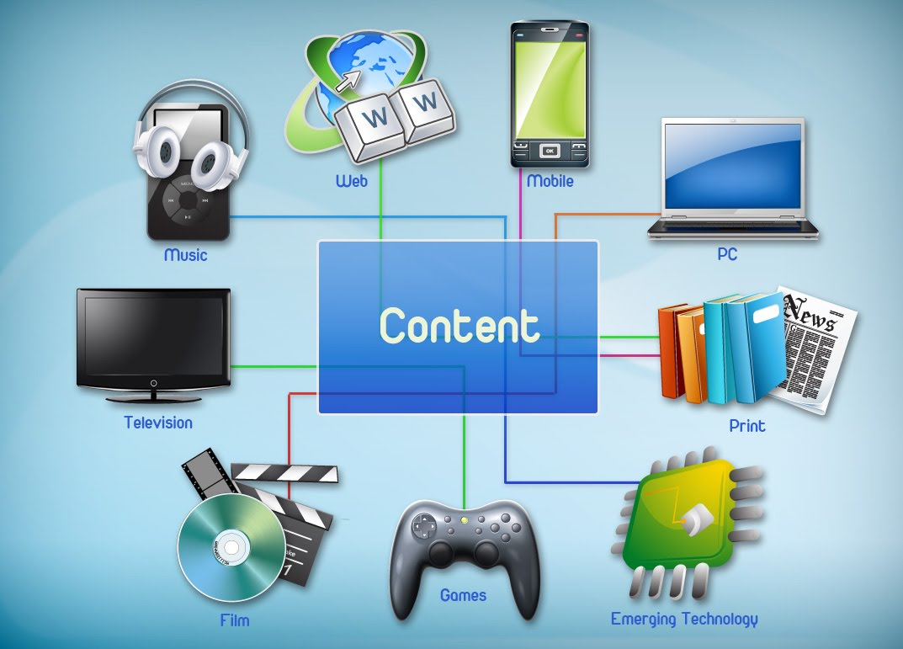
Transmedia Introductions:
Industry, Technology, Narrative
Lecture 1

Slide 12
Today…
What is transmedia storytelling?
Industry context of transmedia storytelling
Transmedia as global storytelling
Transmedia’s observed codes of conventions

Slide 13
What is transmedia?
Transmediality:
“The increasingly popular industrial practice of using multiple media platforms to present information concerning a single fictional world through a range of textual forms.” Elizabeth Evans (2011)

Slide 14
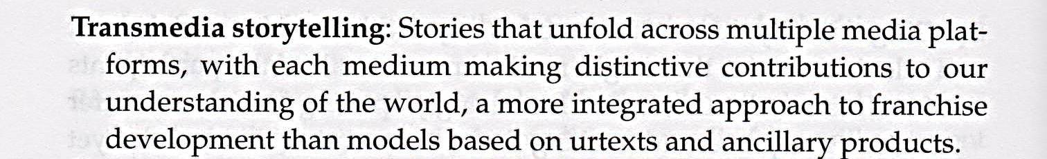
What is transmedia storytelling?
Henry Jenkins, Convergence Culture: Where Old and New Media Collide (New York: New York University Press, 2006), p.334.
http://www.youtube.com/watch?v=o9uX_65IFpY

Slide 15
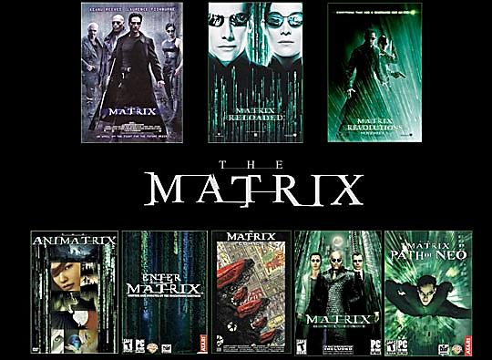
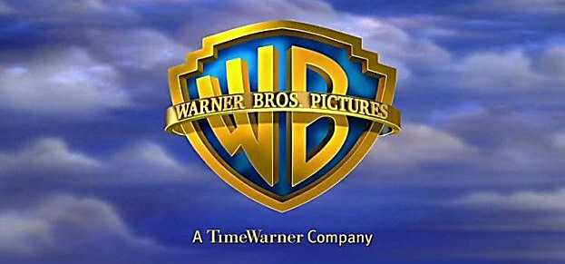
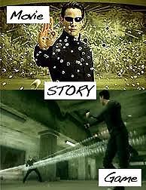


Slide 16
‘Transmedia storytelling represents a process where integral elements of a fiction get dispersed systematically across multiple delivery channels for the purpose of creating a unified and coordinated entertainment experience … In The Matrix franchise, key bits of information are conveyed through three live action films, a series of animated shorts, two collections of comic book stories, and several video games. There is no one single source or ur-text where one can turn to gain all of the information needed to comprehend the Matrix universe.’ (Jenkins 2011)
https://www.youtube.com/watch?v=sHyYig43GYY

Slide 17
Transmedia Context
So why exactly does transmedia even exist?

Slide 18
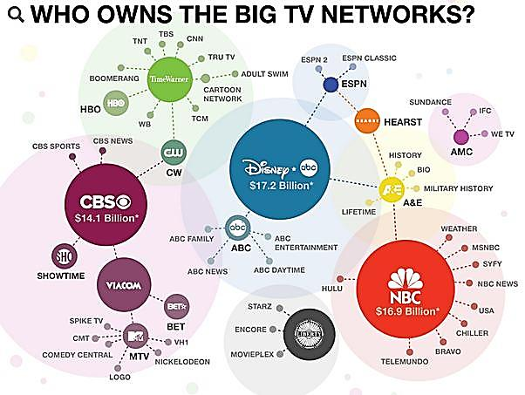
Contemporary Industry Context
(1) Industrial Convergence
(2) Technological Convergence

Slide 19
 | News Corporation: | Time Warner: | National Amusements: |  | NBC Universal: | The Walt Disney Company:
 |  |  | Viacom | CBS Corporation
Cable: | Fox Movie Channel Fox News Channel FX | CNN TNT Cinemax HBO | MTV Networks BET Networks | Showtime | Bravo MSNBC Syfy | A&E Lifetime ESPN
Production and Distribution: | 20th Century Fox, Fox Searchlight Pictures, Blue Sky Studios | Warner Bros. Entertainment | Paramount Pictures, MTV Films | CBS Television Studios, CBS Home Entertainment | NBC Entertainment, Universal Media Studios, Universal Pictures | Touchstone Pictures, Pixar, Walt Disney Studios
Television Networks: | Fox Broadcasting Company (Fox network) Fox Sports | The CW (joint venture with CBS Corporation) |  | CBS, The CW (with Warner Bros. Ent) | NBC | ABC
DBS: | BSkyB, FoxTel
Publishing: | Harper Collins, News International, The Wall Street Journal | Time Inc. |  | Simon and Schuster |  | Disney Consumer Products
Online: | Myspace, Hulu | NASCAR.com, CNN.com | Atom Entertainment | CBS Interactive | Hulu, iVillage | Disney Interactive Media Group
Parks and Resorts: |  |  |  |  | Universal Studios Hollywood | Disneyland Resort Tokyo Disney Resort

Slide 20
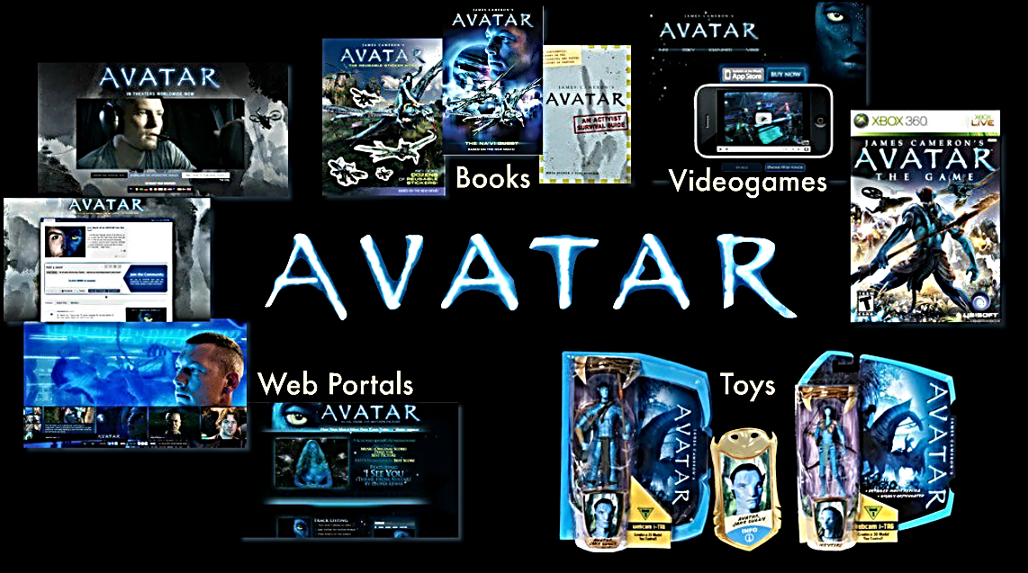
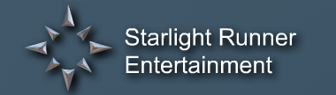
- ‘Creating Blockbuster Worlds’

Slide 21


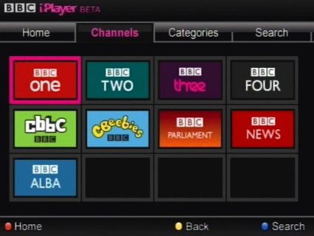


Slide 22

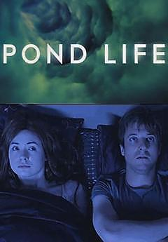
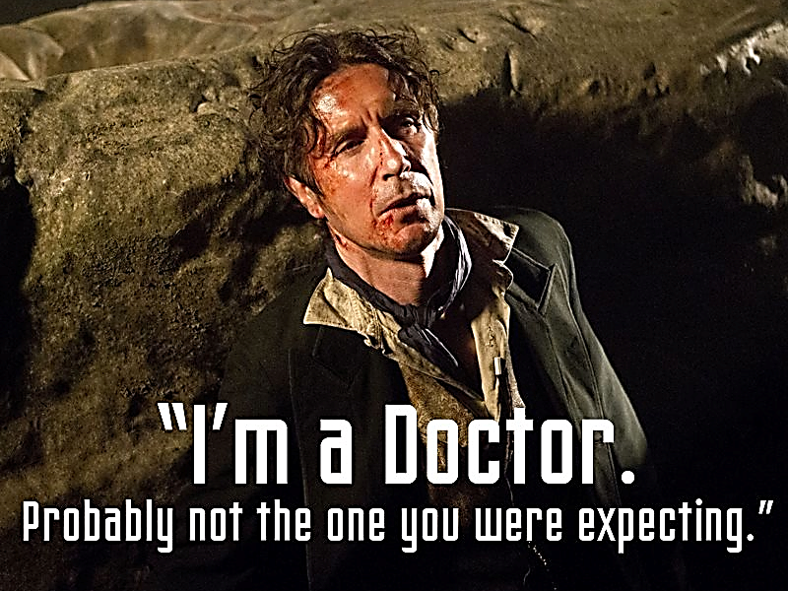
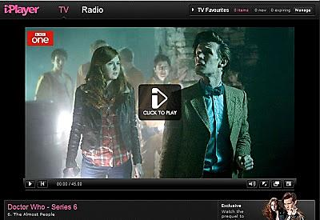


Slide 23
Questions to consider…
Are transmedia stories about re-engaging the same audience over and over again?
Or are transmedia stories about engaging different audiences at different times via different media?
Which ones do you instinctively classify as ‘UK media’, or ‘US media’, or, if any, ‘global media’?
  Do any seem like American products? Why?
  Do any seem like they’re targeting a specific country?
  Do any seem like they’re targeting global audiences?

Slide 24
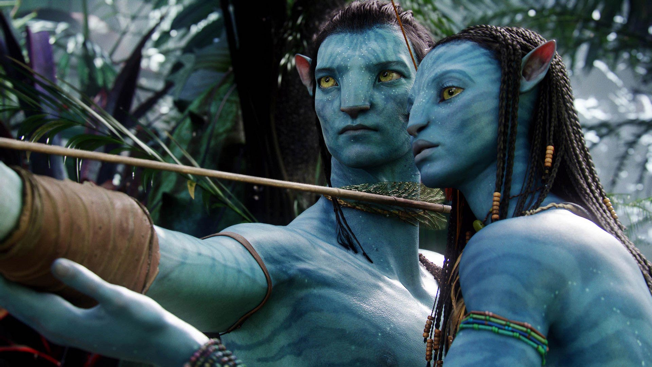

Global Case Study – Avatar (2009)
Box Office Gross
$3 billion (approx.): 27.3% (USA)
72.7% (rest of world)

Slide 25
How ‘American’ is Avatar (2009)?
Based on watching the trailer for Avatar, which aspects “feel” American and which aspects feel more universal? Consider:
  Actors, language, production style
  Genre type, story, characters
  Themes, visuals, sound, etc.
https://www.youtube.com/watch?v=5PSNL1qE6VY

Slide 26
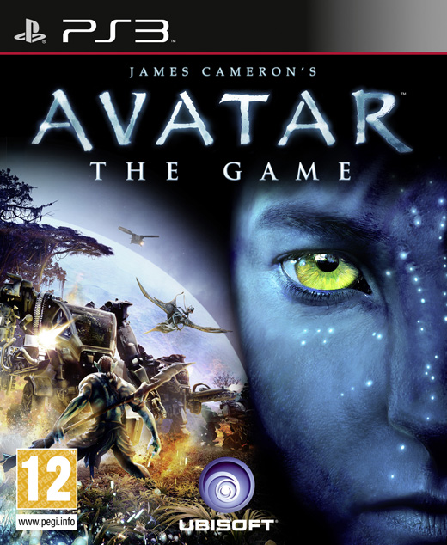
Transmedia – Avatar: The Game
Based on the trailer for Avatar: The Game, what nationality of audience(s) do you think the makers are trying to attract? (i.e. US? Global?). Consider:
  Themes, visuals, language, genre
https://www.youtube.com/watch?v=xw5lV0KgW20

Slide 27
Avatar: The Game (2009)
Avatar: The Game (2009)
Global Sales Percentages
53.0% (USA)
36.3% (Europe)
10.7% (rest of world)

Slide 28
What, if anything, does this show…?
Does the transmedia Avatar example suggest that:
Transmedia is key to engaging wider audiences?
Games are a less global medium that film?
US audiences are drawn to video games?
Global audiences are drawn to sci-fi film?
Non-Western audiences prefer watching imaginary worlds to playing inside them?
Story themes of colonization, war, and love transcend media and travel internationally?

Slide 29
Characteristics of Transmedia
What are the basic codes and conventions of transmedia storytelling according to scholars?

Slide 30
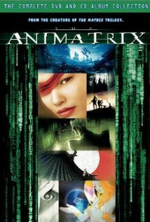
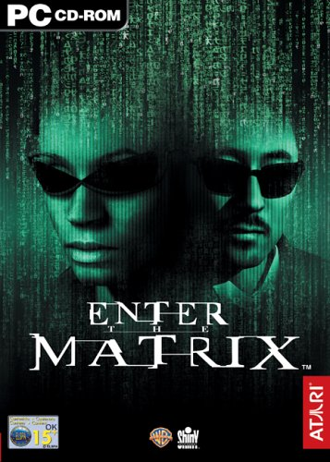

Transmedia Storytelling:
Narrative Coherence

Slide 31
Transmedia Storytelling:
Authorial Coherence

Slide 32
Transmedia Storytelling:
Temporal Coherence

Slide 33
What are the benefits of creating transmedia entertainment that is so narratively, authorially and temporally coherent?

Slide 34
Encourages engagement with a wider range of media texts and consumer products associated with a specific entertainment
Multiplies the potential profits for industries
Increases loyalty from audiences and consumers by rewarding the engaged viewer

Slide 35
Transmedia codes and conventions
(1) ‘a network of intertextuality’ (storytelling)
(2) ‘collectability’ (branding)
(3) ‘accelerates the growth curve of the commercial system’ (cross-promotion)
Marsha Kinder, Playing with Power in Movies, Television, and Video Games: From Muppet Babies to Teenage Mutant Ninja Turtles (Berkeley, California: University of California Press, 1991).

Slide 36
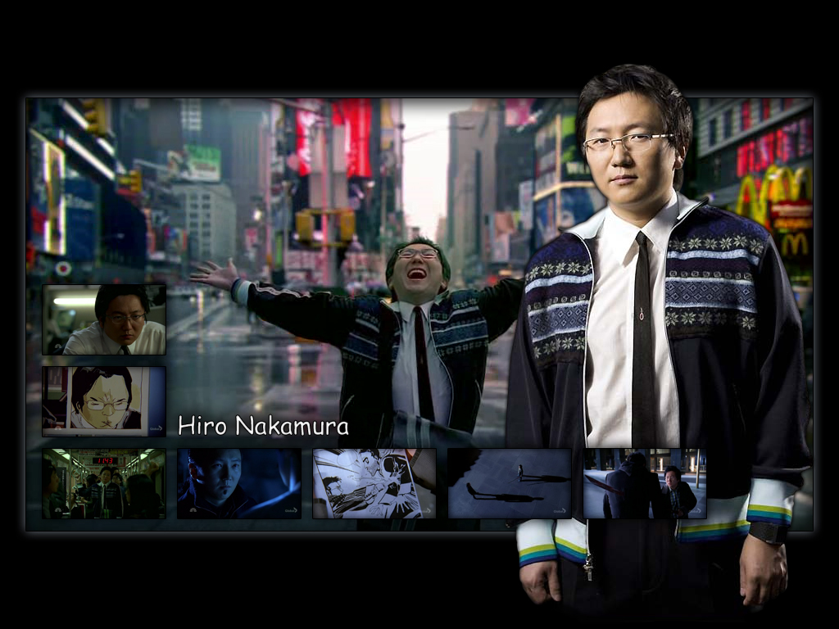



Intertextuality
(storytelling)
Heroes
(2006–2010)

Slide 37




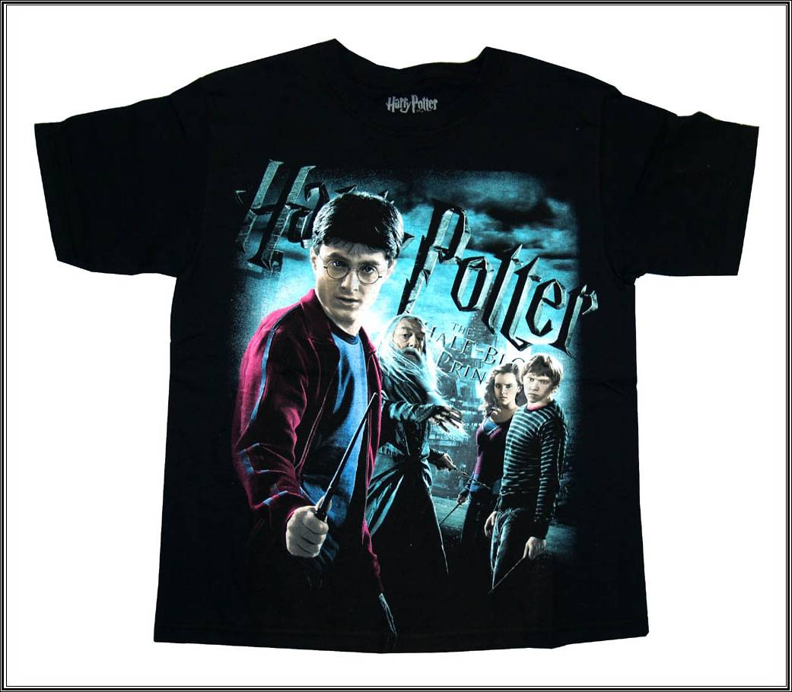

Collectability
(branding)
Harry Potter

Slide 38

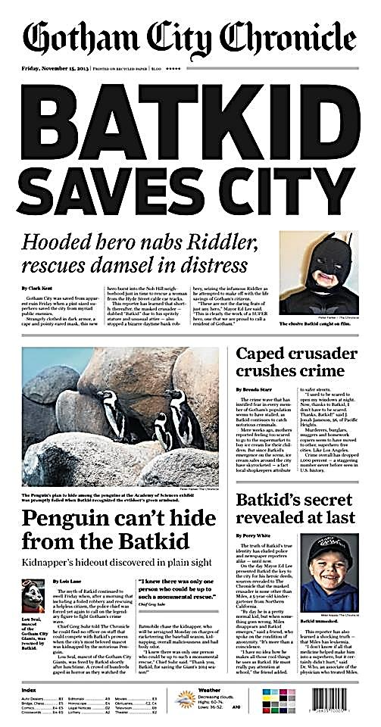
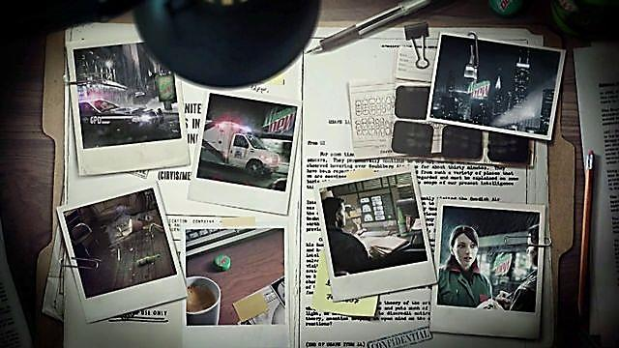
Commercial system (cross-promotion)
http://vimeo.com/51912879

Slide 39
Dangers of transmedia storytelling?
What are some of the potential pitfalls and dangers for the media industries in asking audiences to cross multiple platforms?

Slide 40
Dangers of transmedia storytelling?
Audience fatigue
Confusing/incoherent narratives
High production costs – risk
High expense for audiences
Extra emphasis on production coordination

Slide 41
What to take away from today…
Transmedia storytelling is about continuity, coherence and depth
Stories become storyworlds
Audiences become gatherers of media
Intertextuality (story), collectability (branding), and cross-promotion (commercialism)
Transmedia is key to engaging wider audiences

Slide 42
What’s coming up…?
Lecture 2:
‘Transmedia Conceptions: World, Character, Author – Promotion, Brand, Continuity’
Lecture 3:
‘Transmedia Histories Part I: 20th Century Consumerism’

