Slide 1
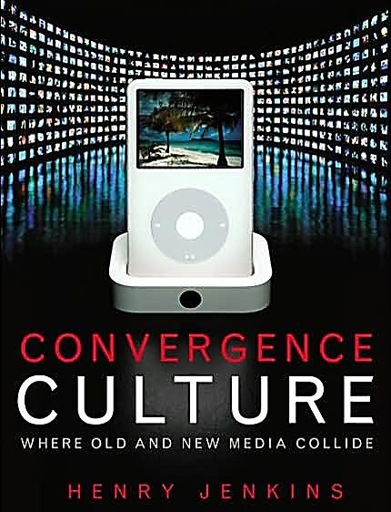
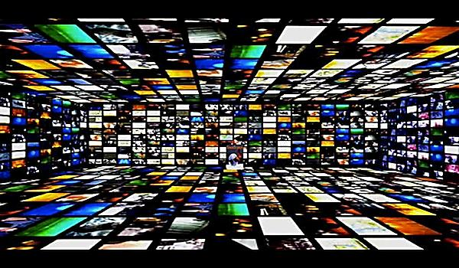
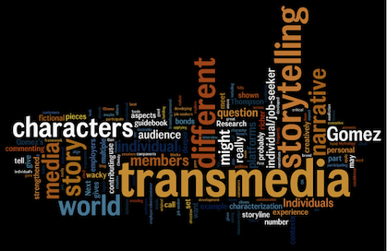
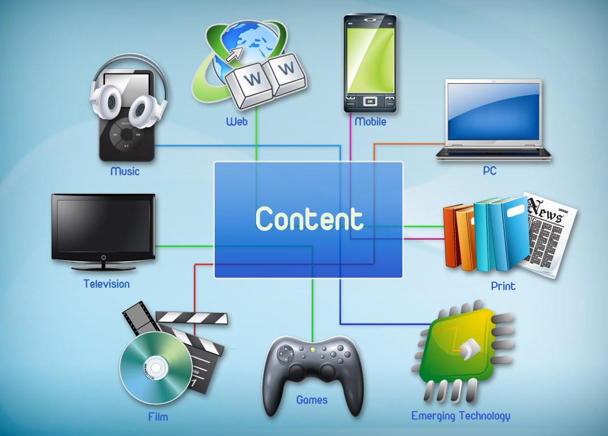
Transmedia Conceptions: World, Character, Author - Promotion, Brand, Continuity
Lecture 2

Slide 2
Today…
Further conceptions of transmedia storytelling
Author, character, world
Functions of transmedia storytelling
Promotion and brand
Industrial models of transmediality
Continuity vs. multiplicity

Slide 3
Learning Objectives
EXPLAIN how all transmedia stories are underpinned by author, character, world
DESCRIBE the function of promotion and branding on transmedia storytelling
ANALYSE the manifestations of alternative models of transmedia on storytelling

Slide 4
Characterising Transmedia
‘When it comes to transmedia, it all starts with story…’ (Starlight Runner Entertainment)
3 characteristics of transmedia storytelling:
Character-building
World-building
Authorship

Slide 5
Conceptualising Transmedia
Transmedia is NOT adaptation
Adaptation is ‘translation’ (Wolf 2012)
Transmedia is ‘growth’ (Wolf 2012)
‘Transmedia does not involve the telling of the same events on different platforms; [it] involves the telling of new events from the same storyworld’ (Evans 2011)

Slide 6
Conceptualising Transmedia
So, transmedia is expansion and extension…
Instead, transmedia is the process of building outward… imagine a number of new room extensions that are added onto the same building to make a larger house…
Notes:
Re. 2nd point: Convergence speaks about multiple pre-existing forms all coming together, but transmedia speaks about building, extension, adding to something.
i.e. like adding a room extension onto a house! That new room is like a new piece of information that connects to the larger house; it compliments the house, but it is new.

Slide 7
Conceptualising Transmedia
Notes:
Like this!

Slide 8
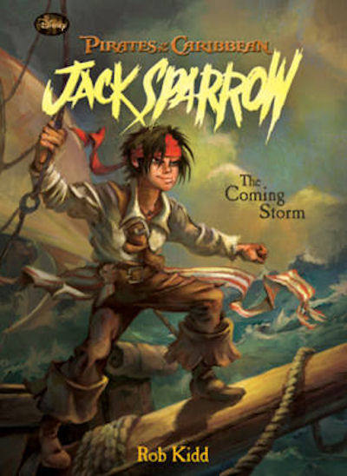
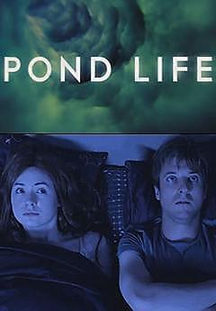
Character-building
Prequels, sequels, the expansion of backstory
Interactions with secondary characters, expand psychology, biography (or backstory)

Slide 9
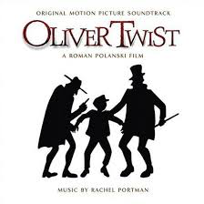
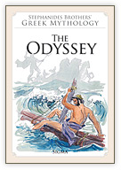
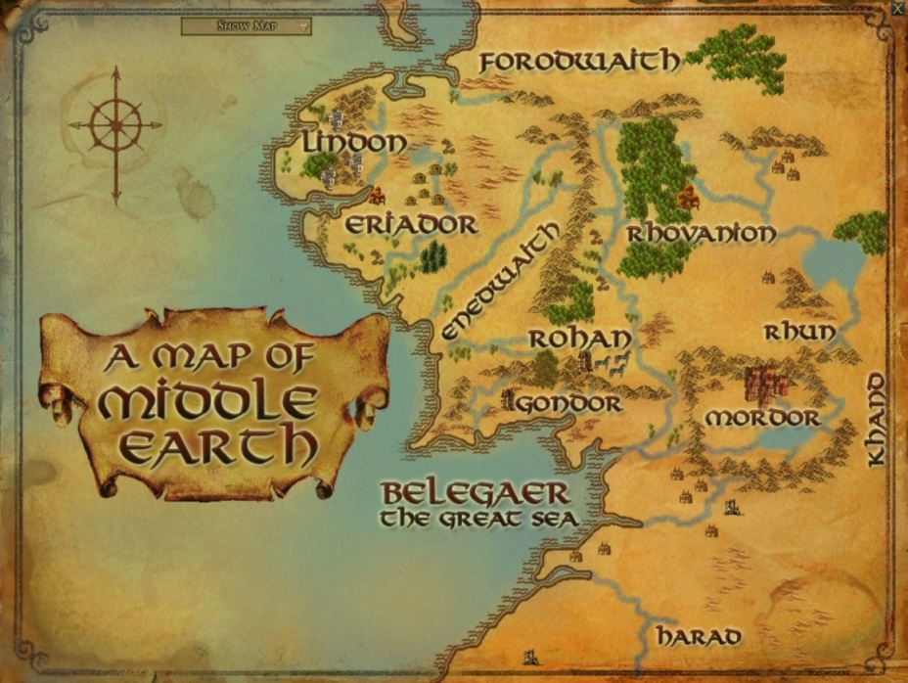
World-building
Adding aspects to an imaginary space, such as mythology, religion, culture, by expanding the timeline of a storyworld to include new events, or by exploring new fictional settings

Slide 10
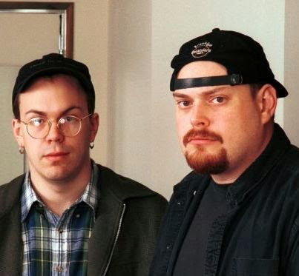
Authorship
Theme of individual authors working within and across larger corporate authors…
Wachowski Brothers/Warner Bros.
Steven Moffat/BBC

Slide 11
Authorship
The strange case of the Star Wars Expanded Universe
‘While Lucasfilm always strived to keep the stories created for the Expanded Universe consistent with our film and TV content as well as internally consistent, George Lucas made it clear that he was not beholden to the Expanded Universe.’
Notes:
Star Wars is an interesting anomaly:
There is an Expanded Universe across media; these texts build on the characters and expand the world…
BUT, audiences often didn’t think of the EU as ‘core’ ‘canonised’ transmedia SW stories…
Why? Because there was a lack of authorship. The film’s author, George Lucas, publically implied a separation between the films and the EU.
This SW case suggests that authorship is crucial – alongside character-building and world-building.

Slide 12
Summary so far…
Character-building, world-building, and authorship underpin transmedia storytelling
However, character-building and world-building, in isolation, do not always constitute transmedia storytelling…
Instead, character-building and world-building must work alongside authorship - this three-way relationship is key to transmedia stories
Notes:
Re. the 2nd point: for example, Star Wars, but also something like Sherlock Holmes (no central authorship)

Slide 13
KEY FUNCTION 1:
TRANSMEDIA AS PROMOTION

Slide 14
Stop and think…
In what ways might transmedia storytelling work as a form of promotion/advertising?
Notes:
DO TASK – 5 mins

Slide 15
Because…
Transmedia storytelling extends the narrative experience by blurring ‘content’ and ‘promotion’ together!
In any transmedia project, one text is both part of the larger story (content) and an advert for a whole series of other stories (promotion)
Notes:
KEY POINT: Transmedia makes advertising less noticeable and more fun; EVERY text in a transmedia project is advertising for each of the others, for each text points audiences to the rest. We want to consume all the pieces of the puzzle, as it were, so the idea of one text pointing to an another feels like commercialism and more like storytelling:
THE DESIRE TO LEARN MORE INFORMATION BECOMES ITSELF ENTERTAINMENT IN THE CONTEXT OF TRANSMEDIA!!

Slide 16
‘creating transmedia storyworlds is itself the process of ‘understanding how to appeal to migratory audiences’ (Henry Jenkins 2006)
‘promotional material for texts operate not exclusively as apparatus for selling but rather for selling via advancing and developing [the] narrative of a text’ (Jonathan Gray 2010)
‘Transmedia storytelling ultimately lures the audience into buying more stuff – today, DVDs; tomorrow, who knows what?’ (Kring)
Notes:
Here’s Henry Jenkins, Jonathan Gray and Heroes’ creator Tim Kring reinforcing this point about transmedia as promotion/promotion as transmedia.
So, with your own projects, you are trying to think of ways to keep your audience hooked, to encourage them to move across platforms: by advancing the information, you are encouraging people to want to learn more and to keep engaging with your project.
For example, if you write a newspaper article about a little boy lost in the woods, then you write a follow-up blog on another platform about the name and upcoming of the boy, and then finally you make a video on another platform about the return of the boy to his family, you are doing transmedia – new info that promotes further consumption!

Slide 17
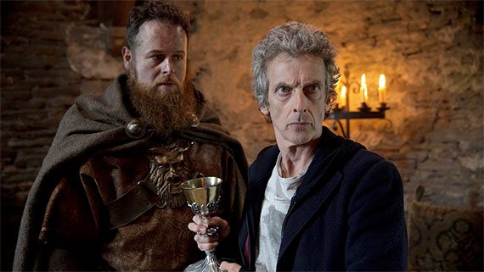
Consider…
Doctor Who series 9 online-only prequel – ‘The Magician’s Meditation’
Works as an advert, promoting the TV series
https://www.youtube.com/watch?v=2IROtC6cAT4
Notes:
Outline the culture of DW producing online-only ‘minisodes’ prior to the release of a new series on TV. These are prequels (like outlined earlier), they are new stories, but they operate principally as adverts for the TV series. In that sense, they are an alternative to producing trailers; both trailers and online-only minisodes are adverts for the TV series.

Slide 18
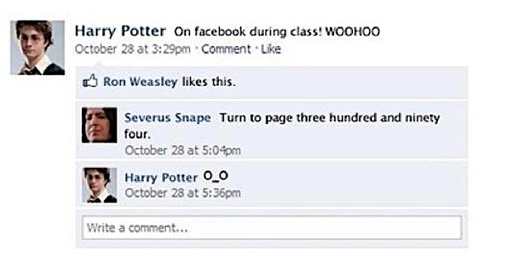
Also consider…
Harry Potter and the Death Hallows Facebook
Works as marketing, bringing entertainment products into our everyday social lives
Notes:
Like DW, here’s a very digital (and cheap and simple) example of transmedia working as promotion…
For the release of the film Harry Potter and the Deathly Hallows, it producers made ‘fake’ Facebook accounts for the film’s characters, and then posted updates from these characters as if they were real conversations going in between the characters outside of the films. So it’s character-building!
But it is also marketing, in so far as it brings entertainment products into the real daily lives of audiences, marketing that product to them by extending the story/information further.

Slide 19
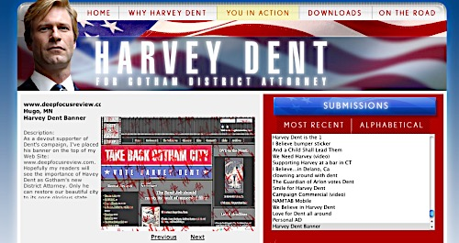
Also consider…
The Dark Knight promotion website ‘ibelieveinharveydent.com’
Works as publicity, encouraging the audience to get more involved in the world of the film
Notes:
Here’s a slightly older (but very famous) example from 2008 Batman film The Dark Knight…
Its marketing team produced a website called ibelieveinharveydent.com – this was the name of the political campaign surrounding the fictional character Harvey Dent, which is acknowledged as a plot point in the film. So, one tip is to take something that is actually acknowledged in one text and expand upon it in another text!
This website was, importantly, very interactive – one aspect of transmedia not yet discussed is the sense that transmedia allows audiences to participate in the storyworld; this is partly what makes the idea of transmedia fun to audiences! So, here, audiences could learn more about the political campaign and vote in that campaign; they could play games… There’s another tip: think how you might make your story/information into a game that people can interact with.
And importantly, an example like this also works as publicity – it builds interest in the film!

Slide 20
Transmedia Storytelling and consumer products
http://www.youtube.com/watch?v=NwCn-D5xFdc
http://www.youtube.com/watch?v=pYDFUvO4upY
Notes:
And, importantly for you all, transmedia isn’t limited to just entertainment. Consumer brands like Coca Cola have adopted it in recent years. What Coke did was use the idea of cross media – using its characteristics to do with extending content across media – to extend the brand message of Coca-Cola into a game app and other platforms so to allow interaction with the Coke brand storyworld and to further educate and build global awareness.
And that meant first creating this idea of a storyworld for Coca-Cola:
SHOW ADVERT: http://www.youtube.com/watch?v=NwCn-D5xFdc
Now, let me show me a video of Jeff Gomez, president of Starlight Runner Entertainment, talking about his team’s strategy for making Coke transmedia:
SHOW VIDEO: https://www.youtube.com/watch?v=pYDFUvO4upY
Note the language: “transmedia is a philosophy of communication”. So it’s a way of thinking about your story/information: What’s the heart of it? What’s the arm or leg? What is going to keep people interested across multiple platforms but how will I make best use of those multiple platforms to articulate particular pieces of the larger message?

Slide 21
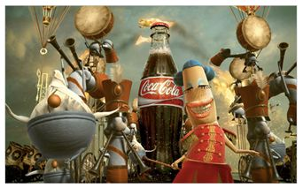
“Transmedia storytelling has been incredibly exciting,” says Jared Konstanty, senior vice president and GM for Snacks at Pepperidge Farm. “It allows companies like ourselves to build vast seamless conversations with consumers that tie across multiple platforms in a media space that is usually fragmented.”
Coca-Cola’s The Happiness Factory:
TV adverts
Mythology book
Short film
Websites
Radio promotion
MSN games
Key features:
Fictional characters
Invites consumers into a fantasy world
Transforms promotional discourse into storytelling/brand universe
Increases commercial success
Notes:
They called the storyworld the Coca-Cola Happiness Factory, which was made up of:
TV adverts, Mythology book, Short film, Websites, Radio promotion, and MSN games
So it’s about creating a more seamless conversation with your audience by using all these additional texts strategically as extensions of the core idea/invites them into the world.

Slide 22
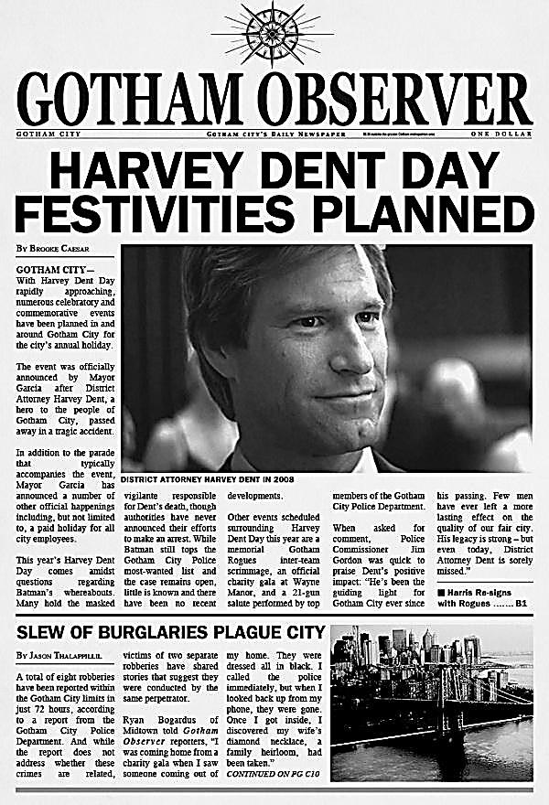
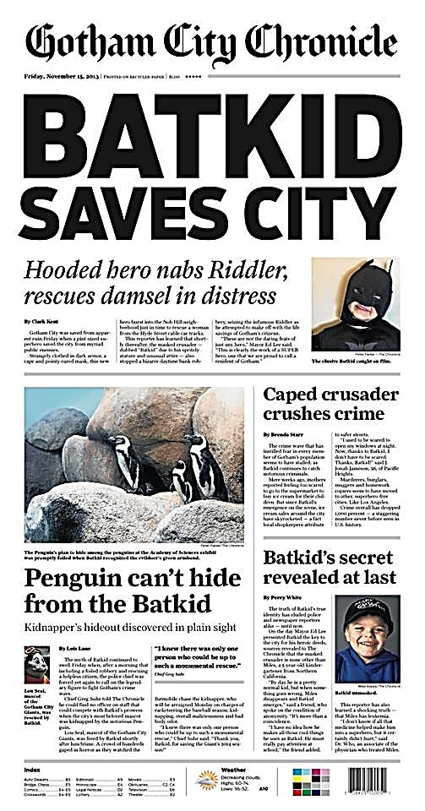
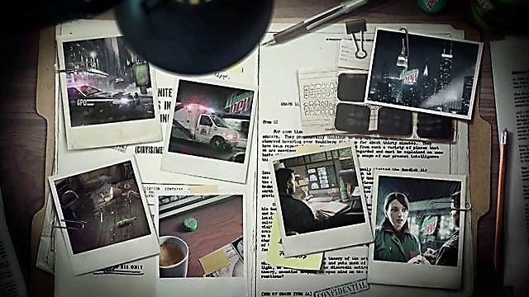
http://vimeo.com/51912879
Notes:
And it’s additional information that isn’t radically different to how transmedia entertainment works today…
Here’s the case of The Dark Knight Rises from 2012 – show video for its transmedia marketing campaign, ‘Go Inside Gotham City’: http://vimeo.com/51912879
So, this is a very new, digital example. But fundamentally, the idea that transmedia allows you to go inside a storyworld, to learn more, etc., is quite old, and it’s the CREATIVITY on the producers part that is important. After all, the production of fake newspapers is almost exactly the same in 1900 with Oz as it is in 2012 with Batman.

Slide 23
Key observation…
In the UK/US, transmedia storytelling is often funded by marketing and advertising funds
Understanding what it means for transmedia promotion to be seen as content is creativity:
Creative use of media platforms/materials
Creation of a ‘world’ around your story/information
Storytelling as a ‘stream of promotion’ to engage audiences and sustain audience interest

Slide 24
Question to consider…
Does knowing that much of transmedia storytelling is essentially advertising make a difference in terms of how you perceive or consume those same transmedia stories?
Is transmediality manipulative at all?

Slide 25
KEY FUNCTION 2:
BRANDING
Notes:
Now, we examine a second model of transmedia – branding.

Slide 26
Defining ‘brand’
‘The process of developing a specific set of identifying marks, symbols and perceptions to distinguish one product from competing products in the same market.’
Jim Blythe 2009, Key Concepts in Marketing, London: Sage, p.163

Slide 27
Defining ‘brand’
In other words…
A brand is an idea or a concept that carries particular meanings and messages
A brand targets and engages a particular audience, who then become loyal

Slide 28
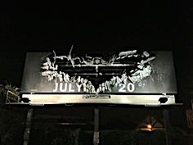
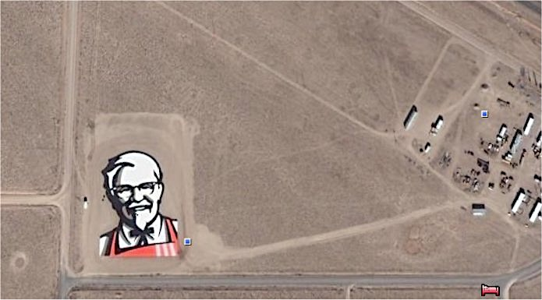
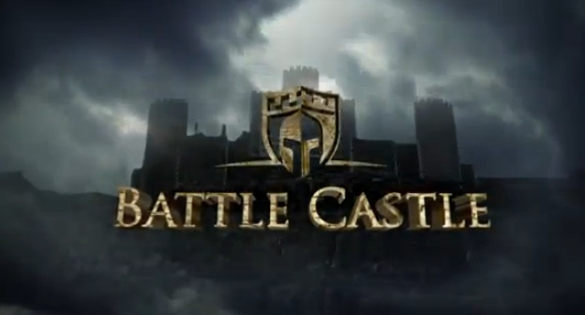
Function of a brand?
Create awareness
Notes:
One function of a brand is to create awareness - we can see this (via brand logos) with KFC and with Batman (both consumer product and entertainment product).

Slide 29
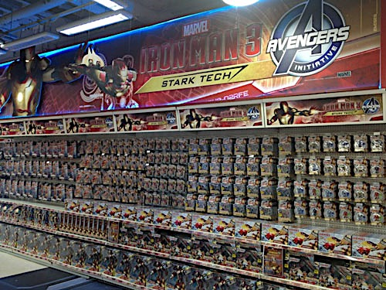
Function of a brand?
Differentiate
Notes:
Branding is about differentiation.
This is important in today’s media culture because it is very crowded; there’s so much content out there that we need branding to differentiate – and, in turn, to help tell audiences what to consume but also what not to consume; branding provided barriers and limits for audiences: it says this is important because x, but this is where it stops.

Slide 30
Function of a brand?
Add value
Notes:
Branding also works to add financial value to your media. Think about HBO and its slogan (“It’s Not TV, It’s HBO”). It connotes a quality and an important that gets it noticed.

Slide 31
Function of a brand?
Boost reputation
Notes:
Branding works to boos reputations. In media, we saw this with the deal between Marvel and Sony which allowed Spider-Man to enter the MCU; Spider-Man’s brand had become tarnished under Sony through poor films, but by bringing that bring into the Marvel brand (which is thriving), it should boost the reputation of the Spider-Man brand.

Slide 32
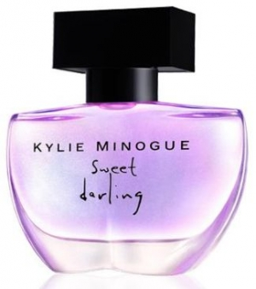
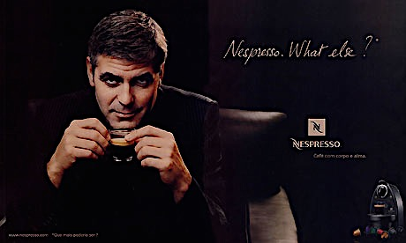
Function of a brand?
Add meaning
Notes:
Branding can also add meaning to your media; it gives it a voice, a message, a meaning; tells audiences what it’s about and why it’s interesting. This might be via cele endorsements of brands, where the meanings of the celeb are carried over to the meaning of the product.

Slide 33
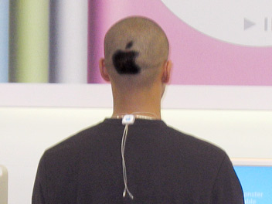
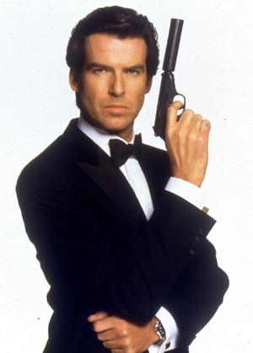
Function of a brand?
Promote loyalty
Notes:
But this is where branding is really important to transmedia: it promotes loyalty from the audience. By having the same logo across all the texts, it reassures the audience that this is still the same product that we know, love and trust. In something like Doctor Who, the main actor changes every few years, so having that same branding across the texts, it reassures the audience that this is still Doctor Who and therefore you should continued to keep watching despite the loss of the actors you grew to know and love.

Slide 34
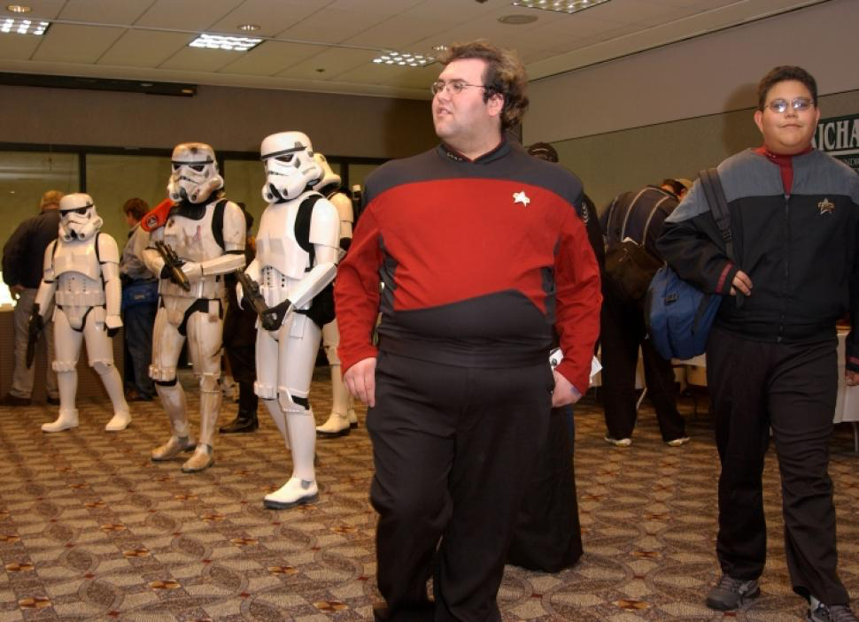
Function of a brand?
Promote audience identity
Notes:
But also, remember how yesterday we said that transmedia might encourage participation from loyalty? Well, with branding, we can say that this helps to give audiences (or fans) an identity. For example, in the US, there is a big divide between Trekkies (fans of Star Trek) and fans of Star Wars. The branding differentiates those people, gives them an identity.

Slide 35
How does this link to transmedia..?

Slide 36
Brand Extension
‘the idea that successful brands are built by exploiting multiple contacts between the brand and the consumer … the brand should not be contained within a single media platform, but should extend across as many media as possible. Brand extension builds on audience interest in particular content to bring them into contact again and again with an associated brand’ (Jenkins, 2006).
Notes:
The link is in terms of Henry Jenkins’ definition of ‘brand extension,’ which overlaps with transmedia greatly.
You should think of your transmedia project as a brand, and one that extends across platforms – promoting loyalty, creating awareness, adding meaning, etc.

Slide 37
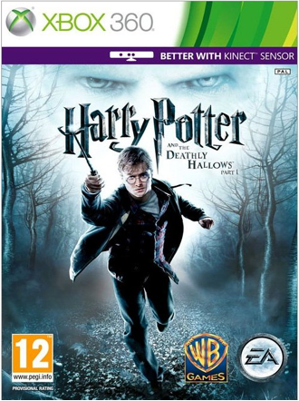
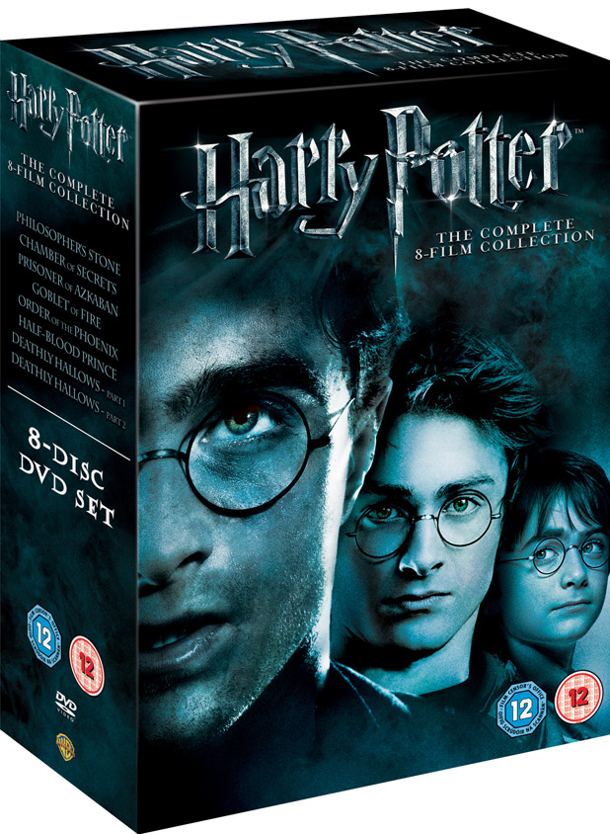
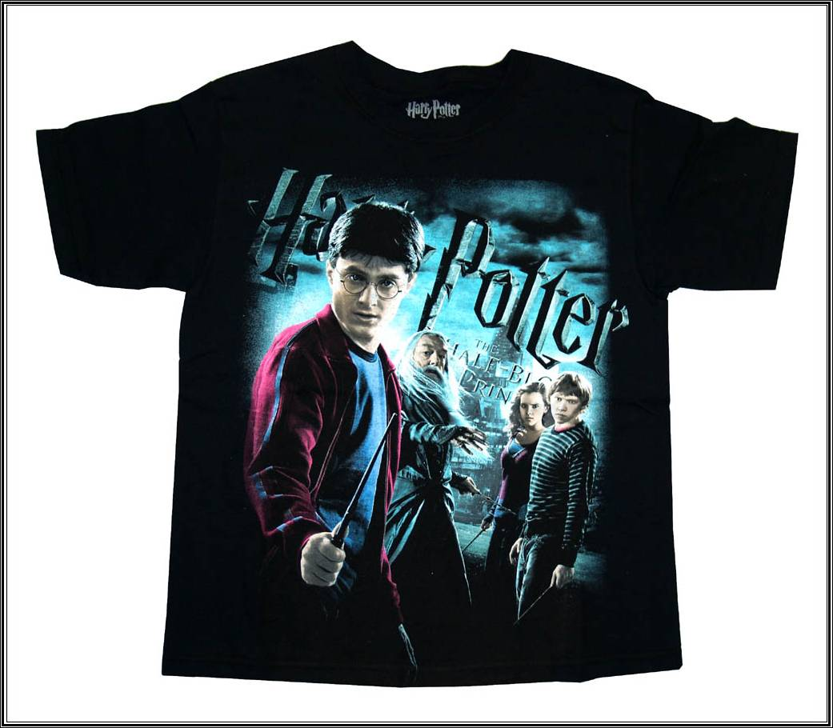
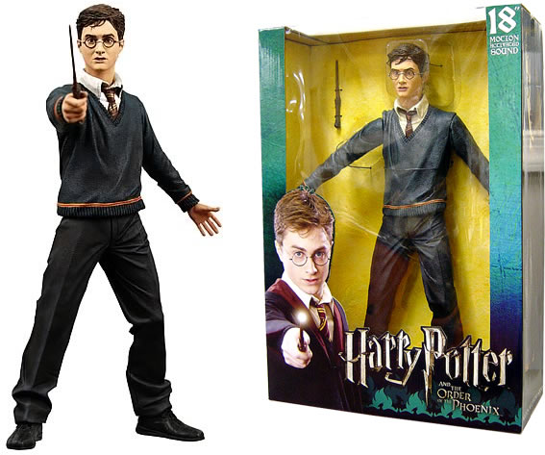
Brand Extension
Notes:
Here’s an example of brand extension in the media – British-originated book series Harry Potter. Through brand extension, we can say that the extensions across media (videogames, merchandise, DVDs, websites, etc., each work to promote greater loyalty, create mire awareness, and add more meaning to the Harry Potter world. They create an identity for audiences, too, which fans now playing Quidich. And these branded products certainly help boost the financial value of Harry Potter, which is now a billion dollar media brand around the world.

Slide 38
Top Gear (BBC, 1978-) Brand Extension as Non-Fiction Transmedia Storytelling
Notes:
An interesting example of a media brand is TV programme Top Gear, which is a British TV show aired on the BBC. It’s a factual programme around cars and motoring, featuring reviews of cars, interviews with celebs who do races, and places an emphasis on comedy.
But a key observation about media brands is that, like transmedia storyworlds are bigger than any individual characters or stories inside them, media brands are bigger than any individual people, characters, presenters. It is designed so that the media content has a set of in-build qualities that lure people in – and everything around those qualities can change. For example, we have Top Gear in many different countries, with many different presenters, but the core brand emphasis on motoring remains intact.

Slide 39
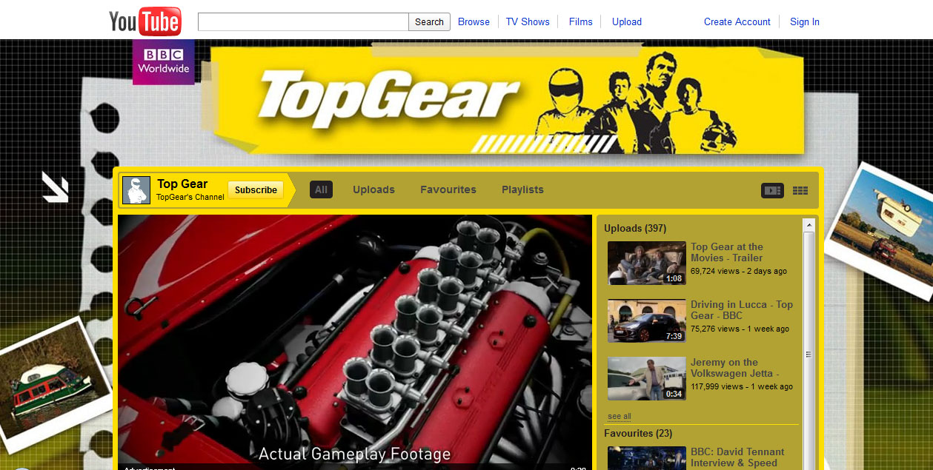
Top Gear (BBC, 1978-)
Central (interactive) space
Notes:
Very important to a media brand is a central hub – a space where audiences can go to find your media content, like a website/

Slide 40
Top Gear (BBC, 1978-)
Extraction of features
https://www.youtube.com/watch?v=eoyBnuP0K9w
Notes:
Another key aspect of the media brand is the ability to extract components from it and market or sell those components separately. For example, in Top Gear, one element of the TV programme is a feature called the ‘cool wall’, where the presenters debate which cars are cool and which are not. This ‘cool wall’ feature can be downloaded as an app for mobile phones – thus also enabling participation from the audience.

Slide 41
Top Gear (BBC, 1978-)
Merchandise
Notes:
Here are further examples of how Top Gear extended the brand and extracted elements of the TV programme for additional products… We have Top Gear Live, Top Gear board games, a Top Gear shop with Top Gear merchandise, Top Gear magazines and Top Gear books. Importantly, these aren’t random – each remains the core brand identity of the TV show (motoring, cars, male audience, comedy, etc) and extracts those characteristics and puts them into related (but different) brand products.

Slide 42
Characteristics of Media Branding
Longevity: The potential to last forever
Transferability: The potential for extension
Multiplicity: The potential for multiple points of engagement for the audience
(Catherine Johnson, Branding Television, Routledge, 2012)
Notes:
Indeed, if we were theorise the most important characteristics of a media brand, we can turn to Catherine Johnson’s book called Branding Television…
Johnson argues that the three defining characteristics of a media brand are:
-Longevity: The potential to last forever(i.e. the way that a factual programme about new cars can, in essence, keep going and going; there’s no shelf-life to its concept.)
Transferability: The potential for extension (i.e. the ability to turn core brand traits of cars, motoring, male audience, comedy) into other related products).
Multiplicity: The potential for multiple points of engagement for different audiences (i.e. the stage shows/books/games can all serve as places where NEW audiences can find Top Gear, then the hope is that, in turn, these new audiences will find the TV show and the other branded products and through it branding, remain loyal fans to that media brand forever.)

Slide 43
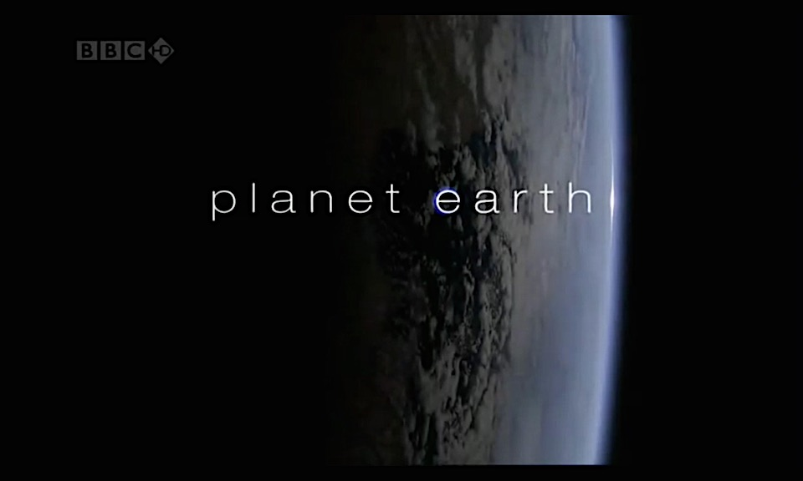
Planet Earth (BBC, 2006):
co-produced with Discovery, sold to over 100 countries
Notes:
What I would like us to do now is to explore how these ideas of media branding – and transmedia storytelling, as defined yesterday – apply to the factual documentary format, rather than a fictional entertainment format like Batman, etc…
Here’s a case study: Planet Earth…
Planet Earth was a nature documentary produced by the BBC and co-produced with the Discovery Channel, in 2006.
Five years in the making, it was the most expensive nature documentary series ever commissioned by the BBC and also the first to be filmed in high definition.
The series comprises eleven episodes, each of which features a global overview of a different habitat on Earth.
By June 2007 had been shown in 130 countries.

Slide 44
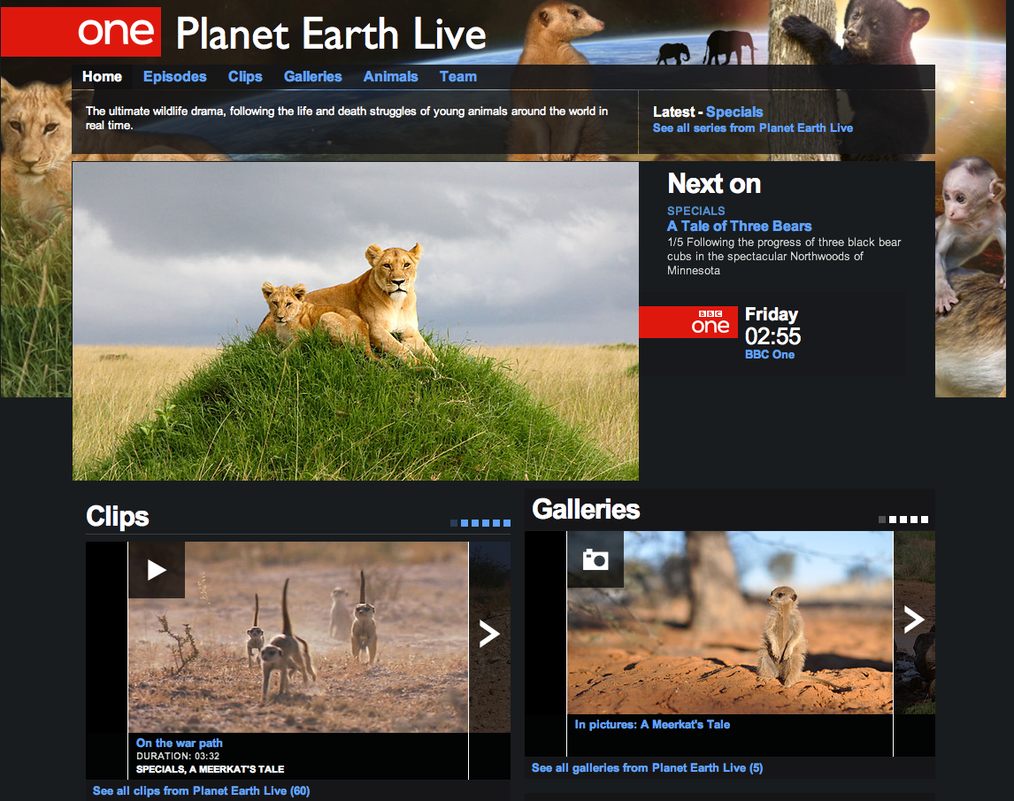
BBC’s Planet Earth Live Website:
http://www.bbc.co.uk/programmes/b01ms18l
Notes:
And on this Planet Earth Live website, you could read background information about the making of the documentary.
But you could also watch additional video clips of the animals (clips not broadcast on the TV show).
There were also picture galleries where you could view photographs of the animals that had been found around the world.
There were also web links where you could learn more information about the various animals seen on Planet Earth Live.

Slide 45
Planet Earth Live
Is this an example of transmedia storytelling as defined by Jenkins? Does the series’ information expand itself through ‘worlds’, ‘characters’ and a coordinated sense of ‘authorship’?
Is this an example of media brand extension? Does the series have the characteristics of ‘longevity’, ‘transferability’ and ‘multiplicity’? How so?
Notes:
DO TASK – 30 mins

Slide 46
Planet Earth Live as Transmedia Brand
Promotions: offer different but related pleasures and are designed to engage audience attention.
Website: offers information, clips, links, extending what is presented in the series and offering new ways of experiencing the content
Social Media and YouTube: offers new clips and invites audience interaction
Authorship – BBC; Character-building – animals; world-building – cultural history of our planet

Slide 47
So are there different types of transmediality…?

Slide 48
Continuity vs. Multiplicity
Continuity model: ‘all of the pieces have to cohere into a consistent narrative world.’
Multiplicity model: ‘celebrating the multiplicity which emerges from seeing multiple versions of the same stories.’
(Henry Jenkins, 2011)

Slide 49
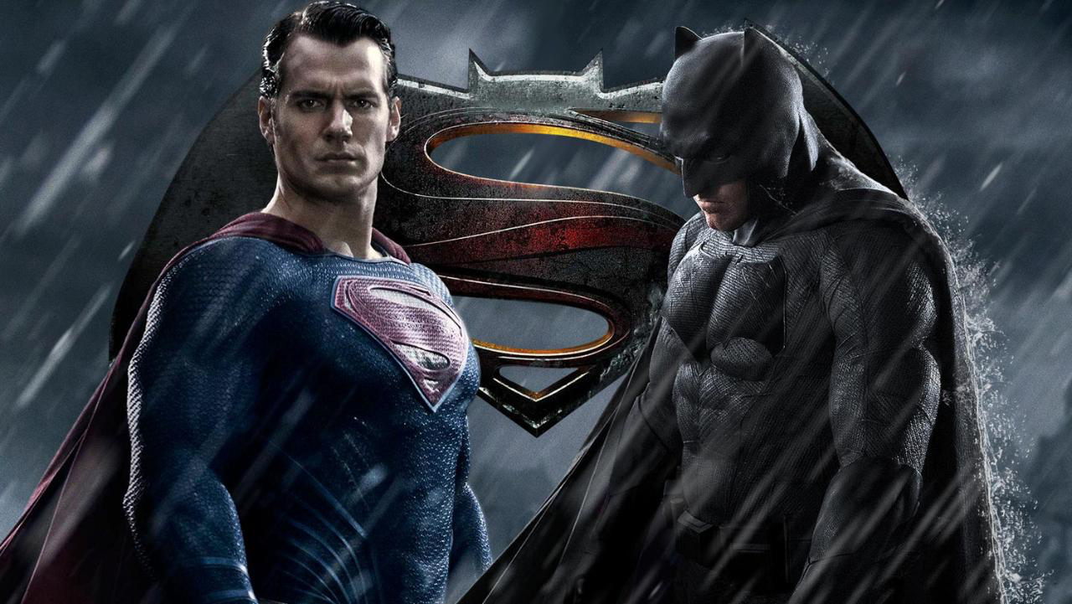
Continuity vs. Multiplicity

Slide 50
Case study: James Bond

Slide 51
Transmedia Bond
Rather than following the continuity model, James Bond’s transmedia texts follow the multiplicity model, specifically by:
Nostalgia
Wish-fulfillment
Retroactive continuities

Slide 52
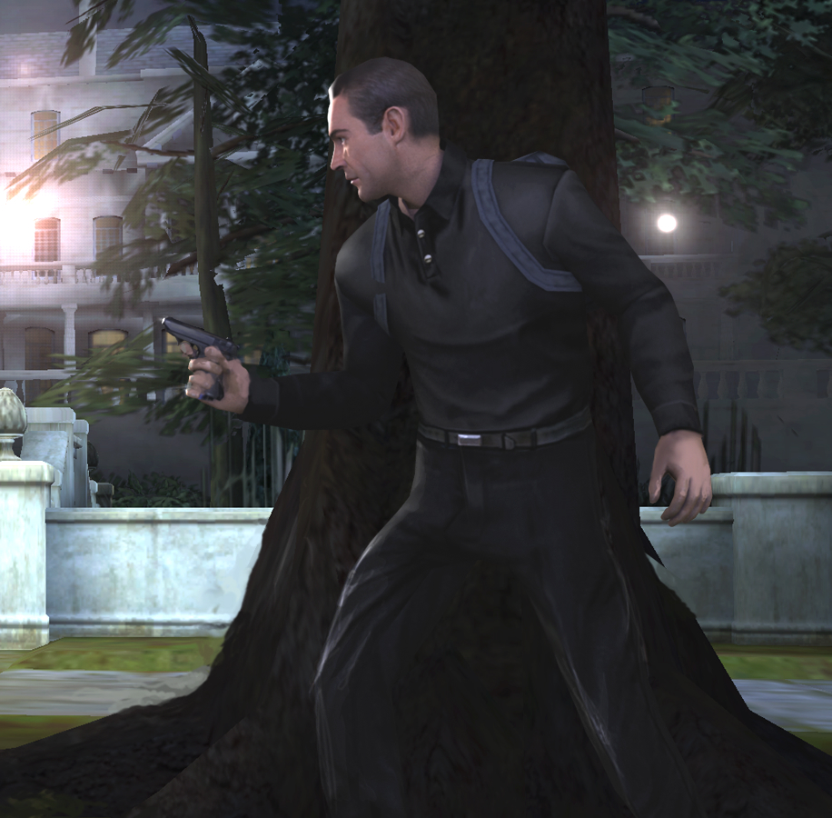
Transmedia Bond as nostalgia
007 Legends videogame “trades in nostalgia, and does so in spades.”
James Bond 007: From Russia With Love videogame: “the first game to let you play as Sean Connery’s 007.” “Starring a beautifully-realised digital double of Connery circa 1963”

Slide 53
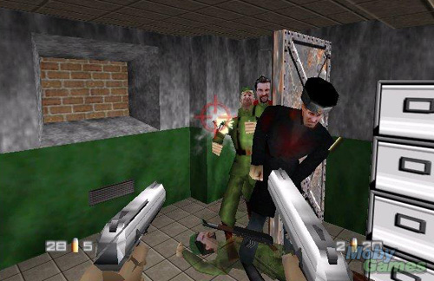
Transmedia Bond as wish-fulfillment
GoldenEye 007 videogame: “Learning how to use your gadgets, and become efficient in learning when not to kill is also a fun part of the game … Discovering how to free yourself (and find a set of knives) when you have no weapons at all with your magnet attract watch is just plain cool.”

Slide 54
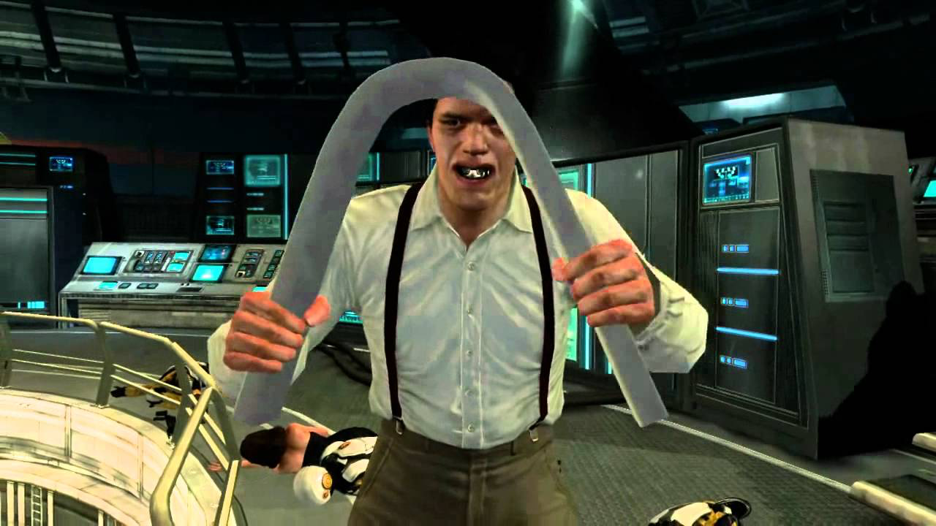
Transmedia Bond as ret-con
007 Legends videogame: “For the most part the efforts to effectively reboot the major story beats of Goldfinger, On Her Majesty’s Secret Service, Licence to Kill, Die Another Day and Moonraker through the eyes of current 007, Daniel Craig, are admirably effective.”

Slide 55
Questions to consider…
What might different stories look like if they followed the multiplicity (not continuity) model of transmediality.
How could you present the same story/information in different ways to engage different audiences?
Which model suits this transmedia story better – the continuity version or the multiplicity version? Why?

Slide 56
What to take away from today…
Transmedia storytelling is always about building: like adding rooms onto a larger house
It is underpinned by conceptions of character-building, world-building and authorship
Transmedia storytelling is itself a stream of promotion – often paid for by advertisers
Transmedia storytelling, as a product, is a form of branding and brand extension – thus, there is a strong commercial aspect to transmedia

Slide 57
What’s coming up…?
Lecture 3:
‘Transmedia Histories Part 2: 20th Century Consumerism’

