Slide 1
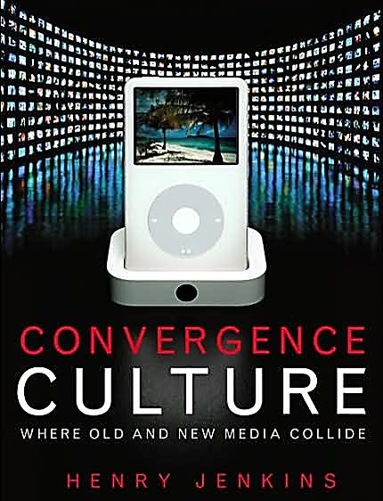
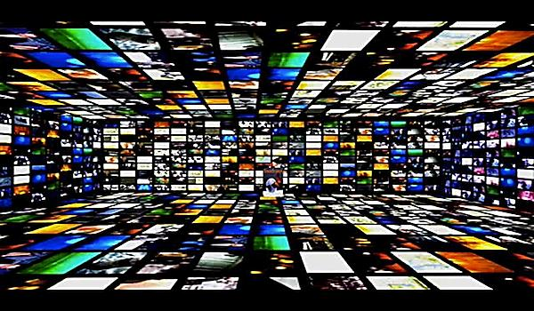
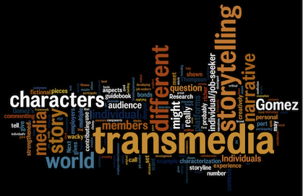
Transmedia Histories Part 1: Early 20th Century: Industrialised Consumerism
Lecture 3

Slide 2
Today…
Exploring the history of transmedia storytelling
Pre-historical histories?
Industrial history in the USA
Industrialisation --- modern advertising
Consumer culture --- licensing
Media regulation --- war propaganda

Slide 3
Learning Objectives
EXPLAIN the core industrial developments that led to historical transmedia storytelling
DESCRIBE the practices of historical transmedia
ANALYSE the different forms, strategies and manifestations of transmedia in the past

Slide 4
Pre-historical transmedia?
‘The narrative of Jesus Christ has been passed down across many centuries through a complex combination of the written word, drama, religious paintings, stained-glass windows, other symbolic icons, and so forth’ (Roberta Pearson)
‘Oral traditions drawn in the visual artistry of pottery and mythological narratives of Ancient Greece might be an ancient incarnation of transmedia storytelling (Derek Johnson)

Slide 5
Historicizing the industry of transmedia storytelling
Why is transmedia a form of promotion?
Why is transmedia about branding?
Where did its production practices come from?
When did the ethos of transmedia consumerism first emerge – and how?

Slide 6
Transmedia Storytelling Circa 1900-1920
INDUSTRIALISATION
Mass production
Mass communication
Printing technologies
Modern advertising
Transmedia Storytelling Circa 1920-1940
Transmedia Storytelling Circa 1940-1960
CONSUMER CULTURE
Franchising
Merchandising
Licensing
MEDIA REGULATION
Propaganda
War Films

Slide 7
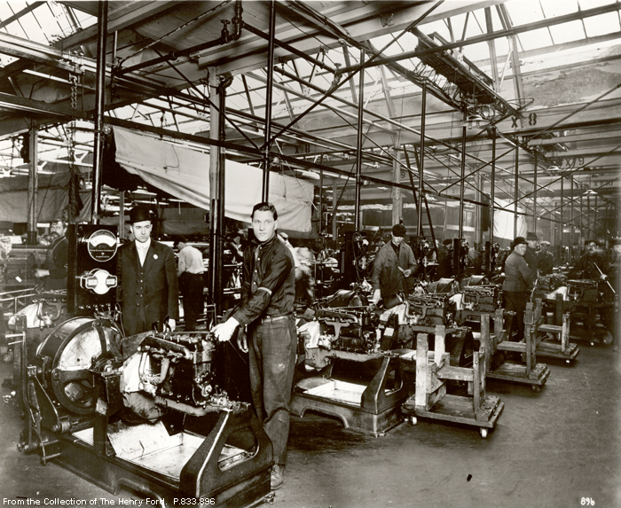

Slide 8
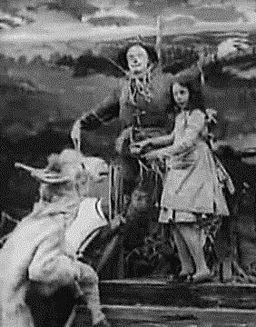
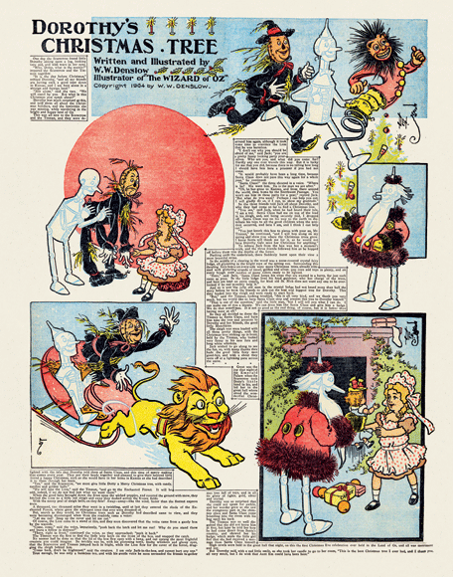
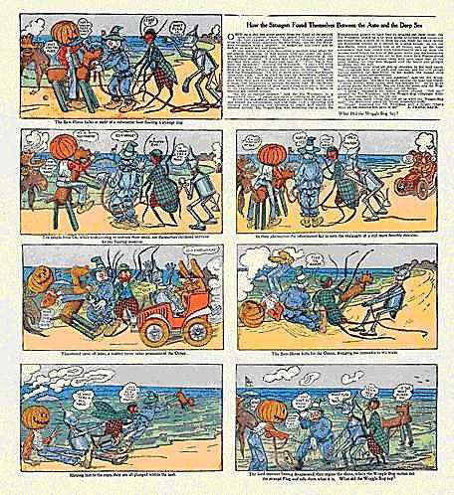
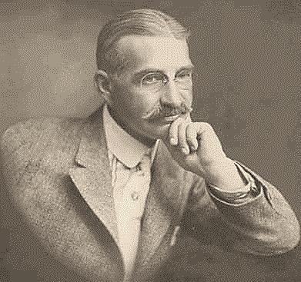
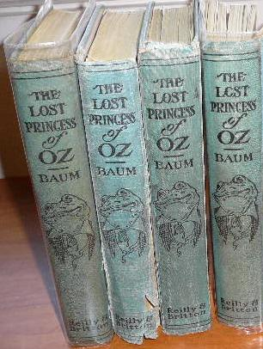
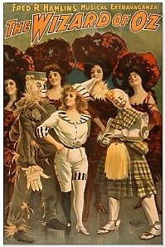
COMIC STRIPS
FAIRYLOGUE TOURS
MOTION PICTURES
BOOKS
THEATRE
NEWSPAPERS

Slide 9
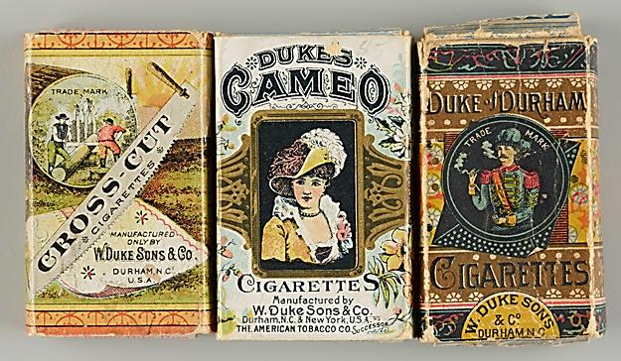
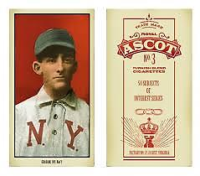
Cigarette cartons and cards

Slide 10
The Wonderful Wizard of Oz (1900)

Slide 11
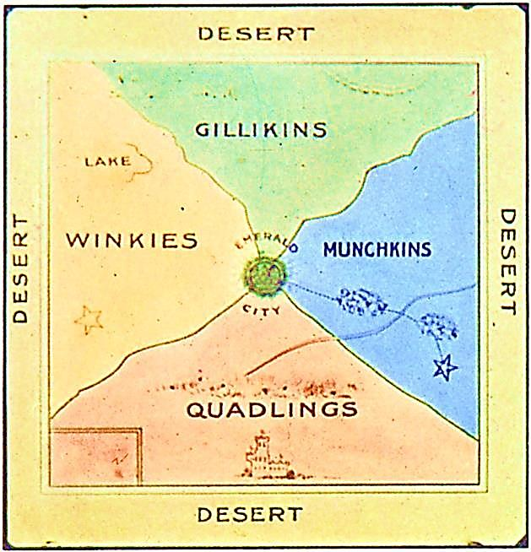
Printed maps as transmedia
‘Authors started to use maps in particular … for establishing the imaginary world as a virtual space consistent in all its details… a geography of the imagination.’ Michael Saler (2012)

Slide 12
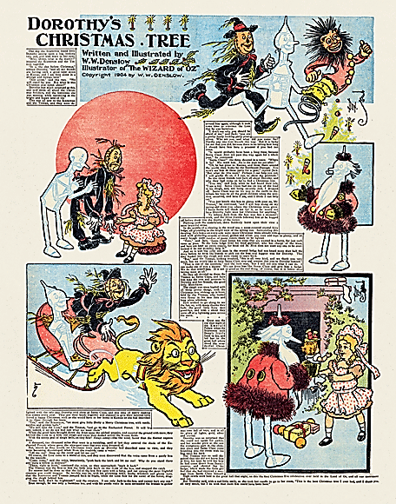

Slide 13
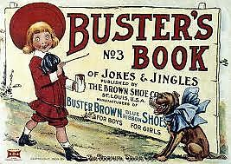
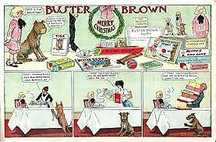
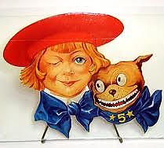
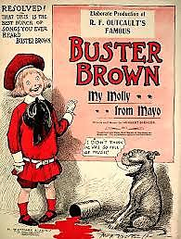
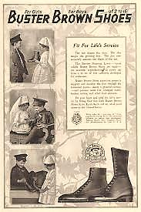
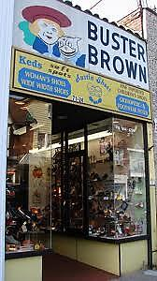

Slide 14
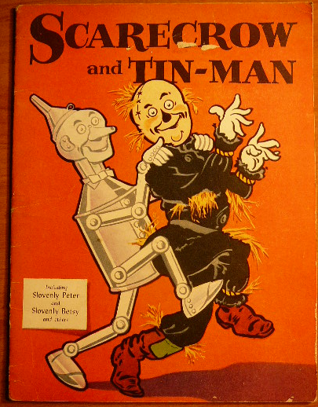
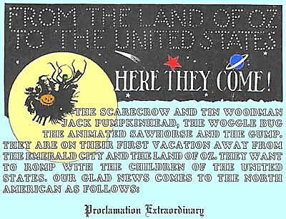
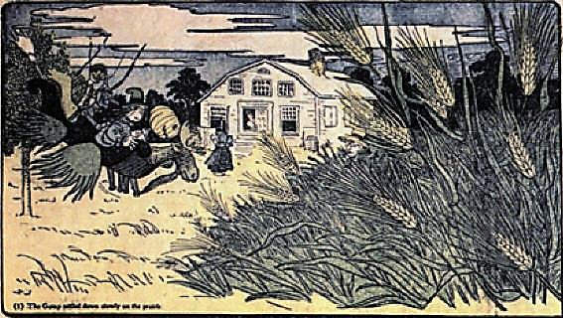

Slide 15
“Certainly the comic pages expand our sense of what the characters of Oz are like … and yet Baum first thought of these comic pages purely as a way of promoting his new book.”
Peter E. Hanff, former President of The International Wizard of Oz Club

Slide 16
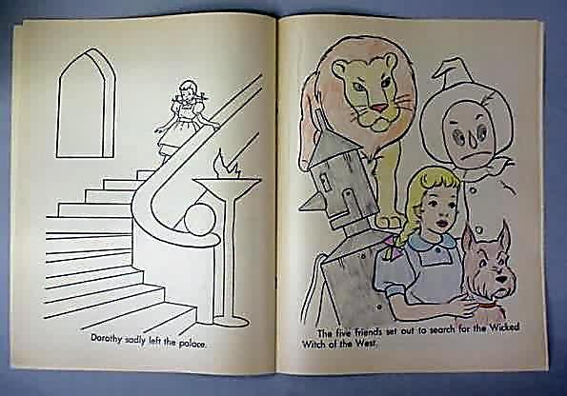
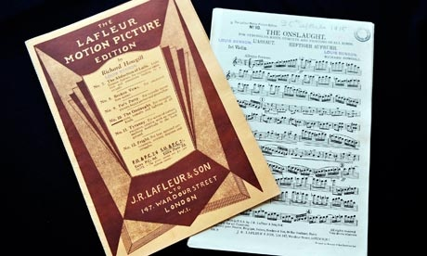
The Wizard of Oz (1910)
https://www.youtube.com/watch?v=jpV29YZ7Ksw

Slide 17
Transmedia as money loser?
“Mr. Baum had sought to follow the whimsical “Wizard of Oz” series with other productions along the same line, in which fairies and hob-goblins ran riot in motion pictures. The venture has Mr. Baum oppressed by the debts contracted in trying to exploit his creations and has now sought the relief of the bankruptcy courts.”
‘“Wizard of Oz” Bankrupt,’ Los Angeles Times, January 15, 1916, p.16.

Slide 18
“Promotion has almost nothing to do with developing or expanding an established narrative like the transmedia storytelling of the digital era.” David Kushner (2013)

Slide 19
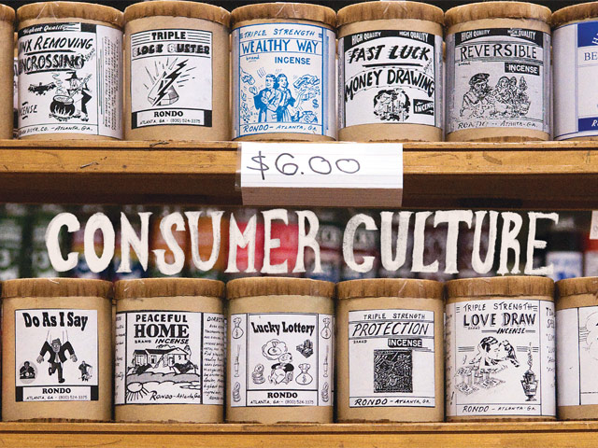

Slide 20
Stepping stones of entertainment
‘My youngest boy collects empty match boxes. The fact that they are all of the same kind makes no difference to him, but in that he shows the true spirit of the collector and of the reader. The really great purpose of fiction is, as I see it, that it is like stepping stones of entertainment. The reading of fiction motivates one’s mind to flow to its next stepping stone, just like a collector of match boxes, and, lo, a new world will be opened to him.’
(Edgar Rice Burroughs, 1923)

Slide 21
Using films in business…
By the mid-1930s, magazines were publishing articles about how to ‘use films in business’, offering tips for how motion pictures could be integrated as part of the interiors of shops so as to increase sales
‘Coolerator consumer picture’ - Husbands Are Good For Something. The film was ‘intended to close the gap between consumers being aware of our product and them becoming specifically interested in it and thus eventually sold on Coolerator advantages’
‘A good film is known by the merchandise it sells’

Slide 22
…Turn to licensing in 1918
A strategy of spreading a product or service beyond the confines of one manufacturer, who issues ‘the rights to manufacture products’ under management’ (Jenkins 2006)
Licensing was the logical response to the rise of consumer culture: ‘As a professional practice, licensing is linked with the development of mass culture industries and advertising agencies at the turn of the 20th century.’ (Santo, 2009)

Slide 23
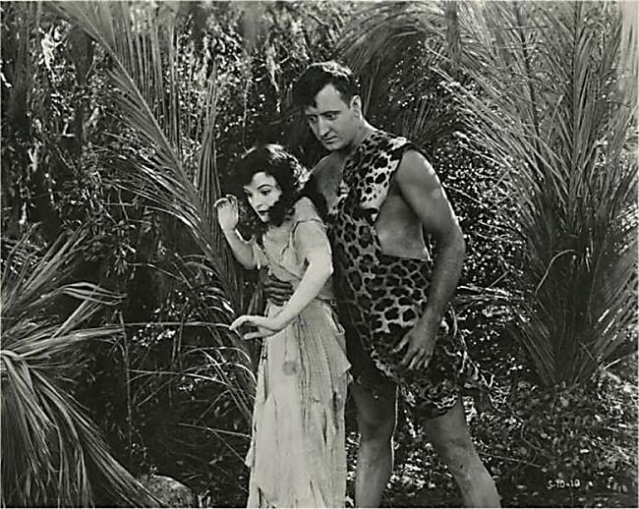
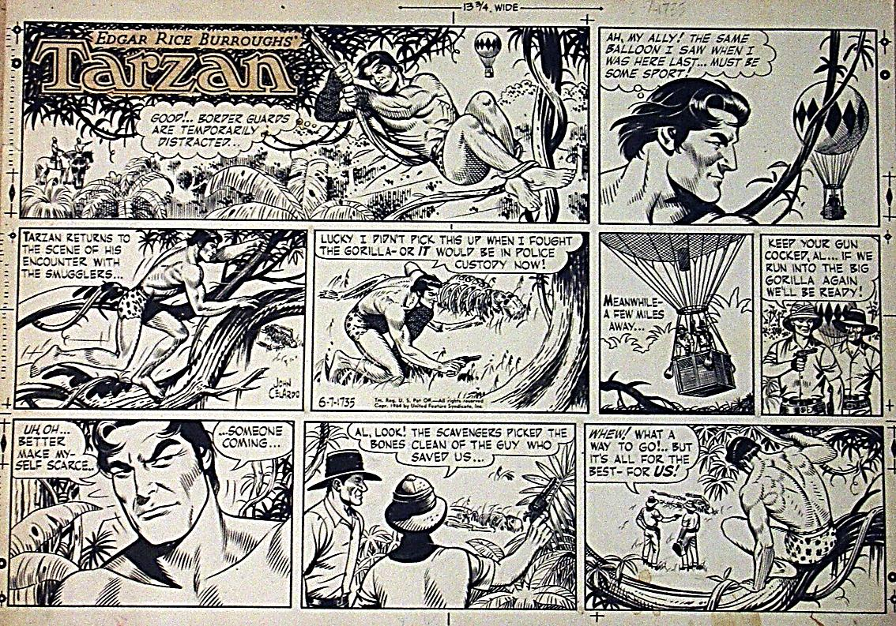
TARZAN – 1920s/1930s
MOTION PICTURESS
COMIC STRIPSS
MERCHANDISES
RADIO SERIALSS
PULP MAGAZINESS
NOVELSS

Slide 24
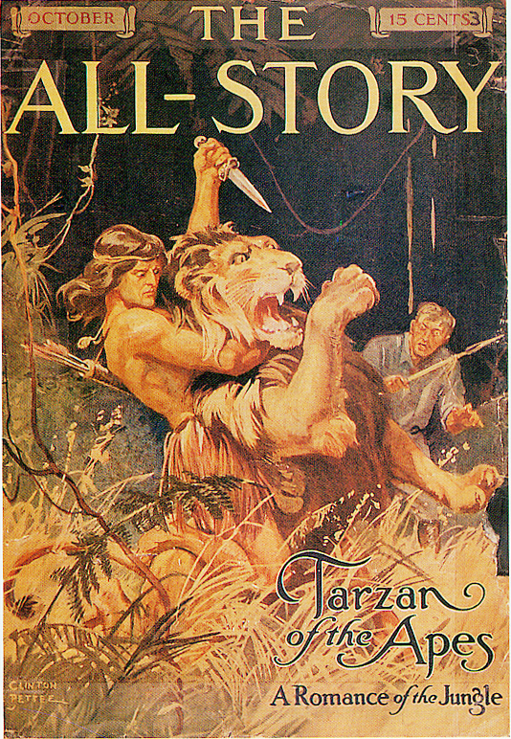
The ‘Burroughsian Universe’

Slide 25
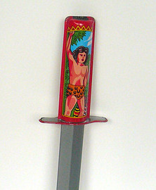
Tarzan merchandise

Slide 26
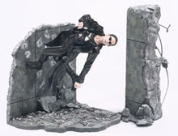
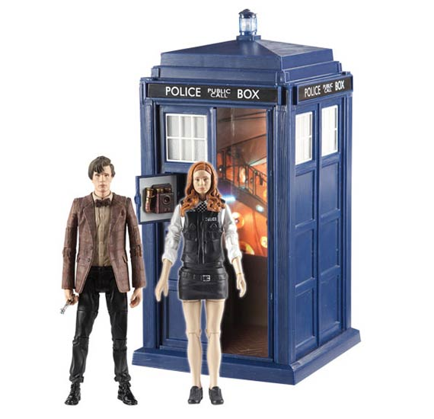

Slide 27
The importance of radio
“In the face of severe social upheaval radio must serve to preserve our population … We must know and honor the same fictional heroes, love the same songs, and realize our common interests together.”
- Merlyn Aylesworth, then head of NBC, 1930

Slide 28
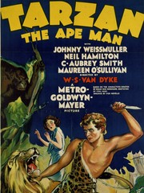
Mass consumerism, public demand and the want of ‘more’ stories
https://www.youtube.com/watch?v=lIoPPD0NKhA

Slide 29
“Since those simple days of twenty years ago, when I blithely gave away a fortune in rights that I did not know existed, many changes have taken place, bringing new rights with them. Today I am closing a radio contract covering the presentation of my stories over the air. What a far cry from second magazine rights.”
“Perhaps in my radio contract I shall insist upon the reservation to me of the interplanetary rights. Why not? Radio rights and sound and dialog rights would have seemed as preposterous twenty years ago.”
- Edgar Rice Burroughs, “Protecting the Author’s Rights,” The Writer’s 1932 Year Book & Market Guide, p.160.

Slide 30
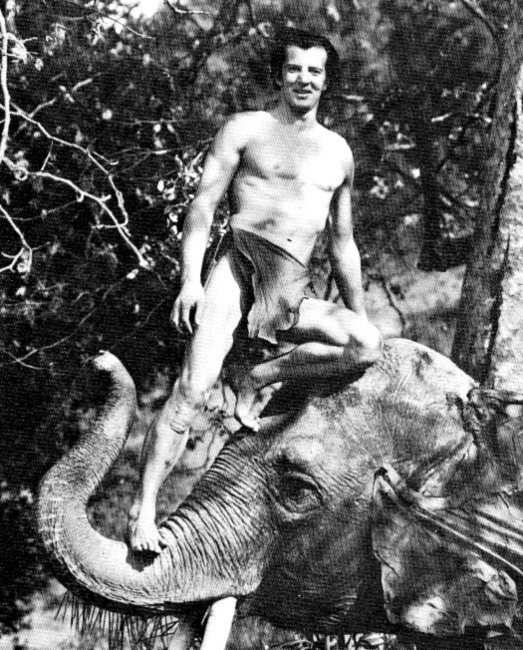
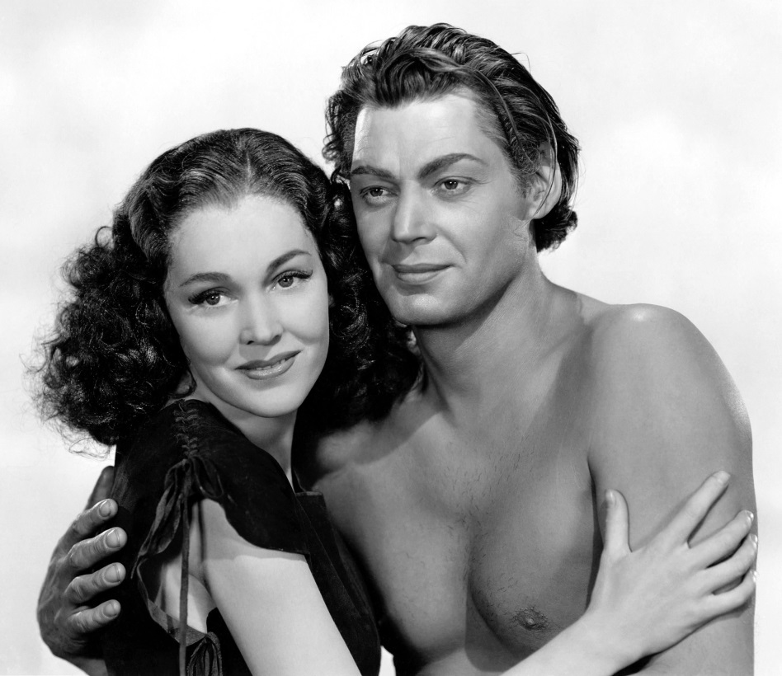
Tarzan incoherence?

Slide 31
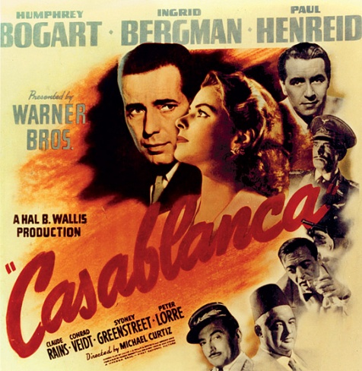
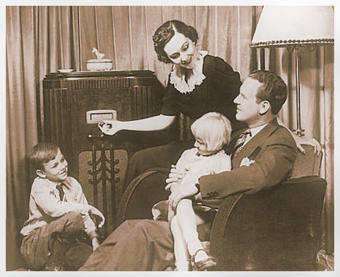
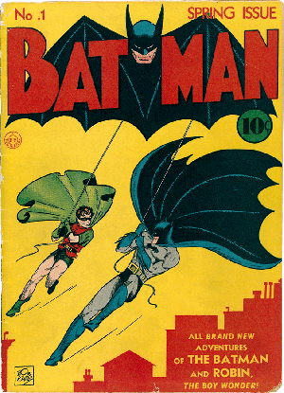
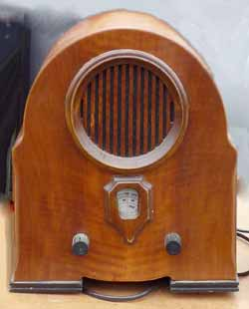
U.S. 1940s

Slide 32
Office of War Information (OWI)

Slide 33
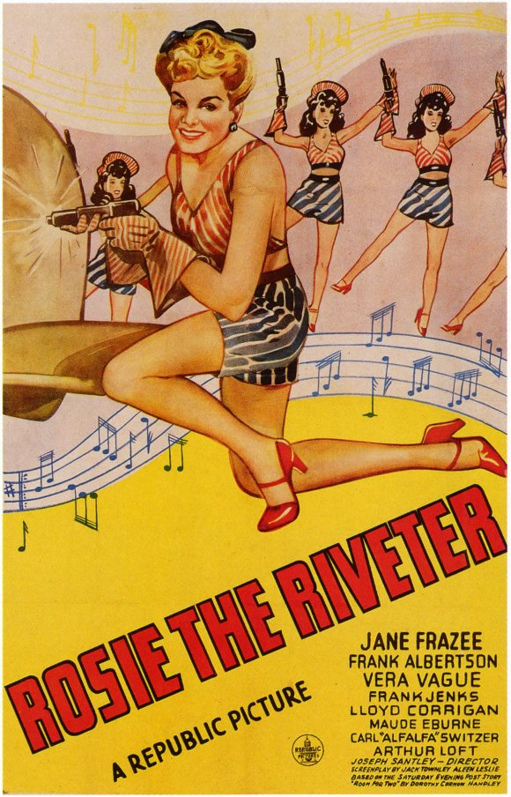
Rosie the Riveter

Slide 34
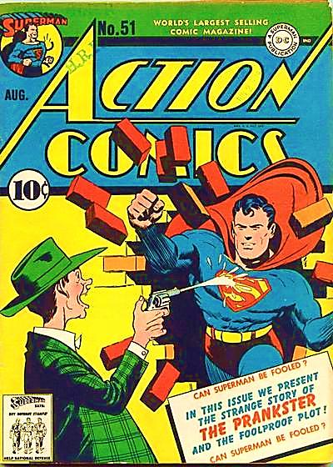
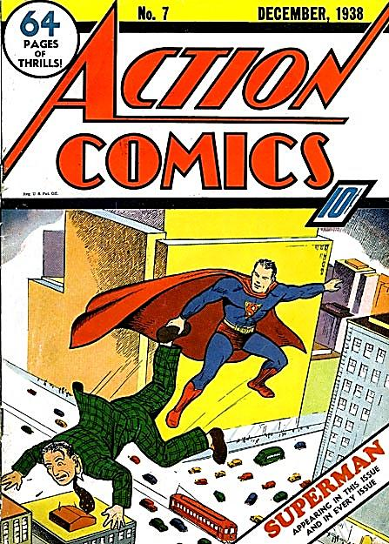
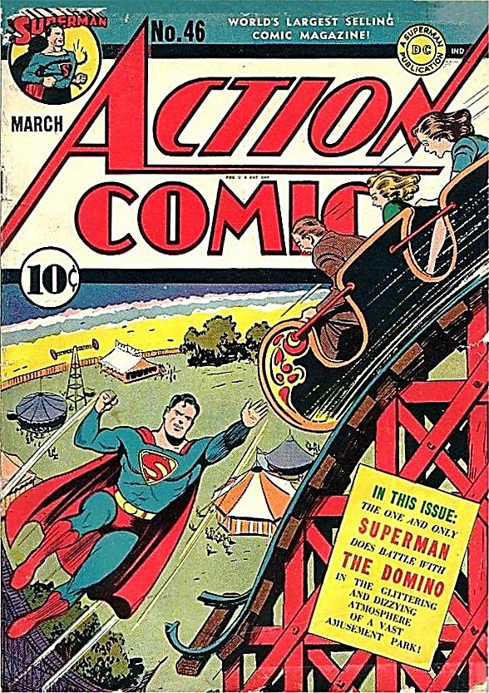

Slide 35
‘More Americans spend more time listening to radio programs than they spend doing anything else, except working and sleeping.’
– William C. Ackerman, Columbia Broadcasting System, 1945
As of 1940, 82.8% of American families owned a radio. As of 1944, 88.9% of American families owned a radio.
As of 1945, 90% of American families owned a radio.
– Decennial Census

Slide 36
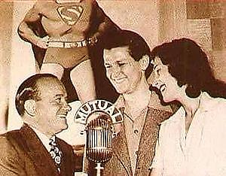
The Adventures of Superman

Slide 37
‘“Superman is going over there to Germany, Italy and Japan, and he’s going to clean them up!” insisted Donenfeld, presiding genius of the Man of Steel.’
‘I have hopes that he’ll bring Hitler and Mussolini to this country and set them down in New York’s East Side. He’ll sweep the world for democracy!’
– Harry Donenfeld, quoted in “The Laugh’s on You and Me,” The Washington Post, October 22, 1940, p. 19.

Slide 38
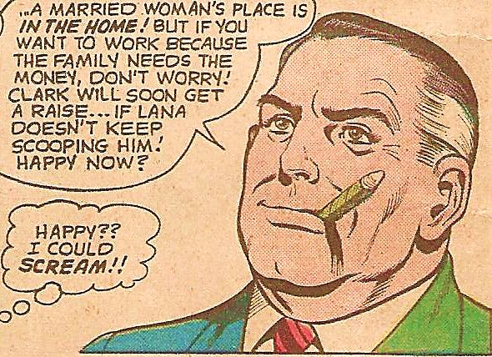
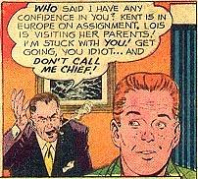
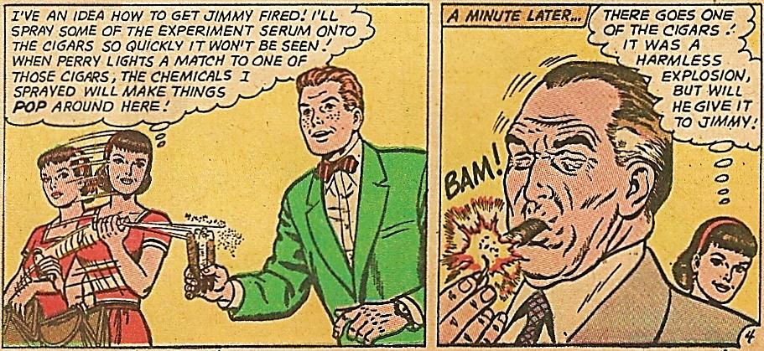

Slide 39
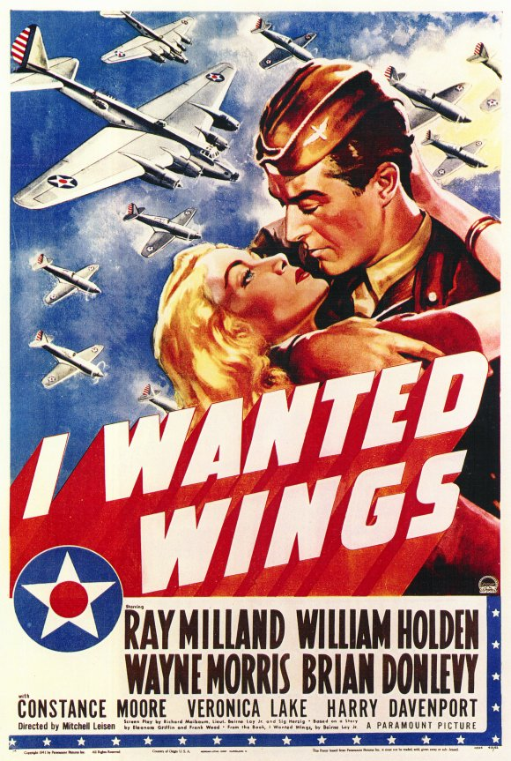
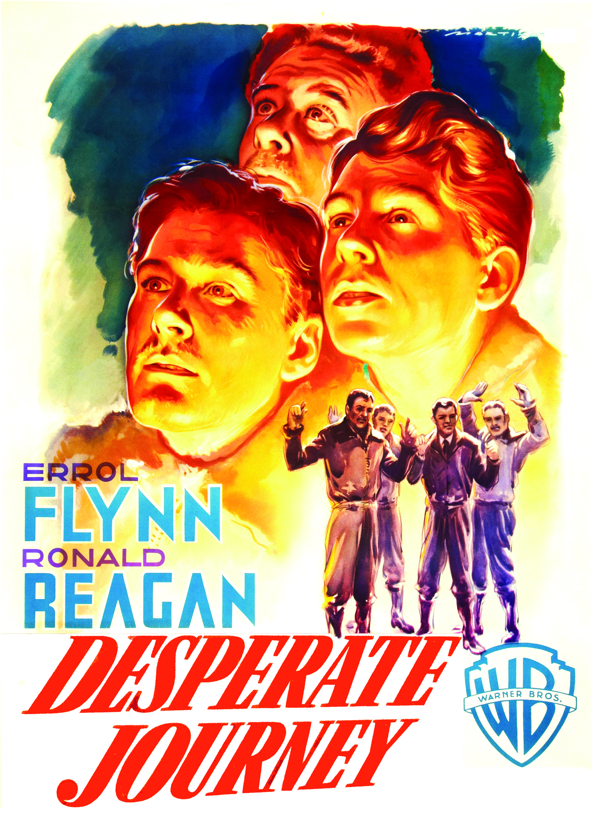

Slide 40
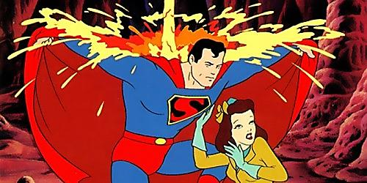
Superman (Paramount, 1941-1943)

Slide 41
Superman in cinema
Superman in comic books
https://www.youtube.com/watch?v=sjdnCC6n4xk

Slide 42
‘A hero that can fly elicits a stronger sense of power, pride, and protective reassurance.’
– The Office of War Information on Superman editorial
‘Parents who haven’t been keeping up with Superman may not be aware of the high moral tone pervading his exploits, or aware that a serious-minded government committee, led by the OWI including educators and psychologists, instruct on editorial policy.’
– Catherine Mackenzie, “Movies – and Superman,”
The New York Times, October 12, 1942, p.22.

Slide 43
‘[…] market tie-ups’ […] Superman’s radio serial opens up an opportunity for theatres playing Superman shorts, who can try for promo announcements at breakdown time.’
– “Planet? Radio Wave? No – It’s Superman!,” Variety, June 24, 1942, p.12.
‘Superman’s popular cartoon stories will be used in connection with the radio program as well as with the mags and newspaper features.’
– “Inside Stuff – Radio,” Variety, February 24, 1943, p.30.

Slide 44
Like The Dark Knight Rises (2012)?

Slide 45
What to take away from today…
Transmedia storytelling is not necessarily dependent on contemporary convergences
Instead, transmedia is a product of mass industrialization and consumer culture
Transmedia is about crossing borders, but it also needs strong industrial regulation
Transmedia’s history suggests that it has a clear socio-political function… more to come!!

Slide 46
What’s coming up…?
Lecture 4:
‘Transmedia Histories Part 2: Brand Hollywood’
Screening:
The Greatest Movie Ever Sold (2011)

