Slide 1
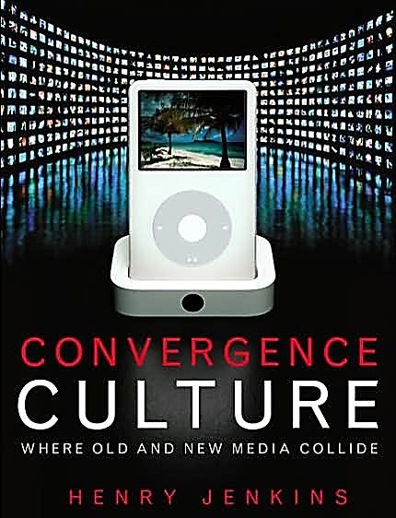
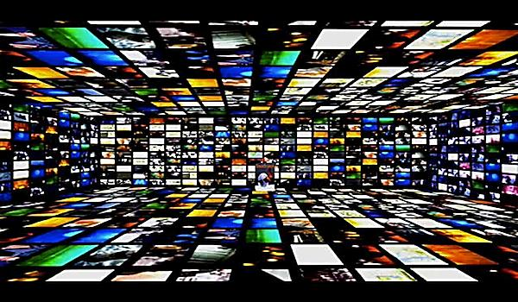
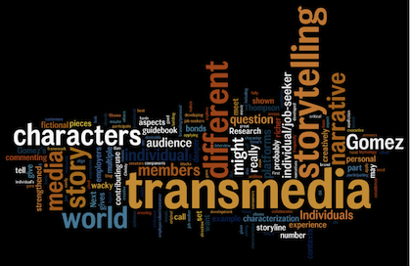
Transmedia Histories Part 2: Late 20th Century: Brand Hollywood
Lecture 4

Slide 2
Isn’t transmedia just franchising?

Slide 3
Today…
Exploring the history of transmedia storytelling
Understand the rise of transmedia franchises
Industrial history in the USA
1920s franchise culture
1980s synergy
1990s high concept
2000s transmedia franchise

Slide 4
Learning Objectives
EXPLAIN the influence of historical franchising developments on historical transmedia
DESCRIBE the shifts in Hollywood branding
ANALYSE the lines between creativity and commerce in today’s transmedia franchises

Slide 5
So, first things first…
Let’s think about the following:
WHAT IS A FRANCHISE FILM?
What type of film or filmmaking style does this term bring to mind?
What examples can you think of?
Do you associate franchise with certain genres, styles, countries, etc.?

Slide 7
We may associate ‘franchise’ with:
American cinema?
Big budget blockbusters?
Commercial films?
‘Popular’ or mass-market films, e.g. superheroes?
Sequels/prequels/remakes?
Merchandise? Spin-offs?
Brands and logos?

Slide 8
Academic definitions…
A film franchise is defined according to its ‘production and distribution of multiple revenue streams…’ (Johnson 2013)
A film franchise ‘consists of cross-marketing across more than one medium. For the owners, the goal of increasing profit through diversity can extend the commercial profitability of the franchise.’ (Lemke 2004)

Slide 9
So then…
Franchise films become tied up with:
COMMERCIALISM (economic motive)
REPLICATION (make more of it)
MULTIPLICITY (make extensions from it)

Slide 10
So film franchises aren’t really about just films…?
“Movies are now no longer free-standing intellectual property; they are one piece in a marketing assault.”
David Alpert and Rick Jacobs (2004)
“Maximizing profits compels a strategy of crossing over across as many of these media as possible.”
Jay Lemke (2004)

Slide 11
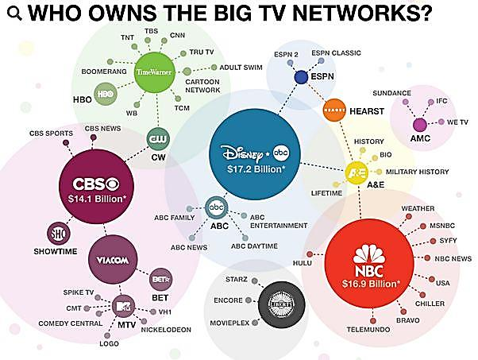
Media convergence is “the flow of content across multiple media…, the co-operation between multiple media industries, and the migratory behavior of audiences,” making ‘the flow of content across media inevitable.”
Henry Jenkins (2006)

Slide 12
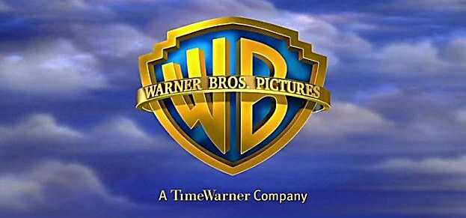
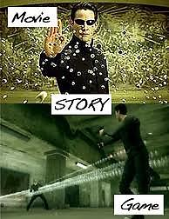
‘The Matrix is franchise entertainment for the age of media convergence…’
(Jenkins 2006)

Slide 13
Yes, but…
Wasn’t The Matrix celebrated for its creativity, artistry, intelligence, technological innovation?
In other words, we shouldn’t necessarily separate ‘commercial’ from ‘creative’ when thinking about transmedia franchises…

Slide 14
Franchise as creativity…?
Transmediality:
“The increasingly popular industrial practice of using multiple media platforms to present information concerning a single fictional world through a range of textual forms.” Elizabeth Evans (2011)

Slide 15
So then…
Film franchises are essentially about:
Producing multiple revenue streams from the same product/intellectual property
Variation on sameness (sequels, etc.)
Cross-marketing/branding (corporate synergy)
Boosting commercial profits via creative extension across products and platforms (e.g. storytelling, world-building, toys, games, apps, etc.)
But what are the implications of this – and where did this all come from anyway???

Slide 16
Media or McDonald’s?
‘Calling something a “franchise” is not a neutral declaration: it prompts us to think about the media in the same terms that we think about McDonald’s.’ (Johnson 2013)
But what are the implications of
thinking about media as mass-
Production, as mass consumption,
as ‘shopping’ or as pure consumerism?

Slide 17
Industry borrowings?
Film franchises involve “a migration to the media industries of market logics from other business sectors.”
(Johnson 2013)

Slide 18
In other words…
Understanding the transmedia franchise means understanding its production context…
… It is not about CGI, superheroes, genre, etc.
And understanding the production context means understanding the historical context!

Slide 19
1918 was the rise of licensing…Licensing afforded franchising!
A franchise is an agreement between stakeholders – a franchisor who develops the system and a franchisee who invests in that system: ‘The franchisor ... attempts to create public recognition of the franchised outlets. The franchisee, following the merchandising and business procedures outlined by the franchisor, proceeds to operate as an independent establishment.’ David J. Swartz

Slide 20
Licensing afforded franchising… but not yet of media!
In the 1900s, franchising was first a phenomenon of transportation sectors, used for extending roads, tram lines, and railways across the country.
‘Bids will be opened for the purchase of the Eleventh-street electric railway franchise … The franchise purchaser will connect with the Main-street line of the Los Angeles Railway Company and if built the road will be operated by that purchaser.’ (Los Angeles Times, May 1904)

Slide 21
Licensing afforded franchising… but not yet of media!
In the 1920s, underpinned by licensing laws, franchising spread to the retail industry:
Fredericks, a hair salon franchise, warned its customers in one advert that ‘not all permanent waves are Fredericks Permanent Waves. To be sure of getting a true Fredericks Permanent Wave, patronize an authorized Fredericks shop. Look for the Fredericks Franchise Certificate, guaranteeing the use of a Fredericks machine.’

Slide 22
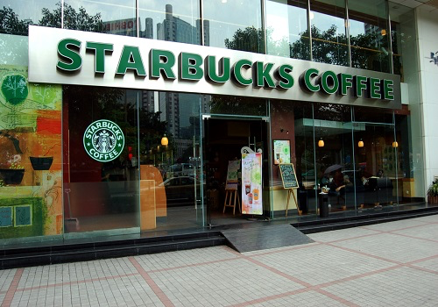
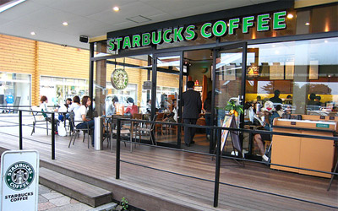

Slide 23
Edgar Rice Burroughs
“Since those simple days of twenty years ago, when I blithely gave away a fortune in rights that I did not know existed, many changes have taken place, bringing new rights with them. Today I am closing a radio contract covering the presentation of my stories over the air. What a far cry from second magazine rights.”
“Perhaps in my radio contract I shall insist upon the reservation to me of the interplanetary rights. Why not? Radio rights and sound and dialog rights would have seemed as preposterous twenty years ago.”
- Edgar Rice Burroughs, “Protecting the Author’s Rights,” The Writer’s 1932 Year Book & Market Guide

Slide 24
Summary so far…
Historically, franchising was born out of:
Industrialisation
Mass production
Consumer culture
Rail road extensions
Shop extensions

Slide 25
And this all explains why…
We associate ‘franchise’ with:
American cinema? – American culture
Big budget blockbusters? – consumerism
Commercial films? – shops/shopping
‘Popular’ or mass-market films, e.g. superheroes? – Mass marketing
Sequels? – replication of same product
Merchandise? – licensed toys/brands

Slide 26
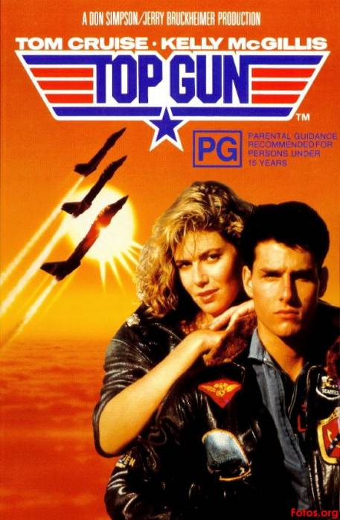
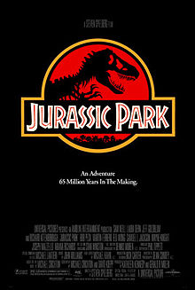
Moving things forward…
Brand Hollywood in the Late 20th Century

Slide 27
Now then. . .
Characterising Hollywood as transmedia franchise production:
Economics of cinema for a global audience
Standardization of Hollywood films
Shift towards the production of ‘product’ over ‘film’
Merchandising and mass-markets as global cinema
High concept and the integration of ‘film’ and ‘marketing’
Imbalance of ‘art’ and ‘commerce’ – does contemporary Hollywood encompass a shift towards the latter???

Slide 28
Film merchandise I own . . .

Slide 29
Top 10 highest grossing films of all time:
Avatar (2009)
Titanic (1997)
Star Wars: The Force Awakens (2015)
Jurassic World (2015)
Avengers Assemble (2012)
Fast and Furious 7 (2013)
Avengers: Age of Ultron (2015)
Harry Potter and the Deathly Hallows – Part II (2011)
Frozen (2013)
Iron Man 3 (2013)
Minions (2015)
The Lord of the Rings: The Return of the King (2003)
Transformers: Dark of the Moon (2011)
Skyfall (2012)
Transformers: Age of Extinction (2014)

Slide 30
What do theSE FILMS have in common…?
Sequels!
Known brands… that exist outside of the medium of film, e.g. based on comics, toys, rides, etc.
Standardized formulas
Globally resonant stories, e.g. historical events, fantasy/sci-fi, superheroes, dinosaurs, aliens, etc.

Slide 31
So then…
Two themes emerge:
Hollywood as a global producer of
Standardized products
Filmed entertainment, not just films
But where did these themes come from??

Slide 32
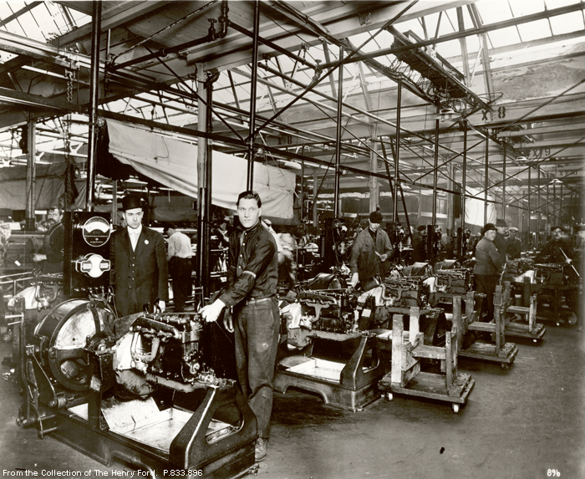

Slide 33
Theodor Adorno

Slide 34
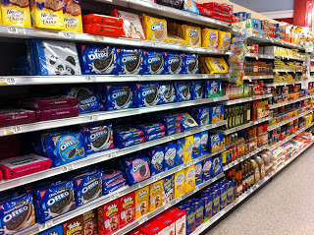

Slide 35
Standardization in film

Slide 36
Standardization across media?

Slide 37
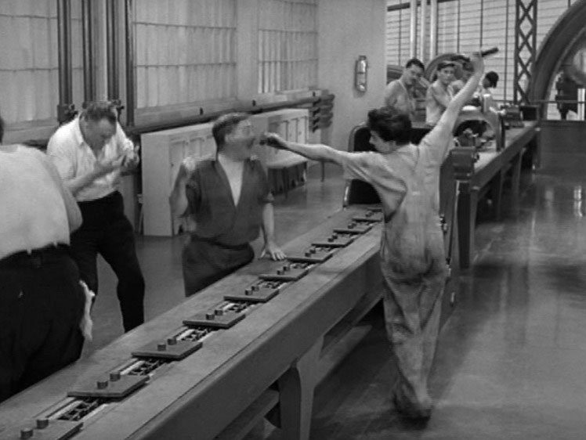
The Studio System: ‘Dream Factory’
standardization of the production process
(production routines, rules for shooting and editing, division of labour to create efficient industrial enterprise)
differentiation of the product
(use of stars, genres, directors, technology to direct the consumer’s attention to the originality and production values of the feature product)

Slide 38
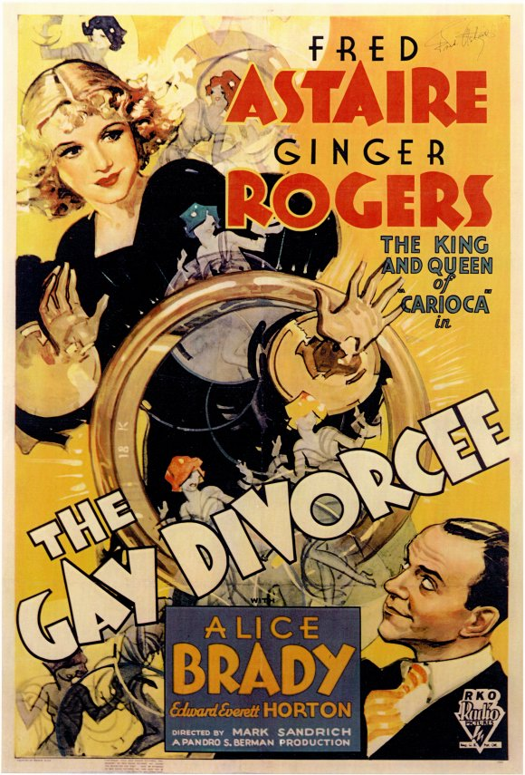
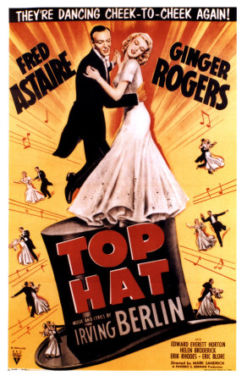
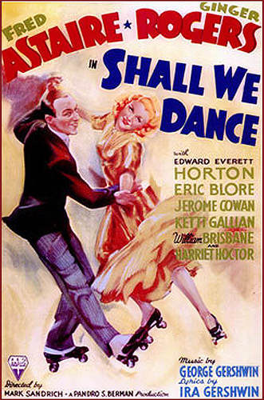
Top Hat (1935): Classical Style

Slide 39
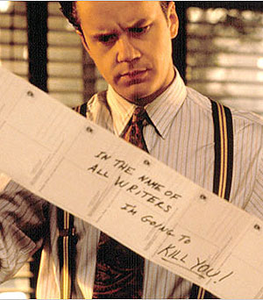
Contemporary Hollywood
Package-unit production - films are proposed and financed as individual packages (put together by agents) that have to be pitched and sold to investors, as well as to audiences.
Market research – increasingly used as a means of identifying profitable market segments.
Conglomeration - studios are part of larger entertainment companies where film increasingly functions as a basis for ‘synergy’and ‘transmedia’

Slide 40
In the 1980s, the film industry and its product underwent a substantial and far-reaching transformation whose implications were still being worked out a decade later, but whose impetus and whose basic alteration of the industry had become clear by the decade’s end.
As a result of these transformations, Hollywood ceased operating as a film industry, and film stopped being its primary product. Instead of making films, the industry shifted to the production of filmed entertainment, a quite different enterprise that encompassed production and distribution of entertainment in a variety of markets and media.
Stephen Prince, A New Pot of Gold (Berkeley: California UP 2000), p. xi

Slide 41
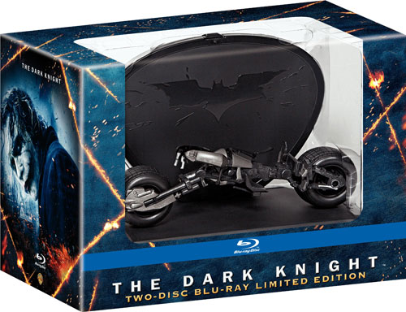
Chicken or the egg…?
Film leads to commerce?
Or commerce leads to film?

Slide 42
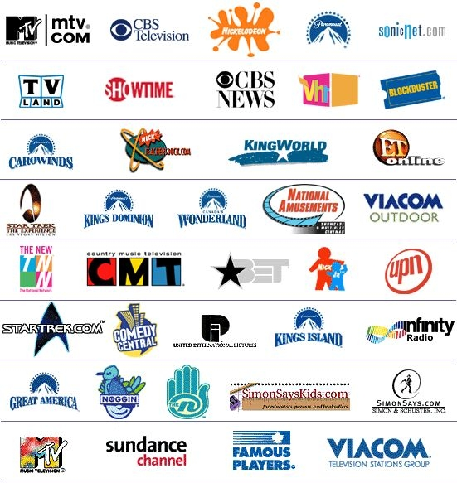
Viacom’s core holdings
Entertainment
Paramount Pictures , Paramount Classics, Paramount Home Entertainment, United Cinema International (UCI)
Cable
MTV Networks, Showtime Networks, Bet Networks, Nickelodeon, Comedy Central . . .
Television
CBS Network, UPN Network, numerous TV stations and television production companies . . .
Video
Blockbuster video stores
Publishing
Simon & Schuster, Scribner . . .
Radio
Infinity Radio, CBS Radio Network . . .

Slide 43
The turn to ‘high concept’ in Hollywood…
The simplification of cinema?
Or the formula for commercially successful transmedia stories?

Slide 44
‘High concept can be conceived as a product differentiated through the emphasis on style in production and through the integration of the film with its marketing. This definition encompasses several aspects of high concept; to gather these aspects together in an appropriately high concept fashion, one can think of high concept as comprising “the look, the hook and the book.” The look of the images, the marketing hooks, and the reduced narratives form the cornerstone of high concept’
Justin Wyatt, High Concept: Movies and Marketing in Hollywood (Austin: University of Texas Press), pp. 21-22.

Slide 45
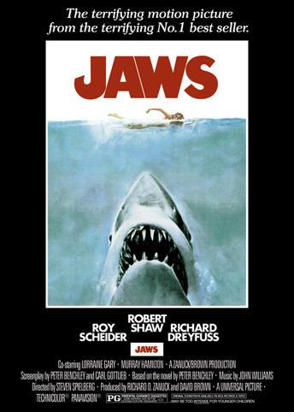
High concept
The look
The hook
The book

Slide 46
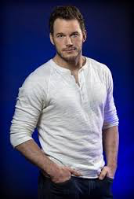
The aesthetics of High concept
Marketing conventions are inscribed into the expressive quality of the film – this effects a film’s visual and graphic look, its use of stars and music, and its development of character and genre

Slide 47
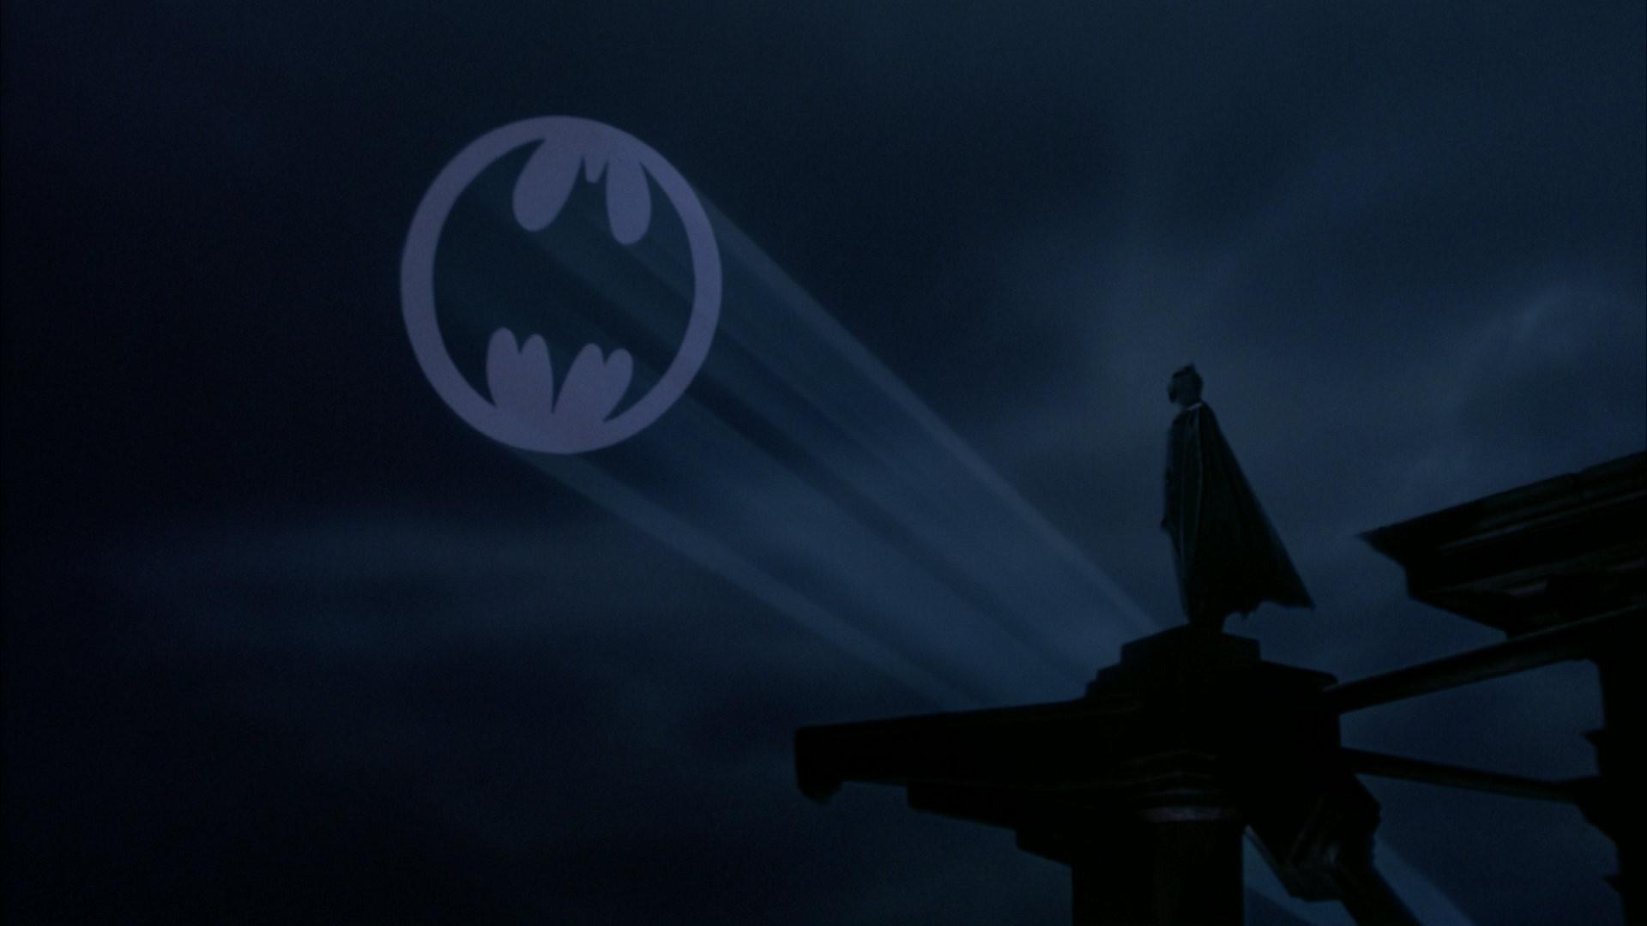
The aesthetics of High concept
High concept film is defined by a degree of ‘excess’ – moments that seem excessive to the story’s development and that are motivated by commercial interests. Excess stands out, according to Wyatt, when there is “a gap in the artistic motivation of the work”.
https://www.youtube.com/watch?v=hUqGwnAolSs

Slide 48
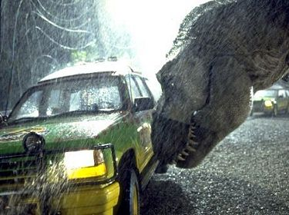
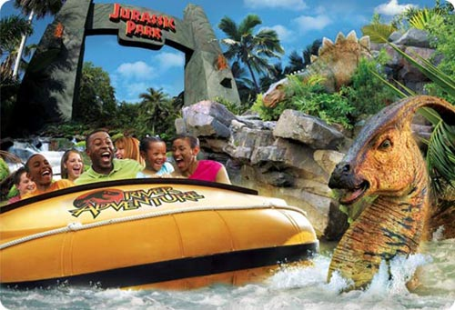
From high concept to transmedia franchise
High concept as period:
‘I hope that this period would not be dismissed as unproductive or stale. Instead, the period offers a chance to examine a specific instance in which the balance between commerce and art in American film tilted strongly towards economics, influencing the construction and market for film’
Justin Wyatt, High Concept: Movies and Marketing in Hollywood (Austin: University of Texas Press), p. 202

Slide 49
What to take away from today…
Franchises emerged out of a very American culture – consumer culture, branding, advertising, mass media, mass production (i.e. standardized assembly line)
Franchised brand media developed from the world of business, leading to integration of filmmaking and marketing in Hollywood – rise of giant conglomerates
It requires the corporate act of licensing
Brand franchises are characterized by multiplicity (e.g. merchandise) and extension (e.g. sequels) often in the name of commerce (known stories travel across media)
But franchises do require much creative strategy
Despite its history, brand media franchising is ideally suited to the convergence structure of the 21st century

Slide 50
What’s coming up next?
Screening:
The Greatest Movie Ever Sold (2011)

Slide 51
What’s coming up tomorrow…?
Lecture 5:
‘Transmedia Futures Part 1: Digital Participation’
Lecture 6:
‘Transmedia Futures Part 2: Global Perspectives’

