Slide 1
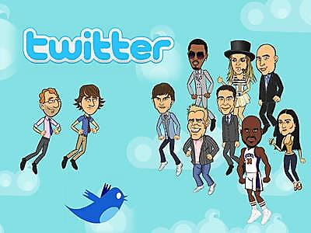
Transmedia Futures Part 1: Digital Participation

Slide 2
Today…
Digital media as transmedia participatory culture
The Internet Age and participatory culture
Producer as audience/audience as producer
Example: Lady Gaga
DVDs as participatory transmedia storytelling
Key question:
Is digital media a tool for fans or for industry?

Slide 3
Learning Outcomes
Define the concept of participatory culture
Analyse how digital media engages audiences
Identify the impact(s) of digital media on the workings of contemporary transmedia culture

Slide 4
The shift to participation…
Thus far we have mostly discussed transmedia storytelling in terms of ‘official texts’
However, ‘transmedia storytelling should be considered in terms of the following formula:
‘Media Industry (Official) + Collaborative Culture (Fandom)’
Scolari, Bertetti and Freeman (2014: 3)

Slide 5
Stop and think…
How, exactly, is the Internet different to other, older media forms?
How does the internet change the form of media?
How does the internet change workings of the media industries?
How does the internet change how audiences engage with media?

Slide 6
So, the internet…
Makes media
more interactive
more easily consumable/sharable
Makes media audiences
more active
more participatory
Makes media industries
more networked
less visible?

Slide 7
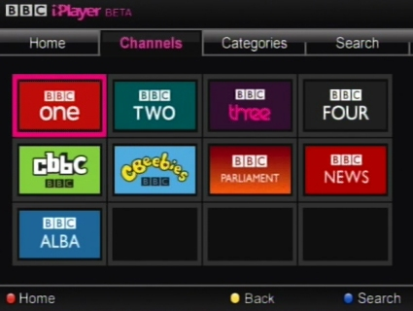
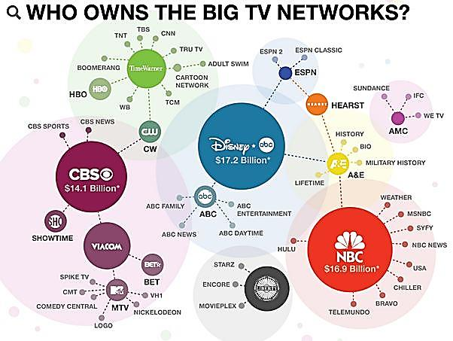
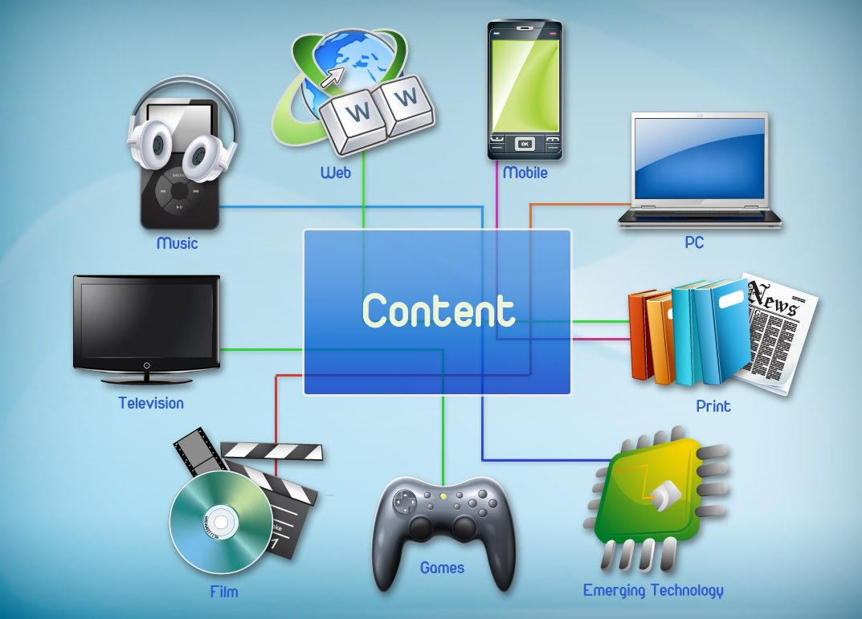
‘The new media ecosystem is based on networked technologies that are peer-to-peer in organisation and collaborative in principle’ (Uricchio, 2004: 86).

Slide 8
‘Convergence therefore must be understood as both a top-down corporate-driven process and a bottom-up consumer-driven process.’
- Henry Jenkins, 2006

Slide 9
Participatory Culture
User-generated content is the internet’s primary source of content production and information
‘Participation can be seen as the defining characteristic of the internet in terms of its hyperlinked, interactive and networked infrastructure and digital culture.’ (Deuze, 2005)
By privileging an active online audience, media forge stronger relationships with audiences. There may well exist a level of transparency and dialogue

Slide 10
Content as a reward for participating

Slide 11
Participatory Culture
Consumers of media become producers of media
‘Producer-consumer model’; ‘prosumers’ (Toffler, 1980)
‘If the process of telling stories, making meaning and sharing mediated experiences becomes more participatory and collaborative, it becomes crucial to understand the roles of the producer and the consumer as (to some extent) interchangeable.’ (Deuze, 2005)

Slide 12
So then…
KEY POINT #1:
Internet forges a closer relationship between audience and media content
KEY POINT #2:
Audiences of media become producers of media
So what does this mean for transmedia culture?

Slide 13
Digital media has changed things!
Social media:
Allows producers to communicate directly with fans
Makes producers more accessible to audiences
Blurs the distinction between ‘producer’ and ‘fan’
Makes promotion feel less like promotion (?)

Slide 14
Transmedia celebrities in the age of media convergence

Slide 15
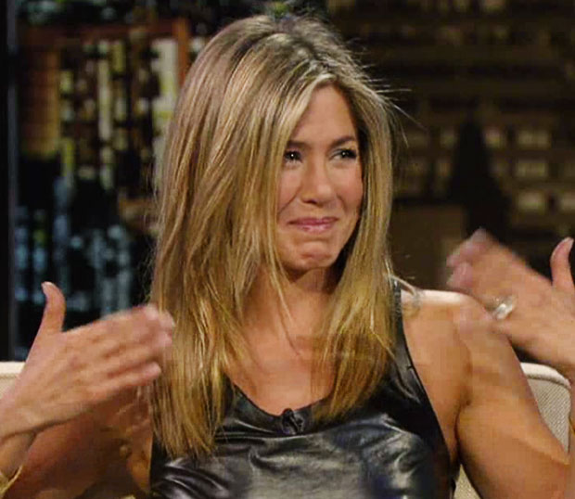
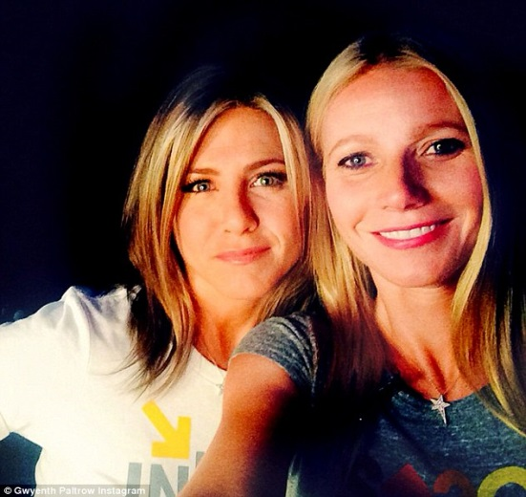
Celebrity constructed across media
FILM
MAGAZINES
TV
SOCIAL MEDIA

Slide 16
The celebrity as transmedia
“The celebrity is a very useful way of connecting … transmedia processes” (Turner, 2004, p.33)
“The mediated intertextuality of celebrity production speaks specifically to the developing mechanisms of convergence culture that characterise contemporary media use” (Jenkins, 2006).

Slide 17
What is ‘celebrity’?
‘The celebrity is a ‘human pseudo event’, fabricated for the media and evaluated in terms of the scale and effectiveness of their media visibility (Boorstein)
‘Celebrity is not a property of specific individuals. Rather, it is constituted discursively, by the way in which the individual is represented’ (Turner)
‘Celebrity, then, is overwhelmingly a product of media representation; understanding it demands giving close attention to the representational repertoires and patterns employed in this discursive regime’ (Turner)

Slide 18
So then…
Let’s analyse the following Twitter pages!
How is the celebrity being constructed discursively and representationally here:
What type of language do they use?
What ‘stories’ from other media forms are being extended and expanded across platforms?
What’s the role of the audience here?
What initial conclusions might we make about the role of social media as a transmedia tool?

Slide 19
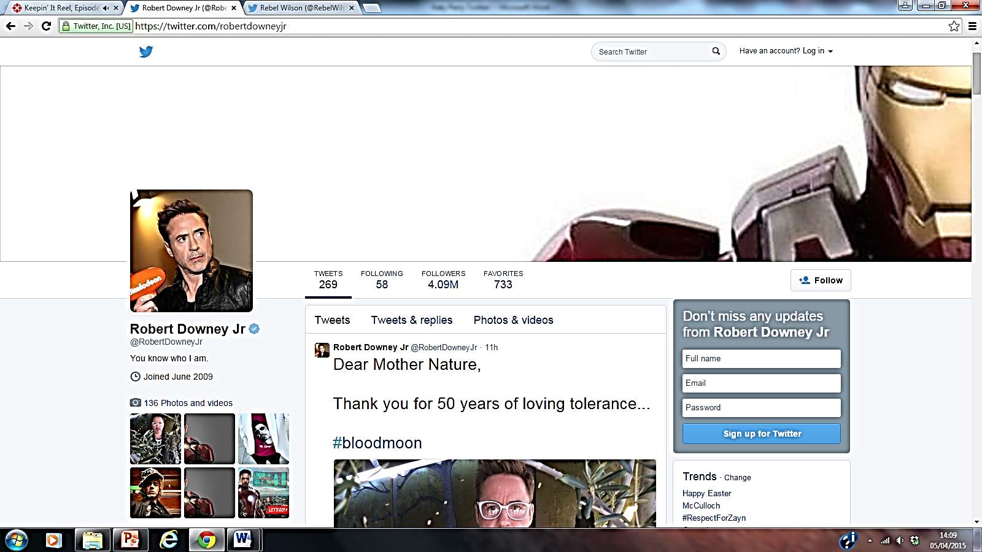

Slide 20
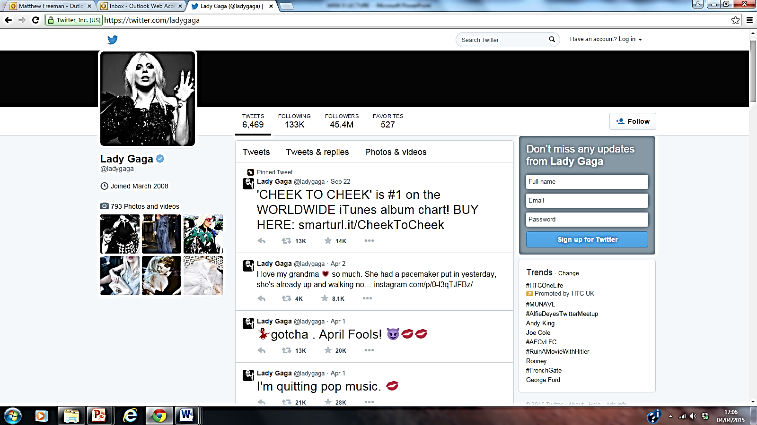

Slide 21
Lady Gaga
‘Controlling and crafting one’s myth is hardly new … what’s remarkable about Lady Gaga is she’s the first star born in and of the Internet Age to master this art.’ (Maureen Callaghan)
In other words, Lady Gaga’s celebrity image is a product of the Internet’s participatory sprawl!

Slide 22
Participation with fans
‘Perception of proximity’ (Beer, 2008)
Removes mediation of traditional media
Makes audiences feel more involved
Harks back to traditions of letter-writing

Slide 23
Social media as humanising celebrity
‘Gaga’s skilled use of social-media platforms delivers some fans a sense of closeness and ultimately cements her authenticity as a ‘genuine person’ and ‘good citizen’’ (Bennett, 2014)
Abolishes distinctions between public/private

Slide 24
Producer as audience… or is it audience as producer?
Social media is a shift in the relationship and distinction between producers and audiences
https://www.youtube.com/watch?v=MMY1br5e1lA
Notes:
9:00-10:30

Slide 25
Producer as audience… or is it audience as producer?
Social media blends things together!
It creates celebrities that are media producers and amateur users, both stars and personalities, both extraordinary talents and ordinary fans
In other words, it creates a transmedia culture that brings (more) equal balance between the industry and the audience, between those creating the stories and those consuming them

Slide 26
What does this mean for fiction?
How does participatory culture manifest as fictional storytelling in film?
What does this digital blending of media and producer/audience functions mean for film?
How does this enhance transmedia storytelling?

Slide 27
Case study: DVDs and Blu-Rays

Slide 28
‘Transmedia storytelling lures the audience into buying more and more stuff – today, DVDs; tomorrow, who knows what?’ (Kring)
DVDs first sold as offering more film content: ‘Choose from features, like director’s notes, behind the scenes footage, trailers, and more’
DVDs as media convergence: bringing together multiple pieces of media content – text, audio, comics, video, etc. – within the same disc format

Slide 29
DVDs as transmedia storytelling
Transmedia storytelling as adding value to DVDs as products worth purchasing
Marvel One-Shots – ‘A Funny Thing Happened On The Way to Thor’s Hammer’
Bridges the gap between Iron Man 2 (2010) and Thor (2011), released on the Captain America: The First Avenger DVD (2011)
https://vimeo.com/140163807

Slide 30
Additional (transmedia) information buried within the DVD disc
DVDs as providing added educational content:
‘Journey of Discovery: Creating Man of Steel’
https://www.youtube.com/watch?v=B7GShUYBqNo

Slide 31
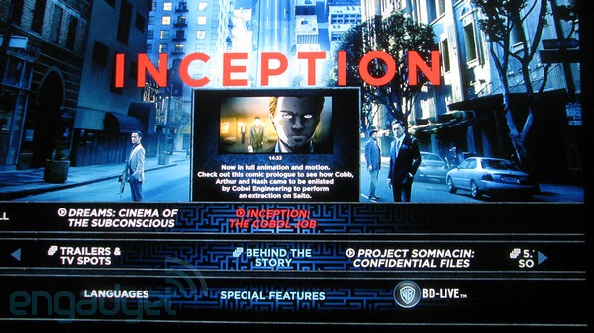
Additional (transmedia) story content buried within the DVD disc
DVDs as providing further story content
‘Extraction Mode’ – Inception (2010)
Convergence of film and comic books?
https://vimeo.com/150471958

Slide 32
Conceptual question…
Does this represent ‘transmedia’ – i.e. telling stories across media and encouraging audiences to migrate across platforms…
Or does this represent ‘multi-media’ – i.e. a complete blurring of what were once separate media forms into single sites of storytelling?
Or better still: Is this now simply ‘media’?

Slide 33
A question worth debating?
Is digital media really for the benefit of audiences: the participatory alternative to the mass media?
Or is digital media for the benefit of media industries: another site of commercial construction (a digitised form of promotion designed to produce more media and sell more media products)?

Slide 34
What to take away from today…
Digital media as interactive transmedia culture:
Producers can now speak directly and immediately to their audience, without the filters of the traditional mass media
The internet brings an abolishment of the former distinctions between public/private and producer/audience
Thus making transmedia content a more participatory site
This has possible implications for the future:
Will we soon be able to distinguish between media?
How much power will producers give to audiences?

Slide 35
What’s coming up…?
Lecture 6:
‘Transmedia Futures Part 2: Global Perspectives’

