Slide 1
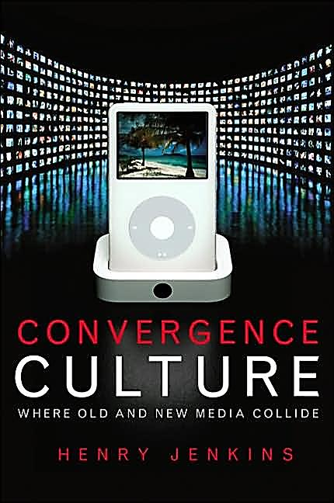
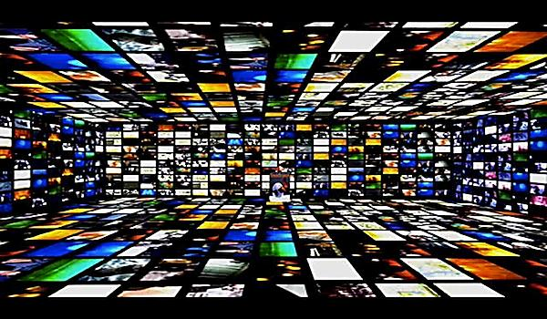
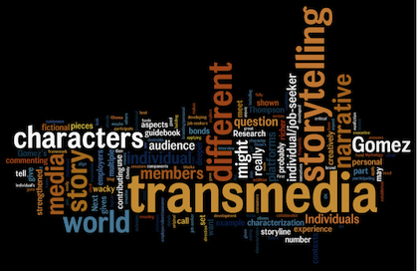
Transmedia Futures Part 2: Transnational and Global Perspectives
Lecture 6

Slide 2
Today…
Global (and local perspectives)
Transnational TV formats and the global audience
Transmedia in the UK right now
Preference for transmedia audiences but global content
Global transmedia
International differences
Socio-political functions

Slide 3
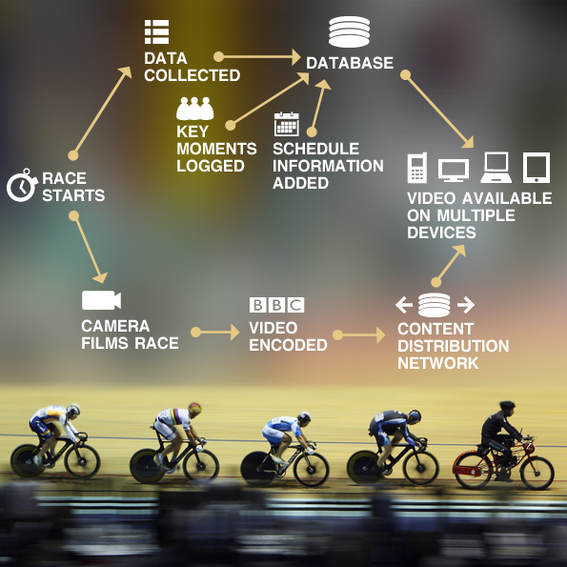
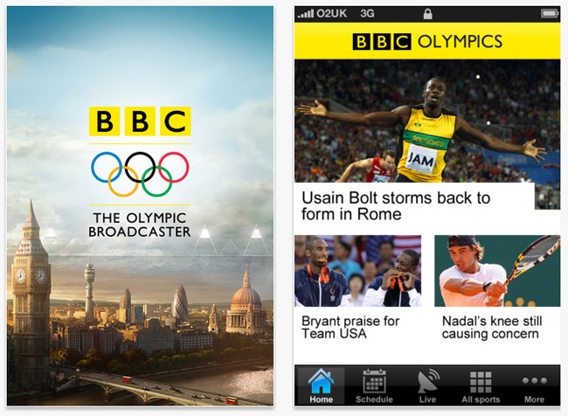
Local roles for transmedia in the UK
Transmedia as ‘informing, educating and entertaining’ (Grainge, 2015)
BBC’s coverage of the London 2012 Olympic Games

Slide 4
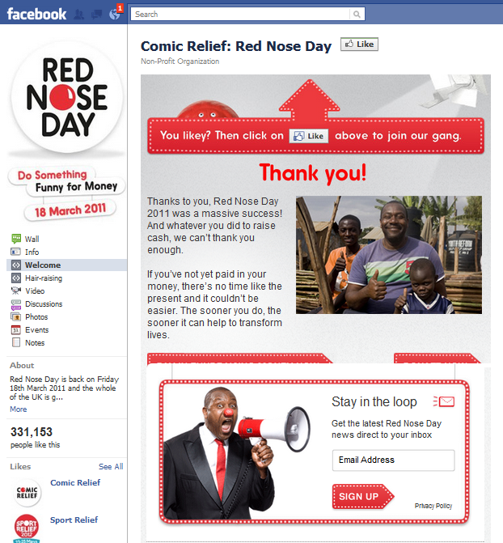
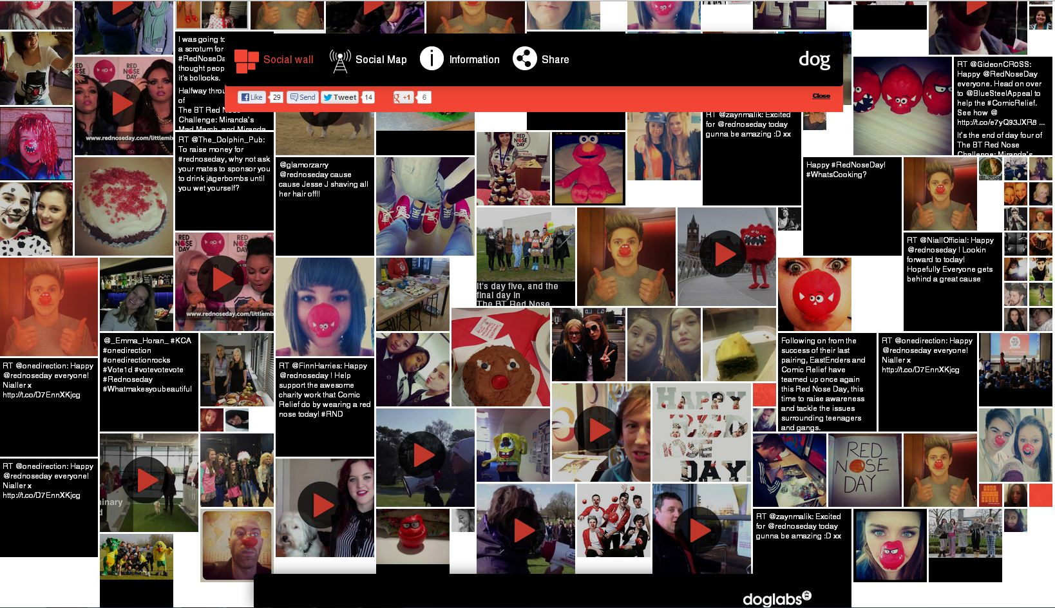
Local roles for transmedia in the UK
Transmedia as national charity campaign
BBC’s coverage of Red Nose Day

Slide 5
Local challenges for transmedia… in the UK
“Transmedia storytelling has struggled to find itself a clear foothold in the UK … transmedia [storytelling] may have seen some recent successes, but the evidence here suggests that the multi-platform world is still largely at the stage of “porting” projects across borders rather than developing new models where industry cooperation and collaboration is more key.” (Johnston, 2013)

Slide 6
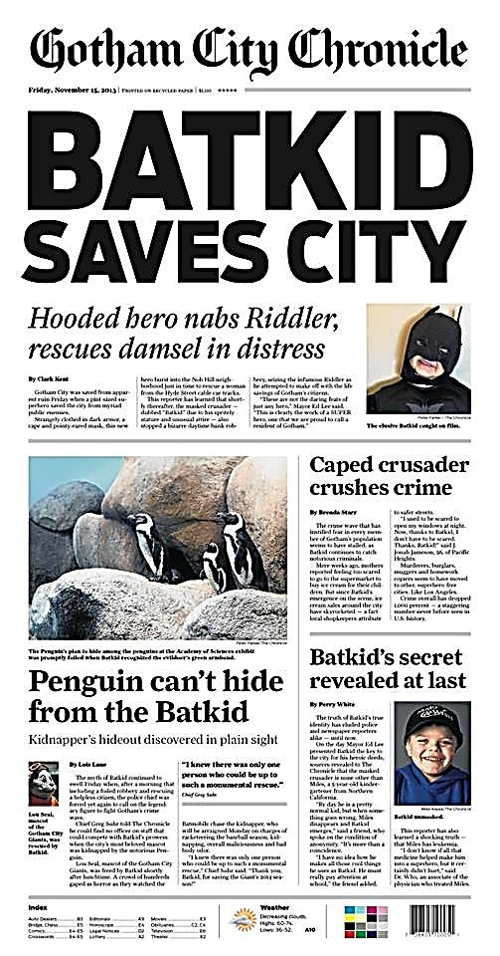
Local challenges for transmedia… in the UK/US
“Most of the UK/US-based transmedia projects today are funded through promotional and marketing funds.” (Brian Clark, 2013)
Raises questions (and problems!) in terms of value, relevance, not to mention salaries!

Slide 7
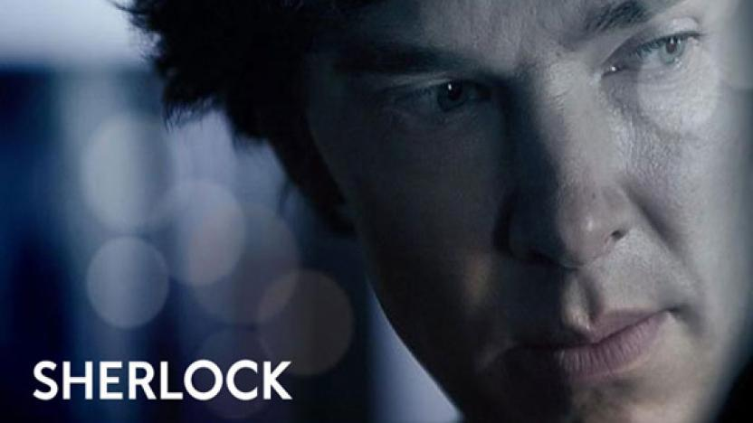
Local challenges for transmedia… in the UK
Transmedia… and promotional and marketing funds in the UK
Digitization, gamification, involved fans… highly creative strategy!
http://www.redbeecreative.tv/work/bbc-one-sherlock-lives

Slide 8
Local challenges for transmedia… in the UK
The ‘marginalization’ of transmedia stories online:
Doctor Who TV episodes averaged 6.47 million to 8.44 million (2013)
‘The Night of the Doctor’ online episode watched by 2.5 million during its entire week available online (2013)
So, is online content the marginal home of transmedia stories in the UK?
Doctor Who showrunner Steven Moffat: “When will we stop calling [online episodes] ‘webisodes’ or ‘prequels’ or ‘promos’ or ‘minisodes’ or whatever else. When will we just start calling them ‘Doctor Who’?” (2014)
https://www.youtube.com/watch?v=EobSTIc-ywA

Slide 9
Uncertainties over transmedia’s future…?
‘There is someone out there who will no doubt figure out how to relate the Internet as a tool of narrative beyond my old-fashioned notions. But I think whoever cracks that is not going to be someone who has made it big in television or film. It is going to be someone we just do not know about yet…’
Joss Whedon (2014)
Industrialisation to consumer culture to government to conglomeration to digital convergence to… Where next???

Slide 10
And so, looking from an industry perspective…
We are entering a phase (in the UK) where the model is often less about extending content across the borders of media and countries…
And more about, at best, the imagination of creative digital media agencies, and, at worst, the repurposing of content across countries

Slide 11
TRANSNATIONALISM IN TELEVISION FORMATS:

Slide 12
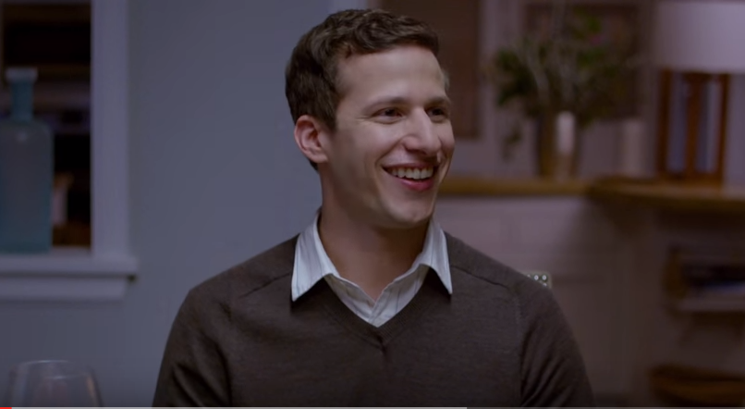
TV’s greatest opportunity is also its greatest challenge at the moment
https://www.youtube.com/watch?v=ZZqFh2YOKCI
Notes:
And it’s all to do with the proliferation – the sheer amount of content that’s out there at the moment.
Deloitte estimates that in an average month, over 360bn hours of long-form video will be watched globally (http://www.bbcworldwide.com/annual-review/annual-review-2015/strategic-report/strategy.aspx)
This opening film at the Emmys in 2015 featuring Andy Samberg illustrated this brilliantly from the audience perspective. PLAY VIDEO VIA WIFI : Andy Samberg opening of Emmys 2015 https://www.youtube.com/watch?v=ZZqFh2YOKCI
Leading figures are saying that the trouble is, good television is getting in the way of great television. And, thanks to on-demand technology, shows aren’t just competing with what’s on the other channels at the same time, they’re competing with the greatest television of all time, to get audiences’ attention.
So, how do TV shows rise to the top and how do production companies, broadcasters (in the broadest sense) and distributers take advantage of the opportunities?
Opportunity : there is more content, funded by more investors, reaching more audiences on more platforms; and also a growing understanding of (& appreciation for) the power of creativity to drive businesses.
Cost: we’re in a market that’s global by default, where the same people consume programs in very different ways, and where content carries ever greater levels of responsibility for hitting business objectives.
But it *is* possible, and there two ways have emerged to get there…

Slide 13
So then…
Rise of convergence culture and digital spread of media has led to a proliferation of media content and continues to grow and grow
This transmedia culture creates more demand on audiences
Because of this proliferation of content, the media landscape is more competitive than ever before, and as a result…
…Producers are looking for global content that travels easily and cuts through this crowded and over-proliferated media landscape

Slide 14
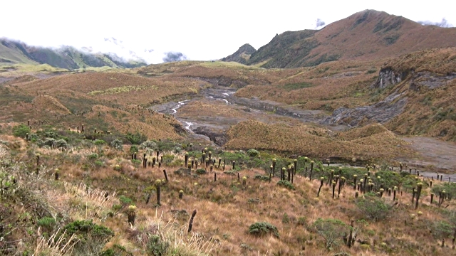
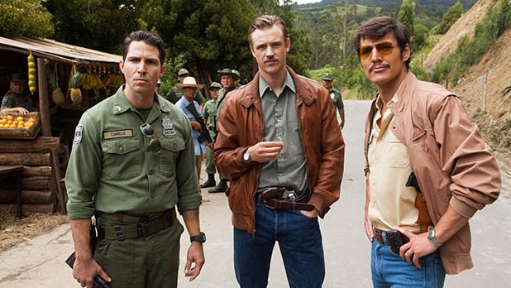
Case study: Narcos
About drug kingpin Pablo Escabar
Available in dual languages
Shot in dual locations
Hired film directors – ‘filmic’
Global social issues – drugs
A global audience by design
i
Notes:
The Pablco Escabar biopic drama, launched on Netflix in August 2015
Co-production with Telemundo, an American Spanish-language broadcast television network owned by the NBCUniversal
From the inception, was intended to be in dual languages with dual locations – automatically having appeal to two massive markets (US/English speaking + Latin America/Spanish-speaking)
The makers took it to non-traditional customer (ie, not broadcaster but a subscription VOD service); fewer boundaries to get to market with Netflix than with traditional broadcaster – less regulation, more creative freedom
Intended to look & feel movie-like; used known movie directors to appeal to global audiences
Global issue of drugs, with a main character whose name is well-known across the world – but about whom there is lots of intrigue (ie, we don’t know his story in detail)
So, lots of the makings – deliberately – of a gobal hit : because it was appealing to a global audience by design

Slide 15
Drama & entertainment travel the best
“
We are building real momentum as we continue to invest in a strong and healthy creative pipeline, focusing specifically on genres that return and travel, namely drama, entertainment and factual entertainment.
“
ITV plc Annual Report and Accounts
for the year ended 31 December 2014
Notes:
As these two examples imply, however you get there whether by design or accident, it’s true that the best opportunities for global hits in TV are in the ents and drama genres. With some notable exceptions around natural history blue-chip documentaries like Blue Planet, Frozen Planet or Africa.
Factual tends to be local stories; comedy (ie, what makes people laugh) is very culturally-driven – although as we’ll see, there are exceptions to that rule
Doctor Who S8 was the top selling programme of 2014/15 for the BBC, licensed to 189 territories
ITV Studios Global Entertainment are promoting new dramas, such as Beowulf and Jekyll And Hyde, plus formats including Love Island, on the global market.
Call the Midwife is big in Latvia, Mrs Brown's Boys is a ratings winner in New Zealand, and Heartbeat is still massive in Finland
To put this in context:
total revenues from the global sale of UK shows were around £1.2bn in 2014/15
The US remained the UK’s largest export market with Australia the second largest acquirer of UK content,
Sub-Saharan Africa and South America have usurped China as the fastest-growing markets for UK television exports (exports to Africa grew by 34%, Mexico was the fastest-growing market with a 46% rise in revenues to £1.6m)
There’s talk of an impending reality and entertainment boom in Asia
http://www.bbc.co.uk/news/entertainment-arts-26326189
http://www.dailymail.co.uk/news/article-2449379/Sales-British-TV-shows-countries-makes-1-22bn.html
http://www.bbc.co.uk/mediacentre/worldwide/2015/bbc-worldwide-annual-review-2015
http://www.broadcastnow.co.uk/news/boom-in-tv-exports-to-africa/5094859.article

Slide 16
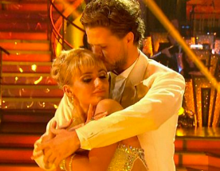
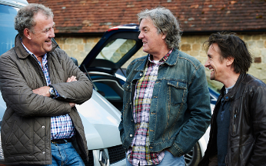
Rooted in universal truths or topical issues
Notes:
Bit of a cliché, but we are truly living in a global world – thanks to travel, as well as media & tech
Global markets + global media creates global concerns – from environmental issues and terrorism (wars which aren’t between nation states and don’t know those boundaries), to what’s the best, coolest music or fashion, to the food and drinks we consume, to who our role models are, whether we’re in Tibet or Timbuktu or Twerton
More than unites us than divides us – due, mainly to the consistency of human nature, expressed differently through a range of cultural norms and expressions.
We have global institutions than unite more nations than they divide – the United Nations, international laws, globally shared objectives in Sustainable Development Goals; these are rooted in common human goals like peace, justice, fairness, prosperity, supporting those in need, and even just an instinct for survival, which transcend geography, politics or culture.
The 2015 World Happiness Report identified that whilst there are vast differences in levels of happiness across the world (Switzerland, Iceland and Denmark are ranked the highest, Syria, Burundi and Togo are the lowest), wherever people are, their happiness levels are influenced by the same social factors – the quality of their external social context. We all want strong relationships with family and friends, we need trust and empathy among our local community, and we all want the support of national institutions and frameworks which allow us to determine our quality of life. Wherever in the world you are, because you are human, that’s what you need to make you happy.
Talking of happiness, Coca Cola is a brand that positions itself around the idea of happiness. That (plus v clever distribution model) means it owns 44% share of the global soft drinks market, and is the most recognised brand in the world, by 94% of the global population. It’s officially sold and marketed in 200 countries (just not Cuba, North Korea, Burma or Sudan) - http://brandongaille.com/24-great-coca-cola-sales-statistics/
If building a product’s appeal around a universal value or emotion like that can work for a drink, it can work for a TV programme
Strictly essence of “fairytale dreams come true through passion and dedication” which so many cultures can related to + universal appeal of dance.
Top Gear as it stood with Clarkson et al was actually about male relationships, which every society has – but there’s also global appeal of cars
First Dates – dating, search for love – whatever the particular rituals and conventions of each culture, the idea of two strangers meeting and seeing if they’re attracted to each other exists in most cultures
While those are enduring, there are also topical issues which work on a global scale at any given point in time – so at a time when the global CCTV market is worth $16.6 billion but predicted to grow to about $37.2 billion by 2020. and we’re questioning the surveillance society Hunted (on C4) which makes a social experiment out of avoiding capture from the authorties has global resonance
And, with an upcoming US election and relations with Latin America high on the agenda, as well as the War on Drugs, Narcos feels very timely – looking at issues which affect every corner of the world

Slide 17
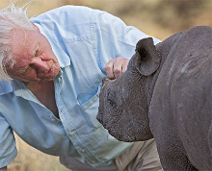
Formats with broad appeal embedded
Notes:
Where the broad appeal is embedded in the original, these shows can be sold as finished products
There are so many of these – mostly dramas. These are just some examples.
NB: Top Gear is also re-made locally in USA and China (but otherwise, they show the UK version) plus Top Model is remade in 54 markets, but the US version shows around the world – just announced they’re axing it after 22 seasons and just crowning their first transgender winner
Top Model – concept of beauty, attractiveness, fashion exists all over – as does the notion of competition, and the competitiveness among women
Top Gear – already talked about re: male banter
Doctor Who & Game of Thrones - sci fi/fantasy genre means there’s no specific location / setting, so not culturally bound
Blue Planet natural history doesn’t work to national boundaries
David Beckham Into The Unknown+ You, Me & The Apocalypse - casting of multi-national talent or global names (According to the Warwick Business School, Brand Beckham is the British icon most recognised by Chinese consumers after the Royal Family); multiple locations; pose universally interesting questions (what would you do with some time off if you were one of the most recognisable faces in the world? How would you escape / what would you do if you knew the world was going to end in 34 days)
David Beckham doc sold to 15 countries before it was even shown in the UK – was aired just before the World Cup (so something of global topical significance), and shown in China on the same day and in Brazil the following week. (http://www.theguardian.com/media/2014/jun/02/david-beckham-wimp-amazon-michael-palin-bbc-england-brazil)
NB: helps that these are in English – although as we’re seeing, doesn’t mean that other language shows can’t travel (cf The Bridge, Deutschland 83)
Cf: Independent article re: David Beckham

Slide 18
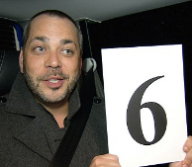
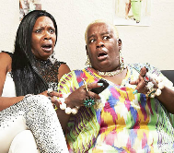
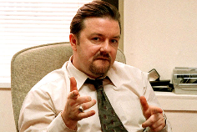
Formats which can be made to feel local
Notes:
In contrast to those that are universal, these work because they can be made local – ie for a specific audience. So , they can be optioned + remade
As I said – some do both (eg Top Model and Top Gear)
And, all need to be rooted in a universal truth or a globally relevant, topical subject area
So everyone cooks, but everyone cooks differently; everyone dances, but some dance differently (eg US version of Strictly includes hip hop, Indian version has Bollywood); everyone sings but their tastes in music differ; everyone entertains/is hospitable, but everyone does that differently; everyone has to go through job application processes, but they deal with that differently; everyone watches TV and reacts to it, but it’s very different types of TV
But it’s not just specific topics, it’s also things that human nature and experience dictates that most people like, but might like in different ways:
So, everyone likes slapstick comedy/people falling over, but how they react to that is different (and the types of people they get willing to do it might also be different); everyone likes to see reactions from celebs/watch them suffer but who those celebrities are will differ; everyone likes to see how people deal with being thrown together with strangers in a confined space; but how people will deal with that (and how you prompt and prod them to get a reaction) will differ (in in Turkey : its format has been adapted to local sensitivities and broadcasting regulations. Changes include separate bedrooms for male and female housemates, as well as bans on sexual conduct and nudity. Meanwhile, the 9th American series added a romantic aspect by pairing up the housemates up and having them compete as couples. In the 14th Brailian series, 7 mothers and 2 aunts, relatives of the 9 remaining housemates, entered the Big Brother Brasil house to celebrate International Women’s Day. By contrast, in UK in 2004/05 in the Big Brother Panto housemates from previous series spent time in the Big Brother House to perform a pantomime at the series' end. Doesn’t get more British than that!
It’s not just factual or entertainment (ie, non-scripted formats) – can also, increasingly, apply to scripted (ie, comedy and drama).
The Office. Massive hit in the US when remade with Steve Carrell – again, about the everyday lives of office employees working in mundane jobs, with idiots – but culturally adapted to work to reflect American experiences. But also it had different comic styles – Ricky Gervais’ character drew comedy from a restrained, subtle approach of cringe-inducing embarrassment, whereas Steve Carell’s engaged in wacky, over-the-top physical gags and some wild buffoonery. And they’re tonally different – UK more cynical and depressing, US more warm and optimistic.
The Bridge. Odd-couple dark crime drama ‘The Bridge’ makes national difference a core part of it’s character-driven narrative, and has been repurposed from the original Danish/Swedish dynamic twice in locations where geopolitical borders and cultural differences are significant. USA/Mexico and France/UK (called The Tunnel - on Sky Atlantic)
Shameless – US version has stuck to the roots of the UK, focussing on how Frank Gallagher’s alcoholism affects his family. The producers had to fight efforts to place the show in the South or in a trailer park because they felt there was already a comedic tradition of making fun of the people in those worlds. Wanted to expose the fact of the reality that these people aren't 'the other' – they're people who live four blocks down from you and two blocks over"
But doesn’t always work for scripted content – it’s harder. Comedy in particular can be hard to reconstruct – as I’ve said. Some examples coming later.4No coincidence that these are some of the highest rating shows in the UK as well

Slide 19
The importance of audience research
“The show is as much for adults as it is for children”
27%
Germany
UK
Notes:
UK consumers of Doctor Who are twice as likely to say that the show is primarily for children than the global norm (although still only at 8% vs 4%),
But… they also feel most strongly than many other markets that the show is as much for adults as it is for children (80%). This is closely followed by USA and Australia – which is typical of patterns across all sorts of measures for Doctor Who.
Meanwhile… Germany is the market least likely to agree that it is for adults as much as children (only 53%), but the implication from other survey answers (which is why it’s important to pull together an overall story from across different data points) is that they believe it is more for adults rather than just for children
So, there’s a 27% points difference between how they feel about it. The average is almost literally in the middle of those (66%) – which is where averages let you down, because you can’t see the range of difference – which is important here. Will have implications on how broadcasters schedule and market the show, but also in terms of tone and topics they cover – to make sure they include all ages

Slide 20
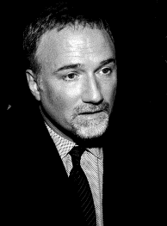
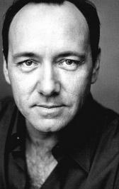
The importance of audience research
+
+
=
The Social Network very popular in the US
Kevin Spacey
very popular globally
Well-rated British drama
3m boost to subscriber base +
First Emmy win for a non-broadcast series
Hollywood actor/director billing: for fans of ‘Se7en’
High crossover between viewers
Notes:
Where research and insight can help shape existing content, it’s also increasingly being used to commission iti n the first place.
Ted Sarandos, Chief Content Officer of Netflix, once called himself a “human algorithm” because of his use of data rather than gut instinct to work out what viewers want. “Big data is a very important resource to allow us to see how much to invest in a project but we don’t try to reverse-engineer,” he says, adding that commissioning decisions are more like “70% science and 30% art”.
Here’s an example of the ‘science’ in Netflix’s creativity. Before green-lighting House of Cards, thanks to their data, Netflix already knew these key things:
1. A lot of users watched the David Fincher directed movie The Social Network from beginning to end.
2. The British version of “House of Cards” has been well watched.
3. Those who watched the British version “House of Cards” also watched Kevin Spacey films and/or films
Helped with their decision-making process once the idea was brought before them.
Apparently, they also used this to explore the business case for taking on Clarkson et al once they left Top Gear – but the data suggested it wouldn’t work for them and their business model.

Slide 21
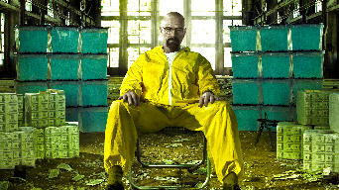
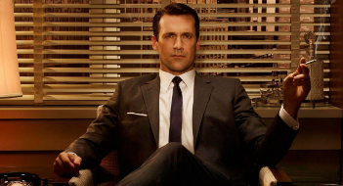
Shows that are made for local audiences, but work very well abroad
Notes:
Many are dramas – they are historical and/or fictions stories which have a clear setting in time and place, but which have appeal all across the world because they deal in universal themes and recognisable characters – and sometimes extreme situations which those who aren’t familiar with are curious about.
Many of the UK exports really play on their distinct Britishness. But… the ubiquity of this British content eroding differentiation for channels and content-providers who have previously traded on that. So, for example, BBC America are finding that it’s not longer as much of a USP. Although it is the first stop British Content for over 80% American viewers, they use other sources too PSB and Netflix. So, Britishness has lost its novelty value – we’re becoming victims of our own success)
Not just drama, as we saw with the example of Strictly. Also, Come Dine With ME, Bake Off and Gogglebox might at first appear to be particularly British – snooping round people’s houses, judging them for their bad cooking, baking cakes and having them judged in a tent like a village fete, or sitting around slagging off telly with a cup of tea and plate of biscuits. But they do work well in other cultures, as we’ve seen

Slide 22
Shows from abroad that haven’t worked as well in UK
So You Think You Can Dance
Rising Star
Married At First Sight
Notes:
some shows have come over to here from other territories and haven’t worked as well for British audiences as they did at home
So You Think You Can Dance – only ran for 2 seasons on BBC One, but has had 12 seasons in USA and still going strong. Should have worked here too – but maybe because we already had Strictly well established before we made our version of this?
Married at first Sight – strangers are matched up by experts and get married, but only meet at the alter. First created by Danish has now been licensed to more than 20 countries. First series took a long time to make in UK – really hard to cast. Only a few couples were matched in the end – one decided not to proceed with the wedding. First series ended about slot average and has been recommissioned. But dismissed as a bit of a stunt, and just another reality show. Time will tell if S2 works better….
Rising Star - Israeli talent contest, highly interactive. Singers compete in real-time as viewers vote via an interactive app – they were standing behind a wall, the more votes they got the higher the wall went up – until they could walk through it, if they’d had enough votes. If they win approval from 70% of the audience, the screen is lifted to reveal the judges and studio audience to the singer, who then goes through to the next round. The show launched on Channel 2 in Israel in September 2013 to huge ratings and made viral stars of duo The Amazing Rabbis. Was sold to over 20 international broadcasters including China’s CCTV and France’s M6. ITV commissioned it, but scrapped it in Sep 2014 – because it wasn’t performing well elsewhere (show was scaled back following its launch in Germany, where its run was reduced from 10 episodes to seven, because of a “lack of audience response”. It performed moderately successfully on Brazil’s Rede Globo and Portugal’s TVI but the 10-part US version, which aired on ABC in June 2014, struggled with its interactive voting elements due to the country’s different time zones and averaged just 4m viewers.
Hole In the Wall - an adaptation of the Japanese game Brain Wall (also known as "Human Tetris") which itself was a component of a Japanese game show hosted by a well-loved comedy duo. Only ran for 2 series in UK, but the original gameshow began airing in 1988 in Japan and still is. “Hole in the Wall”, has been aired in over 30 countries worldwide, including Russia, South Korea, and India. But only 2 series in the UK

Slide 23
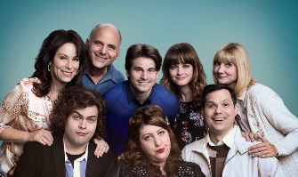
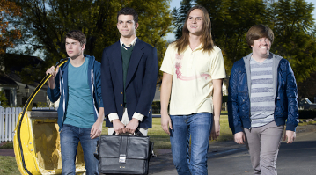
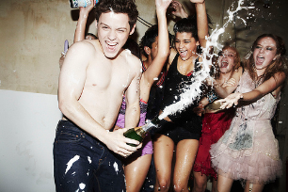
Shows from UK that have not worked as well abroad
The Inbetweeners
Gavin & Stacey
Skins
Notes:
But it works both ways – some shows from here haven’t worked as well when they’ve gone abroad. And, as I’ve hinted at, that has been particularly true of comedies
The Inbetweeners – a coming-of-age comedy about a group of teenage boys who are social 'inbetweeners', neither popular nor misfits, should have translated well. But it didn’t work as well - the boys were just a bit too socially acceptable and the bad language also proved too strong for a US audience. The US version felt more like an episode of the Wonder Years at times as genuine themes of friendship and bonding are referenced far more explicitly and frequently than was ever the case in the British show. Whereas part of the charm and amusement of the British version was the lack of loyalty shown by the four towards one another. Only had one season of 12 eps
Gavin & Stacey – renamed US & Them for FOX in USA, with Ruth Jones and James Cordon as exec producers. Initially had a 13-episode order before Fox whittled it down to six due to dissatisfaction with the quality of the scripts. Apparently they were also unsure about its tone But in never even aired in the USA – although was shown in South Africa and Korea
Skins was axed after one season on MTV – probably due to different cultural insensitivities: generated controversy over its sexual content and scenes of drug use. So several advertisers withdrew and there were some accusations of child pornography since most of its cast members were under the age of 18. Although, some critics said the show was tamer than the British original. Also, it didn’t rate brilliantly : MTV also said they’d cancelled Skins because it wasn't connecting to the U.S. audience,
The IT Crowd didn’t even make it past the NBC pilot in 2006, which was a near shot-for-shot remake – but they’re attempting to make it for the US market again – and creator Graham Linehan has hinted that it will be a departure from the original series. He has said: "You just have to pull back on the surrealism and concentrate more on the character comedy - the Americans do character comedy so beautifully, so I think you have to adapt it to suit that.”
But not just comedies and dramas – can happen with entertainment formats too. Eg, How Do You Solve a Problem Like Maria – search for a West End star for an Andrew Lloyd-Webber production. Very successful for BBC – so much so that ITV did a copycat version Grease is the Word although didn’t work as well. BUT… was only taken up in Holland for more than one series (Canada and Belgium did one series each)

Slide 24
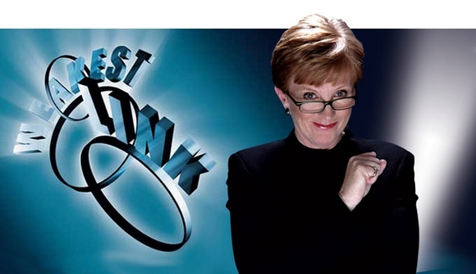
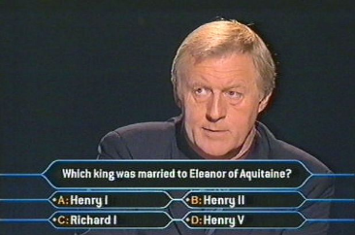
Shows that continue to have a global market after they’ve ended in the UK
Notes:
And finally…. Just to prove that there’s no exact science to this and always exceptions that prove the rule : there are some shows (not many) that have done well in the UK but have worked even better abroad
Who Wants To Be a Millionaire : The UK version debuted on 4 September 1998, and aired on ITV with Chris Tarrant as its host until 11 February 2014 – although latterly it was used more as a platform for fundraising celebrity specials. But it’s been labelled “ the most influential game show in global TV history” and, by its owner, “THE WORLD’S MOST SUCCESSFUL GAME SHOW”. Over 100 different international variations of Millionaire have been produced in 80+ languages and variants have aired in around 160 countries worldwide. And 29 versions are still airing today
Weakest Link – the second most popular international TV franchise, behind only Millionaire. Has been licenced in 41 countries as far flung as Mexico and Malaysia, Azerbaijan and Australia. The and been viewed in over 70 countries worldwide. It ended in 2012 in UK after 11 years and 1,693 episodes. The second longest running series was in Croatia, where in May 2010 the quiz reached its 1008th episode. Today it is still airing in Mexico and Turkey – where it only started in September 2015
Parade’s End – can also see this in drama too. Parades’ End, set in late Edwardian period, only ran for 5 eps in one series in UK in 2012 – and audience fell by more than 1 million between Ep1 and Ep 2 on BBC Two But was show in at least 17 European countries. Clearly worked internationally partly because it was typical of the complex co-production deals required to produce high-end drama. It was produced by the UK company Mammoth Screen in association with HBO Miniseries, BBC Worldwide, Trademark Films and Lookout Point, then co-produced with BNP Paribas Fortis Film Fund and Anchorage Entertainment, and filmed with the support of the Belgian federal government’s Tax Shelter scheme. Again, had an international market in mind from the start, helped by an up-and coming global start in Benedict Cumberbatch, so wasn’t so dependent on being a rip-roaring success in the UK to make global sales

Slide 25
Summary so far…
Transnational formats are sometimes seen as ‘easier’ to produce and to maintain than transmedia stories, at least by some media companies in the UK
The ideal is when a global appeal is ‘baked in’ to the idea from the start
There is greater efficiency and more likelihood of success in embedding global appeal from the start through formats that appeal to lots of different audiences or can be made local, but are rooted in a universal truth or topical subject
But it is not always an exact science – there is also skill in recognising where an idea might stretch transnationally, even if it has not work in its original country
Notes:
Intellectual property is everything – not enough to make it, you have to own the rights to it, so you can exploit it transnationally – whether other markets want to show it as is, or remake it
Transnational formats are the holy grail – what everyone recongises they need in the global market –but, ideally, they have to work and prove their worth in the home territory first
The ideal is when fact the market is global is baked in to the idea from the start; but most of the commercially-minded production companies do this already. You can’t hope for a happy accident anymore – although the BBC has to catch up on this.
How do you do this? There is greater efficiency and more likelihood of success in embedding global appeal from the start through formats that appeal to lots of different audiences or can be made local, but are rooted in a universal truth or topical subject
But it’s not an exact science – there’s also skill in recognising where an idea might stretch, even if it hasn’t work in its original territory. And there still needs to be a strong idea with integrity at the heart of the format.
TV industry is thriving and has a great future, thanks precisely because of its now transnational nature. As I said, it’s greatest challenge is also its greatest opportunity – to up the game and keep telling exciting fresh stories with fantastic talent, that audiences love. And it’s a brilliant – if competitive – industry to work in.

Slide 26
Thinking about transmedia globally?
What does it mean to understand transmedia NOT as a product of US convergences or US/UK industrial manufacturing models?
Is transmedia about more than monetizing media products?
If transmedia is about participation and is a form of communication, then what are the potentials of transmedia around the world?
How are other cultures and communities making use of transmedia?
And can we define transmedia as simply ‘one’ phenomenon – or is it too many things, with too many functions, to pin down concisely?

Slide 27
Transmedia’s many variations…?
“International differences are obscured by the generality of the term ‘convergence culture’, and it can be helpful to consider convergence ‘cultures’ in the plural.”
Hay and Couldry (2011)

Slide 28
Transmedia differences around the globe
Franchising and participatory/digital storytelling
Marketing and brand development
Digital space for virtual reality games
Media tool for religious radicalisation
Creative tool for documentary filmmakers
Political/social activism communication
Construction source for re-building communities
The Transmedia Earth Network
(Freeman & Proctor)

Slide 29
Transmedia as online documentary
Hollow:
Looks at how natural disaster in a small town impacted people
Websites
Online game
Social media

Slide 30
Transmedia as online documentary
High Rise:
Examines impact of urban living on Western society
Looked at class, age and religion
Website
Social media
YouTube

Slide 31
Transmedia as memory-making
“The project is about preserving the memory of the population and seeks recognition of the settlers, victims of internal displacement by generators of violence (criminal gangs).”
Camilo Tamayo Gomez, EAFIT University (2015)

Slide 32
Transmedia as reconciliation
“I believe that transmedia in Colombia can contribute to creating processes of memory, recognition and solidarity for the victims of the Colombian armed conflict. I think that using and developing transmedia with local communities can be the clue to starting real processes of reconciliation in our country.”
Student enrolled on MA in Transmedia Communication at EAFIT University (2015)

Slide 33
What to take away from today…
Transmedia and convergence cultures have led to a proliferated and crowded media landscape with seemingly endless content
Global formats that travel are seen as the solution because it is cheaper and easier (with less perceived risk)… in the UK
Thinking internationally, “transmedia is always an important strategy for generating impact on the public sphere…”
Economically?
Promotionally?
Narratively?
Culturally?
Socially?
Politically?

Slide 34
Thank you
m.freeman@bathspa.ac.uk
Notes:
Good luck with your studies, good luck with your assignments and do get in touch if I can help any futher.

