Slide 1
Experimental Humanities II (HUMB002) 2016
STATISTICAL ANALYSIS
Lecture 1
VARIABLES, FREQUENCIES, DISTRIBUTIONS
MEASURES OF CENTRAL TENDENCY AND VARIABILITY
Pavla Linhartová
The lectures and exercises are based on the lectures from the subject PSY117 – Statistical analysis
by Stanislav Ježek and Jan Širůček from Department of Psychology, Faculty of Social Studies MU Brno

Slide 2
Course introduction
Lectures + Exercises (basic computations, Excel, SPSS, Statistica)
2 tests (20 + 20 points)
1 seminar thesis (15 points)
Final exam project (45 points)

Slide 3
Data and measurement
Target population X Sample
Sample must match population characteristics, so that we can infer data obtained from the sample on the population
Data are some information measured in the sample
Variables are coded data
There is always some measurement error:
Y = T + e (obtained score = true score + error)
There are various measurement error sources
TARGET POPULATION
SAMPLE

Slide 4
Statistics for (experimental) research
Descriptive statistics (data description and visualisation)
  Get to know you data in detail
  Present you data clearly and correctly
  What can we say about the explored phenomena?
  What can we say about relations between them?
Statistical inference (inference on population from a sample)
  How does you model (assumption) fit the data?
  Hypothesis testing, deriving estimates

Slide 5
Statistics for (experimental) research
Statistics is „only“ a tool (a powerful one)
  GARBAGE IN, GARBAGE OUT: output quality depends on input quality
  STATISTICS IN NOT ENOUGH: quality input = quality research methodology (valid and reliable methods, study design, data acquisition and sample selection)
  CORRECT USE OF STATISTICAL TOOLS: tests assumptions, correct choice
  of statistical tests, correct analysis process
  RESULTS INTERPRETATION: understanding the results, correct results presentation, awareness of results (analysis, data) strengths and weaknesses

Slide 6
Statistics for life
Critical thinking
Probability thinking
Understanding measurement and presentation biases
Interpreting statistical reports around you (news, television, internet…)
…statistical literacy

Slide 7
VARIABLE TYPES
AND LEVELS OF MEASUREMENT

Slide 8
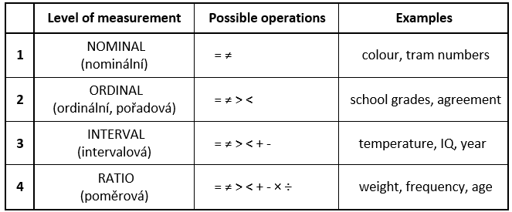
Variables: Levels of measurement
1 + 2 = categorical, qualitative, 3 + 4 = metric, cardinal, quantitative

Slide 9
Considering level of measurement
When you consider variable measurement level, following question can be useful. Let’s take as an example „eye colour“:
  Does George have the same eye colour as Caroline?
  Does George have bigger eye colour than Caroline?
  How much bigger is George’s eye colour than Caroline’s?
  How many times bigger is George’s eye colour than Caroline’s?

Slide 10
Variables according to number of possible values
Continuous variables: infinite number of values (real numbers)
Discrete variables:
  (infinite) number of values, but only some values (typically integers) – we usually treat them as continuous
  Only a few values
    Dichotomous (binary) – only two possible values
    Polytomous – several values

Slide 11
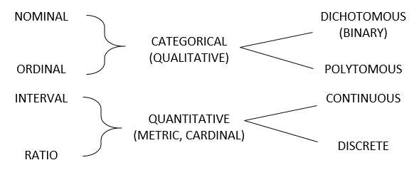
Variables: summary

Slide 12
Level of measurement conversion

Slide 13
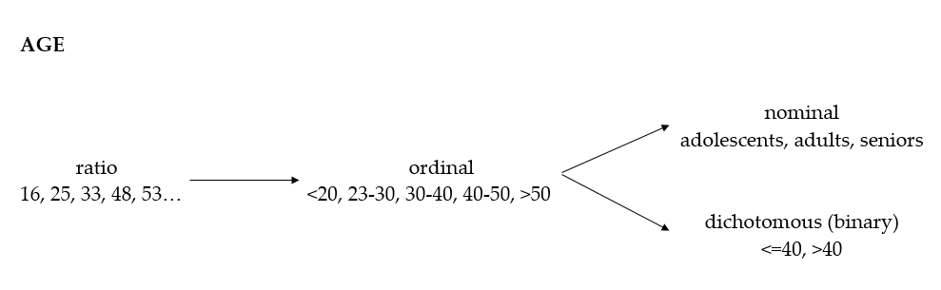
Level of measurement conversion

Slide 14
Treating variable types
Variable type depends on HOW we measure, not what we measure!
Measure on the highest level possible, you can always transfer to the lower levels, not the other way…
Variables measured on discrete ordinal polytomous scale are in psychology
and other sciences usually considered as interval continuous variables,
e.g. attitude scales:
    1=totally disagree, 2=somewhat disagree, 3=neither agree, nor disagree, 4=somewhat agree, 5=totally agree
We usually try to achieve interval variable type (if it´s reasonable)
  -> easier statistics

Slide 15
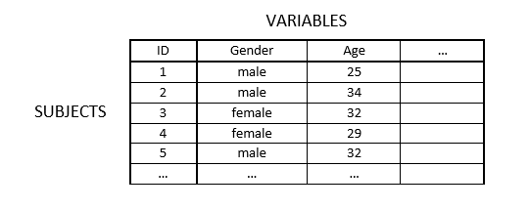
Data matrix
1 column = 1 variable, 1 row = 1 subject (object)
Variable has either string, or numeric coding
Numeric coding + labels
Short variable names + labels

Slide 16
Coding issues
Repeated measurement
    pre-test and post-test scores have to be coded as individual variables, not individual cases!
Forced choice answer formats
  1 question = 1 variable, 1 answer possibility = 1 value
Multiple choice answer formats
  answer possibilities have to be coded as individual variables with values
  1 = checked, 0 = not checked
  View Data matrix handout and Coding rules in study materials

Slide 17
FREQUENCIES AND DISTRIBUTIONS

Slide 18
Frequencies
How many values we have in different variables?
How many people answered this way?
What was the most frequent answer? etc.
Frequency tables and frequency graphs

Slide 19
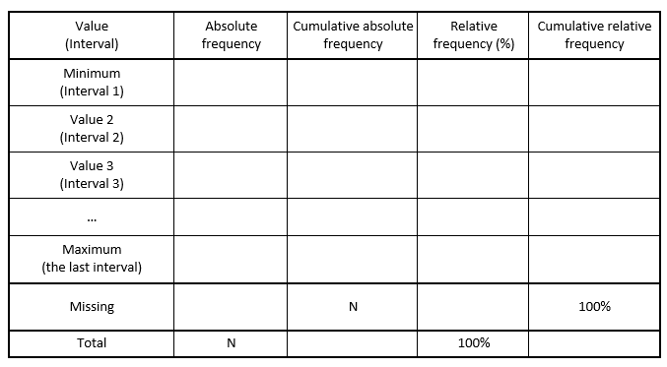
Frequency tables

Slide 20
Frequency tables
Ordered from lowest to highest values
Usually include missing values
Suitable for categorical variables or metric variables with a few values
We can use intervals instead of values
It is better to use graphs for displaying frequencies of variables with many values
Frequency table has to always include absolute and relative frequencies and the last summing row

Slide 21
Frequencies visualisation
Categorical data
  Pie chart – used rarely
  Bar chart
Metric data
  Histogram
  Boxplot
  Stem-and-leaf diagram

Slide 22
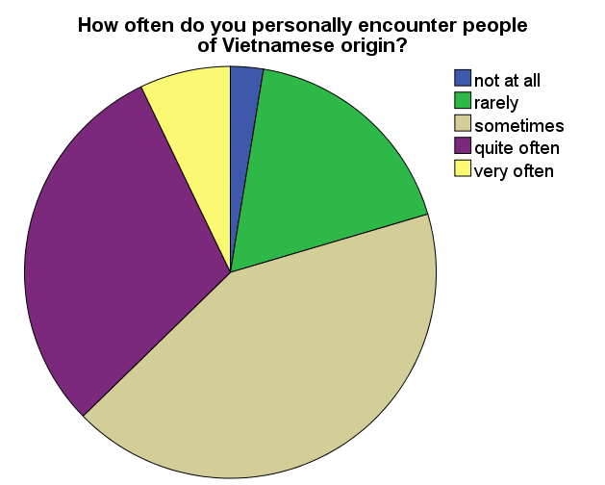
Categorical data: Pie chart
Used rarely – doesn’t show distribution

Slide 23
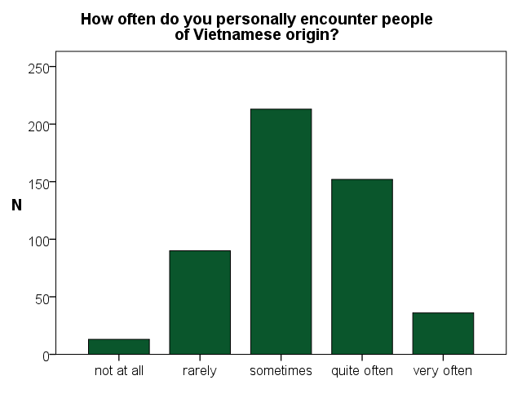
Categorical data: Bar chart

Slide 24
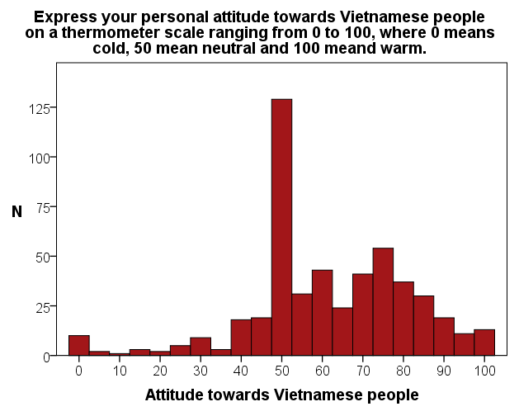
Metric data: Histogram
Similar as Bar chart, but with real values
on X axis

Slide 25
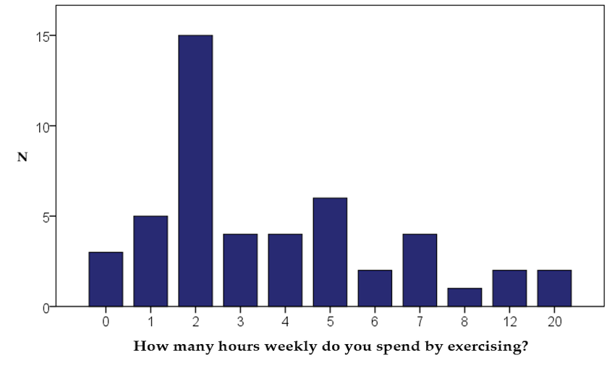
Bar chart vs. Histogram

Slide 26
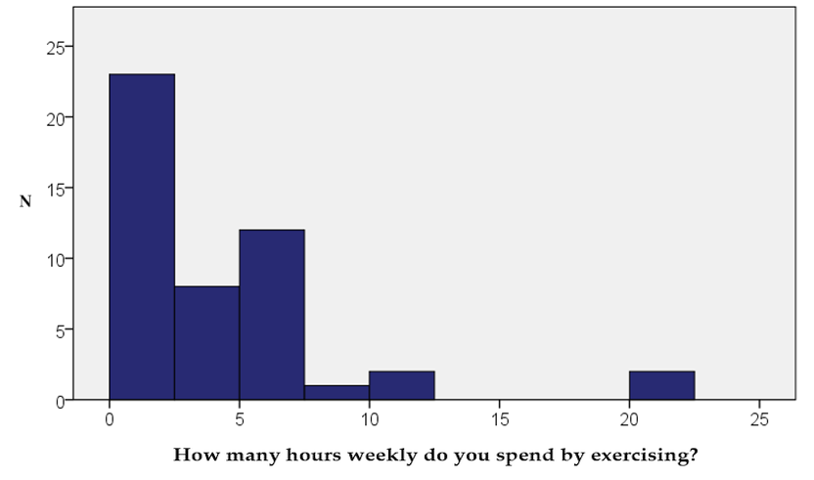
Bar chart vs. Histogram

Slide 27
Metric data: Stem-and-leaf diagram
(numerical histogram)
Frequency Stem & Leaf
32,00 0 . 00000000000000000000000000000000
18,00 1 . 000000000000000000
14,00 2 . 00000000000000
7,00 3 . 0000000
2,00 4 . 00
4,00 5 . 0000
1,00 6 . 0
1,00 7 . 0
10,00 Extremes (>=8,0)
Stem width: 1
Each leaf: 1 case(s)

Slide 28
Correct frequencies visualisation
Each graph and table has to be described enough so that it’s understandable even without reading the source text
Use headings, scale labels, categories labels
Use reasonable scales ranging

Slide 29
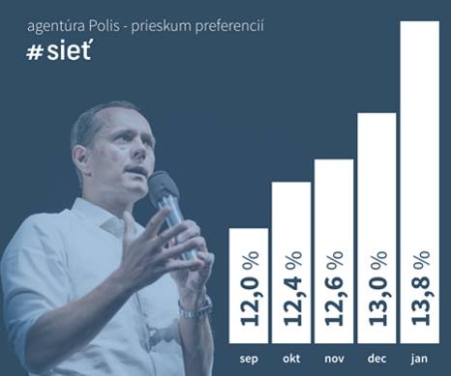

Slide 30
Frequency distribution
Each variable has some frequency distribution, which follows from the nature of the variable
Population frequency distribution X Sample frequency distribution
We need samples representative to population, so that the sample frequency distribution is close to population frequency distribution

Slide 31
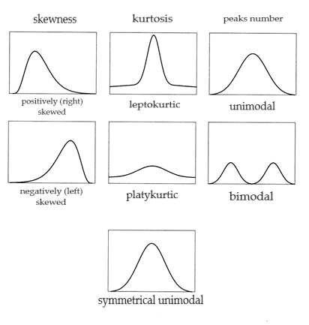
Frequency distribution
Normal
Uniform
Number of peaks: unimodal, bimodal, multimodal
Skewness:
  positively skewed (right-skewed, floor effect)
  negatively skewed (left-skewed, ceiling effect)
Kurtosis: leptokurtic, platykurtic

Slide 32
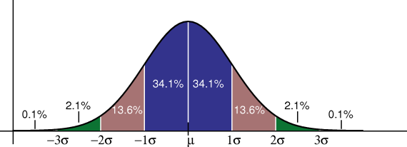
Normal (Gaussian) distribution (bell curve)

Slide 33
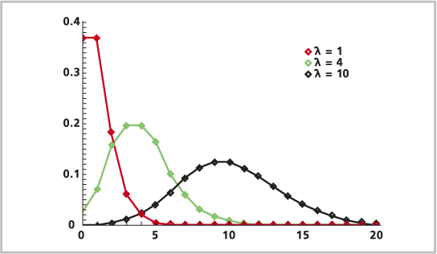
Poisson distribution
Distribution of infrequent events, lambda = number of events per time unit

Slide 34
MEASURES OF CENTRAL TENDENCY
AND VARIABILITY

Slide 35
Central tendency
One number describing variable distribution
    One number: both advantageous and dangerous…
Central tendency indicates mean, typical, representative, expected value
Central tendency indicates where on the scale are the data located

Slide 36
Mode, median, mean
MODE (MODUS): categorical typical value
  The most frequent value, the value with the highest frequency
  The only possibility for categorical data
MEDIAN: ordinal measure of central tendency
  Value of the element in the middle of the rank-ordered sample
  50. percentile (P50)
  If the total number of values is even, median is the centre of the interval between the two middle values
  Can be used for ordinal data and higher measurement levels
ARITHMETIC MEAN: deviation measure of central tendency
  Only for interval and ratio data
  Easily biased by extreme values

Slide 37
Counting mode, median and mean
Mode
  Read from frequency table
  Excel: MODE(data)
Median
  Categorical variables: read from frequency table (best from cumulative relative frequencies)
  For odd N, Me is Xk (kth element of rank-ordered sequence of variable values), where k = (N+1)/2
  For even N, Me is the mean of Xk and Xk+1, where k = N/2
  Excel: MEDIAN(data), PERCENTIL(data;0.5)
Mean
  Excel: PRŮMĚR(data), AVERAGEA(data)

Slide 38
Measures of central tendency: examples
Data A: 1, 2, 3, 3, 3, 4, 5, 5, 6, 8, 10 (N=11)
  M = 4.55, Md = 4, Mo = 3
Data B: 1, 2, 3, 3, 3, 4, 5, 5, 6, 8, 100 (N=11)
  M = 12.72, Md = 4, Mo = 3
Data C: 1, 2, 3, 3, 4, 5, 5, 6, 8, 10 (N=10)
  Md = ?, Mo = ?
  Md = 4.5, Mo = 3 and 5
Data D:
  Md = ?
  Md = 10.5

Slide 39
Group mean X Weighted mean
Group mean: A group of female teachers has average salary of 45 000 CZK and a group of male teacher has average salary of 50 000 CZK. What is the average salary of both groups?
  (45 000 + 50 000) / 2 = 47 500
Weighted mean: If the average salary of 10 female teachers is 45 000 CZK and the average salary of 40 male teachers is 50 000 CZK, what is the average salary of all 50 teachers?
  (10 x 45 000) + (40 x 50 000) / (10 + 40) = 49 000
More on estimating mean, median and mode from group frequencies with examples here:
http://www.mathsisfun.com/data/frequency-grouped-mean-median-mode.html

Slide 40
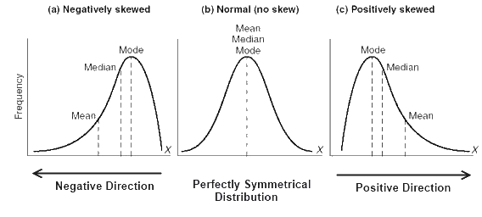
Relations between mode, median and mean

Slide 41
Measures of variability
The second number for distribution description
Indicates how little or how much are the data on the scale distributed
Low variability = most values are the same or close to each other
High variability = values are very diverse (or bimodal distribution)

Slide 42
Range, variance, standard deviation
Ordinal measures of variability
  Range: Xmax – Xmin (extremely biased by end values)
  Interquartile range: Q3 – Q1 (P75 – P25), IQR
Deviation measures of variability
  based on deviations from the mean: x = X – M
  variance = average squared deviation, s², VAR(X)
    population: (Sx² / n) vs. sample (Sx² / (n – 1))
    Sx² = sum of squared deviations = sum of squares
  standard deviation – s, SD
    square root of the variance, return to the original units

Slide 43
Counting measures of variability
IQR = Q3 – Q1
  Q1 = Xk (kth element of rank-ordered sequence of variable values),
  where k=(N+1)*0.25 rounded down
  Q3 = Xk, where k=(N+1)*0.75 rounded down
  Excel: PERCENTIL(data, 0.25), resp. PERCENTIL(data, 0.75)
Variance, Standard deviation
  Count deviation score for every value: x_{i} = X_{i} – M
  Count squared deviations
  Sum squared deviation and divide by N-1
  For SD, we square-root the variance
  Excel: VAR.P(data), VAR.S(data), STDEVPA(data) ~ SMODCH.P(data),
  STDEVA(data) ~ SMODCH.VÝBĚR.S(data)

Slide 44
Statistics vs. Parameters
Population ~ Sample, Parameters ~ Statistics
Statistics: m, s², s
Parameters: μ, σ², σ
A teacher is interested in math knowledge among students in his class (3rd grade). The class is his population.
We are interested in math knowledge of students in third grade in Czech Republic. We collect data from several classes randomly picked from all primary schools in Czech Republic. The classes are our sample, our target population are all third grade student in Czech Republic.

Slide 45
Measures of central tendency and variability
It is necessary to be able to count measures of central tendency and variability
by hand
It is necessary to be aware of how does adding a constant or multiplying
by a constant change different measure of central tendency and variability
Think about when is it appropriate to use different measures and why
How does the distribution shape influence the measure and vice versa:
what can we say about the data distribution from the measures of central tendency and variability
View exercises

Slide 46
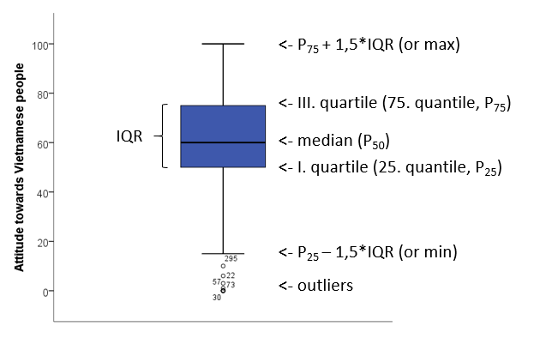
Boxplot (cz: krabicový graf s anténami)

Slide 47
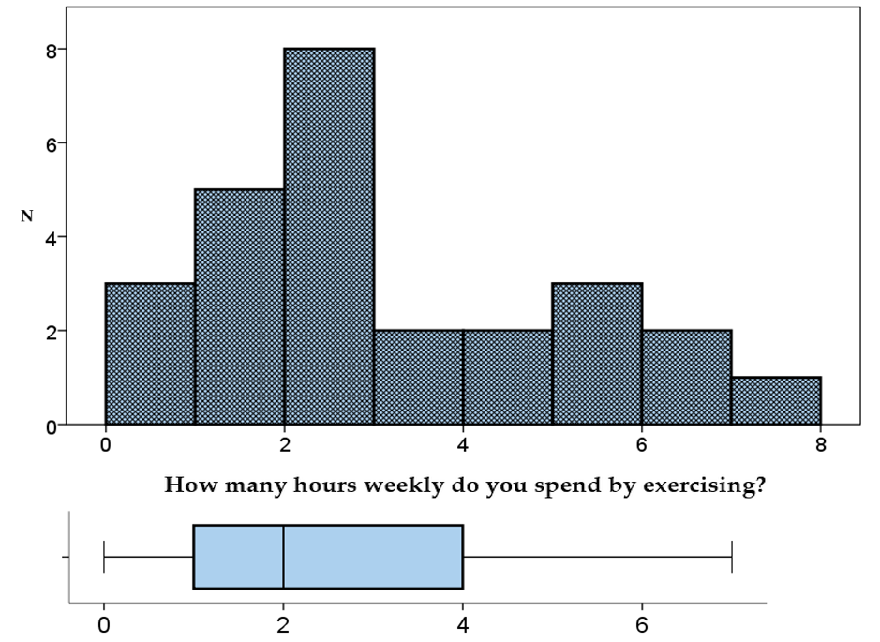

Slide 48
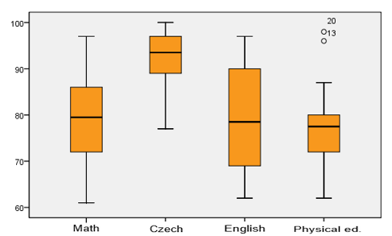

Slide 49
Choice of descriptive statistics
We consider:
  level of measurement
  distribution shape – symmetrical? normal?
  the aim of the study: description X inference, comparison
For (distribution) description only:
  we use mainly ordinal statistics (we can also add deviation statistics)
  N, min, Q₁, median, Q₃, max
  boxplot
  percentiles for individual scores
For statistical inference, comparison etc.:
  we use deviation statistics (if we have sufficient measurement level)
  N, M, SD
  distribution description, z-scores for individual scores

Slide 50
Descriptive statistics in research studies
We always present descriptive statistics
  We usually present descriptive statistics only for variables we work with (we interpret)
  Minimum: N, M, SD (or ordinal equivalents Q₁, Md, Q₃, IQR)
  Usually more appropriate: N, X_{min}, X_{max}, M, SD
  If needed: skewness, kurtosis, interesting quantiles…
Distribution description
  we usually don’t present frequency tables and graphs (if statistical description isn’t the aim
  of the study, e.g. diagnostic test manual)
  If needed, we usually mention the distribution shape only verbally (approximately normal, negatively skewed etc.)
  We usually assess normality and deal with deviation from normal distribution
Usually one or two decimals
Czech in Czech text, English in English text (beware: decimal point/comma etc.)
Usually there are norms for tables presentation, e.g. APA 6th manual

