Slide 1
Aplikovaná herní studia jaro 2016
herní žánry, čtecí týden

Slide 2
Sylabus
01 UVOD
02 ANALYZA HRY (MDA? PROSTOR, HM vs UZITI MEDII - CLOBRDO DEMONSTRACE)
03 SEMIOTIKA, KYBERTEXT
04 HOST: METODOLOGIE, VEDECKA PARADIGMATA – Jakub Macek
05 NARATIV, DISKURZIVNI ANALYZA
06 ČTECÍ TYDEN - VELIKONOCE
07 REFLEXE CETBY + HERNI ZANRY
08 HRACI JAKO PUBLIKUM, VIRTUALNI SVETY JAKO ETNOGRAFICKE POLE
09 PLAYBOUR a VAZBA na HM
10 CROWDRESEARCH + HERNI TELEMETRIE
11 HERNI PRUMYSL (CR) a HERNI ZURNALISTIKA
12 PRIPRAVNY TYDEN - ZAVERECNY PROJEKT
13 ZAPOCTOVY TYDEN PREZENTACE (+ Zhodnoceni predmetu a profilu absolventa)

Slide 3
REFLEXE ČETBY

Slide 4
Četba na čtecí týden
Zubeck a spol. MDA 2004 (design)
J. Juul Space, Rules 2005 (design)
E. Aarseth Cybertext
M. Consalvo Paratext, Cheating 2007 (game in context)
H. Jenkins Transmedia Storytelling, Participatory Culture 1988 (gamers)
Ryan Game Narative
El Nasr Game Analytics, Telemetry
Susi Serious Games

Slide 5
MDA (Zubek a spol., 2004)
Dynamiky
Nástroj
Přínos textu?

Slide 6
Space, Rules (Juul, 2005)
Prostor
Pravidla
Přínos textu?

Slide 7
Paratext, Cheating (Consalvo; 2007)
Paratext
Hráči
Chování
Produkce
Přínos textu?

Slide 8
Transmedia Storytelling, Participatory Culture (Jenkins, 1998)
Vztah autor x recipient
Text
Kánon
Užívání textu
Textuální pytláctví
Přínos textu?

Slide 9
HERNÍ ŽÁNRY

Slide 10
Co je x žánr?
literární
filmový
hudební
vizuální umění

Slide 11
K čemu jsou žánry?
klasifikace
výzkum
teorie
interpretace
kritika
prodej
distribuce
vývoj žánru

Slide 12
„While some video games can be classified in a manner similar to that of films (we might say that Outlaw (1978) is a Western, Space Invaders (1978) science fiction, and Combat (1977) a war game), classification by iconography ignores the fundamental differences and similarities which are to be found in the player’s experience of the game.“
The Medium of the Video Game (Wolf, 2002)

Slide 13
„In the culture surrounding the video game, certain generic terms such as the Shoot ’Em Up are already established and in use among players, and these terms and distinctions are reflected in the proposed list of terms below. Some of these genres overlap commonly‐used genres of moving imagery (such as Adaptation, Adventure, Chase), while others, such as Escape, Maze, or Shoot ’Em Up, are specific to video games and reflect the interactive nature of the medium.“ (Wolf, 2002)

Slide 14
„In a video game, there is almost always a definite objective that the player strives to complete (or find and complete, as in the case of Myst), and in doing so very specific interactions are used. Thus the intention, of the player‐character at least, is often clear, and can be analyzed as a part of the game. The game’s objective is a motivational force for the player, and this, combined with the various forms of interactivity present in the game, are useful places to start in building a set of video game genres.“ (Wolf, 2002)

Slide 15
„More recently, Mark J.P. Wolf has come up with 42 different genres of games according to the kind of interactivity they offer. However, if we see genre‐based categorizations as a means of making sense out of a larger whole, 42 genres ceases to be useful. Or, we have to accept that the diversity of games requires many more genres and subgenres than traditional media products which have benefitted from genre studies. Or, that a game genre equals hybridity, because game genres are complex sums of interaction and rule mechanisms, audiovisual styles, and popular fiction genre conventions.“
—Halo and the Anatomy of the FPS, by Aki Järvinen

Slide 16
Označení žánru | Ste | UP | Or | GP | GMG | Des | Moby | PSN | XBLA | GOG | ND | GFS | GG | #
action | 1 | 1 | 1 | 1 | 1 | 1 | 1 | 1 | 1 | 1 | 1 | 1 | 1 | 13
arcade | 0 | 0 | 0 | 1 | 0 | 0 | 0 | 1 | 1 | 0 | 0 | 0 | 0 | 3
adventure | 1 | 1 | 0 | 0 | 1 | 1 | 1 | 1 | 0 | 1 | 1 | 1 | 1 | 10
strategy | 1 | 1 | 1 | 0 | 1 | 1 | 1 | 1 | 1 | 1 | 1 | 1 | 1 | 12
RPG | 1 | 0 | 1 | 0 | 1 | 1 | 1 | 1 | 0 | 1 | 1 | 1 | 1 | 10
indie | 1 | 0 | 0 | 0 | 1 | 0 | 0 | 0 | 1 | 1 | 0 | 1 | 1 | 6
MMO | 1 | 0 | 0 | 0 | 1 | 1 | 0 | 1 | 0 | 0 | 0 | 1 | 0 | 5
casual | 1 | 0 | 0 | 1 | 0 | 0 | 0 | 1 | 0 | 0 | 1 | 0 | 1 | 5
simulation | 1 | 1 | 1 | 1 | 1 | 1 | 1 | 1 | 1 | 1 | 1 | 1 | 1 | 13
Race | 1 | 0 | 1 | 1 | 1 | 1 | 1 | 1 | 1 | 1 | 1 | 1 | 0 | 11
Sport | 1 | 1 | 1 | 1 | 1 | 1 | 1 | 1 | 1 | 0 | 1 | 1 | 0 | 11
free to play | 1 | 0 | 0 | 0 | 0 | 0 | 0 | 1 | 0 | 0 | 0 | 0 | 0 | 2
FPS | 0 | 1 | 1 | 0 | 0 | 0 | 0 | 1 | 1 | 1 | 0 | 0 | 0 | 5
family | 0 | 1 | 0 | 0 | 1 | 0 | 0 | 1 | 1 | 0 | 0 | 0 | 1 | 5
Logical / puzzle | 0 | 0 | 0 | 1 | 1 | 1 | 0 | 1 | 1 | 0 | 1 | 1 | 0 | 7
cards / casino | 0 | 0 | 0 | 1 | 0 | 0 | 0 | 0 | 1 | 0 | 0 | 0 | 0 | 2
educational | 0 | 0 | 0 | 0 | 1 | 0 | 1 | 0 | 1 | 0 | 1 | 0 | 0 | 4
music | 0 | 0 | 0 | 0 | 0 | 0 | 0 | 1 | 0 | 0 | 1 | 0 | 0 | 2
classic | 0 | 0 | 0 | 0 | 0 | 0 | 0 | 0 | 1 | 1 | 0 | 0 | 0 | 2
fighting | 0 | 0 | 0 | 0 | 0 | 0 | 0 | 0 | 1 | 0 | 1 | 1 | 0 | 3
NABÍDKA | 11 | 7 | 7 | 8 | 12 | 9 | 8 | 15 | 14 | 9 | 12 | 11 | 8

Slide 17
Typologie žánrů (digitální distribuce)
13x Action
13x Simulation
12x Strategy
11x Race
11x Sport
10x RPG
10x Adventure
7x Logical / Puzzle

Slide 18
Škála výběru (digitální distribuce)
Steam 11 kat.
Green Man Gaming 12 kat.
GOG 9 kat.
Origin 7 kat.
PSN 15 kat.
XBLA 14 kat.

Slide 19
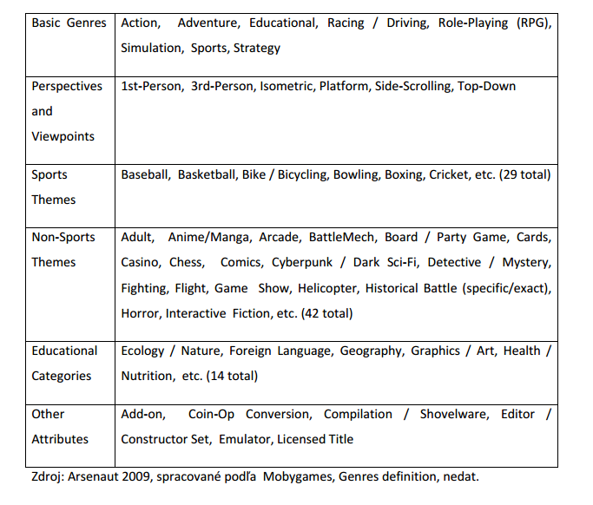
Súčasné klasifikácie počítačových hier a ich kritika
Buček, 2012
MU

Slide 20
„If we look at the accumulated materials associated with genre study in literary, television, and especially film studies, we can categorize them according to their dominant focus: 1) formal and aesthetic considerations, 2) industrial and discursive context, and 3) social meaning and cultural practice. Formal and aesthetic considerations have the longest history of use.“
What Defines Video Game Genre? Thinking about Genre Study after the Great Divide (Clearwater, 2011)

Slide 21
„Looking at the medium of video games, we see practical and theoretical applications of genre by an array of different people: reviewers and journalists, publishers and marketers, fans and retail workers, designers and critics, producers and industry analysts. Not only do they use genre categorization in different ways (simply because they are interacting with cultural products for different reasons) but they also interact and influence one another, thereby furthering the definition of any single genre. As such, as much as genre is characterized by aesthetics or formal traits, it is defined by the various people who come into contact with it.“(Clearwater, 2011)

Slide 22
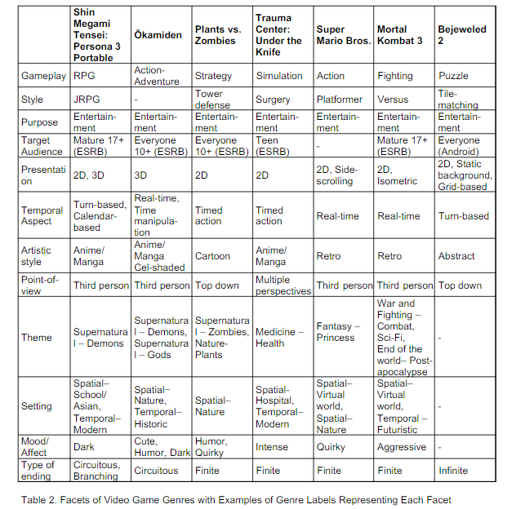
Facet Analysis of Video Game Genres
Lee, Karlova, Clarke, Thorton, Perti; 2014
University of Washington

Slide 24
Beat 'em up
„Brawler“
1984's Kung-Fu Master, 1986's Renegade (městské prostředí)
https://youtu.be/FGWX18zegpc
Populární zejména na arkádových automatech

Slide 25
Bojovky (fighting games)
Boj na blízko s živým oponentem
Jeden z prvních e-sport žánrů
Heavyweight Champ (1976)
Karate Champ (1984)
https://youtu.be/7A9jNDUMZEk

Slide 26
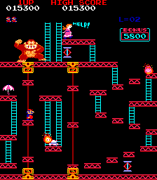
Plošinovky (platform games)
Rychlost, řešení puzzle, souboje
Space Panic 1980
Donkey Kong 1981
https://youtu.be/Pp2aMs38ERY
Opět velice populární na arkádových mašinách, i soutěžní hra
Mario, Sonic, Prince of Persia – technologicky ovlivněný žánr (s příchodem 3d chvíli mrtvý, nyní oživen)

Slide 27
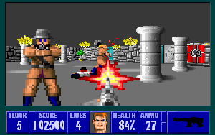
Střílečky (shooters)
Subžánr s mnoha dadlšími subžánry (tactical shooter, 1st person, 3rd person, Shoot em up,…)
Catacomb 3D (1990) – texture mapping
https://youtu.be/F5MzKdjIaPU
Wolfenstein 3D (1992) – považováno za zakladatele žánru
Ikonický žánr

Slide 28
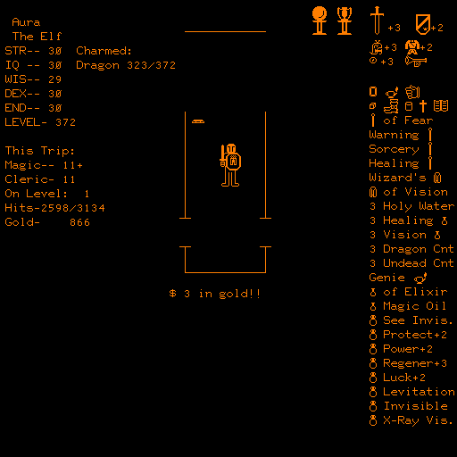
RPG
Začalo v 70‘ letech inspirováno D&D, původně textovky
Žánr populární na západě i na východě (Japonsko)
Typicky silně příběhově založené, pro náročnější hráče
Akalabeth: World of Doom (vznik Ultimy, 1980)
https://youtu.be/nKAlDUu7zko
RPGx dungeon crawlery

Slide 29
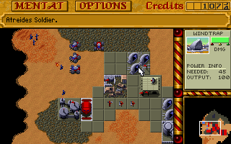
Strategie (RTS, turn-based)
RTS: Hezog Zwei (1989) – napůl arkáda, napůl strategie
https://youtu.be/BYfYrhT82RM
Duna II (1992) jako známější zakladatel žánru (
Turn-based – kolový systém („deskovky“), HoMaM (1995)
4X – eXplore, eXpand, eXploit, eXterminate (Master of Orion https://youtu.be/ku8COzjAoBA, Civilizace)

Slide 30
děkuji

