Slide 1

PTSD: Post Traumatic Stress Disorder
Merve Kaya

Slide 2
What is PTSD?
Experience or witnessing of a life-threatening events
Includes generalized feelings of fear and apprehension
In1980 entered in DSM
September 11 terrorist attack in New York
Nightmares and flashbacks, difficulty in sleeping, feeling detached or estranged

Slide 3

STRESS
A psychological condition that occurs in experiencing or perceiving challenges
Affect both body and mind
Important terms: stressors, stress, distress, coping strategies
DSM: On Axis1 and Axis 4

Slide 4
Which factors predispose a person to stress?
Coping skills
Presence of resources
Individual characteristic
Gene (5HTTLPR), more or less stress-sensitive
Stress tolerance
Self-perpetuating cycle

Slide 5
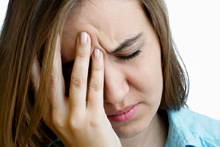
Characteristics of Stressors
1) Severity
2) Chronicity
3) Timing
4) How closely it affects our own lives
5) How expected it is
6) How controllable it is

Slide 6

Measuring Life Stress
Self report checklist
Life Event and Difficulty Schedule (LEDS)

Slide 7
Resilience
Most common reaction after a traumatic event
Factors increase resilience: Being male, being older, being well educated
Factors reduce resilience: Having more negative affect, being more inclined to ruminate, trying to find meaning in what has happened
Self confidence and being overly positive also help people to cope better

Slide 8
Stress and Stress Response
What happens to our body when we experience stress?
Sympathetic-adrenomedullary (SAM) system: Fight or flight response, mobilize resources
Hypothalamus- SNS- secretion of adrenaline- increase heart rate
Hypothalamic-pituitary-adrenal (HPA):
Cortisol, beneficial or harmful?

Slide 9
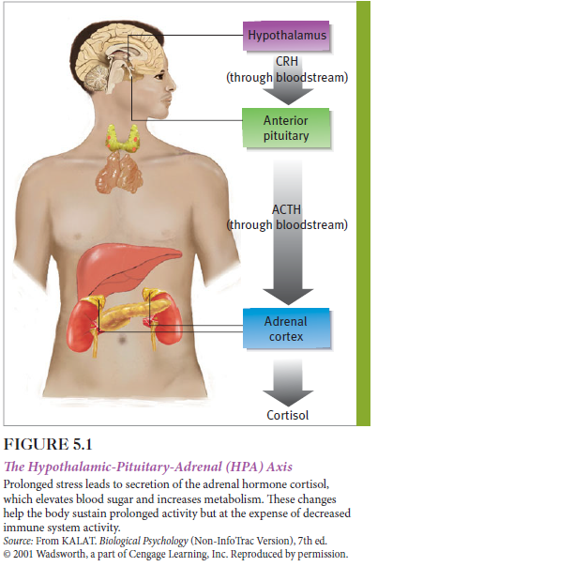

Slide 10
Biological Cost of Stress
Allostatic load: Adapting to stress
Relaxed: Low allostatic load
Feeling pressured: Higher allostatic load
Stress may provoke or maintain certain disorders (e.g. migraine headaches)
Correlational study: Students who experience higher negative events are more likely to develop cold

Slide 11
The Mind-Body Connection
Stress causes vulnerability in immune system functioning
Psychoneuroimmunology
Bidirectional relationship between brain and immune system
Immunosuppression
Cardiovascular Disease

Slide 12
History
The American Civil War (1861-1865) and the Franco-Prussian War (1870-1871) Civil War: Early attempt in diagnosis
Nostalgia, Soldier's Heart, and Railway Spine
Shell Shock
Battle Fatigue or Combat Stress Reaction (CSR)
Development of the PTSD diagnosis
DSM 5

Slide 13
Acute Stress Disorder
Symptoms should be last at least 2 days
It is used to diagnose when symptoms develop shortly after traumatic event
Diagnosis can be changed into PTSD after 4 weeks
Early intervention
Depression and generalized anxiety disorders can also develpp after a traumatic event

Slide 14
Prevalence
Lifetime prevalence of PTSD in USA is 6.8%
Higher in women: 9.7% women, 3.6% men
Why?
It is often co-morbid with other psychiatric disorders.
Most common diagnoses are major depressive disorder, panic disorder, other anxiety disorder and substance abuse or dependence.

Slide 15
Rates of PTSD after traumatic experience
Low rate of natural disaster, low rate of PTSD
Human intent trauma more likely to cause PTSD (e.g. terrorist attack vs. car accident)
Direct exposure
Manner of assessment (clinical interviews vs. questionnaire)

Slide 16
The trauma of military combat
Ordinary coping methods are not useful
Constant fear, unpredictability, uncontrollable circumstances, necessity of killing, separation from family etc.
“shell shock”, World War 1
Combat exhaustion, World War 2

Slide 17

Mental health consequences of deployment to Iraq and Afghanistan
2 million people had deployed
High prevalence in post deployment mental disorders
Importance of mental health screening for pre deployment
Theater-specific duties

Slide 18
Prisoners of war and holocaust survivors
Extensive symptoms; anxiety, insomnia, headaches, irritability, depression, nightmares, impaired sexual potency and diarrhea
Both biological and psychological stressors causes these symptoms
Survivor prisoners showed low frustration tolerance, impaired resistance to physical illness, alcohol and drug dependence, emotional instability

Slide 19
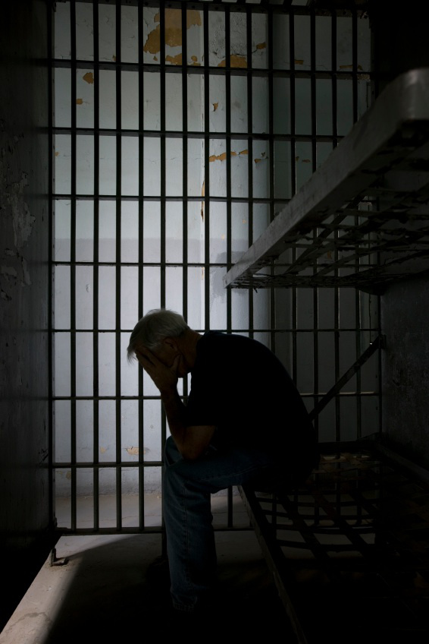
Psychological trauma among victims of torture
Torture survivors highly develop PTSD, anxiety or depression symptoms (e.g. Nepalese refugee camp)
Does preparedness for torture be protective against PTSD?

Slide 20
Symptoms
Re-experiencing symptoms: Upsetting memories, flashbacks, and nightmares, feelings of distress or intense physical reactions when something reminds them the event
Avoidance and numbing symptoms: Avoid activities, places or thoughts that reminds them of the trauma. Feeling detached from others and lose interest in activities and life in general.
Arousal symptoms: Trouble in sleeping, irritability, difficulty concentrating, feeling jumpy and easily startled, and hyper vigilance

Slide 21

Diagnosis
Symptoms must last at least 1 month
Cause significant distress or interfere with work or home life
Person must have 3 different types of symptoms to be diagnosed: re-experiencing symptoms, avoidance and numbing symptoms, and arousal symptoms

Slide 22
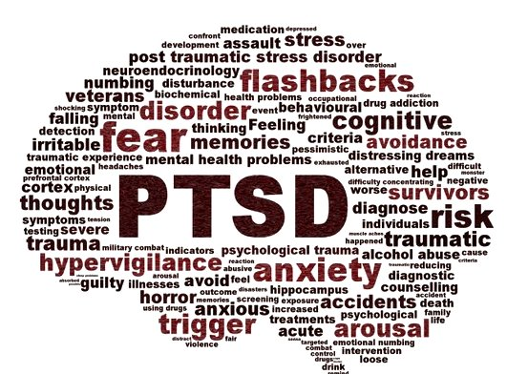
https://www.youtube.com/watch?v=XfkmyKrQk-w

Slide 23
Causal Factors in PTSD
Pre-traumatic risk factors
Previous psychiatric disorder
Gender
Personality
LSES
Lack of education
Race
Previous trauma
Family psychiatric history
Post-traumatic risk factors
Perceived lack of social support
Subsequent life stress

Slide 24
Individual Risk Factors
There are both risks for experiencing trauma and risks for PTSD
Certain occupations( soldier vs librarian)
Being female
Having less than a college education
Having a conduct problem in childhood
Having a family history of psychiatric disorder
High extraversion and neuroticism
Substance abuse

Slide 25
Protective factor against PTSD
Having good cognitive ability (e.g. 6 years old children with above 115 IQ)
Biological factors
Gender (e.g. women with PTSD have higher cortisol level than women without PTSD)
The type of trauma and cortisol level
Gene environment interactions (s/s form of serotonin transporter gene)
Having reduced size of hippocampus

Slide 26
Sociocultural Factors
Being a member of a minority group
Being more educated and having a higher annual income
Returning to a negative and insecure social environment
Justification for the combat and clarity of the war goals

Slide 27
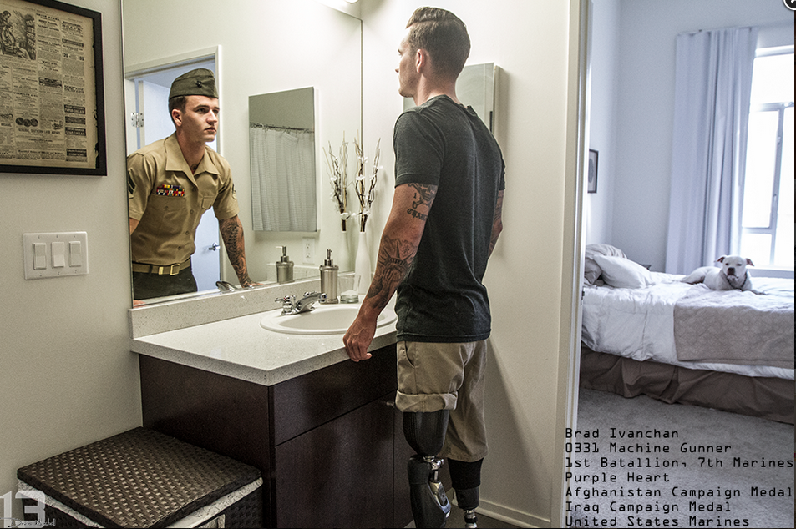
Long Term effects of posttraumatic stress
It can be severe and chronic condition in some cases
Difficulties in readjusting life
Diagnosis of delayed PTSD is more difficult

Slide 28
Prevention
Reduce the frequency of traumatic event
Changes in law and social policy
Preparing people in advance
Cognitive-behavioral techniques: Stress inoculation training
Does playing tetris after a traumatic event reduce flashbacks?

Slide 29

Treatment
Natural recovering is typical
Telephone Hotlines
Crisis interventions

Slide 30
Psychotherapy
Cognitive Processing Therapy (CPT):
Helps patient by changing their way of thinking
Four main parts: Learning About Your PTSD symptoms, becoming aware of thoughts and feelings, learning skills, understanding changes in beliefs
Learning new ways to deal with trauma

Slide 31
Stress Inoculation Training (SIT)
Educate person about skills to manage anxiety and stress
Muscle relaxation, cognitive restructuring, breathing exercises, assertiveness skills, thought stopping, role playing, and guided self-dialogue may be included

Slide 32
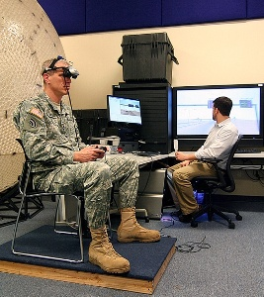
Exposure-based therapy:
Decrease distress
To change reaction for stressful memories
- Prolonged Exposure: Education, breathing, real world practice, talking through trauma
90 minutes therapy session
- Virtual Reality: Head mounted display with 3D images
Combined with relaxation skills

Slide 33
Eye movement desensitization and reprocessing (EMDR):
Integrative
Eight phases: History and treatment planning, preparation, assessment, desensitization, installation, body scan, closure, reevaluation
Individual therapy, group therapy, combination of therapies can be applied by a professional according to the patient needs

Slide 34
Psychological Debriefing
To help and speed up the healing process
Emotional support
Encourage victims to talk about their experiences
Structured discussion
Critical Incident Stress Debriefing (CISD): Group, 2-10 days after trauma, 3-4 hours long

Slide 35
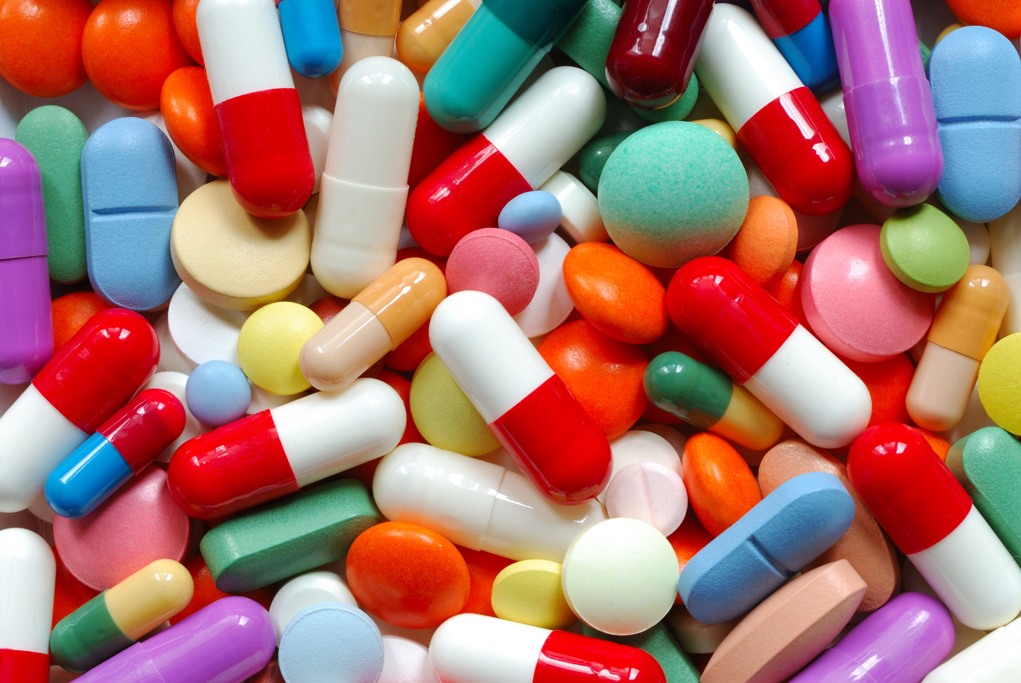
Medications
Antidepressant for depression, intrusion and avoidance symptoms
In some cases antipsychotic medications
Anti-anxiety medications
Prazosin

Slide 36

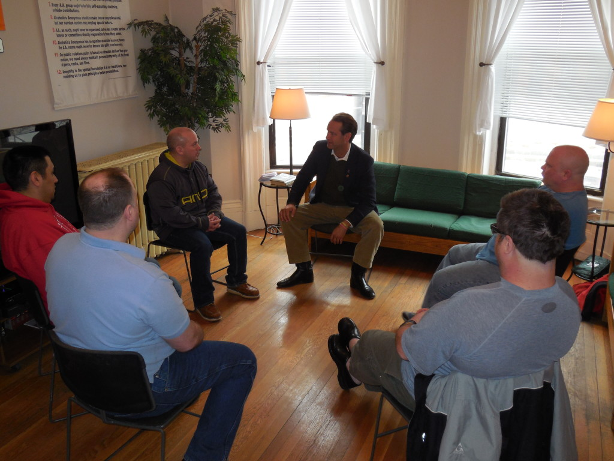
Family Therapy
Group Therapy

Slide 37
Sources
Butcher, J. N., Mineka, S., & Hooley, J. M. (2007). Abnormal psychology. Boston: Pearson/Allyn and Bacon.
Adshead, G. (2000). Psychological therapies for post-traumatic stress disorder. The British Journal of Psychiatry, 177(2), 144-148.
Post Traumatic Stress Disorder. (n.d.). Retrieved March 20, 2016, from http://www.ptsd.ne.gov/what-is-ptsd.html
Bisson, Jonathan I. "Post-traumatic Stress Disorder." Occupational Medicine 57.6 (2007): 399-403. Web.
Andreasen, N. C. (n.d.). Posttraumatic Stress Disorder: A History and a Critique. Retrieved March 20, 2016, from http://www.brainline.org/content/2011/01/posttraumatic-stress-disorder-a-history-and-a-critique_pageall.html
Iribarren, J., Prolo, P., Neagos, N., & Chiappelli, F. (2005). Post-Traumatic Stress Disorder: Evidence-Based Research for the Third Millennium. Evidence-Based Complementary and Alternative Medicine, 2(4), 503–512. http://doi.org/10.1093/ecam/neh127
Andreasen, N. C. (n.d.). Posttraumatic Stress Disorder: A History and a Critique. Retrieved March 20, 2016, from http://www.brainline.org/content/2011/01/posttraumatic-stress-disorder-a-history-and-a-critique_pageall.html
Menon, S. B., & Jayan, C. (2010). Eye Movement Desensitization and Reprocessing: A Conceptual Framework. Indian Journal of Psychological Medicine, 32(2), 136–140. http://doi.org/10.4103/0253-7176.78512

Slide 38
Hamblen, PhD, Schnurr, PhD, Rosenberg, MA, & Eftekhari, PhD. (n.d.). PTSD: National Center for PTSD. Retrieved April 05, 2016, from http://www.ptsd.va.gov/professional/treatment/overview/overview-treatment-research.asp
PTSD: National Center for PTSD. (n.d.). Retrieved April 05, 2016, from http://www.ptsd.va.gov/public/treatment/therapy-med/treatment-ptsd.asp
Virtual reality treatment for Post Traumatic Stress Disorder. (n.d.). Retrieved April 05, 2016, from http://www.vrs.org.uk/virtual-reality-healthcare/ptsd.html
Post-traumatic stress disorder (PTSD). (n.d.). Retrieved April 05, 2016, from http://www.mayoclinic.org/diseases-conditions/post-traumatic-stress-disorder/basics/treatment/con-20022540
Post-traumatic Stress Disorder. (n.d.). Retrieved April 05, 2016, from https://www.med.upenn.edu/ctsa/ptsd_treatment.html

Slide 39


