Slide 1

Cognitive Behavioral Therapy
Margaret Kuchler
Clinical Psychology
Spring 2016

Slide 2


“CBT is a process of teaching, coaching, and reinforcing positive behaviors. CBT helps people identify cognitive patterns or thoughts and emotions that are linked with behaviors” (Somers, 2007)
http://www.beatthewinterblues.info/wp-content/uploads/2013/07/positive-thinking.jpg
https://www.summitiop.com/wp-content/uploads/2014/04/Why-Cognitive-Behavioral-Therapy-Is-A-Useful-Tool-In-Outpatient-Rehab.jpg

Slide 3
What is Cognitive Behavioral Therapy?
Highly effective form of psychotherapy
How a person thinks, feels, and acts is all interconnected
Used to treat many disorders such as depression, anxiety, eating disorders, obsessive compulsive disorder and others
CBT is an umbrella term: many different types for various disorders

Slide 4
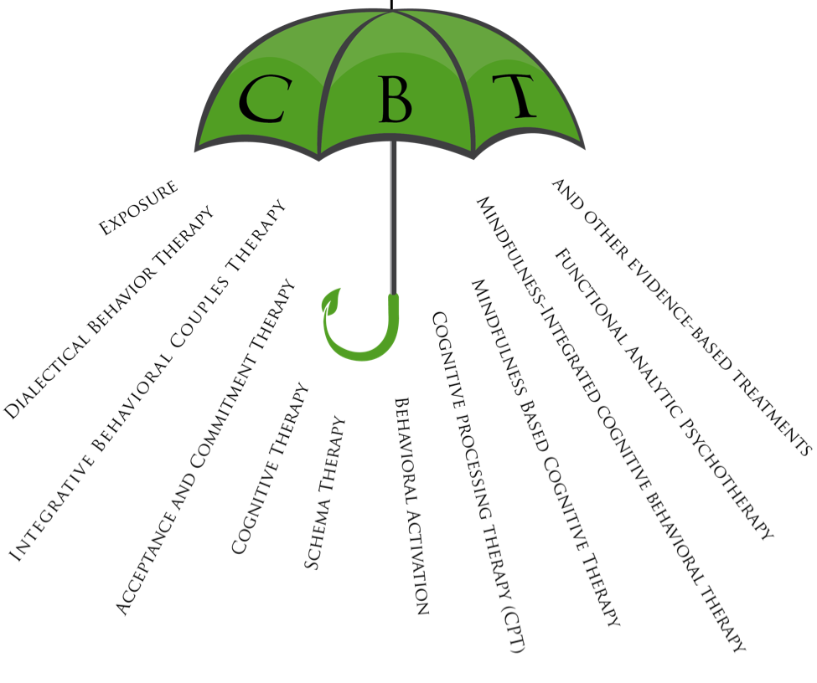
http://bayareacbtcenter.com/wp-content/uploads/2014/07/Untitled.png

Slide 5
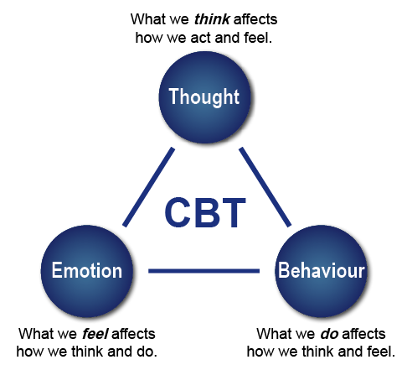
http://pacificcognitivebehavioraltherapy.com/wp-content/uploads/2015/10/CBT-image.png

Slide 6
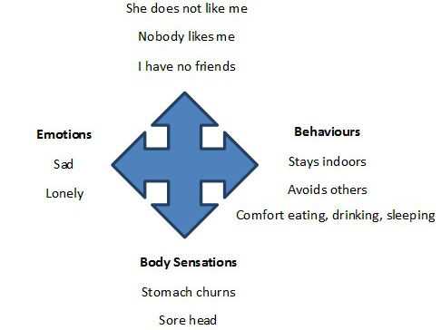
http://thepredominantlyinattentivelife.com/2013/10/14/cognitive-behavioral-therapy-overview/

Slide 7
History of CBT
First developed in 1960s by Aaron Beck, a psychotherapist
Early 1960- Beck developed an approach known as cognitive therapy from his research on depression
Beck’s observation of depressed patients revealed that they had a negative bias in their interpretation of particular life events, contributing to their cognitive distortions
Originally referred to as cognitive therapy because of the emphasis placed on thinking.
  Now known as cognitive-behavioral therapy because the therapy employs behavioral techniques also

Slide 8

Basic Principles of CBT
Present-oriented
  Here and now approach
Teamwork
  Collaborative effort between the therapist and patient
    Therapist role- listen, motivate, teach patient, help patient set goals
    Patient role- voice concerns, implement learning, define managable goals
http://s1290.photobucket.com/user/forharriet/media/For%20Harriet/therapy_zps2bea600c.jpg.html

Slide 9
Basic Principles of CBT
Socratic Questioning
  Asking questions that guide patient and change maladaptive cognitive processes
  Open ended questions
Change Record
  Patient takes notes of automatic thoughts that occur and identify emotions associated with these thoughts
  Identify errors & make changes

Slide 10
Basic Principles of CBT
Structured/ time efficient
  Short-term sessions 1x per week
  Between 16-20 session total
  Patient is aware from the beginning that it will come to an end
“Homework”
  Activities that are completed outside of sessions with therapist

Slide 11
Rationale of CBT
Negative emotions are the result of cognitive processes developed through learning and temperament
Importance of examining ones cognitive beliefs and developing rational responses to those automatic negative thoughts
Cognitive triad: Negative automatic thoughts center around our understanding of:
  The world
  Ones own self
  Ones future

Slide 12
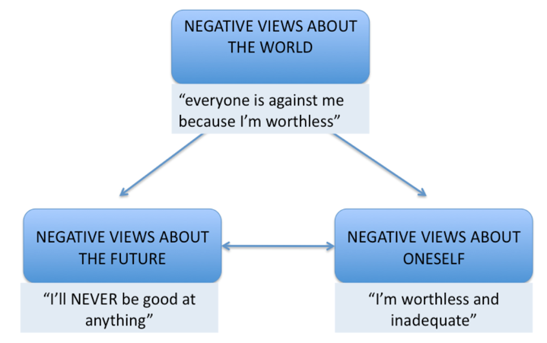
Cognitive Triad
http://s3-eu-west-1.amazonaws.com/tutor2u-media/subjects/psychology/studynote-images/depression-beck-negative-triad.png?mtime=20151116202647

Slide 13
Cognitive Specificity Hypothesis
Distorted appraisals follow themes relevant to the specific psychiatric condition
Psychological disorders are each characterized in their own way
  Depression: Negative view of self, world, and future. Core beliefs usually associated with helplessness, failure, incompetence, and lack of strong relationships and feelings of acceptance

Slide 14
Cognitive Specificity- Depression
Negative Triad
  Self: “I am unable to be loved by anyone”
  Others: “People do not care about me or my wellbeing”
  Future: “There is nothing positive to look forward to in my life”

Slide 15
3 levels of cognition
Consciousness
  Decisions made with full awareness
Automatic thoughts
  Private cognitions
Schemas
  Core beliefs

Slide 16

Depression
Mental Illness that affects ones overall health: especially their thoughts, behaviors, and feelings
Can have physical affects as well
One feels extreme sadness or despair for long periods of time
https://i.ytimg.com/vi/J3L6Nwr8fp8/hqdefault.jpg

Slide 17
Depressive Thinking
Beck’s cognitive triad
Distorted negative thinking about:
  Self
    Low self esteem
  World
    Nothing is meaningful
  Future
    Hopelessness
    Helplessness

Slide 18
CPT Approaches to Treating Depression
Cognitive restructuring
  “Inside out” approach
  Change content of thoughts
2. Behavioral Activation
  “Outside in” approach
  Activity scheduling
  Problem solving
  Change the function/context of thinking
  Make behavior less dependent on thinking or mood

Slide 19
Cognitive Restructuring Example
  “Tonya has come for an initial appointment to the SBHC. During the risk assessment, Tonya reports a number of depressive symptoms, but no suicidal ideation. Tonya seems to display a lot of negative thinking and cognitive distortions. For example, she believes that “nobody” likes her and that s/he will “never” be successful in school. Her math teacher often compliments her work, but Tonya dismisses the teacher’s comments as him “just trying to be nice.” Tonya has good grades in all classes except for one, yet she only acknowledges her below average Chemistry grade.”, (National Assembly on School-Based Healthcare, 2005)

Slide 20
Cognitive Restructuring Example
“Practice the process of Cognitive Restructuring with Tonya.
  Describe the relationship between ways of thinking and depressive symptoms
  Help Tonya to identify her cognitive distortions
  Identify ways of countering cognitive distortions
  Have Tonya practice countering these distortions”, (National Assembly on School-Based Healthcare, 2005)

Slide 21
Behavioral Restructuring Example
  “Tonya has come for an initial appointment to the SBHC. During the risk assessment, Tonya reports a number of depressive symptoms, but no suicidal ideation. Tonya reports not engaging in any activities that she used to. For example, she used to spend time with friends after school, and used to enjoy reading. She hasn’t done either recently, and just seems bored most of the time. She also reports having difficulty concentrating in class because she is constantly thinking about her problems.”, (National Assembly on School-Based Healthcare, 2005)

Slide 22
Behavioral Restructuring Example
“Practice the processes of Activity Scheduling and Thought Stopping with Tonya.
  Discuss with Tonya activities she used to enjoy.
  Identify specific enjoyable activities for Tonya to do this week.
  Identify times and places for each activity, and discuss potential obstacles.
  Explain the process of Thought Stopping to Tonya, and discuss how Tonya could use this strategy when she has intrusive thoughts.”, (National Assembly on School-Based Healthcare, 2005)

Slide 23
Orienting Patient to CBT
What are the therapy strategies?
The evidence for the treatment?
The evidence for the processes of change?
What are the causes of their problem and how are they linked to the change strategies?
Identify causes of their problems to reduce self shame or blame

Slide 24
Important Components of CBT
Good therapist/patient relationship
Educate patient through modeling
Diagnose mental illness and set clear goals
Use proven evidence to support treatment decisions
Structured treatment sessions
Clear, limited treatment length
Homework to promote generalization

Slide 25
General CBT Session
Agenda setting process
  Selecting items that can lead to productivity in a single session
  Homework assignments
Psycho-education
  Use patients own experiences to demonstrate CBT principles and procedures
  Identify automatic thoughts
  Materials used to explain the relationship b/w cognitions and emotions
  Readings and other educational aids

Slide 26
Structure of typical therapy session
Mood check
Setting agenda
Bridge from last session
Discuss today’s agenda items
Homework assignment
Summarization of session
Feedback from patient

Slide 27
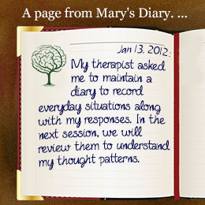

Why is homework so important?
http://www.buzzle.com/img/articleImages/324464-48324-29.jpg
http://nightingalecenter.com/wp-content/uploads/homework.jpg

Slide 28
Test of patient motivation
Provides opportunity to practice
Data collection
Relationship with significant others
Prevents possible relapse
Provides continuity between sessions

Slide 29
Increasing homework compliance
Assign homework collaboratively
Provide patient with rationale for the given homework
Detailed instructions
  Time, place, duration, frequency
  Verify that the patient will be capable of completing assignment
Discuss with patient how likely they are to complete it

Slide 30



Other Components to CBT Treatment
Physical exercise
Meditation or relaxation techniques
Adequate and routine sleep schedule
http://www.noonlife.com/wp-content/uploads/2014/07/background.jpg
http://juicemigourmet.com/wp-content/uploads/meditation.jpg

Slide 31
Video Example
Example of CBT session
Mother of a young child diagnosed with depression
https://www.youtube.com/watch?v=fCZpUIEUsys&feature=youtube_gdata_player

Slide 32
Sources
1. (2011, February 23). Managing depression with 10 Minute CBT. Retrieved from https://www.youtube.com/watch?v=fCZpUIEUsys&feature=youtube_gdata_player
Barlow, D. H., & Nathar, P. E. (2010). The Oxford handbook of clinical psychology. New York, NY: Oxford Press.
Beck, J. S. (2011). Cognitive therapy: Basics and beyond (2nd ed.). New York: Guilford Press.
Beck, P. J. (2012, January 16). Structure of a CBT Session. Retrieved from http://www.huffingtonpost.com/judith-s-beck-phd/cognitive-therapy_b_1224375.html
Dryden, W., & Neenan, M. (2010). Chapter 1 An overview of cognitive therapy. In Cognitive Therapy in a Nutshell. Sage Publications.
History of Cognitive Behavior Therapy - CBT | Beck Institute. (n.d.). Retrieved from https://www.beckinstitute.org/about-beck/our-history/history-of-cognitive-therapy/
Hofmann, S. G. (2012). An introduction to modern CBT: Psychological solutions to mental health problems. Chichester, West Sussex, U.K.: Wiley-Blackwell.

Slide 33
References
Mental health education and training initiative 2005 learning session II [PPT]. (n.d.). Washington, DC: National Assembly on School- Based Health Care.
Ronen, T., & Freeman, A. (2007). Cognitive behavior therapy in clinical social work practice. New York: Springer Pub.
Somers, J. (2007). Cognitive behavioural therapy: Core information document. Victoria: British Columbia, Ministry of Health.
Wright, J. (2006). Cognitive Behavior Therapy: Basic Principles and Recent Advances. FOCUS, IV(2), 173-178. Retrieved from http://jpo.wrlc.org/bitstream/handle/11204/3878/Cognitive Behavior Therapy_Basic Principles and Recent Advances.pdf?sequence=3

