Slide 1
Key studies in psychology
Social psychology
Jiří Čeněk, 2015

Slide 2
What is Social Psychology?
Influence of social processes on the way people:
Think
(thoughts; cognition)
Feel
(feelings; emotions)
Behave
(behaviour; actions)
Notes:
Westen, D., Burton, L., & Kowalski, R. (2006). Psychology. Australian and New Zealand Edition. Queensland: Wiley.
Also note:
Allport's Classic Definition
The scientific study of how the thoughts, feelings, and behaviors of people are influenced by the real, imagined, or implied presence of others (Allport)

Slide 3

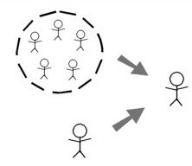

What is Social Psychology?
Social processes:
Relationships
Social influence
Intergroup relations

Slide 4
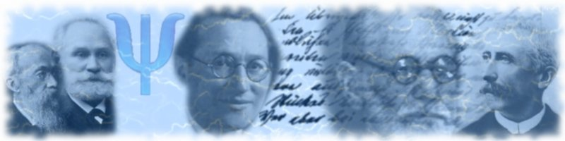
History & Research in Social Psychology
Notes:
Image: http://commons.wikimedia.org/wiki/Image:Bandeau_portail_psychologie.jpg

Slide 5
Early approaches to social psychology
European approaches
Volkerpsychology
Psychology of the crowd
American approaches
Tradition of behaviorism

Slide 6
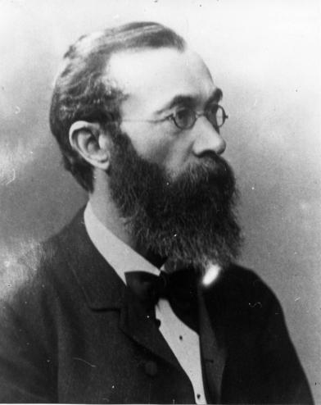
History
Psychology of nations (Volkerpsychologie)
W. Wundt (1860,Germany)
  ‘… psychological exploration the basis of the soul of the nations and its influencing and uncovering the mental processes…’
  Assumption: Nation is the natural form of human society
M. Lazarus, H. Steinthal
  theory of languages and mythology.
Comparison of nations
Notes:
Psychology of nations (1860) (Völkerpsychologie)
Half of the 19th century, Germany
studies development of fenomena such as language: speech and writing, mythology, art etc.
M. Lazarus, H. Steinthal – they studied the problem of the theory of languages (jazykoveda) and mythology
In the book Introductory thoughts to the psychology of nations, they formulated the role of the psychology of nations as
‘… psychological exploration the basis of the soul of the nations and its influencing and uncovering the mental processes…’
However they all summarize that the spiritual life of a person is not based upon individual consciousness, but on the consciousness of the nation

Slide 7
History
Psychology of nations
Volksgeist
(unifiyng mental principle of nation)
Language
Myths
Habits
Individual
(mental life)
Notes:
Psychology of nations (1860) (Völkerpsychologie)
Half of the 19th century, Germany
studies development of fenomena such as language: speech and writing, mythology, art etc.
M. Lazarus, H. Steinthal – they studied the problem of the theory of languages (jazykoveda) and mythology
In the book Introductory thoughts to the psychology of nations, they formulated the role of the psychology of nations as
‘… psychological exploration the basis of the soul of the nations and its influencing and uncovering the mental processes…’
However they all summarize that the spiritual life of a person is not based upon individual consciousness, but on the consciousness of the nation

Slide 8
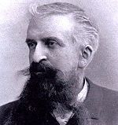
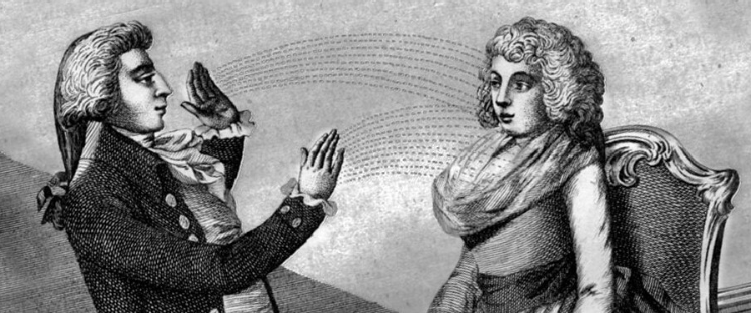
History
Psychology of the crowd
Le Bon (1895, France)
Grounds of the theory:
Concept of the suggestion: 1 person can directly influence thoughts of other person
Notes:
Psychology of the crowd (mass/mob psychology)
Second half of the 19th cent., France
Le Bon defined typical characteristics of behavior of a person in crowd
depersonalization, domination of the feelings over the reason, loss of reasoning, loss of responsibility
The characteristics of a person in crowd - anonymity, affect, lessened intelligence, lessened responsibility
The crowd is mainly characterized by the lack of structure, it is unorganized, chaotic, it needs a leader

Slide 9
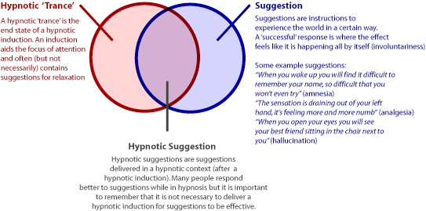
Hypnotic suggestion

Slide 10
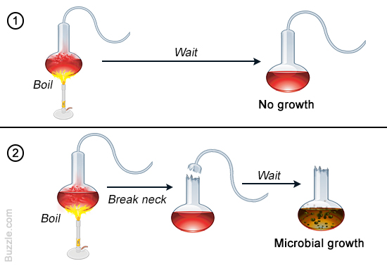
Psychology of the crowd :
Grounds of the theory
Epidemiology (L. Pasteur, R. Koch):
Germ theory of disease
Spreading of negative affects in crowd = mental disease

Slide 11

Psychology of the crowd:
Grounds of the theory
Criminology (Tarde): lowered legal responsibility
Individual in the crowd
  Descends to more primitive level
  Lowered logical thinking

Slide 12
History
Psychology of the crowd
Le Bon (1895, France)
Defined typical characteristics of behavior of a person in crowd:
  Domination of the feelings over the reason, loss of reasoning, loss of responsibility
  Lessened intelligence, lessened responsibility
  The crowd is mainly characterized by the lack of structure, it is unorganized, chaotic, it needs a leader
Notes:
Psychology of the crowd (mass/mob psychology)
Second half of the 19th cent., France
Le Bon defined typical characteristics of behavior of a person in crowd
depersonalization, domination of the feelings over the reason, loss of reasoning, loss of responsibility
The characteristics of a person in crowd - anonymity, affect, lessened intelligence, lessened responsibility
The crowd is mainly characterized by the lack of structure, it is unorganized, chaotic, it needs a leader

Slide 13
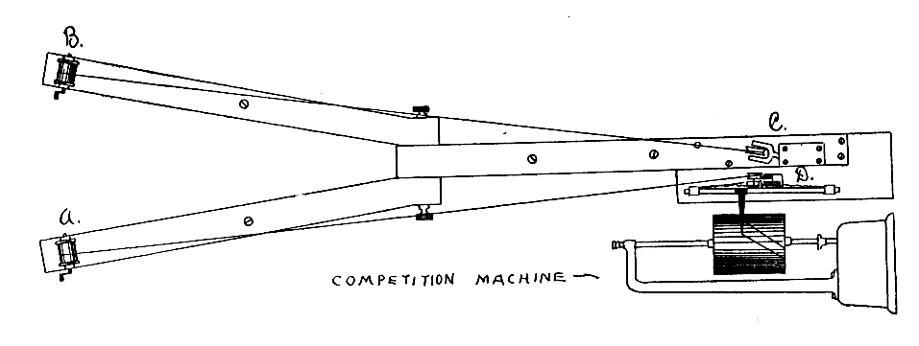
History
First social psychological experiment
- Triplett (1898) – inspired by cyclists
- Social facilitation
Notes:
Triplett – observed that cyclists go faster when racing against others or in front of a crowd. laboratory experiment and concluded that children perform a simple lab task faster in pairs than when performing by themselves. He arranged for 40 children to play a game that involved turning a small fishing reel as quickly as possible. He found that those who played the game in pairs turned the reel faster than those who were alone.Triplett's design involved the creation of two groups (A and B) with the sequence of trials differing for each. Group A: (1) alone, (2) competition, (3) alone, (4) competition, (5) alone, (6) competition. Group B: (1) alone, (2) alone, (3) competition, (4) alone, (5) competition, (6) alone. The rationale for this design was to eliminate practice and fatigue effects. He concluded that moving from isolation to a group context can reduce our sense of uniqueness, but at the same time it can enhance our ability to perform simple tasks rapidly.
Triplett discussed several possible explanations for his findings and concluded that the "bodily presence of another contestant participating simultaneously in the race serves to liberate latent energy not ordinarily available" (Triplett, 1898). Social facilitation has received much attention from social psychologists since Triplett's time, with a number of causal factors implicated, including mere presence, evaluation apprehension, competition, attention, and distraction. Ironically, although the phenomenon of social facilitation is now well established, Triplett's original experiment did not produce strong results, at least by modern standards in psychology (Strube, 2005). Triplett did not have the advantage of sophisticated statistical procedures available today and for his study he simply eyeballed the data. He decided that some children performed better when competing, some performed worse, and others were not affected. The fact that half of his participants showed no evidence of social facilitation would suggest that one should avoid overstating these findings. In Michael Strube's 2005 article he conducted an analysis of the data from the famed 1898 study. First he conducted a between-group analysis and found no evidence of significance. The results show that in 4 of 5 of the between group comparisons, the performance of participants in the presence of a co-acting peer was faster than the performances of the participants winding the fishing reel alone. The differences however are quite small and none of them are close to statistically significant. He also conducted two within subjects comparisons. A trial main effect was found that showed better performance on later trials, however the Trial X Order interaction was not significant. The analyses of Triplett's data hardly indicate an effect of social facilitation.

Slide 14

Historical events
Post WW2 - motivated to explain atrocities committed, learning the „psychology of the enemy“, etc.
Conformity (Asch),
Obedience (Milgram),
Roles (Zimbardo).
Notes:
Much of social psychology was developed to explain war, especially the attempted genocide of WW2 – social psychology is a product of social context e.g., studies by Milgram (obedience) and Zimbardo (roles).

Slide 15
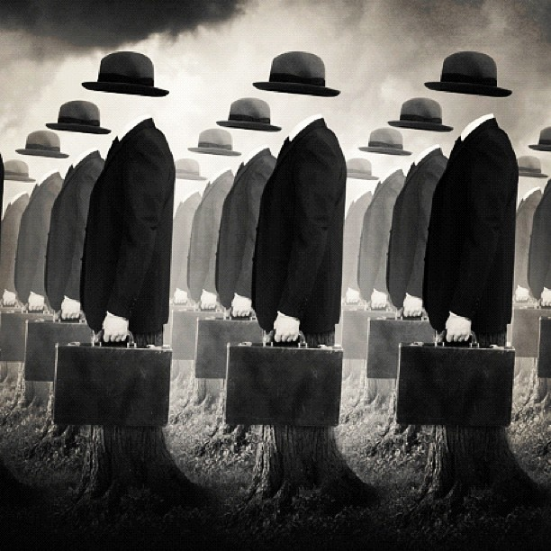
Studies on conformity and obedience

Slide 16
Conformity
Definition: A change in behavior or a belief as a result of real or imagined pressure.
“Conformity is not just acting as other people act, it is being affected by how they act. It is acting differently from the way you would act alone” – David Myers (1999)

Slide 17
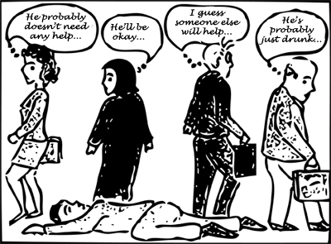
Conformity
Conformity in everyday life:
The bystander effect:
  Conformity
  Defusion of responsibility

Slide 18
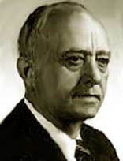
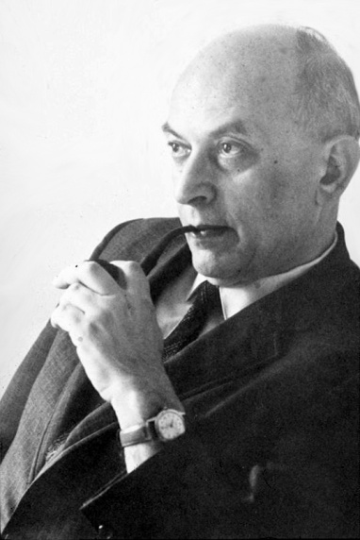
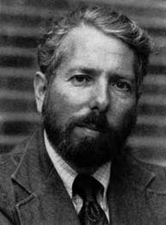
Classic studies
Sherif – Norm formation
Asch – Group pressure
Milgram - Obedience

Slide 19
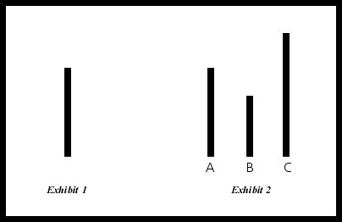
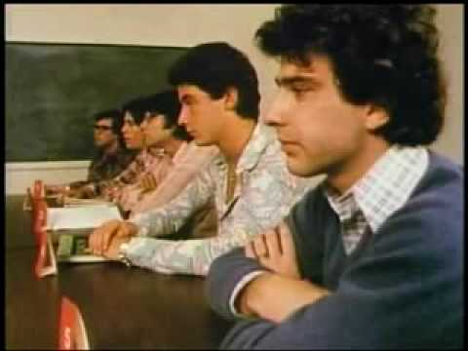
Group pressure (Asch)
Salomon Asch:
  Experiments on group pressure:
    Situations: rewards to conform + no punishment for deviance.
  Perceptual judgements
    http://www.youtube.com/watch?v=QzS5LS6m3KE
  Elevator experiment
    http://www.youtube.com/watch?v=B738X-ibz2o

Slide 20
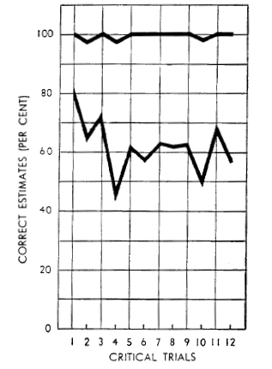
Group pressure
Findings of the main study:
On the critical trials, the average rate of conformity was 32%.
74% agreed at least once.
5% agreed on nearly every trial
26% never gave a wrong answer
Behaviour was constant

Slide 21
Group pressure
Those who did not conform:
Asch states “Those who strike out on the path to independence, do not, as a rule, succumb to the majority”.
confidence in their own judgment
capacity to recover from doubt
felt it was “their obligation to call the play as they saw it”

Slide 22
When do people conform?
  Group size
  Unanimity (unity)
    „Easier to be non-conform with an ally.“
  Status
    Higher status = more impact
    Lower status = more obedience
  No prior commitment
    „ Once you take a position its hard to convince you otherwise.“
  Public/unfamiliar situations
    Conformity decreases in private
  Cohesion
    In and outgroup, more cohesive = more conform with ingroup members.
Notes:
Feelings of warmth towards an ally + deny that they were influenced by him. Examples: Mormons, 12 angry men.
Status – Thats why it is good when as many people as possible

Slide 23
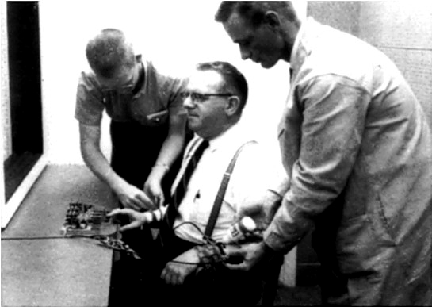
Obedience – Following orders
Definition: Form of conformity when a person simply follows orders given by others (authority).
  http://www.youtube.com/watch?v=fCVlI-_4GZQ
Obedience to authority is not only typical to „weak“ but also to „normal people“.

Slide 24
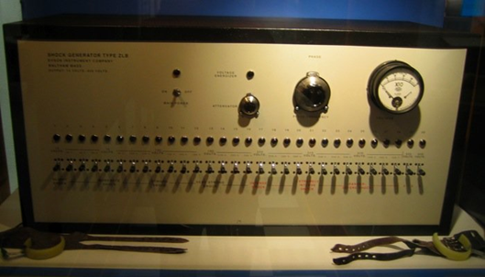
Obedience
The participants in the were 40 men recruited using newspaper ads. Each was paid $4.50.
Milgram developed an intimidating shock generator, with shock levels starting at 30 volts and increasing all the way up to 450 volts. The many switches were labeled with terms including "slight shock," "moderate shock" and "danger: severe shock." The final two switches were labeled simply with an ominous "XXX."

Slide 25
Obedience
Most participants asked the experimenter whether they should continue. The experimenter issued a series of commands to prod the participant along:
"Please continue."
"The experiment requires that you continue."
"It is absolutely essential that you continue."
"You have no other choice, you must go on.“
What if anything happens?
„I am responsible.“

Slide 26
Obedience
Pre-tabed audio:
75-135 volts: “Ugh!!!”
150 volts: “Ugh!!! Experimenter! That's all. Get me out of here. I told you I had heart trouble. My heart's starting to bother me now. Get me out of here, please. My heart's starting to bother me. I refuse to go on. Let me out.”
165-255 volts: (Shouting) “Ugh!!! Let me out!”
270-285 volts (Screaming) “Let me out of here. Let me out of here. Let me out of here. Let me out. Do you hear? Let me out of here.”
300-315 volts: (Screaming) “I absolutely refuse to answer any more. Get me out of here. You can't hold me here. Get me out. Get me out of here.”
330 volts: (Intense and prolonged screaming) “Let me out of here. Let me out of here. My heart's bothering me. Let me out, I tell you. (Hysterically) Let me out of here. Let me out of here. You have no right to hold me here. Let me out! Let me out! Let me out! Let me out of here! Let me out. Let me out.”
345-450 volts: (Silence)
The experiment was terminated by the experimenter after 3 shocks at 450 volts

Slide 27
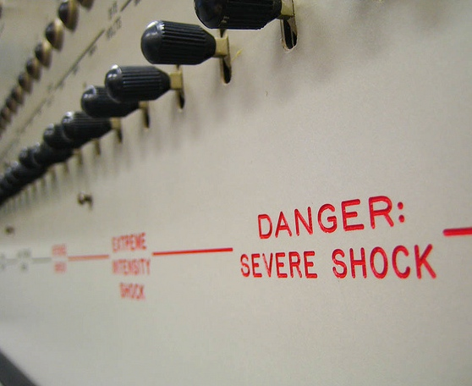
Obedience
How many percent of subjects did continue up to 450 volts?

Slide 28
Obedience
Results:
Signs of high stress observed
3 subjects got uncontrollable seisures
All 40 subjects obeyed until 300 V
25 Obeyed until 450 V

Slide 29
Obedience
Milgram varied the social conditions (variables).
  Obedience 0 % - 93 %
4 factors determining obedience
  Emotional distance of the victim
  Closeness and legitimacy of the authority
    „rectal ear ache“
  Institutional authority
  Group influence
Example: Jaywalking
Notes:
Legitimacy – researcher called of and replaced with a clerk – obedience dropped
In their book , Temple University professors of pharmacy Michael Cohen and Neil Davis attribute much of medication errors to the mindless deference given to the attending physician. Cohen, in Medication Errors: Causes and Prevention (1981), quotes a strange case of the ‘rectal earache’. A physician ordered ear drops to be administered to the right ear of a patient suffering pain and infection there. Instead of writing out completely the location ‘Right ear’ on the prescription, the doctor abbreviated it so that the instructions read ‘place in R ear’. Upon receiving the prescription, the duty nurse promptly put the required number of ear drops into the patient’s anus.

Slide 30
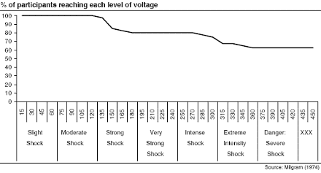
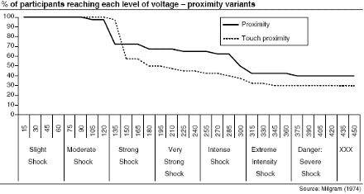
Obedience

Slide 31
Obedience
"Ordinary people, simply doing their jobs, and without any particular hostility on their part, can become agents in a terrible destructive process. Moreover, even when the destructive effects of their work become patently clear, and they are asked to carry out actions incompatible with fundamental standards of morality, relatively few people have the resources needed to resist authority" (Milgram, 1974).

Slide 32

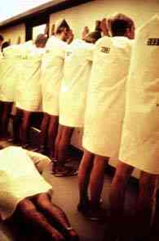
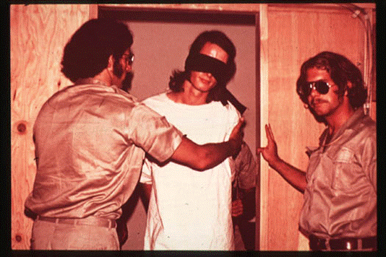
Stanford prison experiment:
Obedience to the role

Slide 33
Stanford prison experiment
Original purpose: Psychology of prison life
What happens when you put good people in an evil place?
Intended duration: 14 days
Terminated after 6 days
  Sadism of guards
  Depression and severe stress of prisoners

Slide 34
Stanford prison experiment
Advertisement in local newspaper: 15 bucks/day
75 replied, 24 most stable chosen
Randomly divided into 2 groups: prisoners and guards
„Prisoners“ arrested for armed robbery and burglary by real cops
  Searched, hadcuffed
  Brought to police station
  Full identification
  Finger-prints
Blindfolded
Brought to „the prison“ – basement of Stanford Psychology department building

Slide 35

Stanford prison experiment
The prison:
https://www.youtube.com/watch?v=TShFPParenk

Slide 36
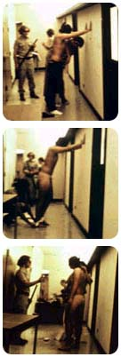
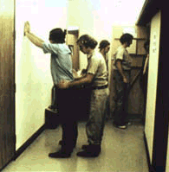
Stanford prison experiment
Arrival of prisoners:
Stripped naked
Searched
Deloused with a spray

Slide 37
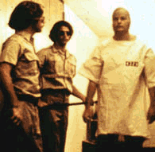
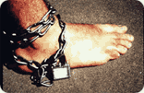
Stanford prison experiment
Dehumanization of prisoners
Dress with ID
No underpants
Stockings over heads
Chain on right ankle
Goal: Arise feelings of anonimity, opression, losing ones individuality

Slide 38
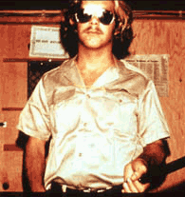
Stanford prison experiment
Guards
Need to maintain law
Command the respect of prisoners
No violence
Appearance:
  Uniforms
  Whistle
  Billy club
  Sunglasses

Slide 39
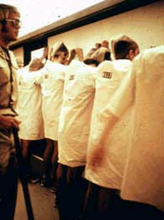
Stanford prison experiment
Asserting control:
„Counts“
Direct confrontations
Punishment:
Breaking rules
Improper attitudes toward guards
Push-ups
https://www.youtube.com/watch?v=x3wxEmHqVCY

Slide 40

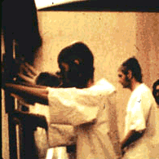
Stanford prison experiment
Rebellion on day II
https://www.youtube.com/watch?v=uTdttd7XTfQ
Harrassment begins:
Guards broken into cells
Stripped prisoners naked
Solitary confinement for leaders
Intimidation
Priviledged prisoners (special treatment)
Breaking alliances, causing distrust

Slide 41

Stanford prison experiment
36 hours from the start:
Prisoner #8612: acute emotional disturbance, disorganized thinking, uncontrollable crying, and rage.

Slide 42
Stanford prison experiment
Conclusions:
3 types of guards:
  Tough and fair following prison rules
  Good guys: favors, no punishment
  Hostile, enjoying power
  No personality assessment discovered it
Prisoners coping styles:
  Rebelling
  Breaking down emotionally
  Good prisoners
Disintegration of prisoners at both group and individual level
Rebels seen as trouble makers

Slide 43
Stanford prison experiment
Prisoner #416:
"I began to feel that I was losing my identity, that the person that I called Clay, the person who put me in this place, the person who volunteered to go into this prison -- because it was a prison to me; it still is a prison to me. I don't regard it as an experiment or a simulation because it was a prison run by psychologists instead of run by the state. I began to feel that that identity, the person that I was that had decided to go to prison was distant from me -- was remote until finally I wasn't that, I was 416. I was really my number.„
Prison guard: https://www.youtube.com/watch?v=fQnOkmvigi0#t=15

Slide 44
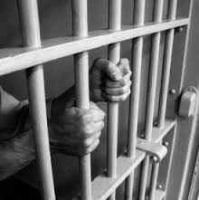
Stanford prison experiment
Discussion: prison system

Slide 45
Thank You!

