Slide 1
Human Nature: Key studies in psychology
Cognitive psychology
Jiří Čeněk

Slide 2
Content
What is CP?
History of CP
Key studies in CP:
  Pictorial perception and culture
  Attention, memory and their nature

Slide 3
Cognitive psychology
CP = study of mental processes such as:
attention,
language use,
memory,
perception,
problem solving,
creativity,
thinking…

Slide 4
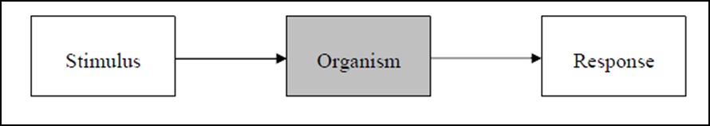
Cognitive psychology
How humans process information

Slide 5
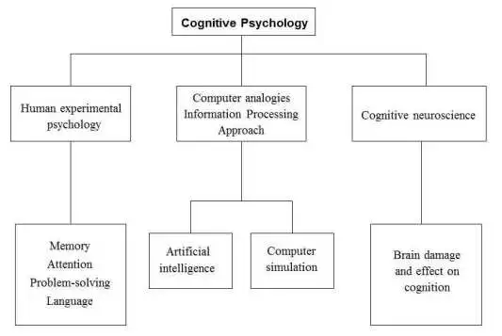
Cognitive psychology

Slide 6
Cognitive psychology
Basic assumptions
Cognitive psychology is a pure science, based mainly on laboratory experiments.
Behavior can be largely explained in terms of how the mind operates, i.e. the information processing approach.
The mind works in a way similar to a computer: inputting, storing and retrieving data.
Mediational processes occur between stimulus and response.

Slide 7
Cognitive psychology
Strenghts:
Scientific
Highly applicable (e.g. therapy, EWT)
Combines easily with other approaches: behaviorism + Cog = Social Learning; Biology + Cog = Evolutionary Psychology
Many empirical studies to support theories
Limitations:
Ignores biology (e.g. testosterone)
Experiments - low ecological validity
Humanism - rejects scientific method
Behaviorism - can’t objectively study unobservable behavior
Introspection is subjective
Machine reductionism

Slide 8
History of cognitive psychology

Slide 9
History
Until 1950s:
  Behaviorism as a dominant approach in US psychology
  Black box
1950s: Cognitive revolution:
  Better experimental methods
  Comparison between human and computer processing of information (terminology)
https://www.youtube.com/watch?t=58&v=AeoyzqmyWug
Notes:
But it was the arrival of the computer that gave cognitive psychology the terminology and metaphor it needed to investigate the human mind. The start of the use of computers allowed psychologists to try to understand the complexities of human cognition by comparing it with something simpler and better understood i.e. an artificial system such as a computer.

Slide 10
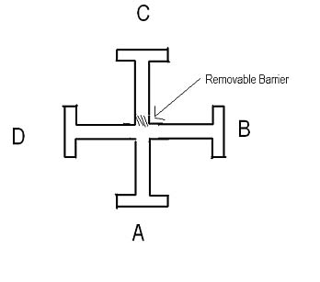
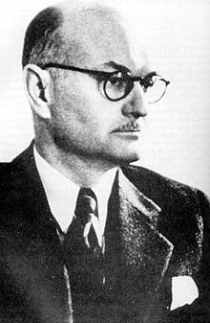
History
Norbert Wiener (1948)
Cybernetics: or Control and Communication in the Animal and the Machine,
Introducing terms such as input and output.
Edward Tolman (1948)
Cognitive maps
Rats in mazes: animals had internal representation of behavior.
VIDEO: Maze

Slide 11
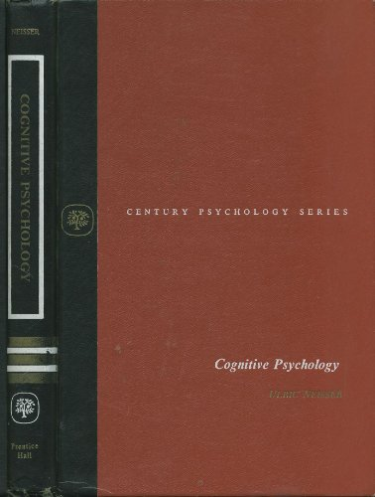
History
George A. Miller (1960)
Center for Cognitive Studies at Harvard
Ulric Neisser (1967)
"Cognitive Psychology„ = official beginning of the cognitive approach.
Cognitive approach highly influential in all areas of psychology (e.g. biological, social, behaviorism, development etc.).

Slide 12
Culture and perception of pictures

Slide 13
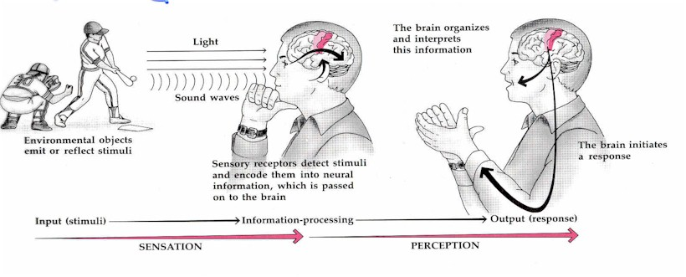
Sensation and Perception
Principles of interpretation:
  Principle of efficiency (the simpliest interpretation)
  Principle of commonness (interpretation which is in harmony with previous experience)

Slide 14
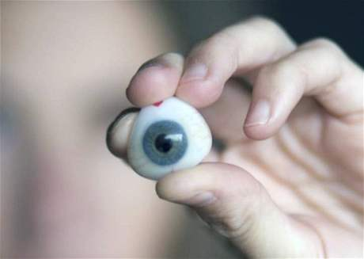
Why do we percieve differently?
2 groups of factors
Experience and environment
(Social factors)

Slide 15
Role of experience and environment

Slide 16
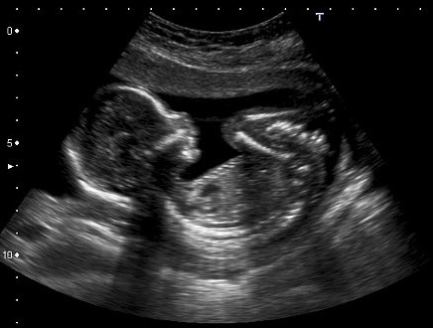
Role of the environment and experience with it as a determinant of perception

Slide 17
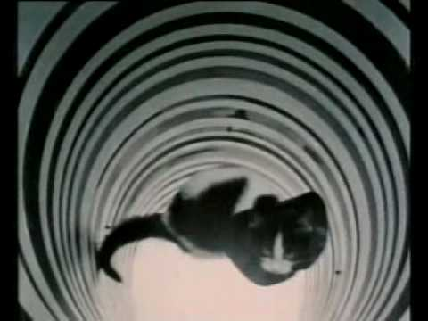
Role of the environment and experience with it as a determinant of perception
Perceptual sets: Blakemore, Cooper (1970)
https://www.youtube.com/watch?v=QzkMo45pcUo

Slide 18
How culture influences our perception? - Experience
Perceptual set
  = perceptual expectations
  Dependent on our previous experience with the enviroment.
  Some interpretations (memories of previous perceptions + feelings + meanings + behavior) of the reality are more likely to occur.
  Some perceptual sets common to people from 1 culture are not necessarily developed in people from other culture. → People from different culture percieve differently.

Slide 19
Role of the environment and experience with it as a determinant of perception
Different environment
=
Different experience
=
Different perceptual sets
=
Differences in perception

Slide 20

Research focus
Civilized vs. „primitive“ cultures

Slide 21
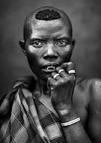
Perception of patterns and pictures
Deregowski et al. (1972). Perceptual recognition in a remote Ethiopian population.
  Me`en (Bodi) people in south Ethiopia.
  Limited access to formal education, little exposure to pictures.

Slide 22
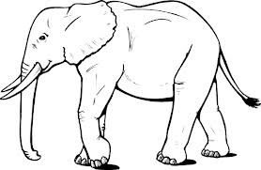
Perception of patterns and pictures
Deregowski – research design:
  Pictures of animals presented
  Bodi people were able to distinguish the animal, but after some time and effort.
  Involvement of other senses: touch, smell

Slide 23
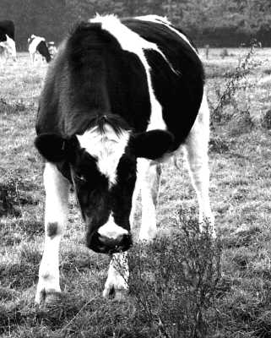
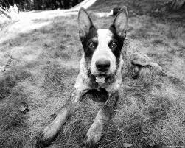
Perception of patterns and pictures
Deregowski (1980): Experiments on native Africans
Notes:
Africans were presented black and white photo of cow and dog (animals they are familiar with), they looked puzzled, didnt recognize the animals.
They recognized the animals in colored photos.
They have never seen black and white photo – no experience in recognizing animals in this format.

Slide 24
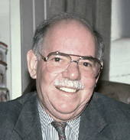
Perception and evironment
Segall et al (1990):
Carpentered world hypothesis
(Foreshortening hypothesis)
Sophistication hypothesis

Slide 25
Carpentered world hypothesis:
Seagall (1966): „Carpentered world hypothesis“
  Degree to which visual enviroment is carpentered.
Western industialized
  Carpentered enviroment
  Right angles
Differences in susceptibility to visual illusions, differences in percieving pictures.
Native societies
  No right angles
  No straight lines

Slide 26
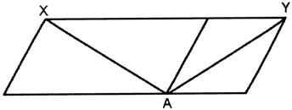
Carpentered world hypothesis:
The tendency of individuals living in higly recangular enviroments to interpret non-rectangular retinal pictures as rectangular objects
Optical illusions
Sander paralelogram

Slide 27
Sophistication hypothesis
Experience with pictures: determine the ability to interpret perceptual cues
Perceptual (depth) cues
  Convergence
  Binocular disparity
  Linear perspective
  Interposition
  Shape and size constancies, relative size
2D a 3D „percievers“

Slide 28
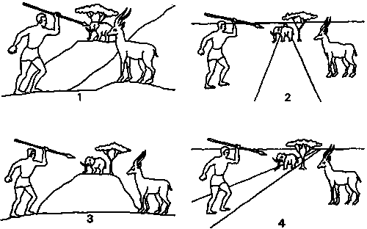
Sophistication hypothesis
Hudson (1960). Pictorial depth perception in sub-cultural groups in Africa.
  Study of depth cues (relative size, linear perspective, interposition)
  Illiterate people in South Africa
Notes:
Respondents presented set of pictures like this.
1st: Asked to identify elements of the picture.
2nd: Asked what the man was doing and whether the elephant or the antelope was closer to him.
Answer: Antelope closer, aiming at the antelope – 3D interpretation (school going respondents)
Other answers: 2D interpretation (other respondents)

Slide 29
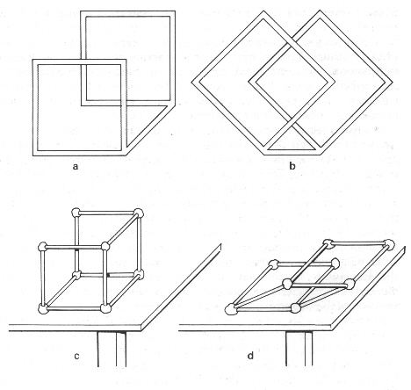
Sophistication hypothesis
Deregowski (1980). Illusions, patterns and pictures a Cross-cultural perspective.
Notes:
Research participants were shown a drawing of two squares, one behind the other and connected with a single rod. They were also given sticks and modelling clay and asked to build a model of what they saw.
Almost all the 3-D perceivers built a 3-D object. Participants who did not readily perceive depth in pictures tended to build a flat model.

Slide 30

Sophistication hypothesis
Notes:
Zambian children classified as 3D/2D perceivers:
- copying a drawing
- ambiguous trident + control figure (non-ambiguous)
- to wiev the figure, the student needed to lift a flap (time measured) + could not write while the flap was open
- 3D viewers spend more time opening the flap

Slide 31
Sophistication hypothesis
Conclusion:
  Picture perception involves a set of skills
  = deal with variety of cues + use these cues appropriately to a given situation
  = one has to learn to read the pictures as representations of the real space
  Cultures differ in:
    The cues which are used
    The relative importance attached to the cues
= One culture may not be able to interpret drawings from another culture.

Slide 32
Attention, Memory and its nature

Slide 33
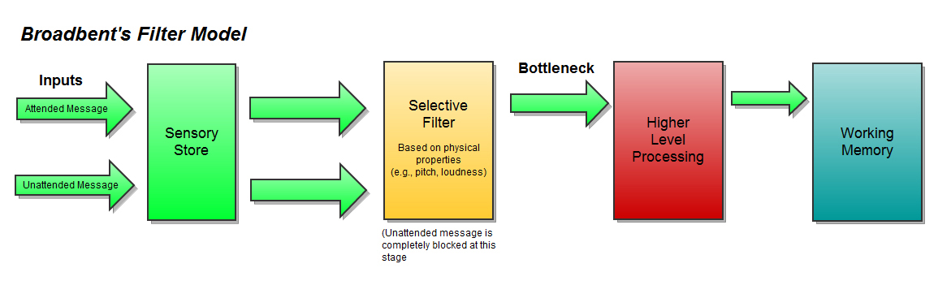

Attention
Attention as a spotlight

Slide 34
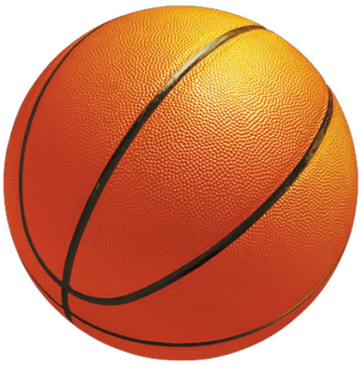
Selective role of attention
Change-blindness experiments:
Video: Count the number of passes!
Video: https://www.youtube.com/watch?v=Qb-gT6vDrmU

Slide 35

Memory
What is the nature of memory?

Slide 36
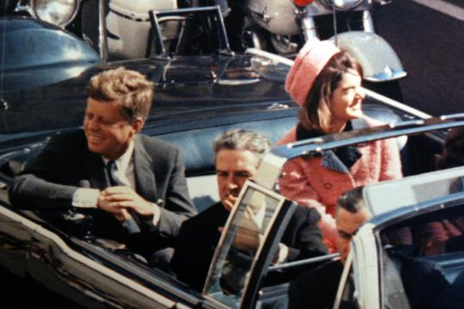
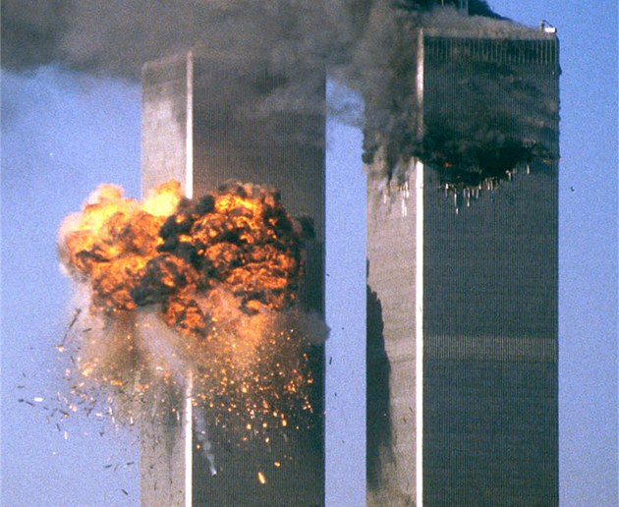
Memory as a camera
Extremely emotional experience
= „flashes“, eidetic memories
(Neisser, Hyman, 1999)
Memories on the crash of Challenger space shuttle, 1 day, 2,5 years later

Slide 37
Memory as a camera
Description 1. “I was in my religion class and some people walked in and started talking about [it]. I didn’t know any details except that it had exploded and the schoolteacher’s students had all been watching which I thought was so sad. Then after class I went to my room and watched the TV program talking about it and I got all the details from that.”
Description 2. “When I first heard about the explosion I was sitting in my freshman dorm room with my roommate and we were watching TV. It came on a news flash and we were both totally shocked. I was really upset and I went upstairs to talk to a friend of mine and then I called my parents.”

Slide 38
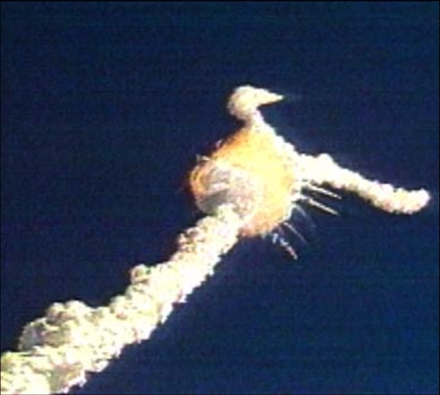
Memory as a camera
Distortions occur even in the case of eidetic memories.
Conviction about the high accuracy of the memory
Low correlation of the conviction and the factual accuracy

Slide 39
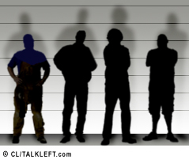
Eye-witnesses

Slide 40
Phases of memory process prone to distortion:
Perception and attention focus
Coding in memory
Storing in memory – forgetting
Recall – tendency to confabulate
Variables: time and duration of the event, gender, age, intelligence, „face memory“, emotions, personality,…

Slide 41
Causes of distortion:
Nature of memory:
NOT reproductive – doesnt copy, what we have experienced
BUT reconstructive – memories + convictions, needs, emotions

Slide 42
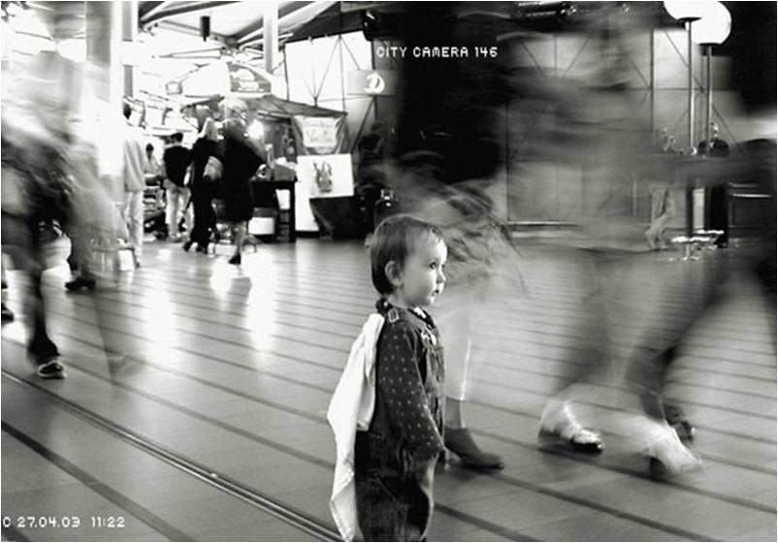
Creation of false memories
Loftus (1993): Lost in a shopping mall
https://www.youtube.com/watch?v=PQr_IJvYzbA
Chris had to state everything he remembered:
Few information
Reconstruction of elaborate memory
Similar experiments: aminal attack, injury, medical intervention, bullying,…

Slide 43
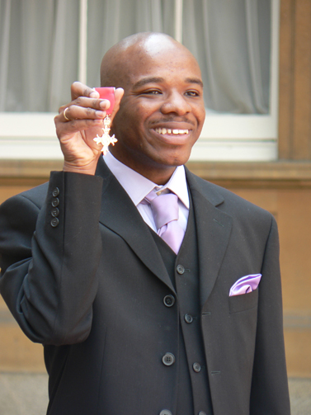
The human camera – Stephen Wiltshire
https://www.youtube.com/watch?v=a8YXZTlwTAU

Slide 44
Thank You!

