Slide 1
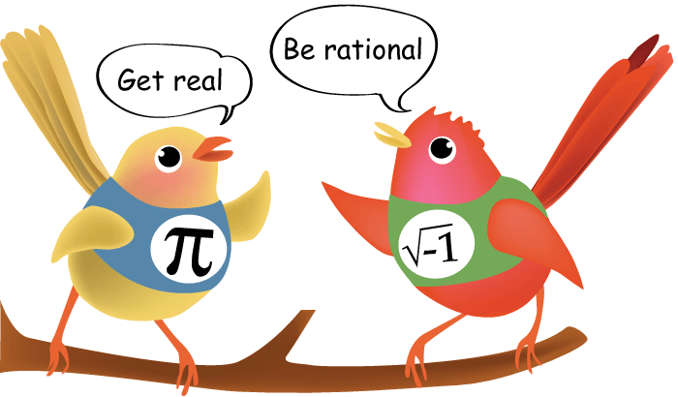
Rationality Myth
How & Why People Make Weird Choices

Slide 2
Rational animal
„Man is a rational animal – so at least I have been told. Throughout a long life I have been looking diligently for evidence in favour of this statement, but so far I have not had the good fortune to come across it.“
B. Russell
What does “RATIONAL” mean?
Reasonable & logical
Unbiased by emotions
Optimal, relative to the information available

Slide 3
Rational choice
Expected Utility Theory:
Expectancy × Value

Slide 4
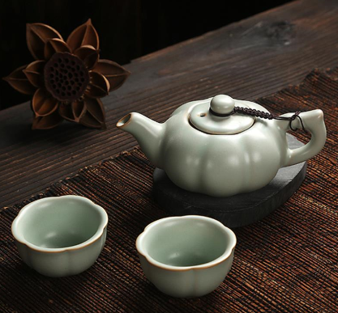
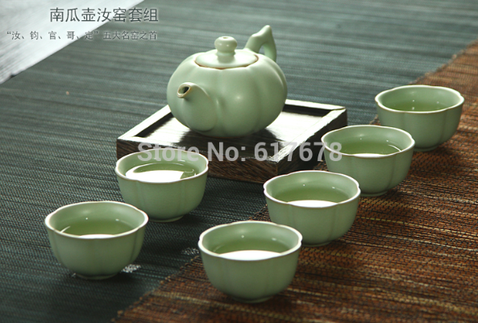
Example 1: Crockery story

Slide 5
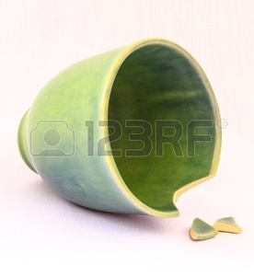
Example 1: Crockery story

Slide 6
Example 1: Crockery story
Hsee, C. K. (1998). Less is better: When low-value options are valued more highly than high-value options. Journal of Behavioral Decision Making, 11, 107-121.
Set A:
24 pieces
Dinner plates 8, all in good condition
Soup/salad bowls 8, all in good condition
Dessert plates 8, all in good condition
Set B:
31 pieces
Dinner plates 8, all in good condition
Soup/salad bowls 8, all in good condition
Dessert plates 8, all in good condition
Cups 8, 2 of them broken
Saucers 8, 7 of them broken

Slide 7
Example 1: Crockery story
Hsee, C. K. (1998). Less is better: When low-value options are valued more highly than high-value options. Journal of Behavioral Decision Making, 11, 107-121.
Three groups:
 | Offered price Set A(24pcs) | Offered price Set B (31pcs)
Group 1 – simultaneous evaluation | $ 30 | $ 32
Group 2 – Set A only | $ 33 | -
Group B – Set B only | - | $ 23

Slide 8
Example 2: Dictionary story
Hsee, C. K. (1996). The evaluability hypothesis: An explanation for preference reversals between joint and separate evaluations of alternatives. Organizational behavior and human decision processes, 67(3), 247-257.
Dictionary A:
Published 1993
10,000 entries
Like new
Dictionary B:
Published 1993
20,000 entries
Cover torn, otherwise like new

Slide 9
Example 2: Dictionary story
Hsee, C. K. (1998). Less is better: When low-value options are valued more highly than high-value options. Journal of Behavioral Decision Making, 11, 107-121.
Three groups:
 | Offered price Dictionary A | Offered price Dictionary B
Group 1 – simultaneous evaluation | $ 19 | $ 27
Group 2 – Dictionary A only | $ 24 | -
Group B – Dictionary B only | - | $ 20

Slide 10
Conclusions
Preference reversal
In certain conditions, our preferences and/or evaluations may change even though the attributes of the objects remain the same.
Rational prioritization (transitive):
A is more than B is more than C
Irrational prioritization (intransitive):
A is more than B is more than C is more than A
amount amount amount
defect defect defect

Slide 11
Conclusions
Preference reversal
Evaluability effect
Our evaluation of options is only based on the information immediately available.
We do not consider relative value of possible alternatives if they are not available.

Slide 12
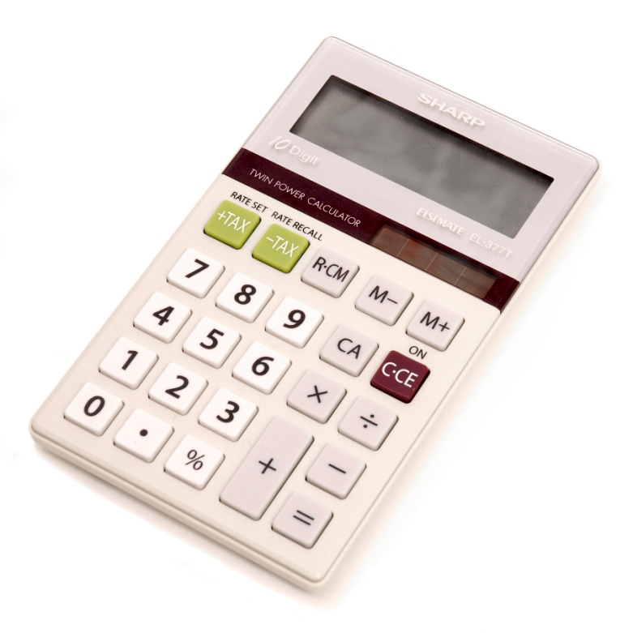
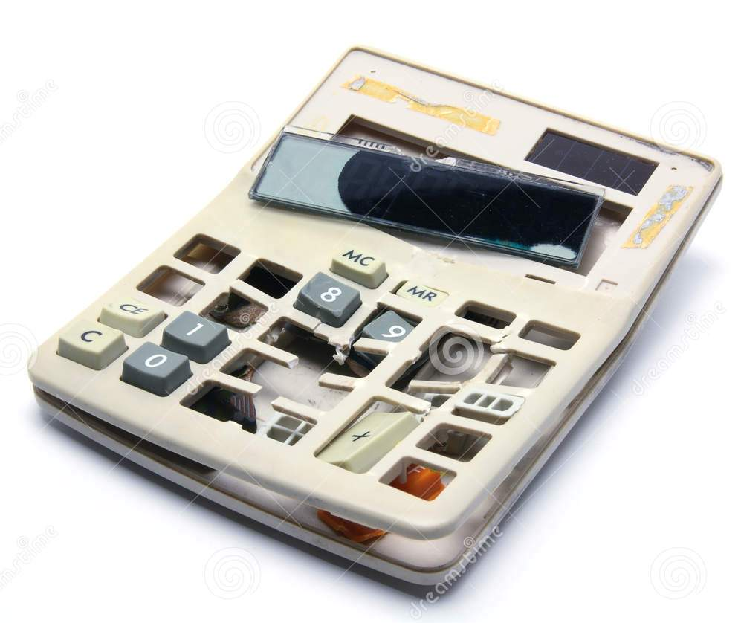
How we think our mind works...
Irrational thinking / decision making
Rational thinking / decision making

Slide 13
How our mind actually works...
HEURISTICS

Slide 14
Conclusions
Preference reversal
Evaluability effect
Loss aversion
We invest more into avoiding losses than into achieving gains (of the same value).
When negative information is available, we tend to give it special attention and prioritize it.

Slide 15
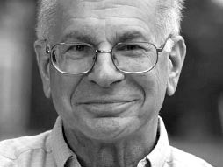
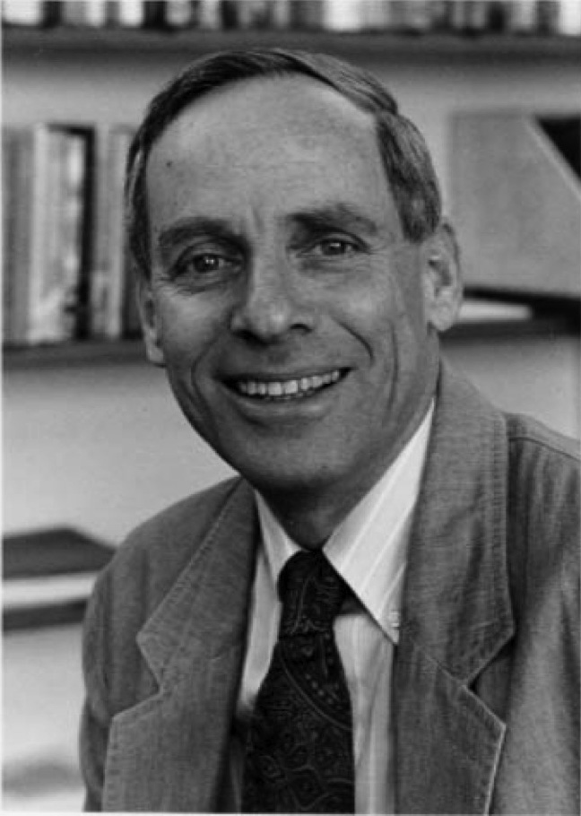
Loss aversion
Daniel Kahneman Amos Tversky
Behavioural economics

Slide 16
Risk aversion
People avoid uncertainty.
(Daniel Bernoulli)

Slide 17
Loss v. risk aversion
Kahneman & Tversky
Situation A:
You have been given $1,000. You are now asked to choose one of these options: 50% chance to win $1,000 OR get $500 for sure
50% chance of $1,000 or $2,000
OR
100% chance of $1,500
Situation B:
You have been given $2,000. You are now asked to choose one of these options: 50% chance to lose $1,000 OR lose $500 for sure
50% chance of $1,000 or $2,000
OR
100% chance of $1,500

Slide 18
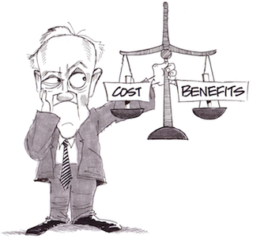
Loss v. risk aversion
Kahneman & Tversky

Slide 19
Loss v. risk aversion
 | Certain $1,500 gain | Uncertain $1,000 or $2,000 gain
Situation A: $1,000 given 50% chance to win additional $1,000 OR get $500 for sure | YES!!! | No, thanks.
Situation B: $ 2,000 given 50% chance to lose $1,000 OR lose $500 for sure | Not if I can avoid it. | THANKS FOR THE CHANCE!!!

Slide 20
Loss v. risk aversion
 | Certain $500 gain | Uncertain $1,000 or $0 gain
Situation A: $1,000 given 50% chance to win additional $1,000 OR get $500 for sure | YES!!! | No, thanks.
Situation B: $ 2,000 given 50% chance to lose $1,000 OR lose $500 for sure | Not if I can avoid it. | THANKS FOR THE CHANCE!!!

Slide 21
Loss v. risk aversion
 | Certain $500 loss | Uncertain $1,000 or $0 loss
Situation A: $1,000 given 50% chance to win additional $1,000 OR get $500 for sure | YES!!! | No, thanks.
Situation B: $ 2,000 given 50% chance to lose $1,000 OR lose $500 for sure | Not if I can avoid it. | THANKS FOR THE CHANCE!!!

Slide 22
Loss aversion
A matter of FRAMING.
”Let’s go for a hike! Adam and Susan said they would also be going!”
”Let’s go for a hike! Adam and Susan said they would also be going, but, unfortunately, Steve cannot make it…”

Slide 23
Loss aversion, preference reversal & any choice
A matter of FRAMING.
Influenced by CONTEXT.

Slide 24
Dictionary story revisited
Hsee, C. K. (1998). Less is better: When low-value options are valued more highly than high-value options. Journal of Behavioral Decision Making, 11, 107-121.
Three groups:
 | Offered price Dictionary A (10,000 entries, like new) | Offered price Dictionary B (20,000 entries, cover torn)
Group 1 – simultaneous evaluation | $ 19 | $ 27
Group 2 – Dictionary A only | $ 24 | -
Group B – Dictionary B only | - | $ 20

Slide 25
Additional materials
Before attempting the first quiz, watch the two videos available in the interactive syllabus in the IS:
Dan Ariely’s TED talk on decision making
Daniel Kahneman’s TED talk on past, present and future selves
Recommended good reading on behavioural economics:
Kahneman, Daniel. Thinking, Fast and Slow.
Ariely, Dan. Predictably Irrational.
Ariely, Dan. The Upside of Irrationality.

Slide 26
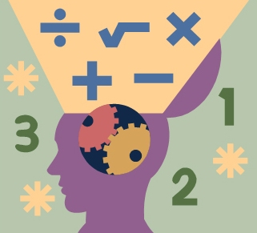
Rationality Myth
To be continued…
Thank you!

