Slide 1
WHAT IS KNOWLEDGE
Consequences for social pedagogy
Radim Šíp
Department of social pedagogy

Slide 2
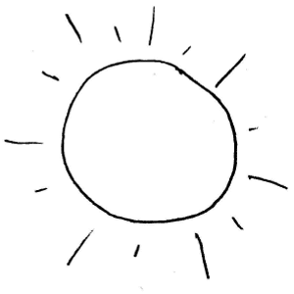
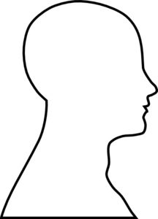
Traditional conception of knowledge
knowledge as a mental picture in the head
knowledge
reality
truth as correspondence

Slide 3
Traditional conception of knowledge
knowledge
that what is in our brain/mind
that what has strict borders
that what has clear meaning
that what we hold and manipulate with
that what is cognitive and not emotional

Slide 4
Problems – ex. activation of seniors
Seniors
lowing their cognitive capacity
destruction of memory
activation - reconstruction of memory
(theatre play with marionettes, - emotinal state that leads
storytelling, drama therapy) to restoration of mental and cognitive capacity

Slide 5
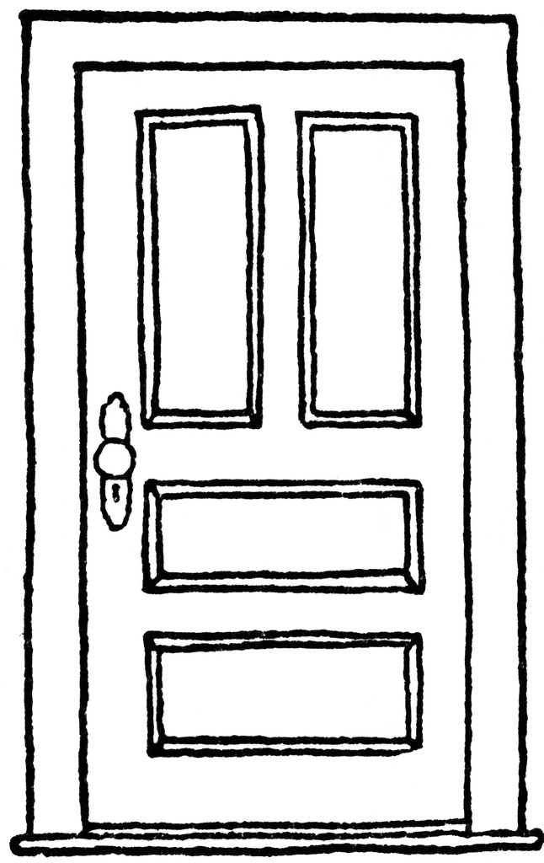
What is knowledge in fact
external conditions (material changes in environment)
piece of knowledge = individual knowledge, skill
Knowledge = key + lock + opening a door

Slide 6
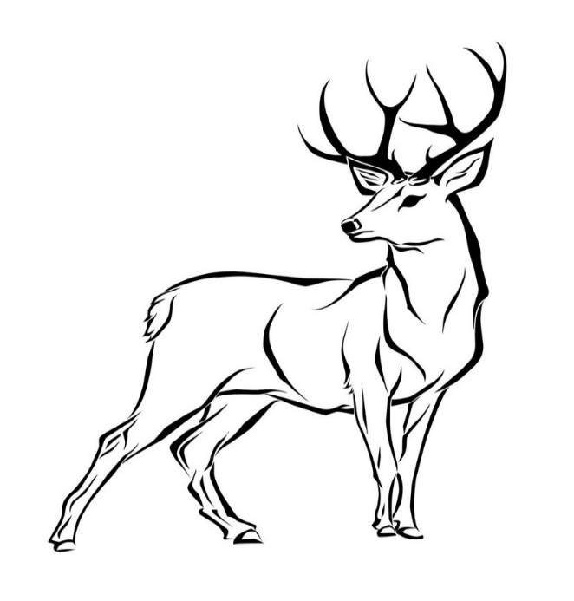
What is knowledge in fact
Key = idea how to use bow and arrow
bow and arrow + animal = lock
external environemental conditions
human artefact
characteristics of environement

Slide 7
What is knowledge in fact
Killed red deer = opening a door / sign that piece of knowledge and external material conditions fitted
together

Slide 8
Tacit knowledge
Michael Polanyi
Hungarian chemist,
refugee, Jew escaped from Hungaria before the WWII
how scientist learn something
there is much more you can be aware of and articulate
TACIT KNOWLEDGE

Slide 9
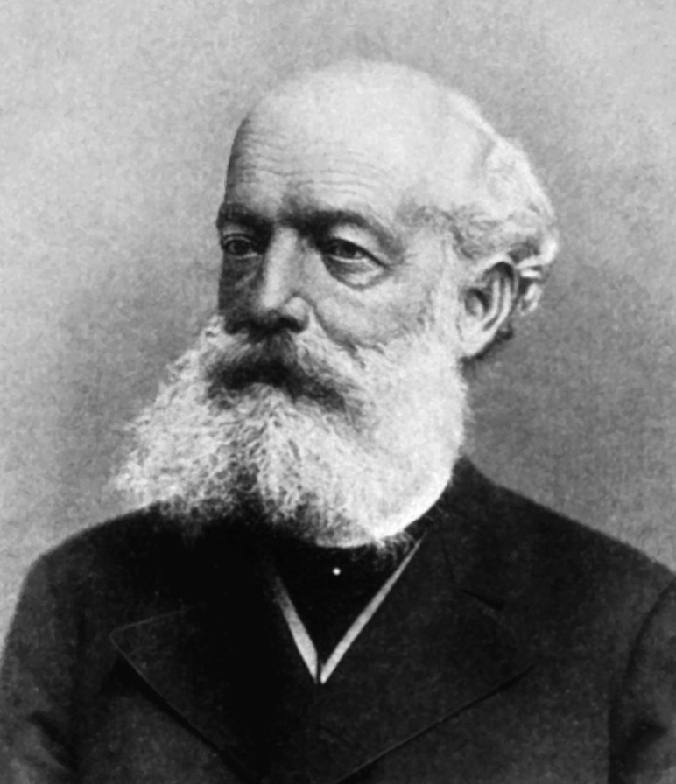
Tacit knowledge - example
Friedrich August Kekulé (1829 – 1896)
German orgnanic chemist
discoverer of structure of benzene
after years of studying carbon-carbon bond
he had a day-dream
the structure of benzene

Slide 10
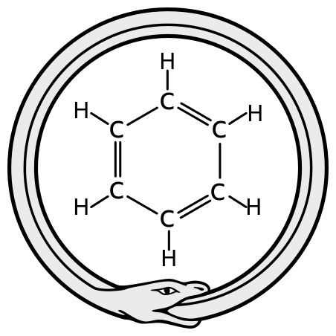
Tacit knowledge - example
= a day dream = UROBOROS
a snake that seize its tail
shift in thinking –
emergence of structural
chemistry

Slide 11
Tacit knowledge and seniors
external conditions (material changes in environment)
piece of knowledge = individual knowledge, skill
Knowledge = key + lock + opening a door

Slide 12
Tacit knowledge and seniors
activation through theatre play with marionettes
= manipulation with an environement in a such way
THAT WE RECONSTRUCT AND SUPPLEMENT INNER STATES OF
SENIORS’ BRAIN/MIND
RECONSTRUCTION OF A STRUCTURE OF PIECES OF KNOWLEDGE

Slide 13
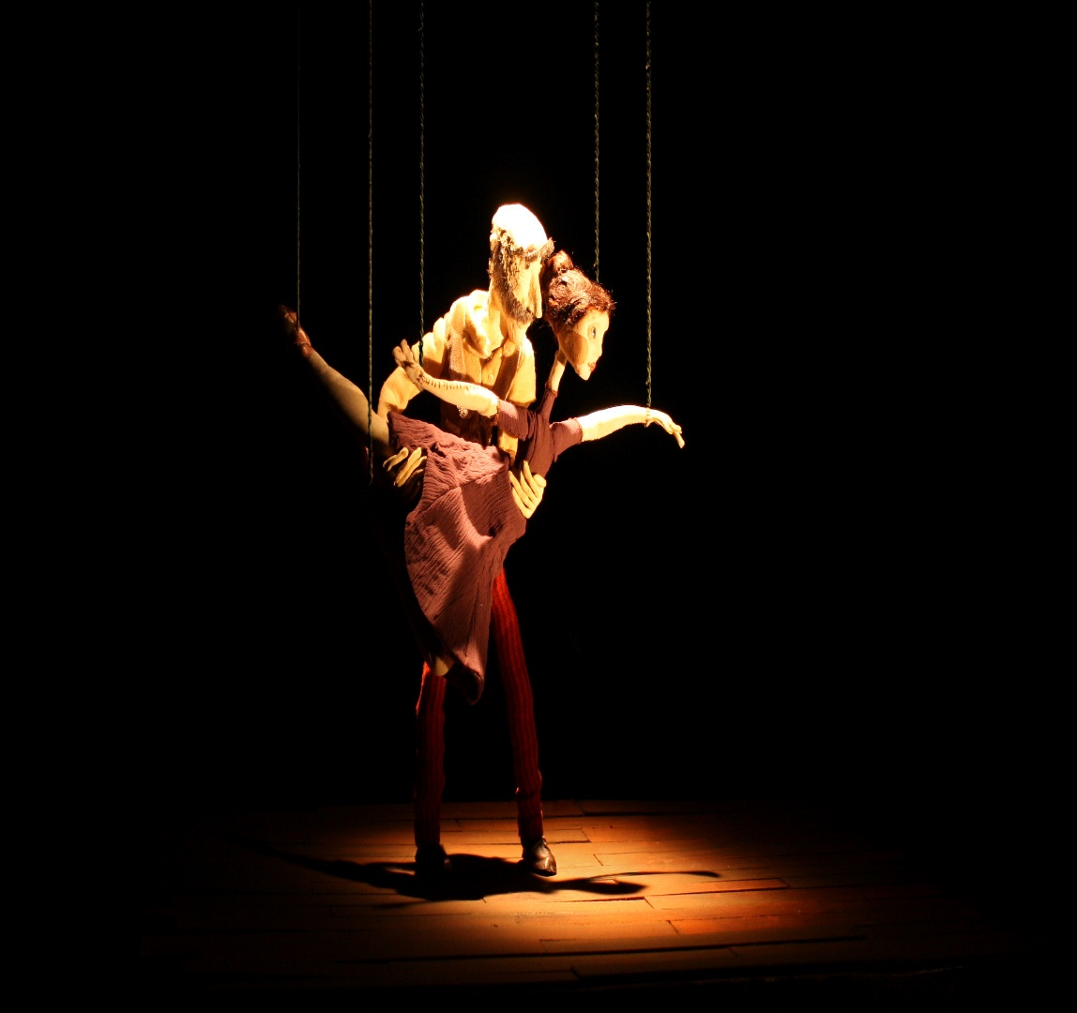
Tacit knowledge and seniors
manipulation in an environement
restoration
of a structure of information

Slide 14
What is knowledge
has its internal and its external features
there is no strict borders (ie. meaning)
borders and meanings are set / make clear by an actual situation
manipulation of external features changes in brain/mind
activation of seniors leads to restoration of memory and cognitive
capacity
manipulation of internal features enable to changes in
manipulation of external features
Kekule’s structural formula enable to manipulate chemicals in a new way

Slide 15
Consequences for social pedagogy
explains why an environment is important (manipulation with external features)
explains why physical activity has great impact (manipulation with external features)
outdoor education, drama education, training courses
explains why personal development or morality are important (manipulation with brain/mind)
explains why structure of information can influence emotions and actions of people (manipulation with brain/mind)
axiology, personal development, traditional education (gathering and structuring of information)

