Slide 1
AJ93100 Seminar II.
15 March 2017
Colourcoding & Copyright

Slide 2
COLOURCODING
When the text is copied into the graphic program, all the word formatting gets lost
We came up with a system of “color coding” to make sure your desired formatting is kept and to make it easier for the graphic designer to deal with all the requests

Slide 3
EXAMPLES
What it looks like when you hand in the final version of the article:
https://docs.google.com/document/d/190qXZT5ZLfW516oSFNd42o719_HTkKEFm-s6HozrU80/edit?usp=sharing
What it looks like in the final PDF:
http://reviewsmagazine.net/category/current-issue/

Slide 4
WHERE TO LOOK FOR PICTURES?
Ask the Re:Views Photo Squad (Helena + Eva + Yume)
Ask people you know for their OWN pictures (they took them, it is their property and people who are on those pictures agree to be on the photo and in the magazine - this does not apply to large crowds of people)
Ask people, companies, etc. if you can use their pictures.
Use pictures on the internet ONLY under Creative Commons licenses (more about that later).

Slide 5
OPTION 1 - THE SQUAD
ask the girls IN ADVANCE
tell them what is your article about and what sort of photos would you like
sync your meetings if you are doing an interview and want them to photograph people
when photographing people, ALWAYS ask them if the agree to be on the photo and published in the mag!
you don’t have to give credit to the photograpers in the magazine (like “Photo taken by HB”) because they are our own photographers and it is stated at the first page of the mag

Slide 6
OPTION 2 - PICS FROM PEOPLE YOU KNOW
it has to be their property (they took the photo, drew the picture, made the infographic and OWN the rights - meaning they DID NOT SELL IT to anyone)
if there are people on the pic other than the person you are asking, the people have to agree to be published in the mag
example: your friend called Magic Horse agrees with giving you a pic of a meadow he took himself when on holiday in France. The title for the picture will then be:
A lovely Meadow. Courtesy of Magic Horse.

Slide 7
OPTION 2 - EXAMPLES
with links (Swing article)
https://docs.google.com/document/d/1osFKV7dx7yGTjPbEVC20srgdactZJ-KLGJrAAjUYvKY/edit?usp=sharing

Slide 8
OPTION 3 - PEOPLE AND COMPANIES
if you see a pic on a website, if you want to use a screenshot from youtube, a film, TV series or a videogame
find the owner’s contact and write them an e-mail and include:
who are you, what is Re:Views magazine and what do we publish, where we are from, that we are non-profit; tell them what is your article about and which pictures are you interested in and ask them if they will allow you to use them for FREE. Include our web page with current issue and our FB page and thell them we’ll be out on 15 May 2017 and that you can send them a copy. BE POLITE.

Slide 9
OPTION 3 - CONTINUED
Big companies like BBC charge an incredible amount of money for their pics and screenshots and studios like Warner Bros. won’t be any different.
It is much easier to obtain pictures from small, indie companies or from particular people. Contact them any way you find (e-mail, FB, twitter,...)

Slide 10
OPTION 3 - EXAMPLES
Website (Brexit)
https://docs.google.com/document/d/14yK5DHTb2AVh0gk9KsdoLP_HqfukaAyljgpXIZgZVl0/edit?usp=sharing
Person (Swing)
https://docs.google.com/document/d/1osFKV7dx7yGTjPbEVC20srgdactZJ-KLGJrAAjUYvKY/edit?usp=sharing
Youtube screenshots (Frankenstein)
https://docs.google.com/document/d/1xslsVMDcYocS5WNWIgnUotE4AlUxllaGLxapZU_l6VY/edit?usp=sharing

Slide 11
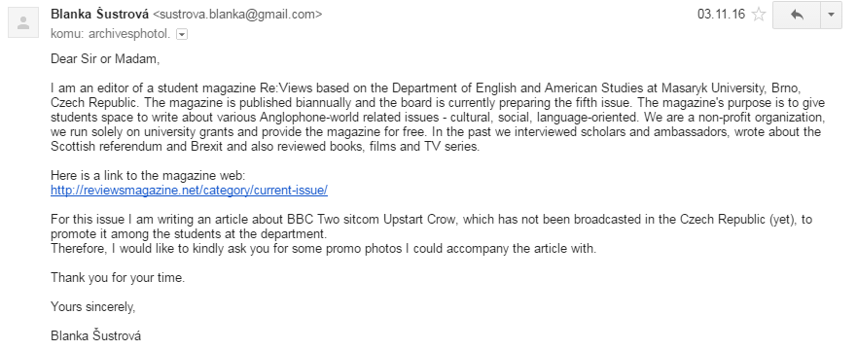
OPTION 3 - EXAMPLE of How to Ask :) (This was sent to BBC)

Slide 12
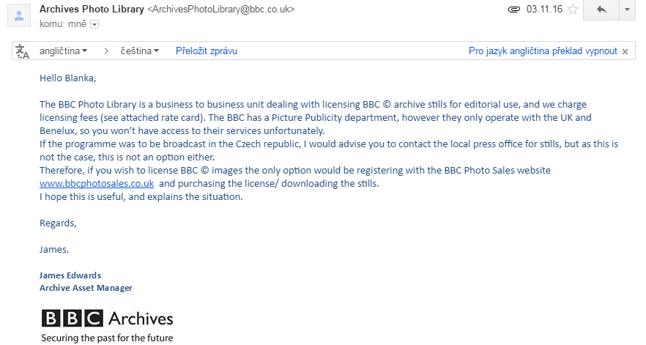
...and I got this back

Slide 13
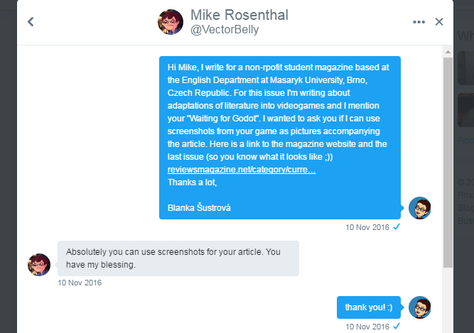
I wanted a videogame screenshot and had to contact the creator of the game via twitter because he had no e-mail address anywhere.

Slide 14
OPTION 4 - THE INTERNET
you cannot just take any picture you like from anywhere, do not forget someone is always the OWNER of the picture
if you want illustrational pics for the topic you write about, use picture banks with pics for free:
www.pexels.com
www.pixabay.com
www.flickr.com

Slide 15
> > > BUT BEWARE < < <
YOU HAVE TO LOOK UNDER CREATIVE COMMONS LICENSES (CC)
http://www.creativecommons.cz/licence-cc/
CC are different in Czech republic and the rest of the world, for example, in CZ we DO NOT HAVE PUBLIC DOMAIN.
The law is territorial, it does not matter that we write in English, we are based in CZ.

Slide 16
Let’s return to your friend, Mr Magic Horse and our imaginary article about meadows.
Magic Horse said he won’t give you any of his pics for whatever reason but you would like some pics of meadow in your article.
And now watch me and make notes.

Slide 17
How to make copyright for the typesetter
download the pic in HQ if possible + upload it to the folder with your article on GDrive
name the pic (like “pic 1”)
create a new word document in the folder and title it “picture notes for graphic designer” and put the info in

