Slide 1
AJ93100 Seminar 1
1 March 2017
The hardest one.
If you’ll manage to sit through this seminar today, you’ll manage everything in life.

Slide 2
Course Participants
SENIOR
Helena Brunnerová - PH
Peter Docherty - PRR
Anna Jílková - ART
Michaela Medveďová (in absentia) - ART
Barbara Ocsovayová - PR, ART
Pavel Peléšek - PR
Pavla Wernerová (in absentia) - PR, ART
Natália Poláková (in absentia) - ART
JUNIOR
Anežka Hřežová - ART
Patrícia Iliášová - ART
Yume Katsumi - ART
Bára Skorkovská - ART
Eva Růžičková - PH
Simona Hromuľáková - PR

Slide 3
Teachers and other good-hearted people
Teacher: PhDr. Kateřina Tomková, PhD.
Assistants: Blanka Šustrová (editor-in-chief) + Tereza Walsbergerová (chief-of-staff)
Good-hearted people AKA the rest of the permanent staff (might become your supervisors):
Markéta Šonková
Anna Formánková
Martina Krénová

Slide 4
Primary means of communication:
FB group: to communicate on daily basis, share ideas, leave messages, set polls (befriend Blanka and Tereza on FB, you will be added there)
Google Drive: to share materials, to submit your work
→ you will need a Gmail account
Supervisor - supervisee(s) contact:
personal FB messages, group chats: organising, questions, tips
emails: more substantial issues, discussing the work, sharing the works-in-progress

Slide 5
Communication with the rest of the world
FB page: Re:Views Magazine
Twitter account: @ReViewsMagazine
Re:Views Magazine website
Magazine email: re.views.magazine@gmail.com
LinkedIn: link
YouTube: link

Slide 6
Guidelines: Article Constituents
VISUAL COMPONENTS
Highlighted sentences (COLORCODING)
Pictures (properly referenced!)
Article layout
TEXTUAL COMPONENTS
Headline
Lead paragraph
Body of the article
Sources
Author’s profile
(Your subject’s profile)

Slide 7
Lead Paragraph
= Perex (in CZ)
The lead, or opening paragraph, is the most important part of a news story. With so many sources of information – newspapers, magazines, TV, radio, and the Internet – audiences simply are not willing to read beyond the first paragraph (and even sentence) of a story unless it grabs their interest. A good lead does just that. It gives readers the most important information in a clear, concise and interesting manner. It also establishes the voice and direction of an article.

Slide 8
Tips for Writing a Lead
The Five W’s and H: Before writing a lead, decide which aspect of the story – who, what, when, where, why, how – is most important. You should emphasize those aspects in your lead. Wait to explain less important aspects until the second or third sentence.
Conflict: Good stories have conflict. So do many good leads.
Specificity: Though you are essentially summarizing information in most leads, try to be specific as possible. If your lead is too broad, it won’t be informative or interesting.
Brevity: Readers want to know why the story matters to them and they won’t wait long for the answer. Leads are often one sentence, sometimes two. Generally, they are 25 to 30 words and should rarely be more than 40.
Active sentences: Strong verbs will make your lead lively and interesting. Passive constructions, on the other hand, can sound dull and leave out important information, such as the person or thing that caused the action. Incomplete reporting is often a source of passive leads.
Audience and context: Take into account what your reader already knows. Remember that in today’s media culture, most readers become aware of breaking news as it happens.
Honesty: A lead is an implicit promise to your readers. You must be able to deliver what you promise in your lead.

Slide 9
What to Avoid
Flowery language: Do not overuse adverbs and adjectives in the leads. Concentrate instead on using strong verbs and nouns.
Unnecessary words or phrases: Watch out for unintentional redundancy. For example, 2 p.m. Wednesday afternoon, or very unique. You can’t afford to waste space in a news story, especially in the lead. Avoid clutter and cut right to the heart of the story.
Formulaic leads: Readers want information, but they also want to be entertained. Your lead must sound genuine, not merely mechanical.
It: Most editors frown on leads that begin with the word it because it is not precise and disorients the reader.

Slide 10
Types of Lead
Summary lead: This is perhaps the most traditional lead in news writing. It is often used for breaking news. Straight news leads tend to provide answers to the most important three or four of the Five W’s and H. Historically this type of lead has been used to convey who, what, when and where. But in today’s fast-paced media atmosphere, a straightforward recitation of who, what, when and where can sound stale by the time a newspaper hits the stands.
Anecdotal lead: Sometimes, beginning a story with a quick anecdote can draw in readers. The anecdote must be interesting and must closely illustrate the article’s broader point. If you use this approach, specificity and concrete detail are essential and the broader significance of the anecdote should be explained within the first few sentences following the lead.
Other types of leads: A large number of other approaches exist, and writers should not feel boxed in by formulas. That said, beginning writers can abuse certain kinds of leads. These include leads that begin with a question or direct quotation and those that make a direct appeal using the word you. While such leads might be appropriate in some circumstances, use them sparsely and cautiously.

Slide 11
Body of the Article
MLA style
Please, avoid plagiarism at all costs!
It is perfectly OK (even recommended) to quote other sources, make sure, though, you reference them all properly.
You can write all sorts of texts: descriptive (overview study), analytical, and argumentative. Other genres are possible too.
We also do interviews and reviews (books, movies, and TV series).
Always bear in mind who your audience is, what is goal of your article (its core message), and how it fits into the concept of the whole issue.
Length is basically up to you: make sure you say all you need to say without it being unnecessary lengthy or too brief.

Slide 12
A bit like MLA but not that stiff - advice on form and style
Follow the MLA rules but don’t be so rigid with the concept of “I’ll state what this is about in the intro and repeat it again in the conclusion”
Think of catchy bomb titles (paraphrased part of the text body, quotation, a wordplay) - you’ll catch reader’s attention from the beginning
Be as much objective as you can. Do not bring your personal attitudes and beliefs in your writing! Use pros and contras and comment on them using reliable and relevant sources!
Don’t use empty academic language to “look smart”, you are writing for fellow students and no one wants to read 5 pages of dead wood. Your articles don’t have to be long
USE STANDARD ENGLISH - no slang, colloquialisms - unless you’re writing about it
Don’t mock, attack, humiliate your reader. Don’t use sarcasm to make them feel inferior.
If unsure, ASK! Always ask us. No question is stupid.

Slide 13
Author’s Profile
Please include a brief profile of yourselves too to introduce yourselves to your readers
You obviously do not have to include anything personal or anything you don’t feel like sharing.
It is a good idea to include what you study, your interests, anything you feel like people might enjoy knowing about you.
It does not have to be long.
Our photographer shall take pictures of all of us.
You can have a look into previous issues on various examples of these.

Slide 14
Your Subject’s Profile
When you are writing about an author, working on a review, etc., please include a brief profile of your subject.
What should be included (depending on type of your piece):
Date of birth (death)
Nationality
Occupation
Crucial bio
Most important works
Picture

Slide 15
Sources
MLA style
It is necessary to make sure it is always possible to trace your sources
List at the end of your article
Please don’t use Wikipedia
IN-TEXT REFERENCING
Books and printed sources: the same way as you are already used to from MLA style
Online sources: instead of reference in brackets, we use embedded hyperlinks
You can also introduce it as you are used to from essays and then we use the hyperlink etc…

Slide 16
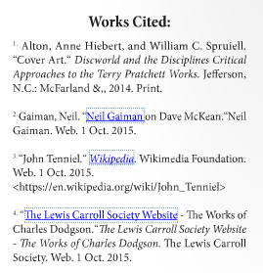
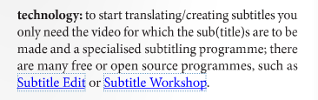

Slide 17
Pictures
The authors are also asked to supply pictures
Pictures should be accompanied with a caption
We shall instruct you on copyright issues in one of the future seminars
Possible ways to find visual material (also depending on the type of your written contribution):
you find it online (copyright!!) → we’ll talk about copyright next time
you use your own material or take your own pictures
the photographer takes it for you

Slide 18
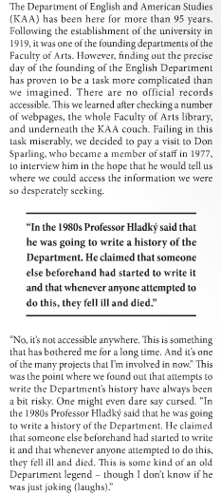
Highlighted Sentences
We use them to visually “break” the lengthy passages
You can choose whichever sentences you like. Mind, though, that taking a sentence out of context may manipulate its message, so careful with that.
How many you choose is up to you (take into consideration how many pictures you wish to supply).

Slide 19
Color Coding
When the text is copied into the graphic program, all the word formatting gets lost
We came up with a system of “color coding” to make sure your desired formatting is kept and to make it easier for the graphic designer to deal with all the requests

Slide 20
Layout
Should you have any specific requirements as of what you want your article to look like graphically, supply the graphic designer with a layout.
You can do so by drawing a picture in hand or just a simple drawing in MS Office programs and uploading it with the rest of your material.
If you don’t have any specific requirements, the graphic designer will do it as he seems best. If you don’t hand in any requirements, please be ready to respect the way it is going to be done by the GD (unless there is something really bugging you ;) ).

Slide 21
Sources
Information on & examples of “lead” (edited): https://owl.english.purdue.edu/owl/resource/735/05/

Slide 22
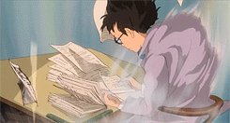
Are you all warmed up? The next part is coming!

Slide 23
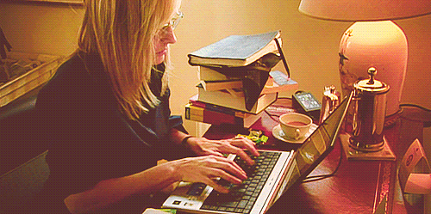
General writing tips

Slide 24
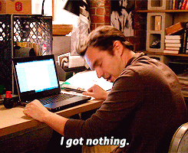
article starter-pack
Brainstorming
Mind Mapping
Keywords
Outline
Data Bank
Actual Writing

Slide 25
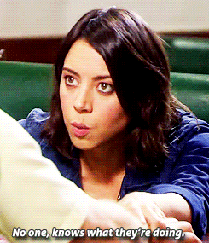
1. BRAINSTORMING
Determine your target group (academia, but fun!)
Write down everything
As in, ALL THE THINGS
Even if they seem silly
Or out of place
Doodle
Anything goes
Try using actual pen and paper if possible (it pleases the brain)

Slide 26
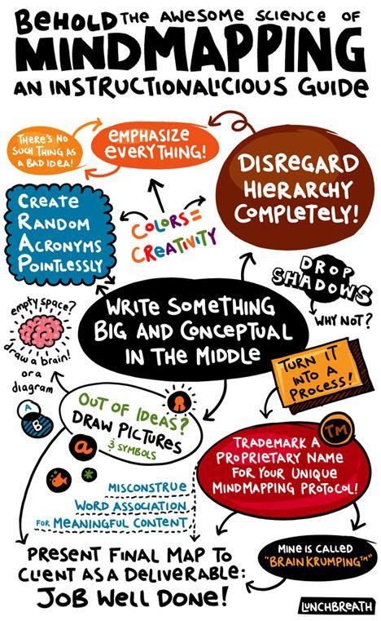
2. MIND MAPPING
Associations + research items
Can be done while brainstorming
Organises your thoughts
Big concepts in the middle
COLOURS!
CONNECTIONS!
© Tobias Lunchbreath

Slide 27
3. KEYWORDS and PHRASES
# STUDYING
# PODCASTING
# FICTION
# MILLENNIALS
# IMMERSION
# FAN-CASTS
(will come in handy later!)
# AUDIOBOOKS x PODCASTS
# ACCESSIBILITY

Slide 28
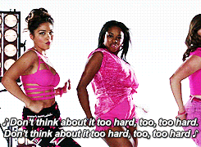
4. OUTLINE
Use your keywords
And your Mind Map
Sub-points are love
Too many paragraphs is better than too few paragraphs
Think about transitions (/segways) and put them in brackets
Don’t overthink it

Slide 29
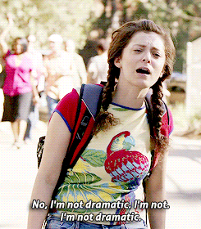
5. DATA BANK
ALWAYS save your sources
Data AND pictures
Preferably in the same document
EVEN IF YOU THINK YOU’LL REMEMBER THEM LATER
YOU WILL NOT!!!!!
Google Drive or Google Keep are your friends

Slide 30

6. ACTUAL WRITING
Decide on a style
Your timeline is the bones
Words are the meat
Don’t worry about being too messy (that’s what editing is for)
Ask questions
Short sentences are good for emphasis or comic relief, but don’t stack too many next to each other, you’ll sound like a robot
fewer adverbs = good
Use transition words
Decide on spelling (UK/US/AUS)
https://docs.google.com/document/d/1m4Heyi5R14Hb9_1VTrskArLW7uKm9t49DCUf4dOOpi8/edit?usp=sharing

Slide 31
CONSTRUCTING YOUR PARAGRAPH
Good starter phrases:
“According to…”
“As…”
Time markers “In the last five years...”
“In fact,…”
Start with a topic sentence
Continue with an analysis (supported by up to 3 pieces of evidence)
End with a /soft/ conclusion
6 Ws of writing:
WHO, WHAT, WHEN/WHERE, WHY, WHO, WHY

Slide 32
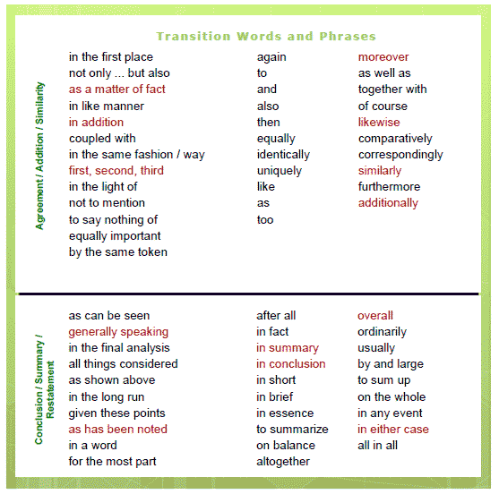
http://www.smart-words.org/linking-words/transition-words.png

Slide 33
HANDY WRITING RESOURCES!
Smart Words
Hemingway Editor
myNoise
Tip of My Tongue
ozdic

Slide 34
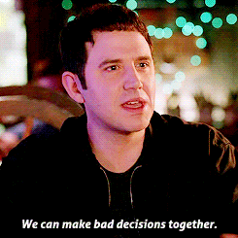
Other random tips
Write your intro (lead paragraph) at the end
Source all your info
EDITING, EDITING, EDITING
Don’t be scared to cut things
Or play with your paragraphs
Read it out loud (flow)
Ask someone (your supervising person, perhaps) to beta-read before submitting
Have fun!

Slide 35
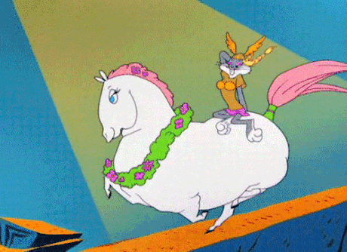
BUT WAIT… THERE’S MORE!!!

Slide 36
INTERVIEWS

Slide 37
For effective interviews, reporters prepare carefully, and they ask questions that induce the source to talk freely.
Questions are directed at obtaining information on a theme that the reporter has in mind before beginning the interview.
If a more important theme emerges, the reporter develops it.
The reporter notes what is said, how it is said and what is not said.
Sources are encouraged by the reporter's gestures and facial expressions to keep talking.

Slide 38
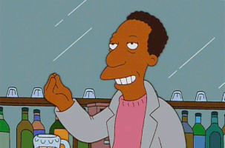
RULES WORTH REMEMBERING
1. Prepare carefully, familiarizing yourself with as much background as possible.
2. Establish a relationship with the source conducive to obtaining information.
3. Ask questions that are relevant to the source and that induce the source to talk.
4. Listen and watch attentively.

Slide 39
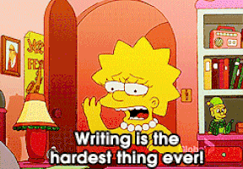
WRITE A PROFILE OF THE INTERVIEWEE
State relevant biographical info
don’t forget any important data, achievements etc. :)
On the other hand, don’t overpraise.
Put the profile in the lead paragraph or alongside/at the end of text.
If possible, include a (good quality) photo. (This is actually highly recommended)

Slide 40
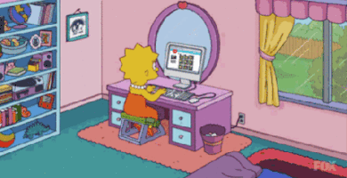
BEFORE THE INTERVIEW
Write down your questions. Don’t prepare too few, always have some extra up your sleeve.
Charge your recording device :)
Don’t ask the questions you know the answers for or that can be looked up in previous interviews with the particular interviewee.
Choose a place that will be quiet and comfortable for both of you.

Slide 41

DURING THE INTERVIEW
Don’t be afraid to interrupt the interviewee if there is a great diversion.
BUT let them speak if it is interesting and topic-related.
Try to keep the interview under 1 hour, otherwise it really is a pain to transcribe.
An example of what will happen when you will not follow these rules:
https://docs.google.com/document/d/11JZClyTj3pPtOFFT-CUOgdSpnlV5CX9GEeQma504-7o/edit?usp=sharing

Slide 42
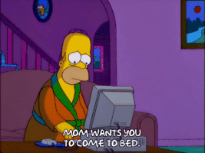
AFTER THE INTERVIEW
Be a careful transcriber and a rigorous editor!
Don’t be afraid to get back to the interviewees if you need to clarify something (spelling etc.).
Re-listen, crosscheck, and ask people for proofreadings.
It’s not obligatory to have your interview approved/authorised, but it is more polite.

Slide 43

MAKING AN ARTICLE OUT OF INTERVIEW
You are writing an article but want to incorporate the information from the interviewee there as well:
You can paraphrase, summarize and quote.
Include passages that reflect inteviewee’s personality - direct quotes will do well.
Stick relevant pieces together and edit, cut, edit, cut and edit again.
Have the original transcript at hand and colorcode the topics - it gets much easier.
Example: History of KAA (an article made out of interview with Don Sparling) in Issue II.

Slide 44

ONLINE INTERVIEWS
Good for smaller interviews when you don’t have time to transcribe. Needs less editing as well.
But you don’t have a face to face contact with the interviewee and cannot control the interview.
Do a good research, prepare simple questions and ask the interviewee for a particular length of the answer.
Don’t be scared to give deadlines to the interviewee! You need them!
E-mail x Chat

Slide 45
SOURCES AND FURTHER READING
http://www.columbia.edu/itc/journalism/isaacs/edit/MencherIntv1.html
http://www.mediahelpingmedia.org/training-resources/journalism-basics/475-20-interviewing-tips-for-journalists
http://matadornetwork.com/bnt/13-simple-journalist-techniques-for-effective-interviews/
http://www.sparkminute.com/2011/11/07/30-tips-on-how-to-interview-like-a-journalist/

Slide 46
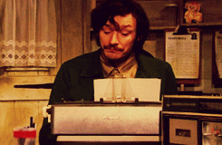
YOU MADE IT :)
Good luck with writing!

