Slide 1
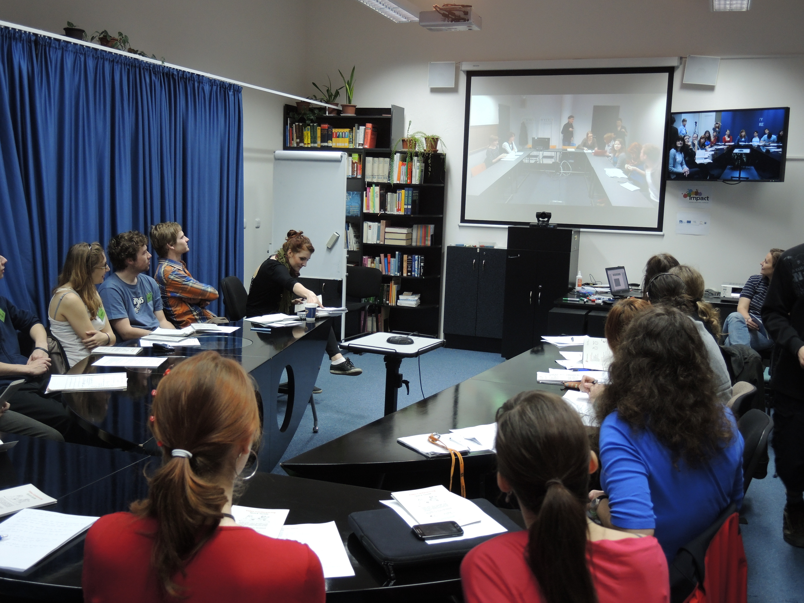
VIDEOCONFERENCING IN ENGLISH

Slide 2

Outline
Videoconferencing
English
Aberystwyth

Slide 3
Discussion
What are the usual reasons for online communication?
In what situations is videoconferencing more useful than other communication modes?
What sorts of meetings have to be face-to-face?
job interviews / team-building sessions / crisis meetings/ complex negotiations / project updates / multinational team briefings

Slide 4
Example
https://www.youtube.com/watch?v=HTG-KYiChjs
This is an advertisement – what for?
What does it depict?

Slide 5
Expectations
Why are you interested in the course?
What would you like to learn?
What can you share?

Slide 6
Vocab check
Sorry, I had a bit problem ______ through.
We are just ______ for Sulaiman.
Did you all get a copy of the ________
As you can see, we have several _____ today.
Can we keep our _____ quite short?
Right, we are running short of ______
I think we have _____ everything for now.
Incompany3.0 p.109

Slide 7
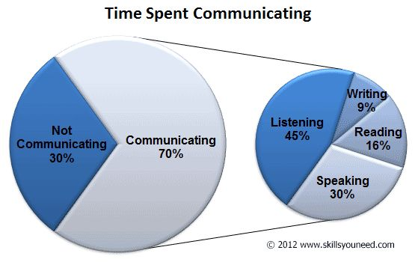
Language Skills Check
Speaking – asking questions
Listening – for specific information

Slide 8
Aberystwyth Check
https://www.youtube.com/watch?v=cxCSgF2XNqI&t=69s
https://www.youtube.com/watch?v=y-Z6pAz4Iu4&t=37s

Slide 9
Cultural Sensitivity Check
You meet a Spanish business contact you haven´t seen for ages who wants to stop and chat, but you are running late for an appointment. Do you stay or do you make your excuses and go?
Your American boss organizes a weekend barbecue. You find yourself amongst a lot of people you´ve never met. Do you join in the fun or leave as early as you can?
In company3.0 P.140

Slide 10
Cultural Differences
What cultures have you encountered?
Were they similar or different to your culture?

Slide 11

Listening
http://www.macmillanincompany3.com/resources/student/resource-centre/intermediate/audio/unit-9/

Slide 12
Course Outline
March 1 – Introduction
March 15
March 29
April 12
April 26
May 10

Slide 13

Thank you for your attention.
Notes:
What is learning? How do you learn???

