Slide 1


THEORETICAL PHONOLOGY
Phonetics
Lecturer:
Irina K. Voytovich
The Phoneme

Slide 2
In this lecture:
What is phonology
The phoneme: its features and functions
The flow of speech
Phonemes, allophones and other variations of speech sounds
The phonological oppositions theory
Phonemic inventory and system

Slide 3
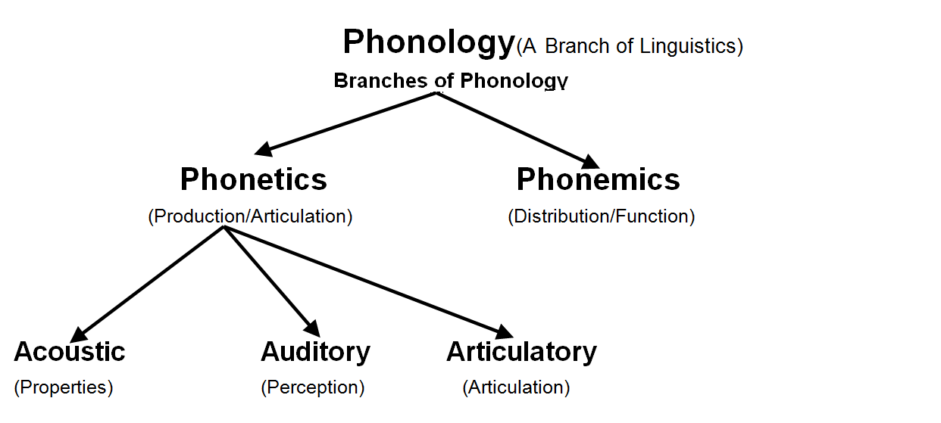
Phonology

Slide 4
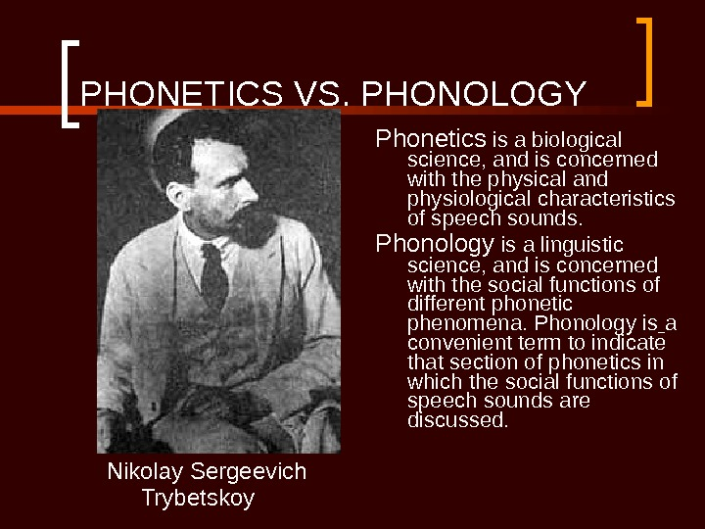

Slide 5
To sum it up:
Which comes first – the dilemma is still there
Phonology is strongly connected to the linguistics, relationship to meaning and the function of consonant and vowel sounds, syllabic structure, word accent and prosodic features, such as pitch, stress and tempo

Slide 6
Phonology studies
4 basic theories
The phoneme theory
The syllable theory
The stress theory
The intonation theory
3 basic functions
Constitutional
Distinctive
Recognitive

Slide 7
Background
The 6th century BC | Ancient Greek Philosophy
1875 | Louis Havet a French Latinist
1878 Memoir | Ferdinand de Saussure a Swiss linguist aged 21
1887 | Jan Baudouin de Courtenay a Polish linguist
1912 | Lev V. Shcherba a Russian linguist
1929-1939 Principles of Phonology | Nikolai S. Trubetzkoy a Russian linguist

Slide 8
Phoneme: definition
The phoneme is unit of the sound system of the language.
the smallest,
linear / segmental
indistinguishable,
independent

Slide 9

Most important functions of a phoneme
Constitutive - phonemes form the sound shells of significant language units, such as morphemes, words, sentences, paragraphs, texts …
[e] [ai] [h] [p] [t]
[u] [k] [l]
[hait]
[tuk] [luk]
[put] [tel] [hel]
[lait] [tail] [let]

Slide 10
Distinctive function
Words are distinguished by means of phonemes
[tip] [top] [teip] | [taip] [tail] [mail]
[lip] [lit] | [a:] [ou]
Phonemes have no meaning
but they are potentially connected with it.

Slide 11

Recognitive function
To recognize and understand words, we must use the allophones of the phonemes correctly
Pride Bride
Pie Buy

Slide 12
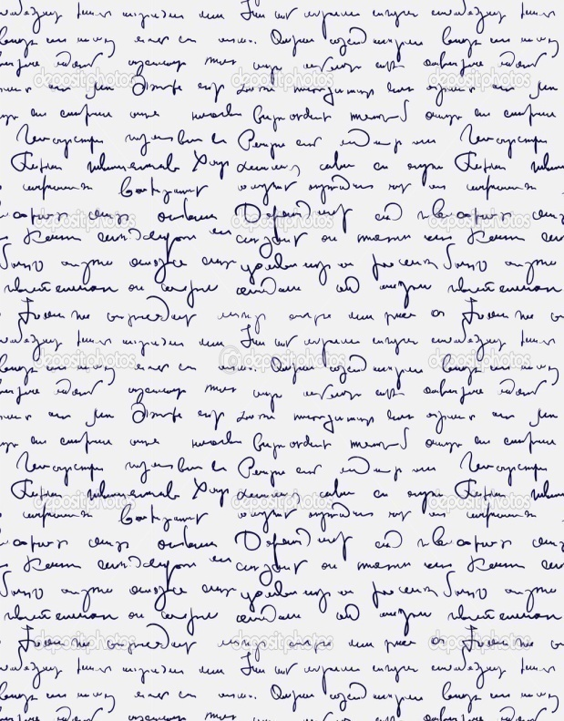

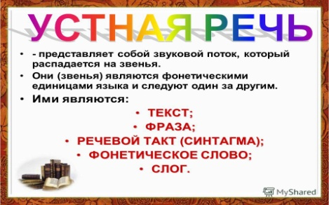
The flow of speech
Written speech
Oral speech
Neither articulatory nor acoustically is it divided into sounds
This is a purely linguistic phenomenon

Slide 13

Black clouds covered the sun
Words
Syntactic function
Morphological structure
Lexical meaning
Morphemes
Lexical meaning
Grammar meaning
Sounds
Associative analysis
Minimal pairs
Morphemic juncture

Slide 14

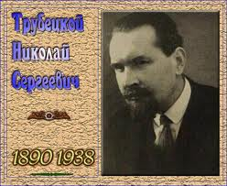
Associative analysis – N. Trubetzkoy
Born 4 (16). 04. 1890 in Moscow
Died on 25.06. 1938 (aged 48 ) in Viena
Linguistic imput:
the phoneme theory
structural method
«Principles of Phonology»
Comes from aristocratic family
His father was the rector of Moscow University
His uncle was a well-known philosofer
His brother was a writer
Notes:
http://ref.repetiruem.ru/referat/prazhskijj-lingvisticheskijj-kruzhok

Slide 15
There are five phonemes in the word DUTY because we meet them in many other words
This method is based on psychological associations and is very subjective
[d]
[j]
[uː]
[t]
[ɪ]
day dog
union few Tuesday
fool cool
thirty fortress
pity dusty

Slide 16
Associative analysis week points
Subjective methods are not reliable
Different phonemes may be viewed upon as one and the same by nonnative speakers
tin ten tan ten thirty
Compound phonemes like diphthongs can get split and give an effect of two different phonemes
there they now know

Slide 17
Minimal pairs
Introduced by N. Trubetzkoy in his “Principals of Phonology”, this method of speech flow segmentation became popular the world over.
It is based on the opposition of phonemes and their ability to distinguish pairs of words in meaning.

Slide 18
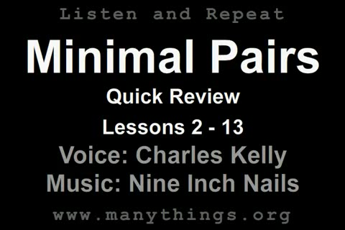
Minimal pairs are pairs of words that differ in one sound and have different meaning tip – tap - top - pin – pen – pan - fan - man – tan – pan
The weak points
The number of minimal pairs in the language is limited
You can also get a wrong impression that phonemes are meaningful units of the language

Slide 19
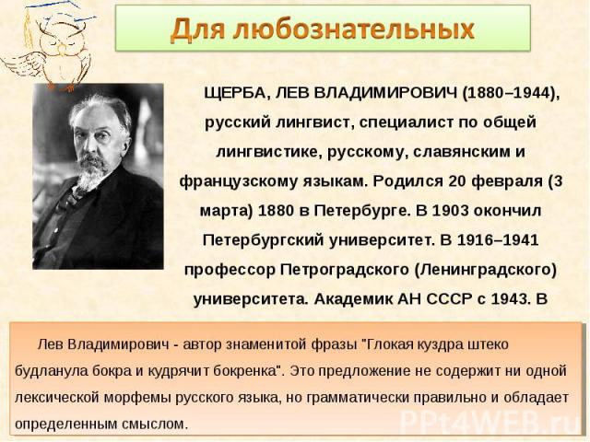
Morphemic juncture
Lev Shcherba, Mauroce Grammont

Slide 20

St. Petersburg State University, Dept. of Phonetics

Slide 21
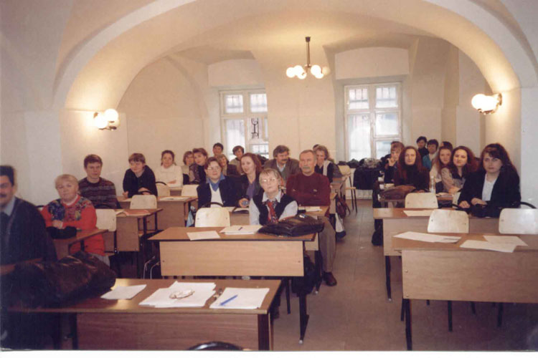
St.Petersburg State University, dpt for phonetics

Slide 22
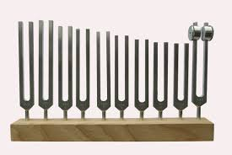
St.Petersburg State University, dpt for phonetics
Pitchforks

Slide 23
Morphemic juncture
Lev Shcherba, Mauroce Grammont
The method states that:
The flow of speech segmentation is possible only phonologically but not phonetically.
Being a non-meaningful unit of the language, the phoneme, nevertheless, is potentially connected with the lexical or grammatical meaning within the morpheme.
The systematic approach to the language is very important

Slide 24
Morphemic juncture: actor
If two sounds find themselves on the morphemic juncture, they are divisible: act -or
The morphemic junctures must exist in the system of the language, not at all in one word: ac-t because of pick-ed
We will find it difficult to divide ac, so we’ll have to look for another method: act-ant.

Slide 25
Morphemic juncture: weak points
too complicated;
the number of morphemic junctures is limited even in the language system;
requires the application of the method of minimal pairs.

Slide 26
The result of the flow of speech segmentation: what is next?
Which sounds belong to one and the same phoneme?
Which sounds belong to different phonemes?
The idea of a Distribution - this is what can help

Slide 27
Phonemes, allophones and optional variants
Types of units | Types of distribution
Phonemes | Contrast
Allophones | Complementary
Optional variants | Free variation

Slide 28
The rules:
If two sounds can meet in one and the same position and the meaning of the word changes – these sound belong to two different phonemes because they are found in the distribution of contrast. [pin] [pen]
If two sounds with more or less similar features never meet in one and the same position but compliment each other - they are allophones of one phoneme, because they are found in a complementary distribution. [til] – [to:l]
If two sounds do meet in one and the same position but the meaning of the is not changed – they are optional variants of the phoneme and they find themselves in the distribution of free variation. When

Slide 29
Phonemic inventory and system
The system of phonemes is the relationship of phonemes between each other

Slide 30
System features
The relations between phonemes in the system are permanent.
Single phonemes are in certain relations among themselves.
Not only individual phonemes, but also groups of phonemes are in certain relations among themselves.

Slide 31
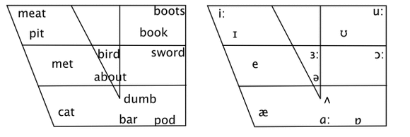
What makes it possible?
Each phoneme is a combination of phonologically relevant and irrelevant features.
Phonologically relevant features are constant distinctive features.
Irrelevant features unite phonemes.

Slide 32
The theory of phonological oppositions
To study the system of phonemes is to study the oppositions they form in the language.
Opposition is a unit in which a sound can differentiate the meanings of two words.
N. Trubetzkoy developed the classification of phonological oppositions

Slide 33
To study the system of phonemes is to study the oppositions they form in the language.

Slide 34
Types of phonological oppositions
The oppositions are classified on the basis on:
relation to members of the opposition:
private [p]-[b]
gradual [i]- [e ]- [æ]
equipollent oppositions [f]-[k]

Slide 35
Types of phonological oppositions
Classification of oppositions in their relation to the system of oppositions as a whole:
multidimensional and one-dimensional
w-h p-b
isolated and proportional oppositions.
w-h p-b t-d k-g

Slide 36
Classification of oppositions by the degree of their sense-distinguishing force or effectiveness in various positions:
permanent and neutralized opposition
Only one-dimensional oppositions can be neutralized

Slide 37
Neutralized opposition
Russian voiced consonants
пруд – прут
луг – лук
English unstressed vowels shwa
Subject – object
Subject – object

Slide 38
The result of neutralization
School | Unit | Result
Prague school | Archiphoneme | Only irrelevant features
Moscow school | Hyper phoneme [t / d] | Both relevant and irrelevant features
St.Peterburg school | Phoneme | The phoneme we hear

Slide 39
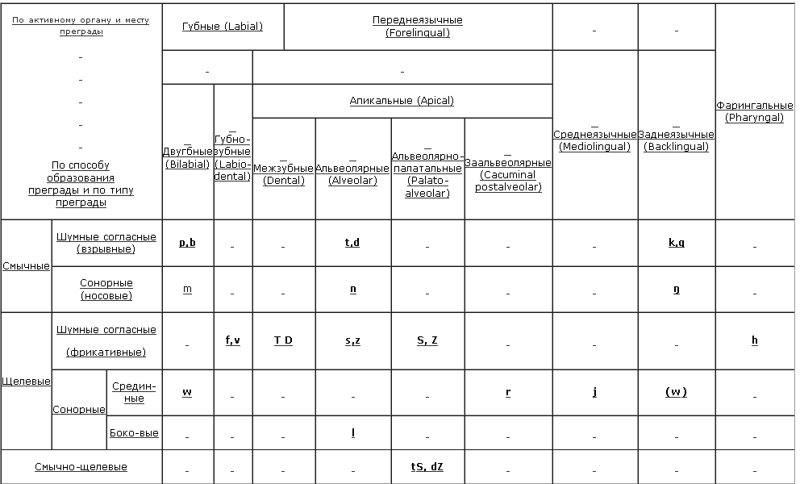
Practical application
Classifications

Slide 40
Phonemic inventory
Phonemic inventory is the total number of phonemes functioning in the language
English: 44 = 20 + 24
There are difficult cases

Slide 41
Difficult cases
Vowels: schwa, diphthongs triphthongs
Consonants: sonants, affricates, w-wh, h- [ŋ]

Slide 42


Attendance check-up
Now you are welcome to give examples
illustrating the basic functions of the phoneme

Slide 43

Thank you for attention!
ivoytovich@yandex.ru

