Slide 1
Lope de Vega
Castelvines y Monteses (1609)

Slide 2
Lope de Vega
Castelvines y Monteses (1609)
Three English translations:
Cynthia Rodriguez-Badendyck (1998), Castelvines and Monteses
Gwynne Edwards (2005), The Capulets and Montagues
Dakin Matthews (2009, 2011), The Capulets and the Montagues

Slide 3
ROSELO
¡Ay, cielos, que fui Montés!
¿No fuera yo Castelvín?
¿Tanto le costaba al cielo?

Slide 4
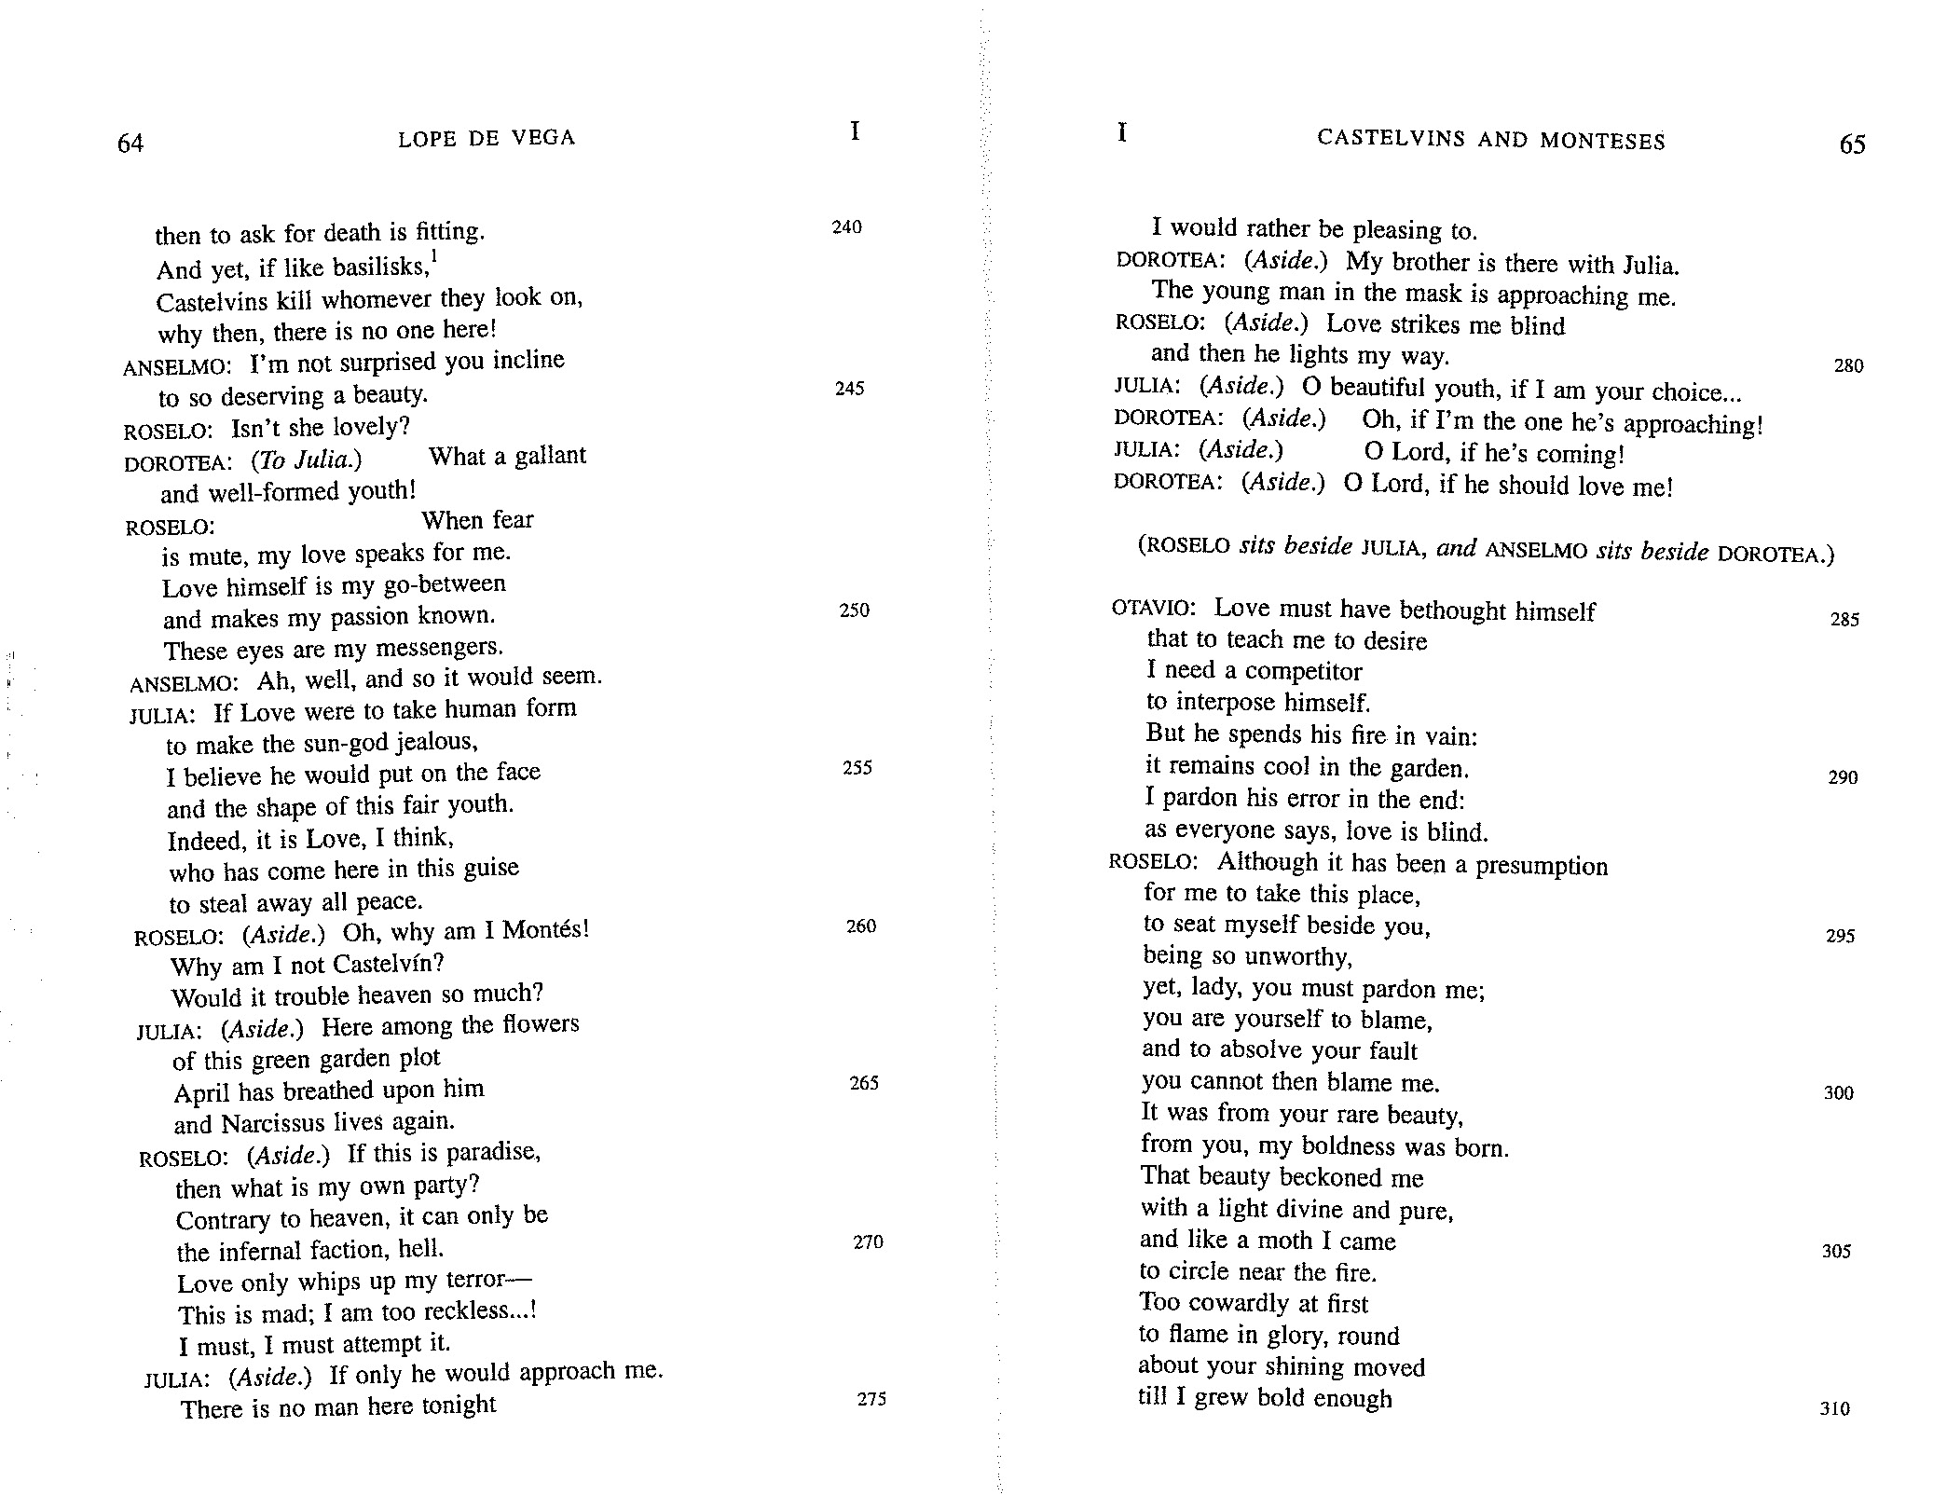
ROSELO
¡Ay, cielos, que fui Montés!
¿No fuera yo Castelvín?
¿Tanto le costaba al cielo?
Cynthia Rodriguez-Badendyck

Slide 5
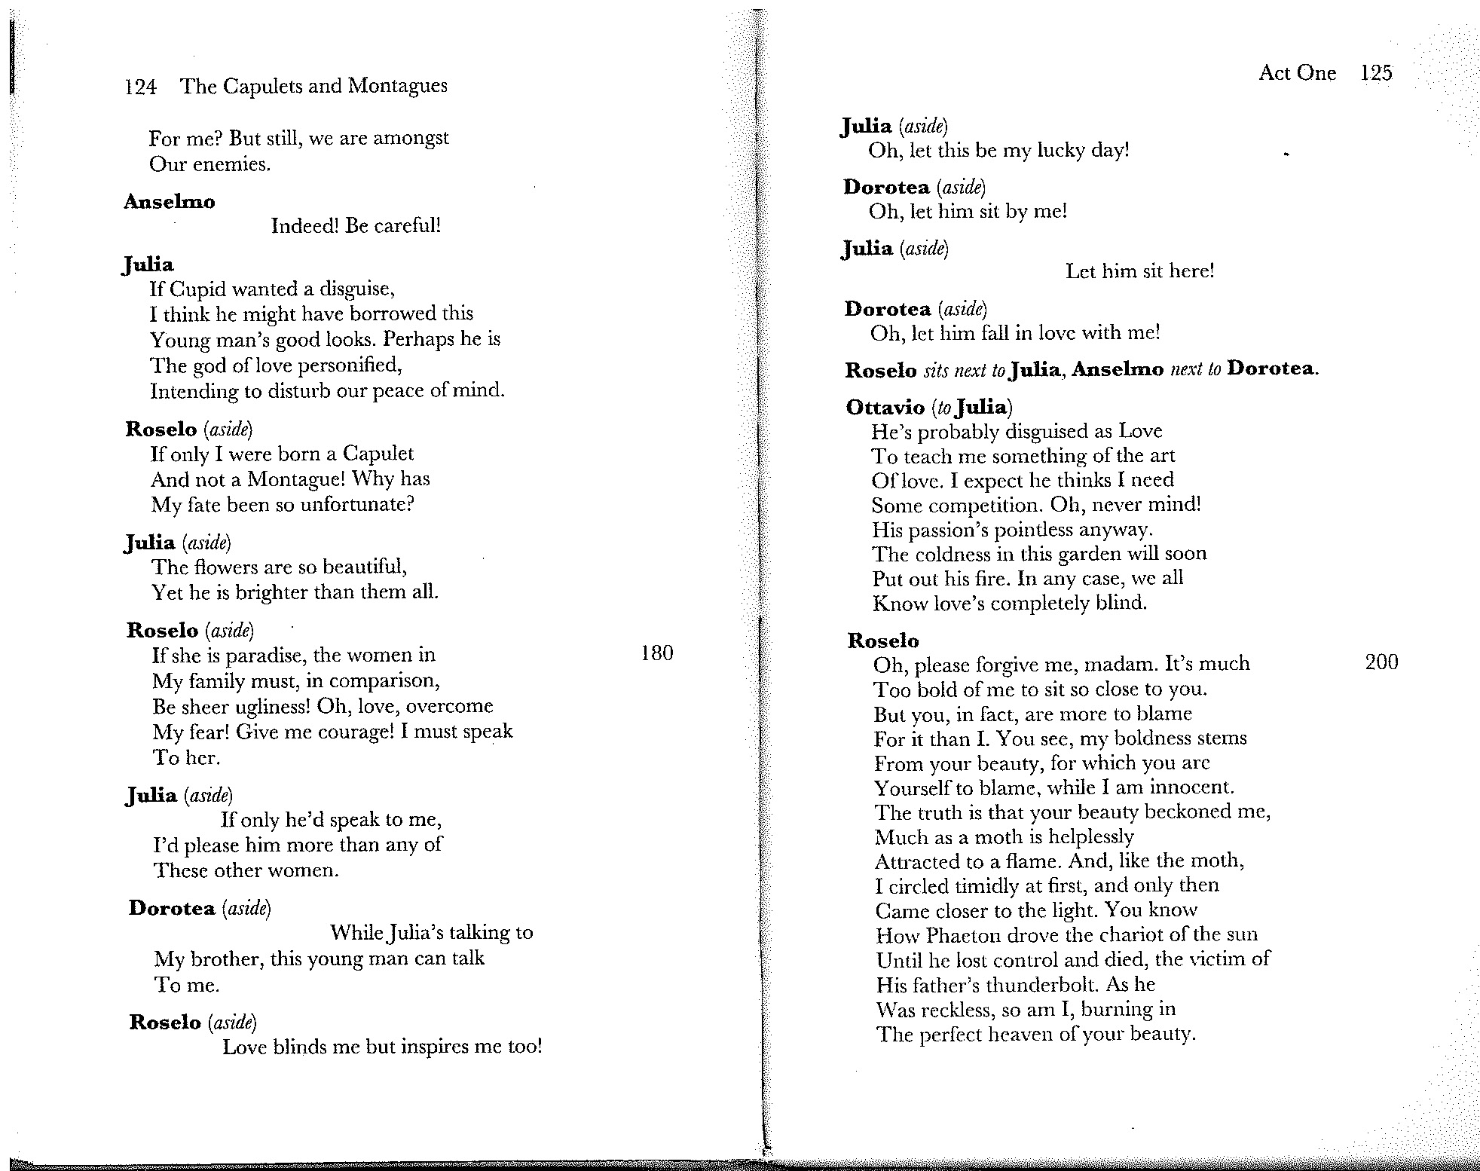
ROSELO
¡Ay, cielos, que fui Montés!
¿No fuera yo Castelvín?
¿Tanto le costaba al cielo?
Cynthia Rodriguez-Badendyck
Gwynne Edwards

Slide 6
ROSELO
¡Ay, cielos, que fui Montés!
¿No fuera yo Castelvín?
¿Tanto le costaba al cielo?
Cynthia Rodriguez-Badendyck
Gwynne Edwards
Dakin Matthews
Romeo. (Aside) God! Why am I a Montague!
Why not a Capulet born and bred?
Would that have been so hard for God?

Slide 7
Cynthia Rodriguez-Badendyck
JULIA
¡Oh, si se llegase a mí,
que de cuantas hay aquí,
más lo pienso agradecer!
DOROTEA
Mi hermano con Julia está,
sin duda que a mí se llega
la máscara.
ROSELO El amor me ciega,
y el mismo me alumbra ya.
JULIA
¡Ay, mancebo, si yo fuese
tan dichosa!
DOROTEA ¡Ay, si tomase mi lado!
JULIA
Ay Dios, si llegase.
DOROTEA
Ay Dios, si amor me tuviese.

Slide 8
Cynthia Rodriguez-Badendyck
Gwynne Edwards

Slide 9
Dakin Matthews
Juliet. (Aside)
Oh if, of all the women here,
That young man chooses me to be near,
I’ll be so kind and welcoming!
Dorothea. (Aside)
My brother and Juliet are in talk;
Surely, that masked one’s coming towards me!
Romeo
Love that will not let me see,
Yet lights the way whereon I walk.
Juliet. (Aside)
Oh youth, if so blest I could be!
Dorothea. (Aside)
Oh, Heaven, if only he’d come near!
Juliet. (Aside)
O Lord, I think he’s coming here!
Dorothea. (Aside)
O God, if he’d just make love to me!
Cynthia Rodriguez-Badendyck

Slide 10
ROSELO
¡Ay, cielos, que fui Montés!
¿No fuera yo Castelvín?
¿Tanto le costaba al cielo?
Cynthia Rodriguez-Badendyck
Gwynne Edwards
Dakin Matthews
Romeo. (Aside) God! Why am I a Montague!
Why not a Capulet born and bred?
Would that have been so hard for God?

Slide 11
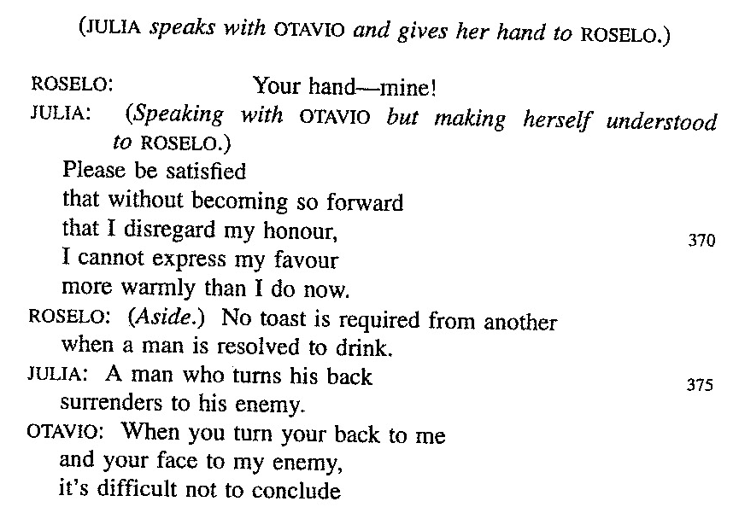
Cynthia Rodriguez-Badendyck

Slide 12
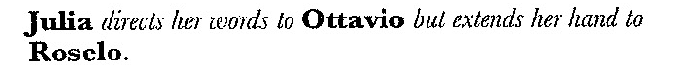
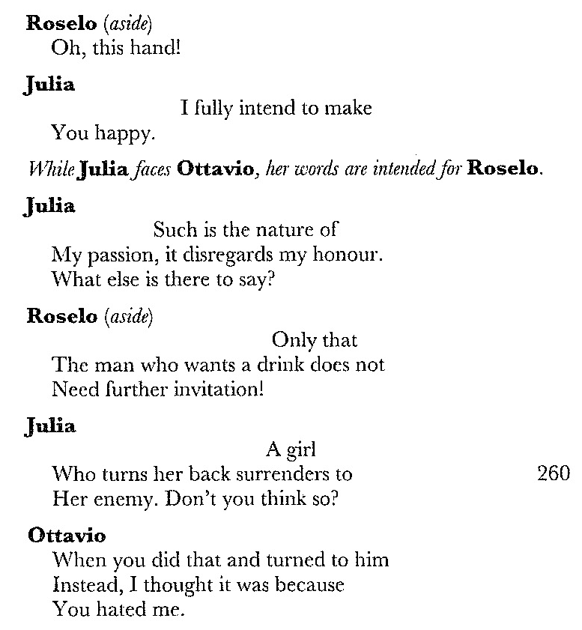
Cynthia Rodriguez-Badendyck
Gwynne Edwards

Slide 13
Dakin Matthews
(Juliet speaks to Octavio, but gives her hand to Romeo.)
Romeo. (Aside) My hand!
Juliet.
I need you, sir, to clearly see
(She speaks to Octavio, but intends it for Romeo.)
And be satisfied with this from me,
For short of behaving in a way
That would dishonor me, I may
Not favor you more openly.
Romeo. (Aside)
So long as I get to drain the cup,
Who cares if she toasts him and not me?
Juliet.
And turning one’s back on a foe can be
A sign of surrender and giving up.
Octavio.
But when you turned your back on me,
And showed your face to my foe instead,
I had to think what your gesture said
Was that you despised me utterly.
Cynthia Rodriguez-Badendyck

