Slide 1
Adaptace a překlad pro divadlo
5. dubna 2018

Slide 2
Roman Jakobson, “On Linguistic Aspects of Translation” (1959)
3 types of translation:
intralinguistic
interlinguistic
intersemiotic

Slide 3
ambice (Ambition)
poslání (Mission)
zakázka (Commission)
vnější vlivy (Exigencies)
dispozice (Conditions)
dokumentace (Presentation), vč. historiografie

Slide 4
Translation Criteria
(1) literary criteria
(2) cultural criteria
(3) acoustic criteria
acoustic temporhythm (rhytmical impulse)
euphony and cacophony
acoustic “colour” of the translation (directions of sound, voice, sung lyrics)
ostension of the language
poetic qualities (poetic function)
(4) actorly criteria
(5) stage criteria

Slide 5
Actorly Criteria
speakability (pronouncibility)
breathability (Atembarkeit): breath scenario
rhythm
Iul. O Romeo, Romeo, wherefore art thou Romeo?
Denie thy Father and refuse thy name:
Or if thou wilt not, be but sworne to my Loue,
And Ile no longer be a Capulet. (RJ F1 2.1.75–78)
gestus (oral gesture)
Come sir, to draw toward an end with you. (Ham 3.4.190)
character determinateness; character individuation
impersonation (embodiment) level; stage presence of the dramatic characters

Slide 6
Actorly Criteria
speakability (pronouncibility)
breathability (Atembarkeit): breath scenario
rhythm
gestus (oral gesture)
character determinateness; character individuation
impersonation (embodiment) level; stage presence of the dramatic characters
Sat. Romaines do me right.
Patricians draw your Swords, and sheath them not
Till Saturninus be Romes Emperour: (Tit F1 1.1.203–205)

Slide 7
Stage Criteria
theatre acoustics
literariness of the script
irony, dramatic irony, wordplay, (meta)theatrical joke, expressivity, Verfremdunseffekt
shifts and consistency; dialogism (heteroglossia) and monologism: also sequential and synchronous construction (dramatic polyphony and homophony)
situational determinateness; the measure explicitneess and interpretation in presenting a dramatic moment

Slide 8
Stage Criteria
the text’s incorporation into the action
mere language cannot contain what [characters] need to communicate to one another. No matter how consciously articulate the speaker, no matter how artful the poetry, language is never the most important thing that is going on; it is irradiated by the dramatic situation, and is merely, as it were, “the vehicle of the soul.”
[This concrete passage] can seem on first reading to be both overwrought and overlong. In fact, it is one of the pitfalls of reading what is in essence a theatrical blueprint to lose the situation for the words. What has happened on stage [… Of that] Apprehension in the audience is immediate, and builds during [the character’s] speech, which is not dramatically the curious academic exercise it in part appears, but rather a device for tightening and tightening the fearful tension [of the situation…]. All he has are desperate, inadequate words. Again language has tremendous importance, and control of it is crucial, not for its own sake, but for the sake of what needs to be conveyed. (Rodriguez-Badendyck 1985: 22)

Slide 9
Stage Criteria
rhythmical structuring:
(i) dynamics of the speaches
(ii) dynamics of sequences (beats)
Ile rather be vnmannerly, then troublesome: you doe your selfe
wrong indeede-la. (MWW F1 1.1.292–293)
I pray you be gon: I will make an end of my dinner; ther’s Pippins
and Cheese to come. (MWW F1 1.2.12–13)
Thou art the Mars of Malecontents: I second thee: troope on.
(MWW F1 1.3.96–97)
Fare-well to your Worship: truely an honest Gentleman: but
Anne loues him not: for I know Ans minde as well as another
do’s: out vpon’t: what haue I forgot. (MWW F1 1.4.158–160)
(iii) character dynamics
(iv) interaction dynamics

Slide 10
Stage Criteria
rhythmical structuring:
(i) dynamics of the speaches
(ii) dynamics of sequences
(iii) character dynamics: empathy and provocativeness of characters (eg. Othello or Richard III)
(iv) interaction dynamics: between individual characters and between the stage and the auditorium

Slide 11
The Translator’s Task
translating the “myth” (canonicity)
consistency / inconsistency
  coherence principles or semantic continuums
translation “mask”
the myth of modern language, authorial style, and comprehensibility:
Oph. What meanes this, my Lord?
Ham. Marry this is Miching Malicho, that meanes Mischeefe. (Ham F1 3.2.130–132)
parodia and anticipated ostension
actorly polyphony:
  intonation | word | body language

Slide 12
Charles Dickens, A Tale of Two Cities (1859)
Chapter I
The Period
It was the best of times, it was the worst of times, it was the age of wisdom, it was the age of foolishness, it was the epoch of belief, it was the epoch of incredulity, it was the season of Light, it was the season of Darkness, it was the spring of hope, it was the winter of despair, we had everything before us, we had nothing before us, we were all going direct to Heaven, we were all going direct the other way--in short, the period was so far like the present period, that some of its noisiest authorities insisted on its being received, for good or for evil, in the superlative degree of comparison only.
There were a king with a large jaw and a queen with a plain face, on the throne of England; there were a king with a large jaw and a queen with a fair face, on the throne of France. In both countries it was clearer than crystal to the lords of the State preserves of loaves and fishes, that things in general were settled for ever. […]

Slide 13
[…] It is likely enough that, rooted in the woods of France and Norway, there were growing trees, when that sufferer was put to death, already marked by the Woodman, Fate, to come down and be sawn into boards, to make a certain movable framework with a sack and a knife in it, terrible in history. It is likely enough that in the rough outhouses of some tillers of the heavy lands adjacent to Paris, there were sheltered from the weather that very day, rude carts, bespattered with rustic mire, snuffed about by pigs, and roosted in by poultry, which the Farmer, Death, had already set apart to be his tumbrils of the Revolution. But that Woodman and that Farmer, though they work unceasingly, work silently, and no one heard them as they went about with muffled tread: the rather, forasmuch as to entertain any suspicion that they were awake, was to be atheistical and traitorous.

Slide 14
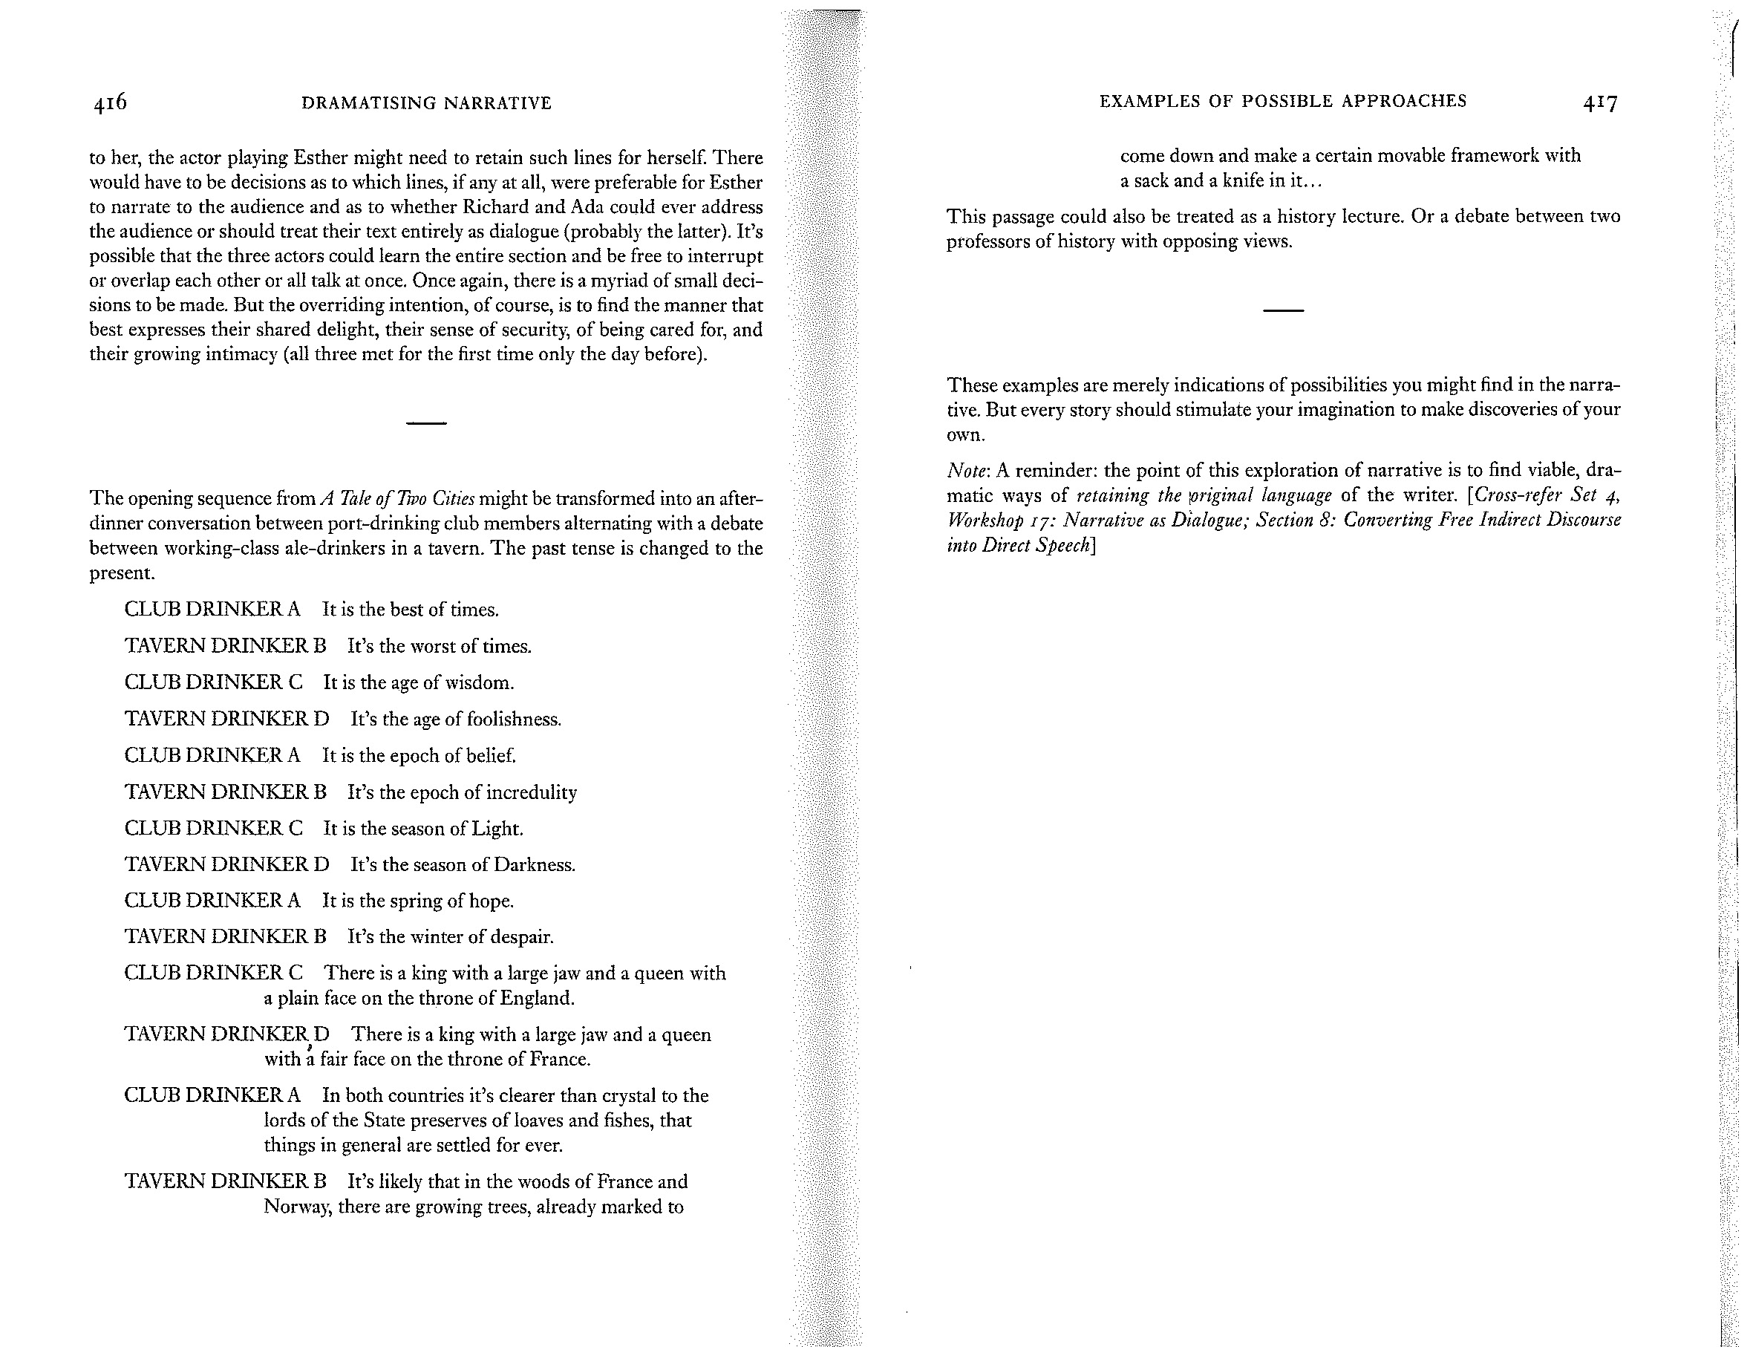
Mike Alfreds. Then What Happens? Storytelling and Adapting for the Theatre. London: Nick Hern, 2013.

Slide 17
Bibliography
Aaltonen, Sirkku. 2000. Time-Sharing on Stage: Drama Translation in Theatre and Society. Clevedon: Multilingual Matters.
Bassnett, Susan. 1991. Translation Studies [1980]. Upravené vydání. London: Methuen, 1996.
Bassnett, Susan. 2013. Translation. London: Routledge.
Brodie, Geraldine. 2018. The Translator on Stage. London: Bloomsbury.
Cetera, Anna. 2008. Enter Lear: The Translator’s Part in Performance. Warsaw: WUW.
Coelsch-Foisner, Sabine, a Holger Michael Klein, ed. 2005. Drama Translation and Theatre Practice. Frankfurt am Main: Peter Lang.
Drábek, Pavel. 2012. České pokusy o Shakespeara. Brno: Větrné mlýny.
Homem, Rui Carvalho, a Ton Hoenselaars, ed. 2004. Translating Shakespeare for the Twenty-First Century. Amsterdam and New York: Rodopi.
Hoenselaars, Ton, ed. 2004. Shakespeare and the Language of Translation. The Arden Shakespeare: Shakespeare in Language. London: Thomson Learning.
Johnston, David, ed. 1996. Stages of Translation: Essays and Interviews on Translating for the Stage. Bath: Absolute Classics.
Johnston, David. 2015. Translating the Theatre of the Spanish Golden Age: A Story of Chance and Transformation. London: Oberon Books.
Kamenická, Renata, Markéta Polochová a Lucie Seibertová, ed. 2012. Kontury dramatického překladu. Zvláštní číslo Theatralia 15.1. http://digilib.phil.muni.cz/handle/11222.digilib/124377

Slide 18
Bibliography (cont.)
Krebs, Katja, ed. 2014. Translation and Adaptation in Theatre and Film. London: Routledge.
Mathijssen, Jan Willem (2007). The Breach and the Observance: Theatre retranslation as a stratégy of artistic differentiation, with special reference to retranslations of Shakespeare’s Hamlet (1777–2001). Utrecht University. http://www.dehamlet.nl/BreachandObservance.pdf
Romanowska, Agnieszka. 2005. Hamlet po polsku: teatralność szekspirowskiego tekstu dramatycznego jako zagadnienie przekładoznawcze. Kraków: Księgarnia Akademicka.
Totzeva, Sophia. 1995. Das Theatrale Potential des dramatischen Textes: Ein Beitrag zur Theorie von Drama und Dramenübersetzung. Forum Modernes Theater 19. Tübingen: Gunter Narr.
Walton, J. Michael. 2006. Found in Translation: Greek Drama in English. Cambridge: Cambridge UP.
Walton, J. Michael. 2009. Euripides Our Contemporary. London: Methuen.
Walton, J. Michael. 2016. Translating Classical Plays: Collected Papers. London: Routledge.
Zatlin, Phyllis (2005). Theatrical Translation and Film Adaptation: A Practitioner’s View. Clevedon: Multilingual Matters.
Zuber, Ortrun, ed. 1980. The Languages of Theatre: Problems in the Translation and Transposition of Drama. Oxford: Pergamon Press.

