Slide 1
OD APROPRIÁCIE K OTVORENÉMU ZDROJU
http://www.thomson-craighead.net/thap.html http://www.triggerhappy.org/
http://www.triggerhappy.org/
Thomson and Craighead:
TRIGGER HAPPY 1998, web-based video game
arcade game, Space Invaders

Slide 2
Eva and Franco Mattes aka 0100101110101101.ORG
Net art pioneers
Subversive approach
Manipulated videogames
Digital collage...
Radical internet coup:
Vaticano.org:
http://0100101110101101.org/vaticano-org/
http://www.vatican.va/
Fake identity: Darko Maver, The most famous made-up artist 1998 – 1999 http://0100101110101101.org/darko-maver/

Slide 3
OD APROPRIÁCIE K OTVORENÉMU ZDROJU
Hybrids: Online Net Art collages 1998 – 1999
„It is no longer necessary to deface paintings or to put a mustache on postcards of Mona Lisa, now art can be downloaded, modified and uploaded again, with absolute delight“
(Luther Blissett, Art Hacktivism)
http://0100101110101101.org/hybrids/

Slide 4
OD APROPRIÁCIE K OTVORENÉMU ZDROJU
0100101110101101.ORG:
„Copyright is boring“
http://0100101110101101.org/copies/
Hell.com
Art.Teleportacia http://art.teleportacia.org/#CenterOfTheUniverse
Jodi.org

Slide 5
0100101110101101.org
No Fun, 2010, Online Performance
http://0100101110101101.org/no-fun/
My Generation, 2010, Video collage, broken computer
http://0100101110101101.org/my-generation/

Slide 6
OD APROPRIÁCIE K OTVORENÉMU ZDROJU
Cory Arcangel: Super Mario Clouds (2002)
https://www.youtube.com/watch?v=fCmAD0TwGcQ
Cory Arcangel: I Shot Andy Warhol (2002)
https://www.youtube.com/watch?v=Nbej4iuUN4Q
PAPER RAD : Wyld File "Theme Song", 2006
http://www.youtube.com/watch?v=BxzbVpo7zuE

Slide 7
Natalie Bookchin: The Intruder http://vimeo.com/30022802
Tina La Porta: Distance
http://turbulence.org/Works/Distance/fps.html

Slide 9
FLUXUS EFFECT
„The limits of art are never where you expect them to be.“
The Nike Ground 2003 /NIKE PLATZ: http://0100101110101101.org/nike-ground/

Slide 10
Fluxus performance: REENACTMENTS in Second Life
Marina Abramovic and Ulay's Imponderabilia 1977
https://www.youtube.com/watch?v=hnV89ZaXomg
0100101110101101.ORG: Reenactment of Marina Abramovic and Ulay's Imponderabilia. 2007, Synthetic Performance
http://0100101110101101.org/reenactment-of-marina-abramovic-and-ulays-imponderabilia/

Slide 11
REENACTMENTS in Second Life
Touch cinema
Valie Export 1968-71
http://www.youtube.com/watch?v=JGv7F_S-rYk
http://0100101110101101.org/reenactment-of-valie-export-and-peter-weibels-tapp-und-tastkino/

Slide 12
REENACTMENTS in Second Life
0100101110101101.ORG Reenactment of Chris Burden's Shoot 2007, Synthetic Performance
http://0100101110101101.org/reenactment-of-chris-burdens-shoot/
Chris Burden : Shoot, 1971
https://www.youtube.com/watch?v=26R9KFdt5aY

Slide 13
Second Life
Matej Vakula:
Videoinštalácia Československo – Second Life
http://artycok.tv/lang/cs-cz/1453/traumwerk

Slide 15
http://artycok.tv/lang/cs-cz/1453/traumwerk

Slide 16
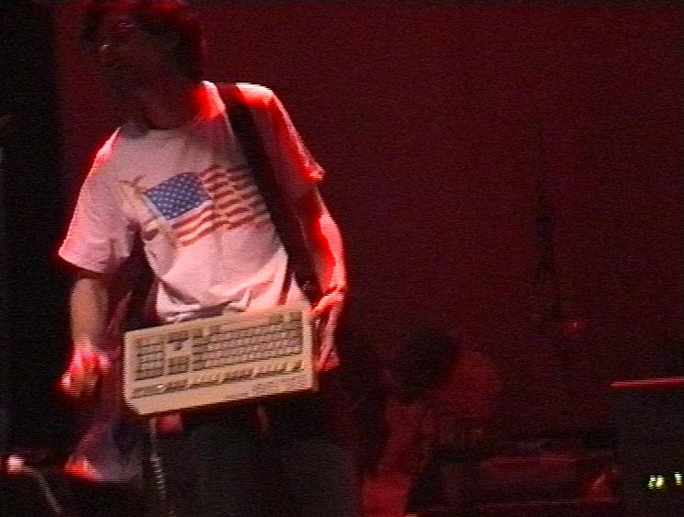
Alexei Shulgin
386 DX, 1998
http://www.easylife.org/386dx/
aesthetics of
obsolence
Aesthetics of
Crudeness
„dirt style“

Slide 17
Alexei Shulgin:
http://www.easylife.org/
FORM ART 1997
http://www.c3.hu/collection/form/
“Turn off the tv set” http://www.desk.nl/~you/turnoff/

Slide 18
Natalie Bookchin, Alexei Shulgin:
March-April 1999: Introduction to net.art (1994-1999)
http://www.easylife.org/netart/

Slide 19
Mark Napier :Digital Landfill 1998
http://potatoland.org/landfill/
Shredder
http://www.potatoland.org/
Mark Napier: Feed 2001 http://potatoland.org/feed/

Slide 20
LIFE SHARING
http://interartive.org/index.php/net-art/
http://0100101110101101.org/life-sharing/

Slide 21
ANGELO PLESSAS: ElasticEnthusiastic, 2004, Courtesy Miltos Manetas collection,
http://www.elasticenthusiastic.com/

Slide 22
MILTOS MANETAS JacksonPollock.org

Slide 23
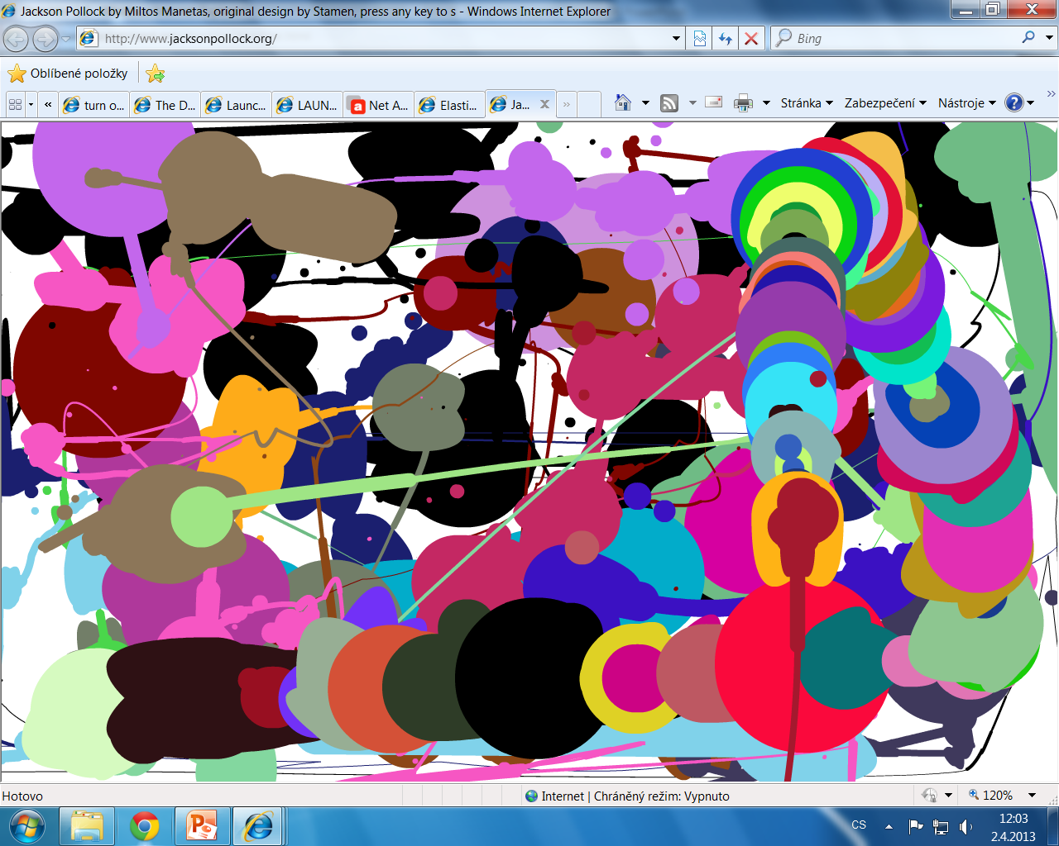
Collective work of art 2.4.2013 IM083

Slide 24
Miltos Manetas :
Jackson Pollock for iPhone:
http://vimeo.com/3099477
SuperMario Sleeping, video, 1998
http://www.supermariosleeping.com/
Flames 1997, By Miltos Manetas. http://www.youtube.com/watch?v=t1Ih5lojELM

Slide 25
Machinima
vytváranie animovaných filmov v reálnom čase prostredníctvom využívania technológie počítačových hier.
Základnou časťou je herný engine - software vytvorený tvorcami PC hier.
Engine má na starosti zobrazovanie grafiky, textúr, osvetlenie zobrazované scény, hernú fyziku. Teda chod celej hry ako takej.
Za pomoci prostredia a pohybových možností, ktoré hra používateľovi poskytuje, môže hráč natočiť vlastný film, podobne, ako je tomu v klasických hraných filmoch.

Slide 26
Machinima
Stanislav Veselovský:movieGAME
Ateliér Digitálne média
http://idm.aku.sk/stanislav-veselovsky/moviegame

