Slide 1
中国文化活动
Chinese cultural activities

Slide 2
chuī méi
吹梅

Slide 3
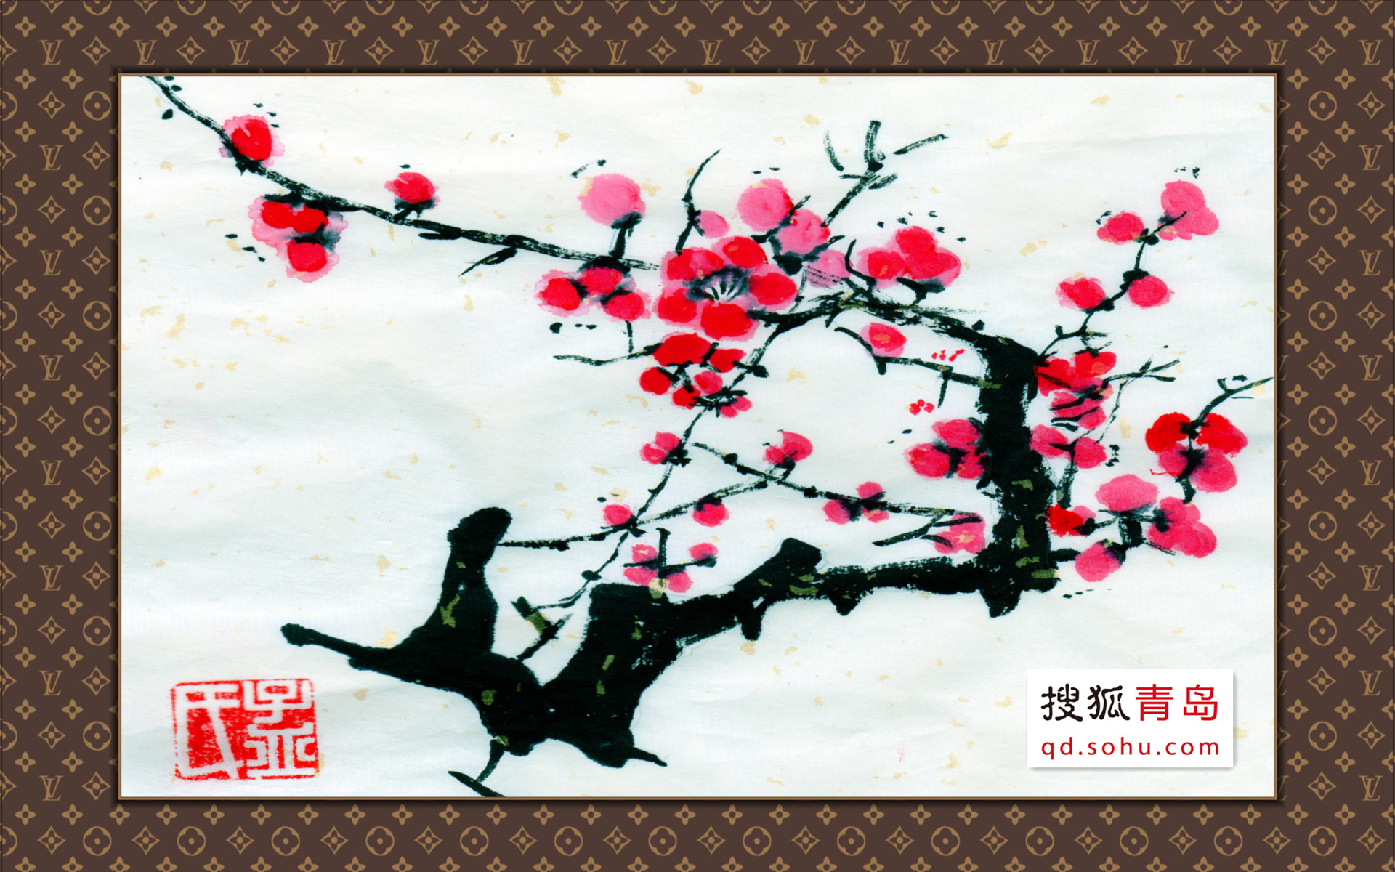
https://www.youtube.com/watch?v=bnvDR9S2UjA

Slide 4
jiǎn zhǐ
剪纸

Slide 5
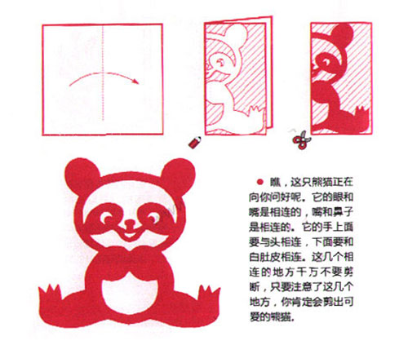

Slide 6
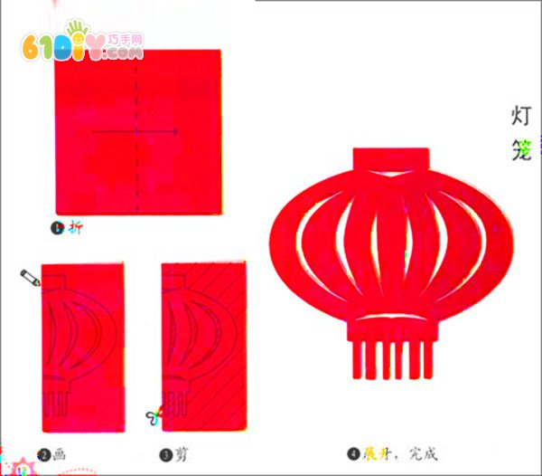

Slide 7
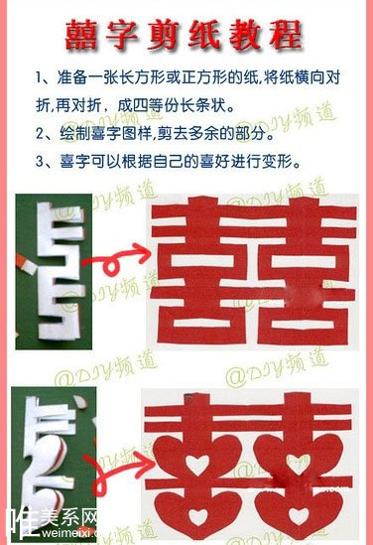

Slide 8
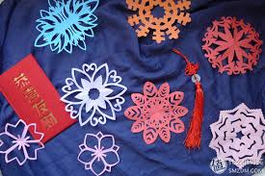
https://www.youtube.com/watch?v=GUZOQdGmprU
https://www.youtube.com/watch?v=mrLvaytBsB4

