Slide 1
Modern Chinese IV
KSCX04

Slide 2
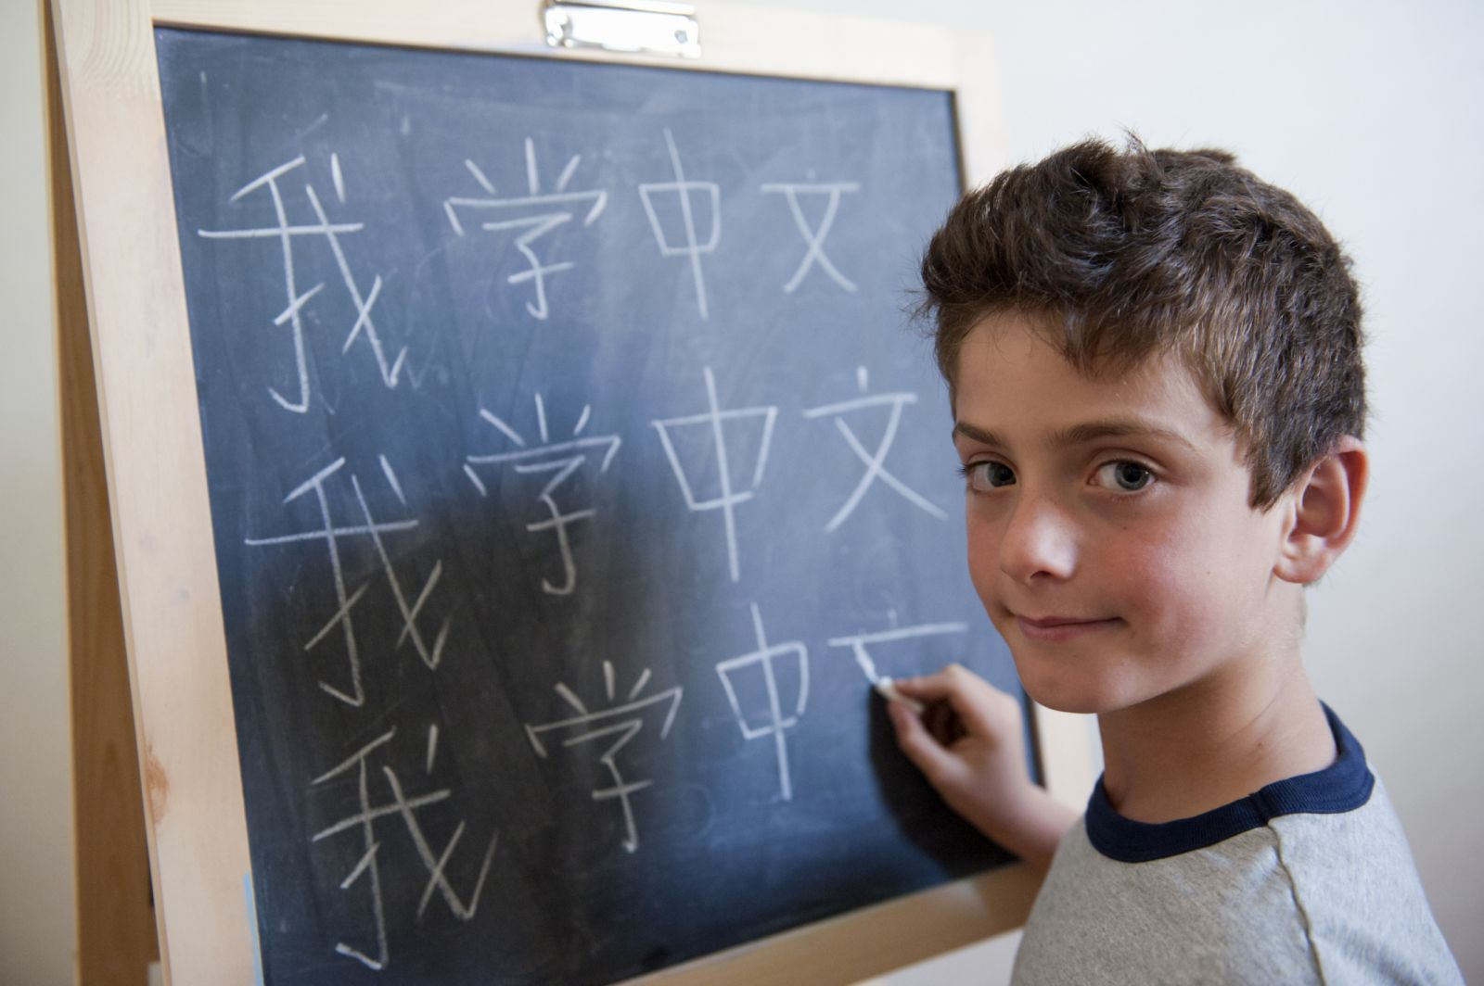
第七课 学中文

Slide 3

Activity
Separate groups and see pictures or vocabulary and chose correct answer.

Slide 4

A 真[zhēn]
B 写[xiě]
C 上个[shàng gè ]

Slide 5

A 真[zhēn]
B 字[zì]
C上个[shàng gè ]

Slide 6

A 说话[shuō huà]
B 懂[dǒng]
C 语法[yǔ fǎ]

Slide 7

A 纸[zhǐ]
B 怎么[zěn me]
C 笔[bǐ]

Slide 8

A 笔[bǐ]
B 怎么[zěn me]
C 生词[shēng cí ]

Slide 9

A shēng cí
B duō
C shuō huà

Slide 10
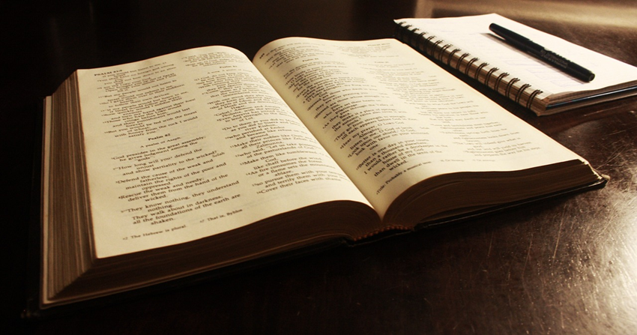
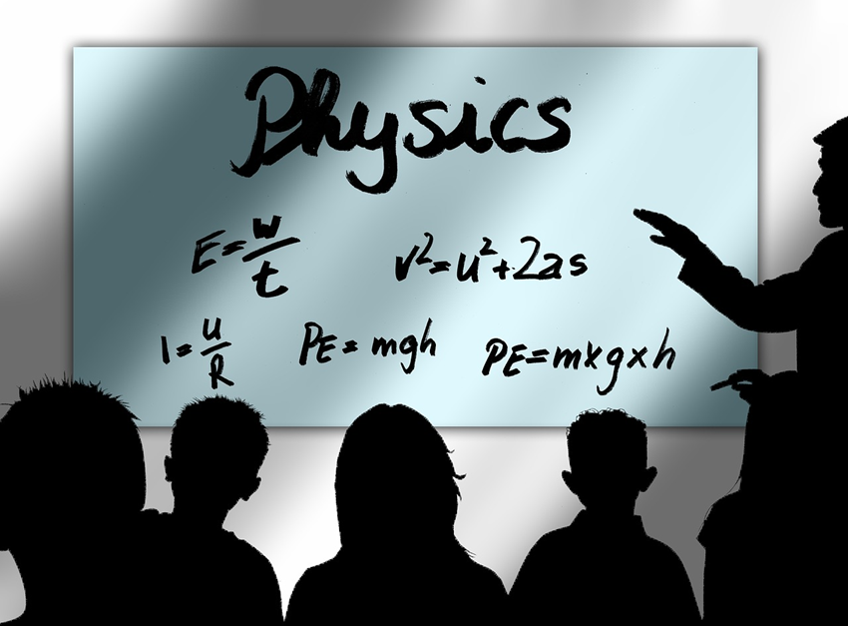
A màn
B nǎ lǐ
C yù xí

Slide 11
A hàn zì
B dǒng
C shēng cí
懂

Slide 12
A màn
B jiāo
C róng yì
容易

Slide 13
A yù xí
B fù xí
C zhī
复习

Slide 14
A xué
B huà
C dì
第

Slide 15
A zhī
B zhǐ
C zì
枝

Slide 16
Activity
Separate groups and see pictures or vocabulary and say it in Chinese.

Slide 17


Slide 18



Slide 21


Slide 22
Activity
Separate groups and vocabulary and say it in Chinese.
After say it in Chinese, try to figure out the meaning and say it in English.

Slide 23
学

Slide 24
怎么

Slide 25
难

Slide 26
预习

Slide 27
语法

Slide 28
张

Slide 29
枝

Slide 30
哪里

Slide 31
第

Slide 32
语法[yǔ fǎ /grammer]

Slide 33
得[de]
Uesd after verb or adjective
Descriptive complement
懂得多
[know a lot]

Slide 34
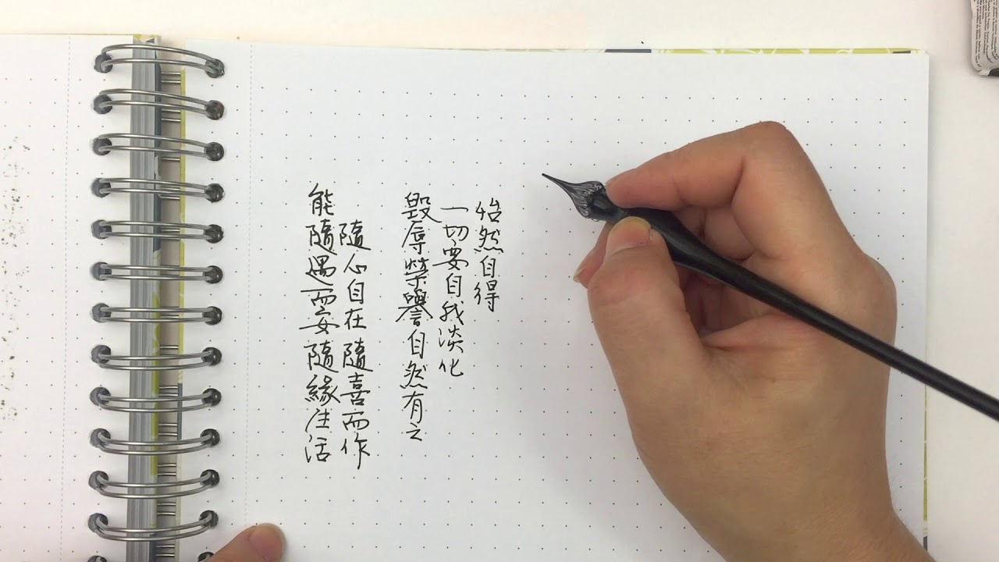

得[de]
写 得 慢
xiě dé màn

Slide 35


得[de]
教 得 好
jiāo dé hǎo

Slide 36
真[zhēn]
really
懂真多
[know really a lot; for objective]
懂得多
[know a lot; for verb]
懂得真多？

Slide 37

真[zhēn]
Really difficult
真 难
Zhēn nán

Slide 38
真[zhēn]
写 真 慢
xiě zhēn màn

Slide 39
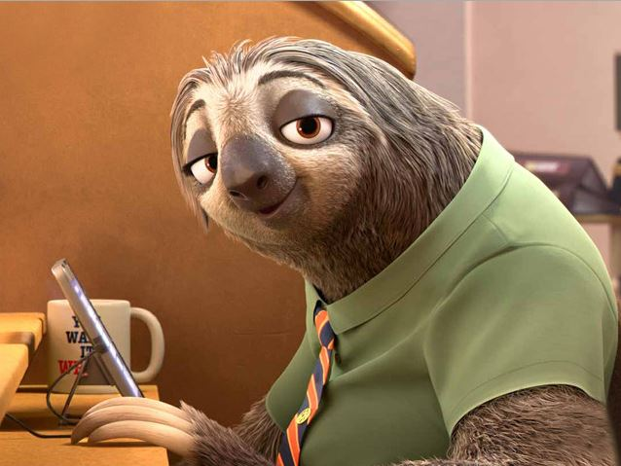
真[zhēn]
写 得 真 慢
xiě de zhēn màn

Slide 40
太[tài]
Too
Usually combine with 了[le]
太多了
[too much]

Slide 41
太[tài]
Too slow
太 慢 了
tài màn le

Slide 42
太[tài]
Too difficult
太难了
难

Slide 43
就[jiù]
Before a verb
To suggestion the earliness, briefness or quickness of action
现在[xiàn zài/now]就写
Write it now

Slide 44

就[jiù]
Learn it now
现 在 就 学
xiàn zài jiù xué

Slide 45
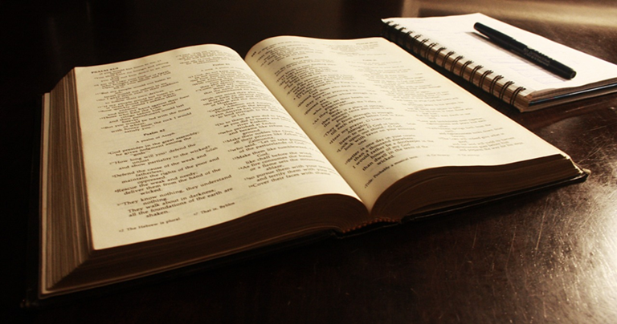
就[jiù]
preview it now
现在 就 预习
xiànzài jiù yùxí

Slide 46
才[cái ] 就
Before a verb
To suggestion the tardiness or lateness of action
现在才写

Slide 47
才[cái ]
现在 才 预习
xiànzài cái yùxí

Slide 48
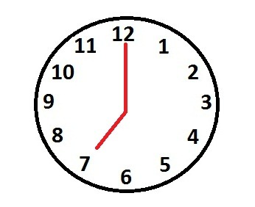
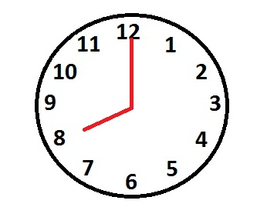
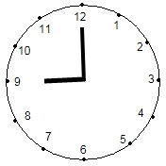
才[cái ]
八点上课[shàng kè]，他七点就来了。
Class started at 8:00, but he come [as early as] 7:00pm.
八点上课，他九点才来
Class started at 8:00, but he didn’t come until 9:00pm.

Slide 49
第[dì]
+ number
第一 [the first]
第二 [the second]
第三 [the third]
第四 [the forth]
…

Slide 50


第[dì]
第几个是中国人？

Slide 51
第[dì]
第几个是中国人？

Slide 52
第[dì]
第几个是中国人？

Slide 53
第[dì]
第几个是中国人？

Slide 54
有[一]点儿
有 [一] 点儿
yǒu yī diǎnr
A little bit
有一点儿难
A little bit difficult
Warning
X 有一点儿容易

Slide 55
有[一]点儿
A little bit much/many
有[一]点儿多

Slide 56
有[一]点儿
A little slow
有[一]点儿慢

Slide 57
Activity
Fulfill the sentence by 语法.

Slide 58
他写字写 得 很好
His writes characters well.

Slide 59

她说话说 得 很慢
She speaks slowly.

Slide 60

汉字 真 的很难
Chinese characters are really difficult.

Slide 61
我的语法 太 不好了!
My grammar is too awful!

Slide 62
生词 太 容易了
Vocabulary is too easy.

Slide 63

你懂 真 多
You understand many things.

Slide 64

现在 就 教我
Teach me now.

Slide 65
我们现在 就 写
We write it now.

Slide 66
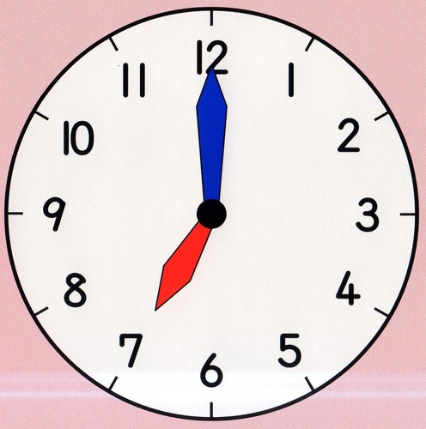
他七点 就 来了。
He come here (as early as) at 7:00pm.

Slide 67




Which one is Czech?[first, second…]

Slide 68
Which one is Czech?

Slide 69
Which one is Czech?

Slide 70
Which one is USA?

Slide 71
中文 有一点儿 难
Chinese a little bite difficult.

Slide 72
这一课生词 有点儿 多
There are a few too many new words in this lesson.

Slide 73

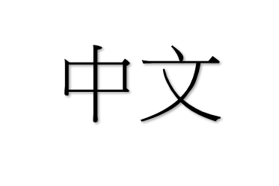
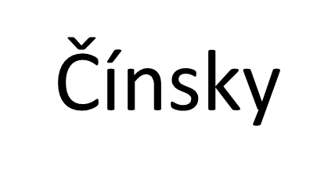
我说中文说得 有一点儿 慢
I speak Chinese a little bit slow.

Slide 74
他写字写 得 真 好
He writes characters really well.

Slide 75
老师教 得 太 慢
Teacher teaches too slow.

Slide 76
Activity
Fulfill the paragraph by 语法.

Slide 77

这一课生词 太多，而老师教得有一点儿快，我还没懂，就到下一张了。而语法真难，我要预习和复习才懂。
有一点儿
太
就
真

Slide 78
Discussion
Talking about how you feel about this class in Chinese.

Slide 79
Discussion
生词
语法
老师
教
得
真
很
太
容易
难

