Slide 1
Human Nature: Key studies in psychology
Cognitive psychology
Lenka Krajčíková

Slide 2
Content
What is CP?
History of CP
Key studies in CP:
Focus on attention, memory and perception

Slide 3
Cognitive psychology
CP = study of mental processes such as:
attention,
language use,
memory,
perception,
problem solving,
creativity,
thinking…

Slide 4
Cognitive psychology
How humans process information

Slide 5
Cognitive psychology

Slide 6
Cognitive psychology
Basic assumptions
Cognitive psychology is a pure science, based mainly on laboratory experiments.
Behavior can be largely explained in terms of how the mind operates, i.e. the information processing approach.
The mind works in a way similar to a computer: inputting, storing and retrieving data.
Mediational processes occur between stimulus and response.

Slide 7
Cognitive psychology
Strenghts:
Scientific
Highly applicable (e.g. therapy, EWT)
Combines easily with other approaches: behaviorism + Cog = Social Learning; Biology + Cog = Evolutionary Psychology
Many empirical studies to support theories
Limitations:
Ignores biology (e.g. testosterone)
Experiments - low ecological validity
Humanism - rejects scientific method
Behaviorism - can’t objectively study unobservable behavior
Introspection is subjective
Machine reductionism

Slide 8
History of cognitive psychology

Slide 9
History
Until 1950s:
Behaviorism as a dominant approach in US psychology
Black box
1950s: Cognitive revolution:
Better experimental methods
Comparison between human and computer processing of information (terminology)
https://www.youtube.com/watch?t=58&v=AeoyzqmyWug
Notes:
But it was the arrival of the computer that gave cognitive psychology the terminology and metaphor it needed to investigate the human mind. The start of the use of computers allowed psychologists to try to understand the complexities of human cognition by comparing it with something simpler and better understood i.e. an artificial system such as a computer.

Slide 10
Attention, Memory and its nature

Slide 11
Attention
Attention as a spotlight

Slide 12
Experimental testing of attention...
Auditory: Dichotic listening task, Cocktail party syndrome.
Visual: visual search:
Feature search
2. Conjunction search
(Pop-out effect)
Analysis of eye movement (eye tracking)

Slide 14
Selective role of attention
Change-blindness experiments:
Video: Count the number of passes!
Video: https://www.youtube.com/watch?v=vJG698U2Mvo

Slide 15
Change blindness / Inattentional blindness
https://www.youtube.com/watch?v=NSCliuAqIG8
https://www.youtube.com/watch?v=E1VyG2Ou-yE
https://www.youtube.com/watch?v=jbJzvZok9PI
https://www.youtube.com/watch?v=ubNF9QNEQLA

Slide 16
Change blindness II.
It´s caused motion signals failed to draw attention
Changes in the centre of visual field draw attention better
Only one change at a time can be detected

Slide 17
Change blindness blindness ☺
Metacognitive error
Participants overestimate their ability to detect change in their visual field
Overestimation not only own ability, but also ability of others
Why? (test situation is compared with real life situations, where there´s easier to detect change)

Slide 18
Memory
What is the nature of memory?

Slide 19
Memory model
Multi-Process model: Atkinson, Brelsford and Shiffrin (1967).
sensory register
memory buffer
long term storage
Short term vs. Long term memory: Miller, 1956; Magic number 7 +/- 2

Slide 20
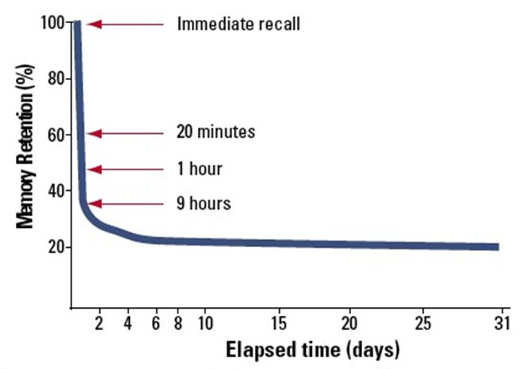
How to test memory?
Ebbinghaus´s studies and forgetting curve
Forgetting curve

Slide 21
Amnesia
https://www.youtube.com/watch?v=Vwigmktix2Y
Retrograde and anterograde amnesia
Korsakoff´s syndrome (residual ability to learn; confabulation)

Slide 22
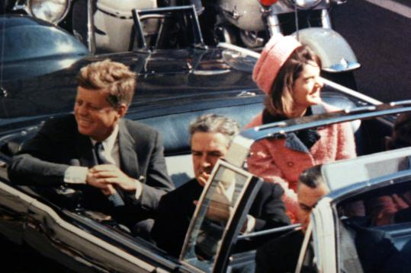
Memory as a camera
Extremely emotional experience
= „flashes“, eidetic memories
(Neisser, Hyman, 1999)
Memories on the crash of Challenger space shuttle, 1 day, 2,5 years later

Slide 23
Memory as a camera
Description 1. “I was in my religion class and some people walked in and started talking about [it]. I didn’t know any details except that it had exploded and the schoolteacher’s students had all been watching which I thought was so sad. Then after class I went to my room and watched the TV program talking about it and I got all the details from that.”
Description 2. “When I first heard about the explosion I was sitting in my freshman dorm room with my roommate and we were watching TV. It came on a news flash and we were both totally shocked. I was really upset and I went upstairs to talk to a friend of mine and then I called my parents.”

Slide 24
Eye-witnesses

Slide 25
Phases of memory process prone to distortion:
Perception and attention focus
Coding in memory
Storing in memory – forgetting
Recall – tendency to confabulate
Variables: time and duration of the event, gender, age, intelligence, „face memory“, emotions, personality,…

Slide 26
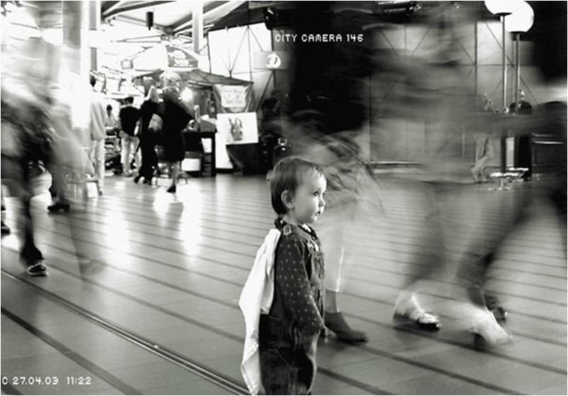
Creation of false memories
Loftus (1993): Lost in a shopping mall
https://www.youtube.com/watch?v=PQr_IJvYzbA
Similar experiments: aminal attack, injury, medical intervention, bullying,…

Slide 27
False memories and recovered memories
Loftus, her research of „false memories“ and case studies: Steve Titus etc.
Cross-racial identification
Line up bias (line up vs. show up)
weapon focus
Etc.

Slide 28
„Recovered memories“
Recommendation no. 1.
Loftus, E.F. & Ketcham, K. (1991). Witness for the Defense; The Accused, the Eyewitness, and the Expert Who Puts Memory on Trial. NY: St. Martin’s Press.

Slide 29
„Recovered memories“
Memories of past trauma, that are repressed and recovered in therapy.
Devis and Bass: The Courage to Heal: A Guide for Women Survivors of Child Sexual Abuse (1988).
Checklist for the victims of rape and abuse, that „helps“ discovering memories of this trauma.

Slide 30
„Recovered memories“ part II.: Satanic cults
Recommendation no. 2.
!!!! Only for those with strong stomach
- In extreme cases „recovered false memories“ reported by not only victims, but also accused.

Slide 31
Thank You!

