Slide 1
Digitální kompetence
Michal Černý
2017

Slide 2
Organisace
Páteční přednášky
Pondělní cvičení
Úkoly:
  Vytvořit vzdělávací modul v Moodle nebo v jiném LMS (respektive ucelený kurz ve skupině)
  Napsat odborný text na téma digitálních kompetencí
  Vytvořit infografiku
  Napsat test
  Bude Libffest? (záleží na vás)
  (recenze na knihu)

Slide 3
Digital Competence
Complex definition
Unclear borders
They can include several different concepts:
  Digital literacy
  Information literacy
  Data Literacy
  Media Literacy
  Computer literacy
  Informative thinking
  New literacy

Slide 4
The Digital Competence Framework 2.0
Digicomp 2.1
  http://publications.jrc.ec.europa.eu/repository/bitstream/JRC106281/web-digcomp2.1pdf_(online).pdf
European Digital Competitiveness Reference Framework
More levels of knowledge and skills
Continuity with national projects

Slide 5
The Digital Competence Framework 2.0
Information and data literacy: To articulate information needs, to locate and retrieve digital data, information and content. To judge the relevance of the source and its content. To store, manage, and organise digital data, information and content.
Browsing, searching and filtering data, information and digital content
Evaluating data, information and digital content
Managing data, information and digital content

Slide 6
The Digital Competence Framework 2.0
Communication and collaboration: To interact, communicate and collaborate through digital technologies while being aware of cultural and generational diversity. To participate in society through public and private digital services and participatory citizenship. To manage one’s digital identity and reputation.
Interacting through digital technologies
Sharing through digital technologies
Engaging in citizenship through digital technologies
Collaborating through digital technologies
Netiquette
Managing digital identity

Slide 7
The Digital Competence Framework 2.0
Digital content creation: To create and edit digital content To improve and integrate information and content into an existing body of knowledge while understanding how copyright and licences are to be applied. To know how to give understandable instructions for a computer system.
Developing digital content
Integrating and re-elaborating digital content
Copyright and licences
Programming

Slide 8
The Digital Competence Framework 2.0
Safety: To protect devices, content, personal data and privacy in digital environments. To protect physical and psychological health, and to be aware of digital technologies for social well-being and social inclusion. To be aware of the environmental impact of digital technologies and their use.
Protecting devices
Protecting personal data and privacy
Protecting health and well-being
Protecting the environment

Slide 9
The Digital Competence Framework 2.0
Problem solving: To identify needs and problems, and to resolve conceptual problems and problem situations in digital environments. To use digital tools to innovate processes and products. To keep up-to-date with the digital evolution.
Solving technical problems
Identifying needs and technological responses
Creatively using digital technologies
Identifying digital competence gaps

Slide 10
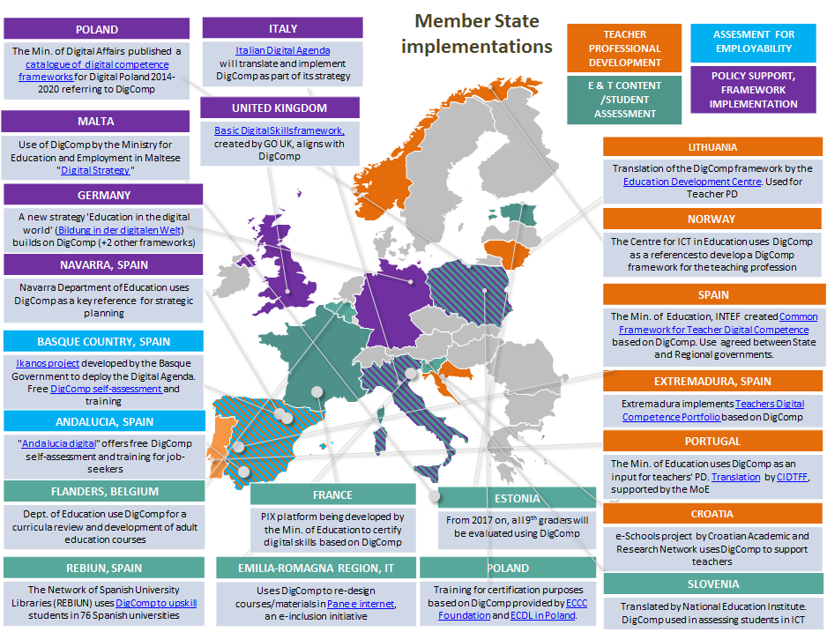

Slide 11
To be continued...

