Slide 1
Pavel Švanda, Milan Uhde, Zdeněk Rotrekl.
On the Historical Memory of Brno.
Zdeněk Mareček,
Letní škola slovanských (bohemisitckých) studií .
Brno 2019

Slide 2
Brünno
Can you still sense the legacy of German-speaking inhabitants of Brno?
When have you first heard of the the expulsion of Germans from Czechoslovakia after World War II?

Slide 3
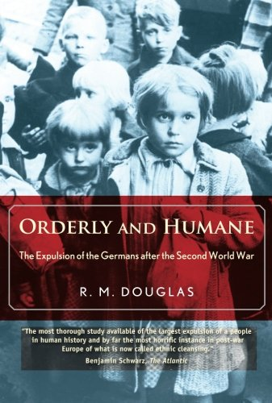
“The ‘Wild Expulsions.’” Orderly and Humane: The Expulsion of the Germans after the Second World War, by R.M. Douglas, Yale University Press, 2012,
On the night of May 30th, 1945, 20.000 people, often women, and children, were forcibly marched to the Austrian border. A number, possibly 1691, died.

Slide 4
Marie Ranzenhoferová, † 2019
https://www.radio.cz/en/section/czechstoday/marie-ranzenhoferova-a-survivor-of-the-1945-brno-death-march
a Czech father and a Hungarian mother. Thanks to her knowledge of both German and Czech, she could stay and work in Perna, a village near Mikulov.
I lived in Modřice, outside Brno, and I had an admirer there whom I rejected. So one day he came to me and said that I had my son with an SS officer, and I had to join the march. But if I went and lived with him, he would turn a blind eye. I told him he could keep his eyes open, that I’d rather go.

Slide 5
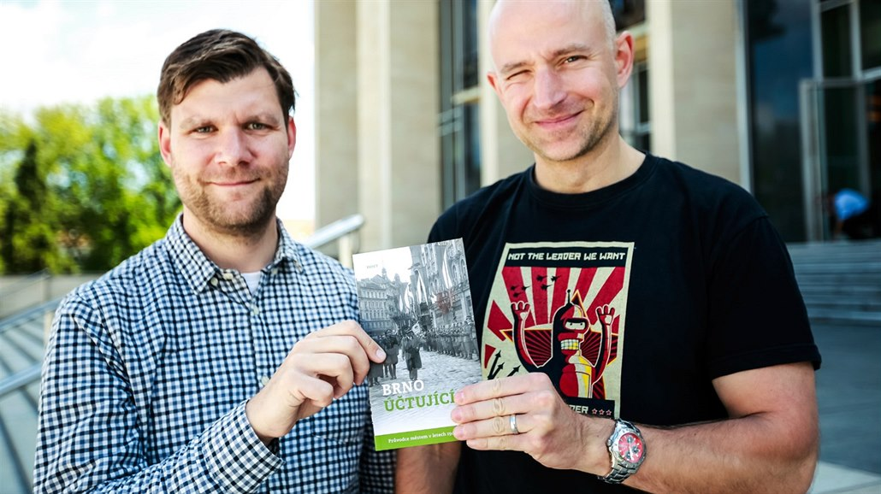
Michal Konečný, Alexandr Brummer: Brno účtující.
Brno: Host, 2017.
More than 16500 German from Brno were interned in the camp Maloměřice-Borky, and 6500 in v Bohunice, before the transports to Germany started.

Slide 6
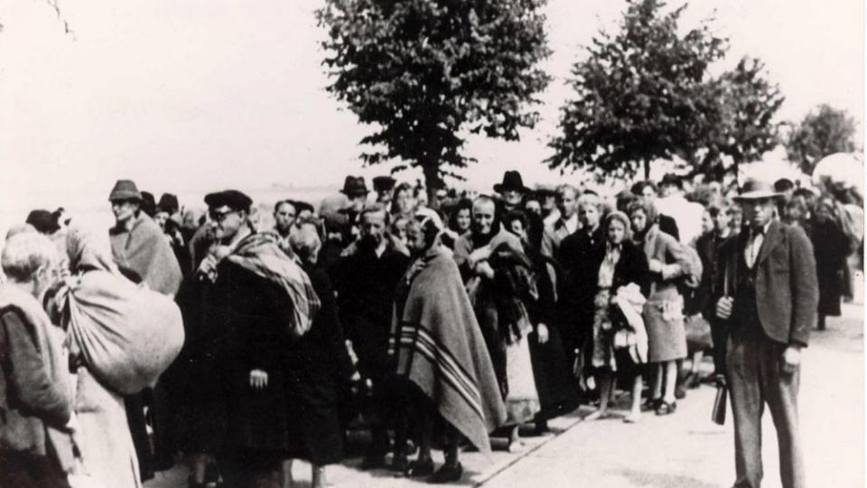
To what extent do Brno natives remember these events and to what extent they suppress the memories?
Title page of Rovnost boasted on June 1st, 1945 that Brno was rid of Germans.
Vyčištěno / cleansing
„Dies Haus ist judenrein“

Slide 7
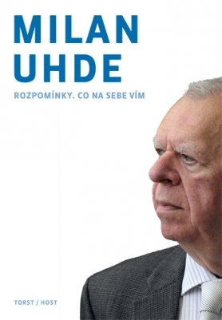
Milan Uhde, nar. 1936. Rozpomínání. Co na sebe vím. (2013).
The history of Brno‘s Germans, which he told in his short story (Jak jsme vítali pana prezidenta) and invited talks (2007 till 2018) are missing.
Why?

Slide 8
Milan Uhde: Má cesta v k našim Němcům (2018)
Ms. Czerná, a German-speaking neighbour in the Kralovo Pole neighbourhood in 1945.
174 people signed a petition for her removal from the expulsion:
During the German occupation, she has been friendly with the Czech-speaking neighbours, did not ask for any preferential treatment, and did not express sympathy towards Hitler.
Uhde‘s parents declined to signe the petition. They commented that they were lawyers and knew that the expulsion order was a law, and you cannot make exceptions to any law. Perhaps, the 9-year old was disappointed?

Slide 9
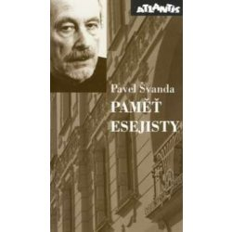
Pavel Švanda, nar. 1936, Paměť esejisty. (2006)
The war atrocities turned into a money spinning business across the literature, film, and beyond. I would have to repeat the cliches.
úhledně zadrátovaný koncentráček

Slide 10
Pavel Švanda, Paměť esejisty.
Just a fleeting remark on the Star of David, which I have seen for the first time while out walking with my mum along Brno‘s Prikop promenade.
„Mum, what is it?“ „Don‘t look that way. Come. Come.“
The Jews were not discussed at home. Considering most of them signed up for the German nationality of the Census, my parents felt that this was largely a German internal war, which need not concern the Czechs too much.

Slide 11
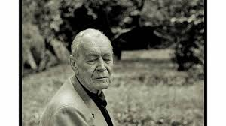
Zdeněk Rotrekl, Hnízda ze stromu, který odchází.
Nevydáno (1920-2013)
Once, I visited a watchmaker, who has admired a large collection of Tyrolean woodcarvings of Madonnas and angels at one German family. A collector through and through. Later, a working class family moved in instead.
How does he continue?

Slide 12

Zdeněk Rotrekl: koláž textů v představení Podezřelá krajina s anděly.
The German collector and his family took the poison in the garden: father, mother, and two daughters. There are an awful number of suicides. – –
From the novel Světlo přichází potmě.

Slide 13
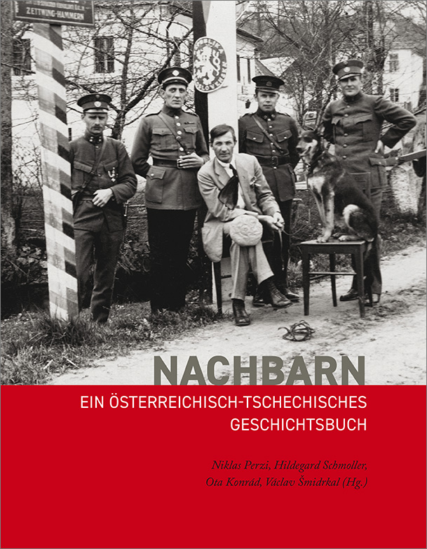
Brno Reviled (Reduta Theater)
Martin Františák and Petr Maška start this cyklus from the history of Brno.
My hope: The development of cadres socieaux and the fearlessness of the authors strengthenes the convergence of European historical memory.

