Slide 1
STELARC: Robotické umenie a performance
Stelarc: The Man with Three Ears, 16m
http://www.dailymotion.com/video/x9tjoe_stelarc-the-man-with-three-ears_creation

Slide 2
1. fáza: telo ako socha- suspensions- koža ako interface
PERFORMANCES: Remote Controlled Suspension
https://www.youtube.com/watch?v=oLjx8j3K6oc&t=11s
Stomach sculpture
https://www.youtube.com/watch?v=IFFizqMmlOQ

Slide 3
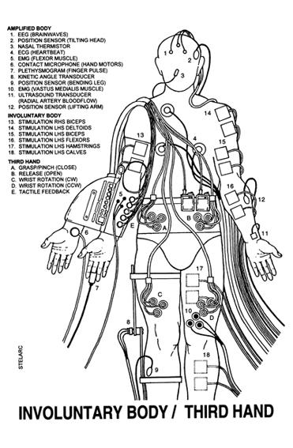
2. fáza: REALIZÁCIA KYBORGA
Extended Arm/THIRD HAND , Mutalogues, Avignon, 2000
https://www.youtube.com/watch?v=PWSYkplTG2s

Slide 4
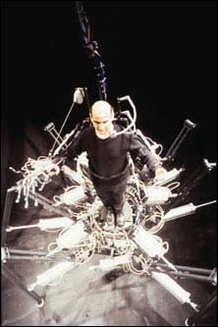
Exoskeleton , Cyborg Frictions, Dampfzentrale, 2003
https://www.youtube.com/watch?v=rTOGhVmye-A

Slide 5
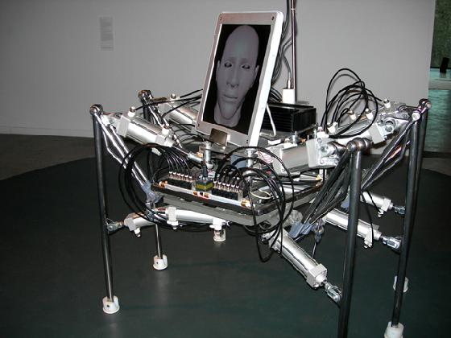
Walking Head , Centre of Life, Newcastle, 2008
https://www.youtube.com/watch?v=4SWoIRlEn6E

Slide 6
3. fáza : Symbióza človeka a stroja
Posthuman
THIRD EAR
https://www.youtube.com/watch?v=k1AhxTbMdF4
https://www.youtube.com/watch?v=fam73mQQhmk

Slide 7
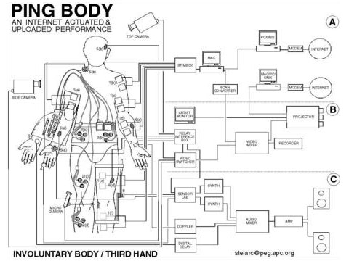
4. fáza: TELEMATIKA-ovládanie tela na diaľku
PING BODY
https://www.youtube.com/watch?v=smdBFx1EYGU

Slide 8
PING BODY
„During the Ping Body performances, what is being considered is a body moving not to the promptings of another body in another place, but rather to Internet activity itself - the body's proprioception and musculature stimulated not by its internal nervous system but by the external ebb and flow of data“

Slide 9
Otvorená diskusia
Ako nahliada Stelarc na ľudské telo?
Akými spôsobmi integruje do tela technológiu a prečo?
Prečo je podľa Stelarca telo zastaralé?
Spočíva evolúca ľudstva v Tretej ruke?

Slide 10
GRINDHOUSE WETWARE
https://www.youtube.com/watch?v=cN6Ok6hqXE4
BIOHACKERS
https://www.youtube.com/watch?v=K0WIgU7LRcI
DONNA HARAWAY: CYBORG MANIFESTO
https://www.youtube.com/watch?v=rnY9TGbvIXA

Slide 11
Literatúra
Featherstone, Mike. Burrows, Roger. 1996. „Cultures of Technological Embodiment: An Introduction.“ Pp. 1 – 19 in Cyberspace/Cyberbodies/Cyberpunk ed. by Featherstone, Mike – Burrows, Roger. London – Thousand Oaks – New Delhi: SAGE Publications.
Hakken, David. 1999. Cyborgs@Cyberspace? : An Etbographer Looks at the Future. New York, London: Routledge.
Haraway, Dona. 2002. „Manifest kyborgů: Věda, technologie a socialistický feminismus ke konci dvacátého století.“ Pp. 51 – 58 in Sociální studia 7. Brno: FSS MU.
Navrátilová, Jolana. 1998. „Kyberpunk v díle Williama Gibsona a jeho přínos pro sociální teorie“ (Diplomová práce). Brno: FSS MU.
Tomas, David. 1996. „Feedback and Cybernetics: Reimaging the Body in the Age of the Cyborg.“ Pp. 21 – 43 in Cyberspace/Cyberbodies/Cyberpunk ed. by Featherstone, Mike – Burrows, Roger. London – Thousand Oaks – New Delhi: SAGE Publications.

Slide 12
HOMEWATCH
Stelarc Psycho Cyber. Dokument 57 min
https://www.youtube.com/watch?v=DD7fhxlw9xE

