Slide 1
6. Artificial life

Slide 2
How artificial intelligence will make technology disappear | Rand Hindi | TEDxÉcolePolytechnique
https://www.youtube.com/watch?v=U88Ya9krtBk

Slide 3
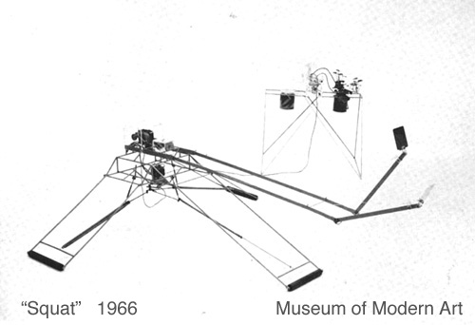
Robotické umenie_rozdelenie
2. Spojenie organického a strojového _ kybernetika
Tom Shannon: Squat 1966

Slide 4
Robotické umenie_rozdelenie
3. Autonómia stroja a AI
Edward Ihnatowicz : Senster 1969-1970
http://www.youtube.com/watch?v=1jDt5unArNk&feature=related

Slide 5
Robotické performance
Louis Philippe Demers a Bill Vorn: No Man´s Land 1996, Interactive Robotic Installation http://www.youtube.com/watch?v=opBD8HOQNVY

Slide 6
Louis Philippe Demers a Bill Vorn
The Trial / Lé Proces: Robotic Performance
http://www.youtube.com/watch?v=aV6ChawH2KI
Frenchman Lake: 1995, Interactive Robotic Installation
http://www.youtube.com/watch?v=bnb4YowfXmY
Robotické tanečné performance: Devolution (Australian Dance Theatre)
https://vimeo.com/127557329
The robotic art project Hysterical Machines/ Bill Vorn performed in the Hexagram Black Box. 2006
http://www.youtube.com/watch?v=TbEIwOI-hYM&feature=related

Slide 7
Bedlam : Robotic art project, Bill Vorn and Simon Penny
http://www.youtube.com/watch?v=4snPIAn4z8g
Grace State Machines in the Hexagram Black Box, http://billvorn.concordia.ca/robography/GraceState.html
Louis-Philippe Demers / THE BLIND ROBOT
https://www.youtube.com/watch?v=cVmlPvTcH2o
Ken Rinaldo:Autopoiesis 2000
https://www.youtube.com/watch?v=3w53KboB-00

Slide 8
Survival Research Laboratory: 1997
http://www.youtube.com/watch?v=KvWo-OV1Nrc
SRL 2012 :
http://www.youtube.com/watch?feature=player_embedded&v=BjF1zoAd-AI#!
SRL - A Plan For Social Improvement. Amsterdam, 1988
http://www.youtube.com/watch?v=Jxzr6bd31io

Slide 9
Robotický výskum pohybu
MIT Leg Laboratory 1996-2001
Walking Robots : Spring flamingo, spring turkey
https://www.youtube.com/watch?v=tOp1DX4De0g
BIGDOG ROBOT (DARPA): http://www.youtube.com/watch?v=b2bExqhhWRI
BIGDOG ROBOT (DARPA) / „beta version“☺
http://www.youtube.com/watch?v=VXJZVZFRFJc
Agility robotics
http://www.theverge.com/circuitbreaker/2017/2/9/14563036/bipedal-two-legged-robot-cassie-agility-robotics
ATLAS, z dielne Boston dynamics https://www.youtube.com/watch?v=rVlhMGQgDkY

Slide 10
Robotický výskum správanie
Contemporary behavioral robots
2009 AEC: Hiroshi Ishiguro, Osaka /JP: GEMINOID
https://www.youtube.com/watch?v=WijMCSfX0RA
AEC: Environment: TELENOID (2010) / Hiroshi Ishiguro, Osaka University, ATR (JP
https://www.youtube.com/watch?v=bvfVznGU2CE

Slide 11
Paro (seit 2003). Japans National Institute of Advanced Industrial Science and Technology (AIST)
http://www.youtube.com/watch?v=b1HbBqZrpe8
Human Robot Harmony – Humanoid „Honda ASIMO“
https://www.youtube.com/watch?v=9ctvilK76us
KISMET: https://www.youtube.com/watch?v=8KRZX5KL4fA&t=40s

Slide 12
ASIMO by Honda laying a bunch of flowers to Karel Čapek’s bust in the Prague
National Museum (August 22, 2003)

Slide 13
Diy useless robot devices ☺
https://www.youtube.com/watch?v=ab47XHidvwQ

Slide 14
ARTIFICIAL LIFE PREZENTÁCIA NA PREZI:
https://prezi.com/pz-jshmvwgis/artificial-life-art/?utm_campaign=share&utm_medium=copy

