Slide 1
GLITCH MUSIC and GLITCH ART

Slide 2
"It is failure that guides evolution; perfection offers no incentive for improvement." Colson Whitehead (1999)
The Aesthetics of Failure: "Post-Digital" Tendencies in Contemporary Computer Music KIM CASCONE
http://www.bussigel.com/systemsforplay/wp-content/uploads/2014/05/Cascone_Aesthetics.pdf
http://subsol.c3.hu/subsol_2/contributors3/casconetext.html

Slide 3
If it works, it’s obsolete.
Marshall McLuhan
A Phenomenology Of Glitch Art “Failure” has become a prominent aesthetic in many of the arts in the late 20th century, reminding us that our control of technology is an illusion, and revealing digital tools to be only as perfect, precise, and efficient as the humans who build them.
- Kim Cascone

Slide 4
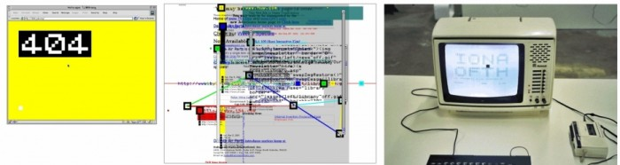
2005: World wide wrong , Jodi (Joan Heemskerk and Dirk Paesmans) Netherlands Media Art Institute.
https://www.youtube.com/watch?v=ip3m-oqPKUQ
https://networkcultures.org/_uploads/NN%234_RosaMenkman.pdf

Slide 5
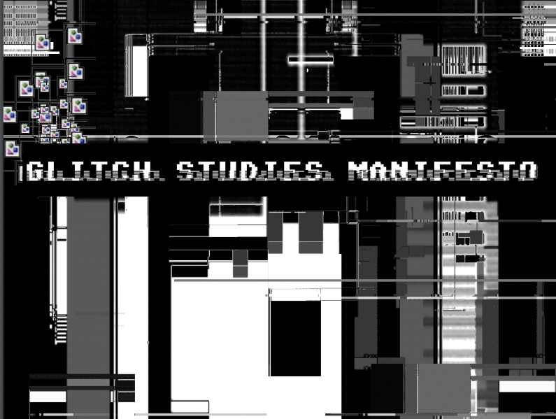
https://amodern.net/wp-content/uploads/2016/05/2010_Original_Rosa-Menkman-Glitch-Studies-Manifesto.pdf

Slide 6
Glitch art
https://www.youtube.com/watch?v=gr0yiOyvas4

Slide 7
Sound art, electronic music, glitch music
Precedenty:
Luigi Russolo: Risveglio di una cittá
LUIGI RUSSOLO: Manifest Umenia hluku 1913
John Cage: 4:33 for piano (1952)
John Cage: Imaginary Landscape No. 1.
John Cage: Imaginary Landscape No. 4 ,12 radios (1951)
Edgard Varèse - Le Corbusier - Iannis Xenakis: Poème électronique (Expo, 1958)
I.Xennakis: Xenakis: La Légende d'Eer (1977-78)
https://www.youtube.com/watch?v=JjPYpLvdW0k

Slide 8
glitch
OVAL
http://www.youtube.com/watch?v=vvW6qiTkZdw
Pan Sonic: Vakio 1993
http://www.youtube.com/watch?v=kpqBe1uL9dQ
http://www.youtube.com/watch?v=o97Al8KM9JQ
Carsten Nicolai:
http://www.youtube.com/watch?v=9KV0Gi2vwEM

Slide 9
An Anthology of Noise & Electronic Music: First A-Chronology
Corale: Russolo, Russolo 2:06
Wochende: Ruttman 11:23
Cinq Etudes de Bruits: EtudeViolette
Schaeffer 3:25
Scambi: Pousseur 6:33
The Dresden Interleaf 13 February1945
Mumma 12:11
Trance #2 Cale, Conrad, MacLise 5:12
Untitled #1 Jeck, Tétreault, Yoshihide
October 24, 1992: Graz, Austria
Survival Research Laboratories
6:15
Ragout: Küchen Rezpt Von Einsturzende Neubauten
Einsturzende Neubauten 4:14
Aspekt Boehmer 15:14
Hommage À John Cage: Paik 4:13
Rozart Mix Cage 7:18
Audience: Sonic Youth 6:00
Poème Électronique Varèse 8:08
Concret Ph Xenakis 2:44
https://www.youtube.com/watch?v=XsOyxFybxPY
FTP > Bundle/Conduit 23 Miller
8:15
A Little Noise in the System (Moog System) Oliveros 30:22
One Minute Ikeda 1:00

Slide 10

http://archive.aec.at/prix/

Slide 11
Telepresence
Telematics
Telerobotics

Slide 12
Art by Telephone:
from static to mobile interfaces :
1922 Moholy-Nagy: telephone-based art
https://www.youtube.com/watch?v=NHC5pGI9B04

Slide 13
Art by telephone remake 2019

Slide 14
The neologism "telematique" was coined by Simon Nora and Alan Minc
in L’informatisation de la societe
( Computerizácia spoločnosti 1978)

Slide 15
PREDCHODCA TELEMATIC ARTU
myron krueger: Videoplace, 1975
http://www.youtube.com/watch?v=dmmxVA5xhuo
Ukážka/remake
https://www.youtube.com/watch?v=7G-6LinmDCI

Slide 16
Roy Ascott: Is there love in Telematic Embrace? (1990)
- Telematika je umelá extenzia ľudskej inteligencie a percepcie
- Telematická kultúra - nemyslíme, nevidíme a necítime v izolácií, kreativita je zdieľaná a autorstvo distribuované

Slide 17
TELEMATIC ART - Prvý krát použil termín v roku 1983 – termín označuje počítačovú komunikáciu a sieť medzi geograficky vzdialenými jednotlivcami či inštitúciami, ľudskou mysľou, umelými systémami inteligencie a vnímania.

Slide 18
Paul Sermon : Telematic Dreaming (1993)
http://v2.nl/archive/works/telematic-dreaming/view?_sm_au_=iHV0J7PDkv1NtRLF

Slide 19
TELEPRESENCE
the ability to produce action at a distance
KEn GOLDBERG: Telegarden 1996
http://www.youtube.com/watch?v=gbyy5vSg8w8
Tele-Actor http://teleactor.berkeley.edu/introduction.html
Lynn Hershmann: Tillie, the Telerobotic Doll 1995
https://www.youtube.com/watch?v=QsbjbpLvQPk
http://www.lynnhershman.com/tillie/three.html

Slide 20
TELEPREZENCIA A DOHĽAD
EDUARDO KAC: Rara avis 1996: http://www.ekac.org/raraavis.html
Telecommunications art – before the www
Videotext Works (1985/86)
RC Robot (Telepresence), 1986
Conversation (Slow Scan TV), 1987
Retrato Suposto/Rosto Roto (Fax/TV Hybrid), 1988
Three City Link (Slow Scan TV), 1989
Ornitorrinco (Telepresence), 1989
Impromptu (Fax and Slow Scan TV), 1990
Interfaces (Slow Scan TV), 1990
Elastic Fax 1 (Fax), 1991
Elastic Fax II (Fax), 1994

Slide 21
Pohľad do histórie: koncept sledovania:
Peter Weibel : Observation of the Observation: Uncertainty, instalation 1973
http://www.youtube.com/watch?v=WiVTmCjV3xg
http://www.medienkunstnetz.de/works/beobachtung/video/1/
Dan Graham : «Time Delay Room» 1974,
Closed-Circuit
http://www.medienkunstnetz.de/works/time-delay-room/video/1/

Slide 22
VPLYVY VEDY NA UMENIE / UMENIE A KYBERNETIKA / POČIATKY ROBOTICKÉHO UMENIA
Kinetické umenie
Kybernetické skulptúry
Inscenovanie technológie
Robotické umenie

Slide 23
Kinetické umenie: L.M. Nagy: Light-Space Modulator (1922-30) https://www.youtube.com/watch?v=nVnF9A3azSA
Bio https://www.youtube.com/watch?v=vBZj4Me3RK8
Duchamp: Bicycle wheel 1913, Rotary Plates
https://www.youtube.com/watch?v=OxCljj1Z0r0
https://www.youtube.com/watch?v=tqySnbbyB2U about readymade
Naum Gabo: kinetické konštrukcie, aspekt času
https://www.youtube.com/watch?v=BR9Z0wzWjBQ

Slide 24
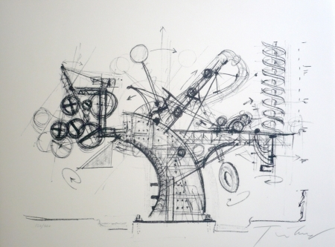
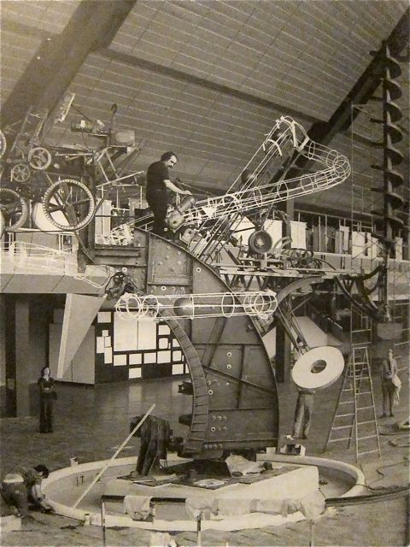
Kinetické umenie
Jean Tinguely: Building "Chaos 1", 1974

Slide 25
VPLYVY VEDY NA UMENIE / UMENIE A KYBERNETIKA / POČIATKY ROBOTICKÉHO UMENIA
Jean Tinguely- ´50 - ´60 – kinetické umenie - disturbatívne intervencie do časo-priestoru
Jean Tinguely : Universal Newsreels (1960)
http://www.dailymotion.com/video/xcx4bn_universal-newsreel-jean-tinguely-19_creation
Jean Tinguely: Rotozaza II
http://vernissage.tv/blog/2010/11/30/jean-tinguely-rotozaza-ii-at-museum-tinguely-basel/
Jean Tinguely- Le Cyclop 1969 http://www.youtube.com/watch?v=-Ss4CSFahCc
Jean Tinguely- Méta Matics, 1959 http://www.britishpathe.com/video/robot-art/query/wildcard
Jean Tinguely: Hommage to New York 1960 http://vimeo.com/8537769
JEAN TINGUELY: Study for an End of the World No.2 (1962)
http://www.criticismism.com/2017/02/22/jean-tinguely-study-for-an-end-of-the-world-no-2-1962/#sthash.GI7e6uwF.dpbs

Slide 26
VPLYVY VEDY NA UMENIE / UMENIE A KYBERNETIKA / POČIATKY ROBOTICKÉHO UMENIA
Britský neurológ, pionier robotiky:
grey walter: machina speculatrix – turtle 1953
Správanie na základe senzorov svetla a zvuku
https://www.youtube.com/watch?v=wQE82derooc
Reaktívny autonómny robot, schopný vyhýbať sa prekážkam.
Robot má dva simulované neuróny, ktoré evokujú komplexné správanie.
Ide o prvú demonštráciu umelého života

Slide 27
VPLYVY VEDY NA UMENIE / UMENIE A KYBERNETIKA / POČIATKY ROBOTICKÉHO UMENIA
Gordon Pask: Musicolour 1953 - musical cybernetic system
teaching and learning machines :
«SAKI» (1956), «CASTE» (1972), «Thoughtsticker» (1974)
Publikácie:
«An Approach to Cybernetics» (1961),
«Conversation, Cognition and Learning» (1975) and «Conversation Theory» (1976)
http://www.youtube.com/watch?v=yt-fXmzF9WQ&feature=related

Slide 28
Robotic Art I.
Nicolas Schöeffer: CYSP I Cybernetic Spatiodynamic Sculpture)
http://www.youtube.com/watch?v=gJD27tJLoaQ
1948: Spatiodynamism
1957: Luminodynamism
1959: Chronodynamism
LUMINO DYNAMICS
http://www.britishpathe.com/video/lumino-dynamics
Technický popis a fotografie:
http://cyberneticzoo.com/?p=815

Slide 29
Maďarský dokument o rodákovi Schöffer Miklósovi:
http://www.youtube.com/watch?v=bX6danl4kLI&feature=related
Nicolas Schöffer, Chronos 5, 1960 :
http://www.youtube.com/watch?v=gu7d06vj-u0&feature=related

Slide 30
HOMEWATCH
Stelarc Psycho Cyber. Dokument 57 min
https://www.youtube.com/watch?v=DD7fhxlw9xE

