Slide 1
Basque language i

Slide 2
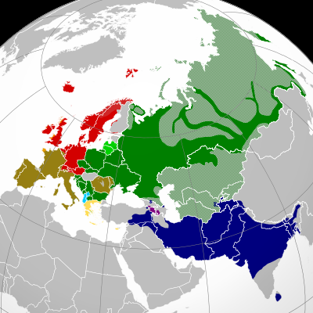
INDOEUROPEAN LANGUAGES

Slide 3
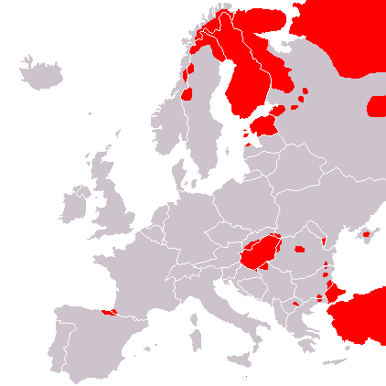
Non Indo-european languages
Source: Wikipedia Commons.

Slide 4
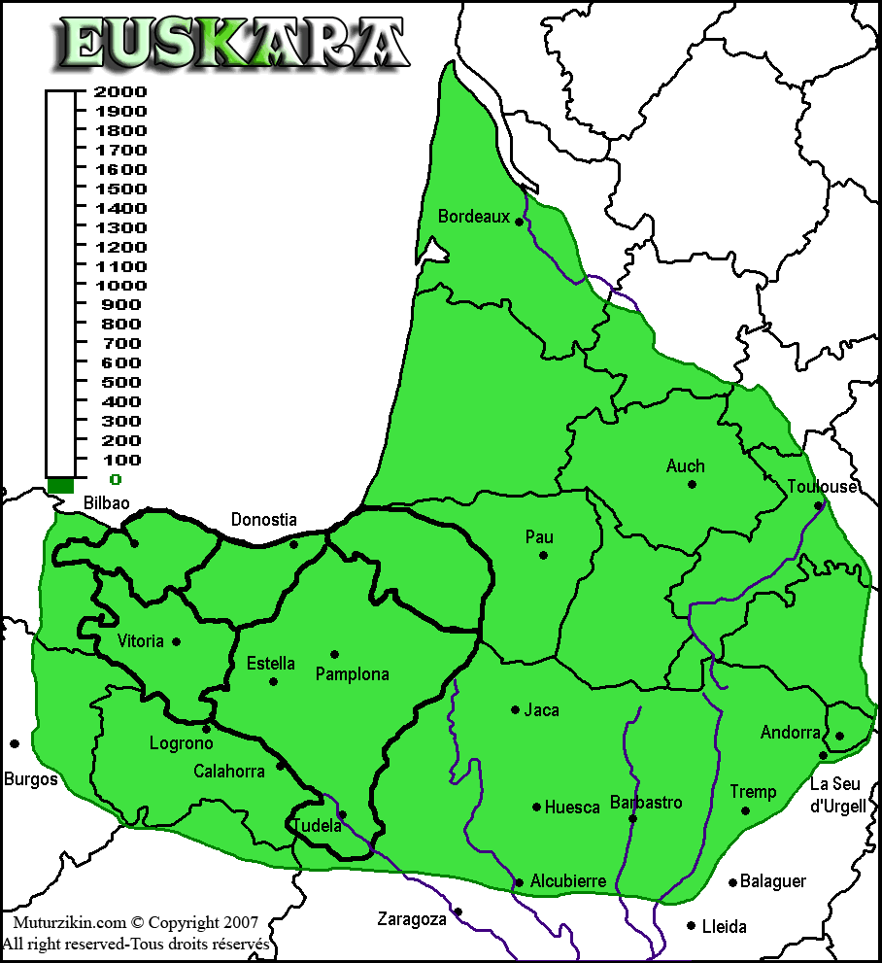
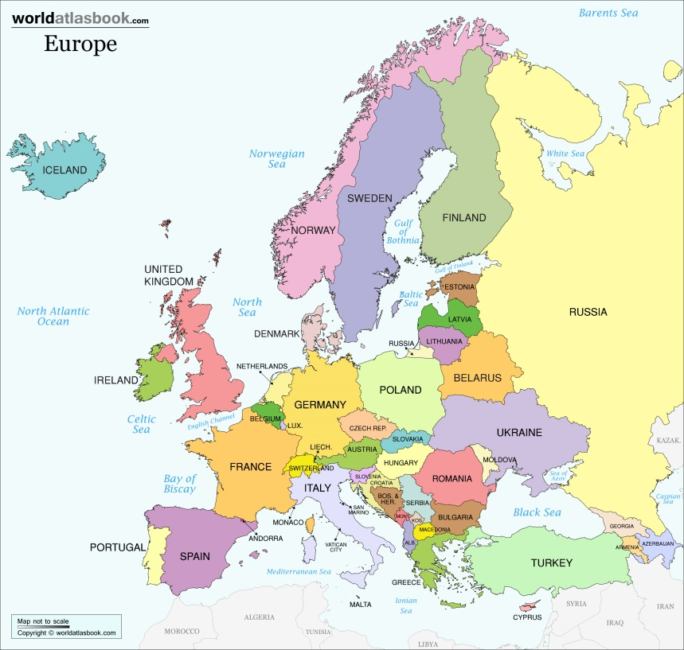
Basque language in 1st century
http://www.muturzikin.com/imagescarte/euskara.gif

Slide 5
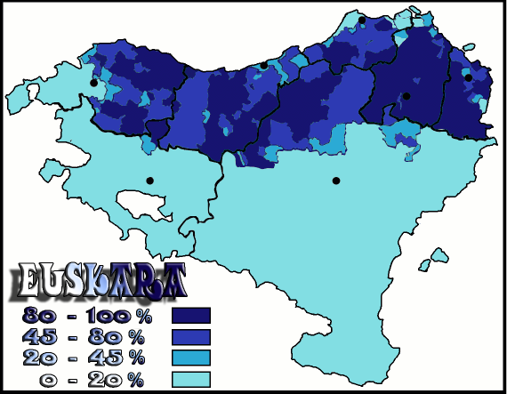
Basque language in basque country
Source: Wikipedia Commons.

