Slide 1
Introduction to Phonetics & Phonology Jezek Session 1
Mgr. Miroslav Ježek, Ph.D.
Brno, 24th February 2020

Slide 2
Linguistics
scientific study of language
DISCIPLINES: phonetics, phonology, morphology, syntax, semantics, stylistics, sociolinguistics, pragmatics, lexicography, historical linguistics, comparative philology, language acquisition, philosophy of language, neurolinguistics, psycholinguistics, forensic linguistics and others…
many inter-disciplinary fields, e.g. language variation and change

Slide 3
Phonetics
the science of human speech sounds with no specific reference to their function in a given sound-system
highly autonomous within linguistics (true science: instruments, computers, scaled measurements, etc.)
It studies 'the defining characteristics of all human vocal noise' (Crystal 1990: 167); => phonetic symbols (IPA).
three interdependent viewpoints:
articulatory (speech production)
acoustic (transmission of sound)
auditory (perception of sound)

Slide 4
Phonology
Studies 'sounds and their contrasts within a specific sound-system' (Crystal 1990: 172).
functional aspect of sounds
PHONETIC STATEMENT: /b/ is a voiced bilabial plosive.
PHONOLOGICAL STATEMENT: there are 6 short vowels in English.
phonemics: 1/ synonym of phonology (sound-system of one language)
2/ theoretical study of phonemes

Slide 5
Phoneme & Allophone
Phonemes are contrastive units of sound which can be used to change meaning (Collins & Mees 2003: 11).
Phoneme is an abstract entity shared by a native community.
Allophones are actual sounds uttered by speakers and interpreted as one phoneme despite possible phonetic differences.

Slide 6
Phoneme & Allophone
One cannot pronounce a phoneme, only an allophone; hence phoneme, being a feature of language structure, cannot be defined acoustically. In Saussurean terms, it is part of langue, not parole.
phonemic /ki:p/ v. phonetic [k̟ʰi:p] transcription

Slide 7
Phonemes-contrastive distribution
Two phonemes (never allophones) appearing in the same environment and with a change in meaning:
pit and bit – minimal pairs
pit, bit, kit, lit, sit ; beat, bean, beam, beef, bees – sets of minimal pairs

Slide 8
Allophonic variation–examples
/k/ - advanced keep v. retracted cool –accommodatory (intrinsic) alternation (determined by the phonetic environment, i.e. the following vowel).
/l/ - clear [l] light v. dark [ɫ] till – non-accommodatory (extrinsic) alternation (determined by the position within a word).

Slide 9
Allophonic variation–examples
/l/ - clear [l] light v. dark [ɫ] till – the two allophones are in complementary distribution (i.e. one or the other).
Other examples of complementary distribution:
[p] in spare, supper (after a voiceless alveolar fricative and intervocallicaly preceding an unstressed vowel) v. [pʰ] in pear (syllable-initial preceding a vowel under stress).
also syllable-initial only [h] v. syllable-final only [ŋ]; but they are not considered allophones of one phoneme due to their lack of phonetic similarity.

Slide 10
Allophonic variation–examples
The varied quality of /r/, namely e.g. [ɹ] in RP red, [ɾ] in Scottish terrible, [ʁ] in French rouge or in traditional Northumbrian accent. These allophones are in free variation.
Other examples of free variation: /t/-glottaling in right [ɹaɪʔ]; Czech long /a/.
Are there, however, any cases of really free variation in language?

Slide 11
The phonemic principle
Two or more sounds are realisations of the same phoneme if
(a) they are in complementary distribution and;
(b) they are phonetically similar.
two or more sounds are realisations of different phonemes if
(a) they are in contrastive distribution;
(b) they serve to signal a semantic contrast.
(adopted from Carr 1999: 41)

Slide 12
Phonemic neutralisation
Two phonemes show overlap in phonetic realisation, i.e. ‘a sound may appear to belong to either of two phonemes’ (Cruttenden 2014: 47).
Examples:
lenis (non-aspirated) realisation of plosives after s: /st/ star, /sp/ spar, and /sk/ scar—possible allophones of /d/, /b/, and /g/ respectively?
cf. Welsh sbectol (spectacles) and sgyrt (skirt).
(from Collins & Mees 2003: 70)
/m/ and /n/ in infamous and emphatic are both, in anticipation of the following labiodental fricative /f/, labiodental nasals [ɱ]; which phoneme does this sound belong to?

Slide 13
Phonemic neutralisation
More examples:
in Czech dip, tip v. pod, pot.
Q: So, which phoneme does the plosive in spin belong to: /p/ or /b/?

Slide 14
Archiphoneme
A: it belongs to an archiphoneme /P/ + /B/.
It combines the characteristics of two normally distinct phonemes that cannot be differentiated in certain contexts.
VIDEO: Prof. Jurgen Handke, Marburg University, Germany
https://www.youtube.com/watch?v=C1EhcdSMHGg

Slide 15
Phonemic merger
Absolute phonemic neutralisation is also called a phonemic merger; i.e. two previously separate phonemes become one.
Example:
US English LOT-THOUGHT merger.
Middle English meat-meet merger.

Slide 16
One phoneme or two?
affricates /tʃ/ and /dʒ/-how many phonemes?
One phoneme: phonotactically (see the next slide) they function in a different way from other affricates (especially /ts/ and /dz/) in word-final positions as they do not typically contain a syllable boundary.
Cf. patch, badge v. cats, dogs. (even word-initial affricate in tsar is not pronounced as [ts], but [z]).
Two phonemes: if /tʃ/ and /dʒ/ are just one phoneme, why not /tr/ and /dr/?
Universal consent, native intuition…

Slide 17
Phonotactics
Refers to restrictions on the possible combinations of phonemes within a particular language (accent).
CCCV- in English limited to /s/ + plosive + approximant /j/, /r/, /w/, /l/. Thus stew, stream, spleen, square are possible, but not zdream.
/ɳ/ in word-final positions only
/h/ never in word-final positions

Slide 18
Phonemicisation- phonemic split
Establishment of a new phoneme in a given language (accent).
Also called a phonemic split
Examples:
lowering of EModE blood [ʊ] => [ʌ]
loss of /g/ in –ing endings => new phoneme /ŋ/
TRAP and BATH split in southern varieties of BrE

Slide 19
Phoneme- theoretical perspectives
The notion of phoneme was known in the 19th century-but it referred to a phonetic unit (sound) in diachronic comparative philology.
Phoneme as an abstract contrastive unit was, however, intuitively felt.
Kazan School of Linguistics:
Jan Baudoin de Courtenay (d. 1929), Mikolaj Kruszewski (d. 1887)
physiophonetic v. psychophonetic alternations
American anthropological linguistics
Edward Sapir (d. 1939)
anthropological focus on native American languages
important v. unimportant sound-units in language

Slide 20
Phoneme- theoretical perspectives
Ferdinand de Saussure (d. 1913) Cours de linguistique générale (phoneme impicitly present in the langue v. parole distinction).
Phoneme first thoroughly described by the Prague Linguistic Circle in the 1920s and 30s (Nikolay Trubetzkoy, Roman Jakobson, Vilém Mathesius, Josef Vachek).
Structuralists: focus on synchrony, on functional relationships between elements within language.

Slide 21
Phonology - Prague Linguistic Circle
Trubetzkoy’s Grundzüge der Phonologie (posthumously 1939)
first explicit theoretical account of phoneme
clear separation of phonetics and phonology (with heavy focus on the latter)
system of phonological oppositions=>it is the difference between /t/ and /d/ in tear v. dear that is worth scientific interest, not the actual quality of the two sounds.
Jakobson later spread the ideas of the PLC abroad: the distinctive feature theory (see below).

Slide 22
Phonology - Prague Linguistic Circle
PLC: centre v. periphery
level of integration into the phonemic system
high/low functional yield
Case in point: /h/ phoneme

Slide 23
Phoneme- theoretical perspectives
The PLC: phoneme as a purely abstract, contrastive (functional) unit.
Other approaches at that time:
phoneme as a class of sounds; thus /l/ phoneme consists of clear [l] and dark [ɫ].
phoneme as a class of features of sounds; /l/ phoneme consists of features like laterality, alveolarity, etc. (Leonard Bloomfield: Language, 1933).
cf. rationalism v. nominalism in epistomology

Slide 24
Roman Jakobson- distinctive feature theory
After WWII in the USA, d. 1982.
Continued with what Trubetzkoy did not manage to finish.
Phonological oppositions: relative (not absolute) values that keep phonemes distinct, e.g. Aspiration.
Next step: to establish a set of distinctive features to analyse phonological oppositions in a language.
Ultimate aim: to establish a limited set of distinctive features to analyse any language.

Slide 25
Jakobsonian set of distinctive features
Universal binary (i.e. two mutually exclusive options) system of twelve distinctive features to describe all languages of the world.
All contrasts must be stated in terms of these features.
All restrictions on distribution must be stated in terms of these features.
Distinctive features: e.g. +/- nasal, +/- consonantal, +/- vocalic
Many later modifications: more features and different labels

Slide 26
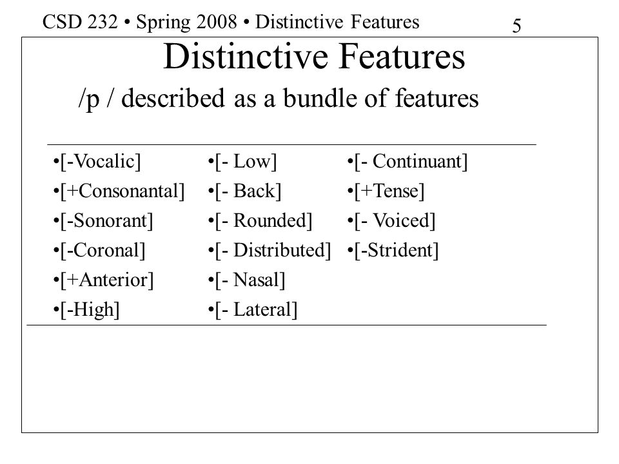
Distinctive feature theory

Slide 27
Generative phonology
Noam Chomsky and Morris Halle: The Sound Pattern of English (1968)
It is a subdiscipline within generative grammar (particular focus on syntax).
It is heavily based on Jakobson’s distinctive feature theory.

Slide 28
Generative phonology
Aim: to create and analyse phonological rules that map an underlying (abstract) representation onto a surface (sound) representation.
Examples:
Context-free rule: in RP the underlying form of get is /get/, surface forms may be [t], [tʰ], [tˢ], or even [ʔ].
Context-sensitive rule: in AmE fat /fat/ may surface as [t] or [ɾ].
The surface representations are merely the tip of the iceberg; it is what lies beneath (the unconscious knowledge of language) that linguistics should focus on.
Phonological rules delete, insert, modify sounds.

Slide 29
Generative phonology
input …rule 1…rule 2…rule N…(correct/incorrect) output
Example (correct v. incorrect rule ordering):
(Wells 1982: 67)
Input | fə hɪz ˈfrɛndz
by Unstressed H Dropping | fə ɪz ˈfrɛndz
by R Insertion | fər ɪz ˈfrɛndz | = correct output
Input | fə hɪz ˈfrɛndz
by R Insertion | - | Rule cannot apply due to structural restrictions
by Unstressed H Dropping | fə ɪz ˈfrɛndz | = incorrect output

Slide 30
Phonetic conditioning
Refers to the way in which sounds are influenced by adjacent sounds=>phonemes vary in their realisations according to the phonetic context.
Four main types:
allophonic variation (here dealt with elsewhere);
assimilation;
elision;
liaison.

Slide 31
Assimilation
A phoneme is replaced by another one due to the influence of yet another phoneme
Types of assimilation:
leading: bad girl in casual speech becomes [bag gɜ:ɫ]; frequent in Italian (Latin octo => ModIt otto)
lagging: on the site [ɒn nəˈsaɪt]
---------------------------------------------------------------------------
place: woodpecker [ˈwʊbpekə]
manner: till they see [tɪɫ leɪˈsi:]
energy: I have to [aɪˈhaf tə]

Slide 32
Elision
Refers to the deletion of a phoneme.
Examples:
tasteless [ˈteɪsləs];
historically, the silent letters in write, knee, castle, cupboard, chalk, thumb, etc.

Slide 33
Liaison
Refers to the insertion of a phoneme to enable easier articulation of the sequence.
Example:
intrusive /r/: I saw it [aɪˈsɔ:r ɪt]; the idea of, vodka on ice, etc.

Slide 34
Phoneme as a source of inspiration
prosodeme: a phoneme stretching over more than one segment of sound; e.g. yes pronounced with different pitch patterns.
toneme (=tonal phoneme): in tonal languages like Chinese, the only distinctive element is the different tone.
morpheme, grapheme, behavioureme: e.g. gusteme, kineme, etc.

Slide 35
References
Collins, Beverley and Inger Mees. 2003. Practical Phonetics and Phonology. London: Routledge.
Cruttenden, Alan. 2014. Gimson’s Pronunciation of English, 8th ed. London: Routledge.
Crystal, David. 1990. Linguistics. London: Penguin Books.
Wells, J C. 1982. Accents of English. Cambridge: CUP.

