Slide 1
Introduction to Phonetics & Phonology Ježek Session 3
Mgr. Miroslav Ježek, Ph.D.
Brno, 23rd March
2020

Slide 2
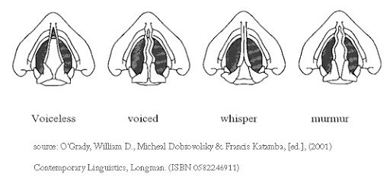
Vocal folds

Slide 3
Articulatory level
Throat (pharyngeal cavity)
Mouth (oral cavity)
Nose (nasal cavity)
---------------------------------------------
Place of articulation (e.g. lips, teeth, alveolar ridge)
Manner of articulation (e.g. plosive, fricative)
Energy of articulation (fortis/lenis)

Slide 4
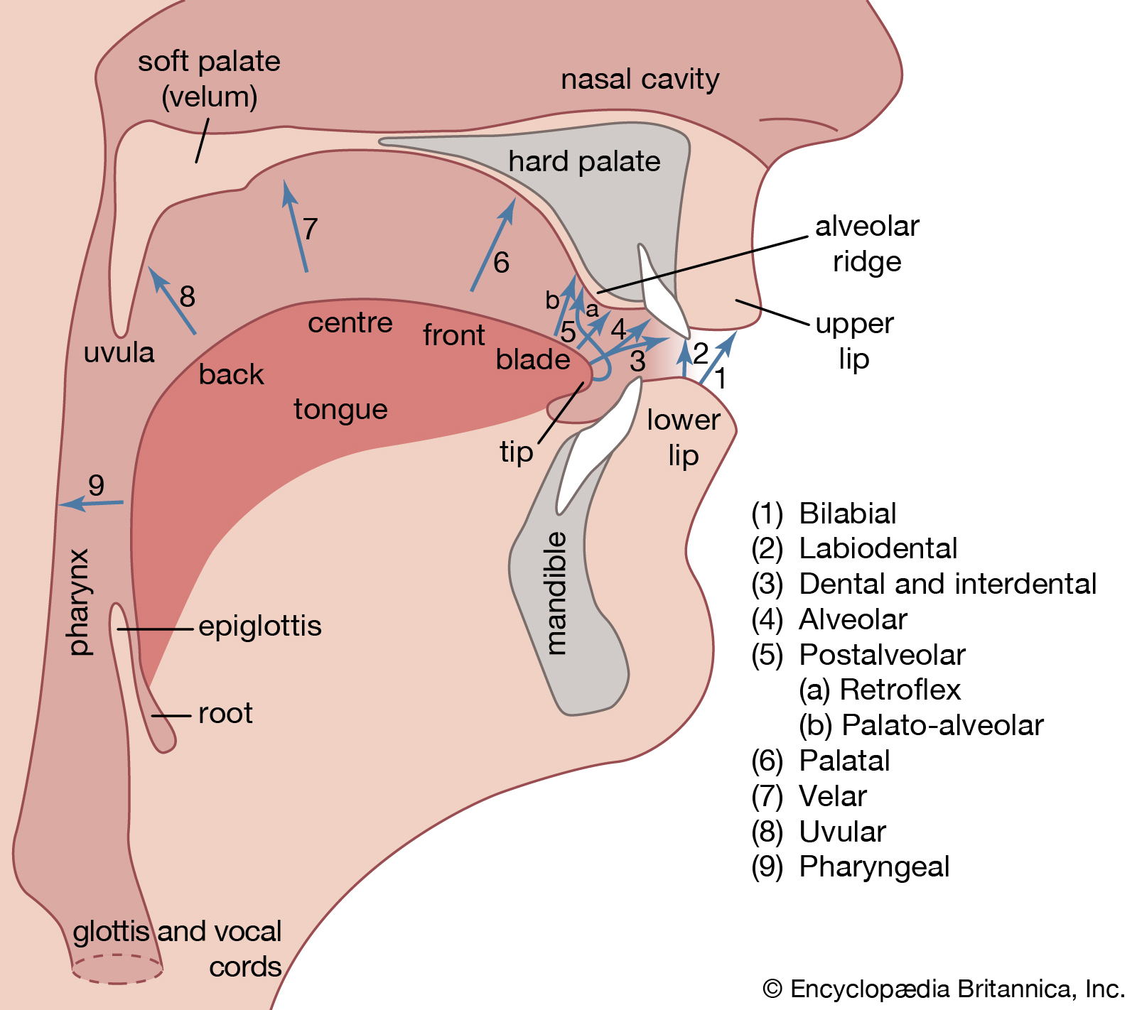
Articulatory system

Slide 5
Consonants
Sounds produced by obstruction of the airflow somewhere in the vocal tract (i.e. in nasal, oral or pharyngeal cavity).
The crucial criteria for the description of consonants are:
place of articulation (where the obstruction takes place);
manner of articulation (what type of obstruction it is);
energy of articulation (voiced v. voiceless; also devoiced).
Phonologically, consonants are non-syllabic, i.e. they appear at the beginning and the end of syllables (bit).

Slide 6
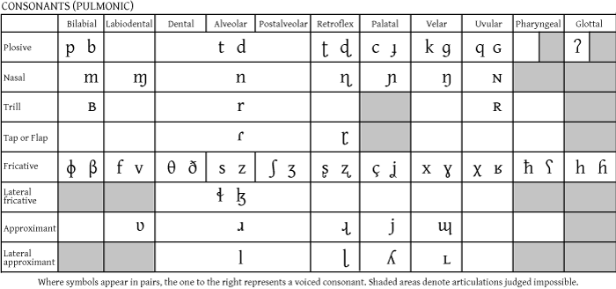
Consonants

Slide 7
ENGLISH CONSONANTS

Slide 8
Place of articulation
bilabial (upper and lower lip): /p/ and /b/;
labio-dental (lower lip and upper teeth): /f/ and /v/;
dental (upper teeth and tongue tip): /ð/ and /θ/;
alveolar (alveolar ridge and tongue tip): /t/ and /d/, /s/ and /z/;
post-alveolar, palato-alveolar (behind alveolar ridge and tongue): /r/, /tʃ/ and /dʒ/, /ʃ/ and /ʒ/;
palatal (hard palate and tongue): /j/;
velar (soft palate (velum) and tongue): /ɳ/, /k/ and /g/;
glottal (glottis): /h/ and [ʔ].

Slide 9
Manner of articulation
plosives (stops): complete obstruction in oral cavity; closing, compression, release stages; /p/ and /b/, /t/ and /d/, /k/ and /g/ + /ʔ/;
nasals: complete closure in mouth so air escapes through nasal cavity; they are frictionless continuants /m/, /n/, and /ɳ/;
affricates: release stage is prolonged so friction occurs at the place where plosives are articulated; /tʃ/ and /dʒ/;
fricatives: two articulators held sufficiently close so escaping air causes friction; /f/ and /v/, /ð/ and /θ/, /s/ and /z/ + /h/;
approximants: articulators narrowly close but not enough to cause friction; between fricatives and vowels; /r/, /j/, /l/, /w/;

Slide 10
Manner of articulation
taps (flaps): single contraction where one articulator is thrown against another; US [ɾ];
trills: vibrations between active and passive articulators; Scottish or Czech [r];
laterals: consonants (affricates, fricatives, approximants, taps) where airflow is blocked in the centre of the tongue and the air escapes through the sides of the tongue; lateral approximant /l/.
PLUS SOME MORE TERMS OFTEN MENTIONED IN ACADEMIC LITERATURE:
obstruents: a single term covering plosives, fricatives and affricates.
sonorants: continuous non-turbulent airflow; term covering nasals, approximants, flaps, some trills + vowels.
continuants: no complete closure in oral cavity; term covering fricatives, approximants + vowels

Slide 11
Energy of articulation
Voiced consonants (e.g. /b/, /d/, /g/, /v/…); lenis articulation; vocal cords vibrating.
Voiceless consonants (e.g. /p/, /t/, /k/, /f/…); fortis articulation; vocal cords open.
Devoiced consonants (e.g. cod in pre-pausal environments)
Cf. Eat the cot. v. Eat the cod. v. Eat the cod on the table.

Slide 12
Description of consonants
Combines the three modes of articulation (energy + place + manner), thus:
/b/ is a voiced bilabial plosive;
/f/ is a voiceless labio-dental fricative, etc.

Slide 13
Secondary articulation
labialisation: lip-rounding; e.g. swan; rude
palatalisation: centre of tongue closer to hard palate; e.g. tune, Czech ťukat
nasalisation: part of airflow escapes through nasal cavity; e.g. morning; French bon
velarisation: back of tongue closer to soft palate; e.g. dark [ɫ] pill
uvularisation: back of tongue close to uvula; sounds in Arabic, Semitic languages
pharyngealisation: pharynx (epiglottis) is constricted; some Danish consonants
glottalisation: addition of the glottal stop; e.g. put (see below)

Slide 14
SELECTED CONSONANTAL PHENOMENA

Slide 15
Glottalisation
Insertion of the glottal stop [ʔ] before voiceless plosives (p, t, k) - pre-glottalisation (also glottal reinforcement); e.g. pot [pɒʔt].
Insertion of the glottal stop in place of voiceless plosives (p, t, k) - glottalisation (also glottal replacement), e.g. pot [pɒʔ].
Though not present in any transcription model of RP, glottal replacement is a very frequent feature (even in RP) especially before obstruents (quite good, quite cheap, quite strong) and approximants (quite well, quite light)
RP speakers avoid glottal replacement especially before syllabic nasals and syllabic /l/ (button, bottom, little), and in intervocalic positions (butter, water, matter)

Slide 16
/g/-dropping
alveolar [n] instead of velar [ɳ] in –ing endings; e.g. doin’
Dropped /g/ stigmatised because of strong relation to orthography (but, curiously, [ɳg] forms stigmatised as well; e.g. West Midlands and Liverpool).
upper class the same as lower working class: [n]
Why? No social pressure; i.e. no danger for members of the upper-class of being mistaken for lower classes.

Slide 17
/th/-fronting
Dental fricatives replaced by labio-dental ones; thus /ð/ and /θ/ are replaced by /f/ and /v/ respectively.
nothing, brother, southern, etc.
possible age-grading feature?
Age-grading refers to features that occur in younger speakers but later disappear. This, however, does not signal linguistic change taking place as it reoccurs with every generation.
Typically associated with London / Estuary English, but first spotted in Yorkshire in 1876 (Upton 2012: 395).

Slide 18
/h/-dropping
Refers to the omission of /h/ in word-initial positions.
Stigmatised due to influence of spelling.
Found in many regional dialects in England.
/h/ has always been subject to great variation (e.g. historical, hotel in today’s English.
hypercorrection (hour, honest as well as horange)
In some words /h/ was added where there was none in the original source (e.g. Latin eremita, ModE hermit).
Differences between GB v. US (e.g. herb)

Slide 19
/h/-dropping
Subject to heavy stigmatisation: ‘so important indeed is the question of the use of h’s in England … that no marriage should take place between persons whose ideas on this subject do not agree’ (Hill 1902: 13, qtd. in Beal 2008: 27)
Many anecdotes, e.g.:
Doctor: I can tell you what you are suffering from, my good fellow. You’re suffering from acne!’
Patient: ‘Ackney??! I only wish I’d never been near the place!
(Mr Punch’s Cockney Humour, 1841)

Slide 20
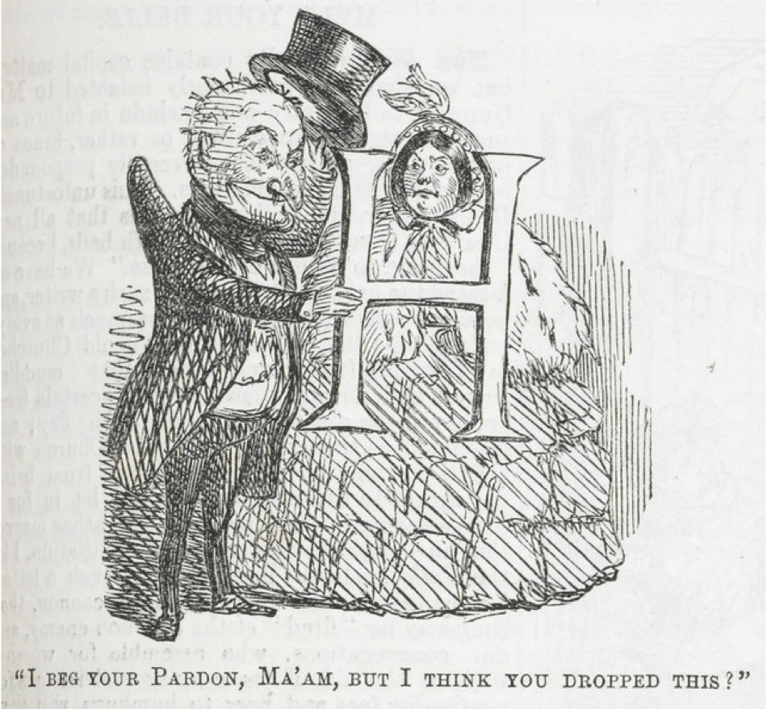
/h/-dropping
(Poor Letter H, 1866)

Slide 21
/l/-vocalisation
Dark /l/ [ɫ] is not released laterally (sides of tongue) and becomes a rounded vowel.
The vowel is somewhere between [o] and [ʊ], sometimes this symbol is chosen [ɤ].
Spreading rapidly, but not accepted in RP yet.
If it becomes an RP feature, then new diphthongs silk /ɪʊ/ and help /ɛʊ/ appear.

Slide 22
/r/-dropping
Started in the 18th C, that’s why US English is (predominantly) rhotic (exceptions e.g. New York working-class English).
In the past, stigmatised for the lack of accordance with spelling.
rhymes such as morn / dawn considered vulgar
Dropped /r/ created new diphthongs, namely /ɪə/, /ɛə/, /ɔə/, and /ʊə/
Interestingly, in modern RP there is no /ɛə/ and /ɔə/ and the status of /ʊə/ is increasingly less certain.

Slide 23
labio-dental /r/
/r/ is replaced by a labio-dental approximant [ʋ].
No phonemic contrast between ring v. wing.
Considered a speech defect (imperfect children’s pronunciation maintained into adulthood) by some, for others it is a modern variant of the phoneme.

Slide 24
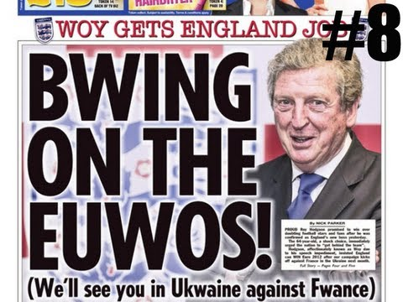
labio-dental /r/
Roy Hodgson- former England football manager. Notowiously known for labiodental /r/.

Slide 25
Intrusive /r/
Linking /r/ supported by spelling (e.g. here is).
Intrusive /r/ not supported by spelling but inserted to avoid a vocalic hiatus across word boundaries (e.g. I saw him, law and order) as well as word-internally (e.g. drawing).
Used after /ɑ:/, /ɔ:/ and, in particular /ə/.
Extremely frequent in RP, even non-native learners encouraged to adopt it (e.g. Trudgill 2002).

Slide 26
yod-dropping
Yod refers to the /j/ sound present in some words of the GOOSE and CURE sets (boom v. mute ; poor v. pure).
In the past, yod was far more common: (e.g. chew, juice, rude, crew, blue, flew, etc.; now in RP these words are /j/-less).
Yod now dropped in tune, student, duke, reduce, new, numerous, suit, solution; in RP all of them /j/-full apart from the last two; in US English all of them /j/-less.
Yod-dropping frequent in Cockney, East Anglia (GB) and US English

Slide 27
yod-coalescence
Alternatively, yod can coalesce (merge) with the preceding plosives and fricatives to produce palatalised consonants:
within one word: tune, duke, issue ;
across word boundaries: could you, don’t you, this year.
historically, yod-coalescence was stigmatised in many words where it is common today: e.g. sugar only [sju:gə] in the 18thC.
In modern RP common in unaccented syllables (perpetual, graduate), not so in accented ones (Tuesday, dew)

Slide 28
whale-wale merger
In the past, two different phonemes /hw/ v. /w/ (phonetically [ʍ] v. [w].
Educated speakers retained /hw/ well into the 20th C.
Now rare in RP, but the standard form in Scottish English.

Slide 29
Pronouncing dictionaries: ODP (2003), LPD (2008), CEPD (2011) - consonants
/t/-glottalisation: being an allophone, [ʔ] is absent from the transcriptions, but commented on in glossaries (extra information boxes)
Intrusive /r/:
In ODP present in e.g. Clara /klɑ:rə(r)/, drawing /drɔ:(r)ɪɳ/;
In LPD present in drawing / drɔ:^{r}ɪɳ/;
In CEPD not present, only explained in Glossary.
Yod-coalescence:
ODP gives tune both as /tju:n/ and /tʃu:n/- no variant preferred.
LPD gives tune both as /tju:n/ and /tʃu:n/- first variant preferred.
CEPD also gives both /tʃu:n/ and /tju:n/ for tune, but in the reversed order compared to LPD.
the dictionaries comment on coalesced yod across word boundaries (e.g. could you), agreeing it belongs to RP.

Slide 30
References
Beal, Joan. 2008a. ‘Shamed by Your English?’. In Joan Beal, Carmela Nocera and Massimo Sturiale (eds) Perspectives on Prescriptivism. Bern: Peter Lang, pp. 21-40.
Hammerton, J. A. 1841. Mr. Punch’s Cockney Humour. London.
H. Hon. Henry. 1866. Poor Letter H: Its Use and Abuse. London.
Trudgill, Peter. 2002. Sociolinguistic Variation and Change. Washington: Georgetown University Press.
Upton, Clive. 2012. ‘Modern Regional English in the British Isles’. In Lynda Mugglestone (ed.) The Oxford History of English. Oxford: Oxford University Press, pp. 379-414.

Slide 31
References- dictionaries
Roach, Peter, Jane Setter, and John Esling (eds.) [Daniel Jones]. 2011. Cambridge English Pronouncing Dictionary, 18th ed. Cambridge: Cambridge University Press.
Upton, Clive, William A. Kretzschmar Jr and Rafal Konopka. 2003. The Oxford Dictionary of Pronunciation for Current English. Oxford: Oxford University Press.
Wells, J. C. 2008. Longman Pronunciation Dictionary, 3rd ed. London: Pearson Longman.

