Slide 1

Introduction to
Phonetics & Phonology
Ježek Session 2
Mgr. Miroslav Ježek, Ph.D.
Brno, 9th March
2020

Slide 2
Speech production
Three levels of description:
  articulatory level (head);
  phonatory level (throat);
  respiratory level (chest).

Slide 3
Respiratory level
Speech sounds are:
  egressive (breathing out) v. ingressive (breathing in);
  pulmonic (air pressure from lungs) v. non-pulmonic (ejectives, implosives, clicks).
Vast majority of sounds in European languages are egressive and pulmonic.

Slide 4
Phonatory level
Trachea
Larynx
Vocal folds (cords):
  open=voiceless sounds;
  closed and vibrating=voiced sounds;
  closed without vibration=glottal stop.
Glottis

Slide 5
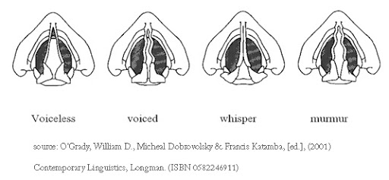
Vocal folds

Slide 6
Articulatory level
Throat (pharyngeal cavity)
Mouth (oral cavity)
Nose (nasal cavity)
---------------------------------------------
Place of articulation (e.g. lips, teeth, alveolar ridge)
Manner of articulation (e.g. plosive, fricative)
Energy of articulation (fortis/lenis)

Slide 7
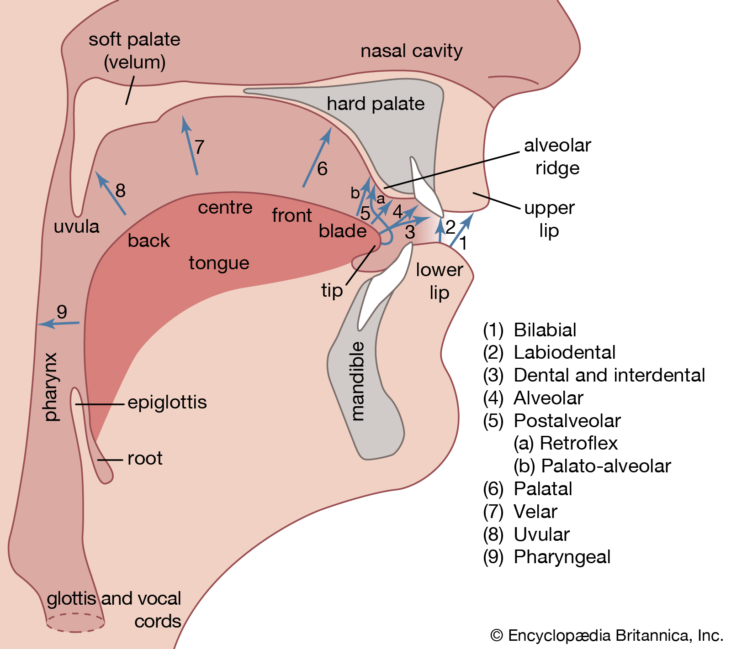
Articulatory system

Slide 8
Vowels
There is no obstruction to the airflow coming from lungs.
Place, manner and energy of articulation useless for vowels (tongue, approximants, lenis) => other criteria.
Vowels are described in the following way:
  tongue shape;
  lip shape (rounded v. neutral v. spread);
  monophthongs v. diphthongs;
  position of soft palate (nasality);
  duration.
      (from Collins & Mees 2003: 57-66)
Phonologically, vowels are syllabic, i.e. they form the nucleus of syllables.

Slide 9
Tongue shape
The most important criteria are:
  vowel height: close v. open vowels (say [i] v. [a]) – how close the tongue is to the roof of the mouth;
  vowel backness: front v. back vowels (say [i] v. [u]) – which part of the tongue is the highest.
  (actually, it is formants F1 and F2 respectively that define the height and backness of vowels; the spectral shapings just correspond to the given positions of the tongue in the mouth)

Slide 10
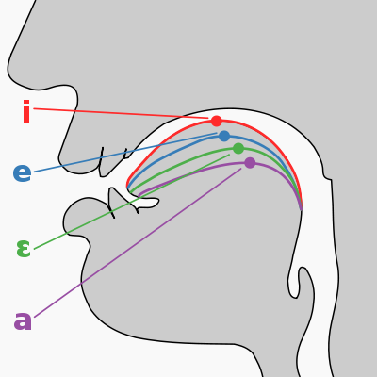
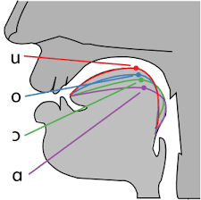
Tongue shape
Source: http://singingmastermind.com/singing-tongue-vowels/

Slide 11
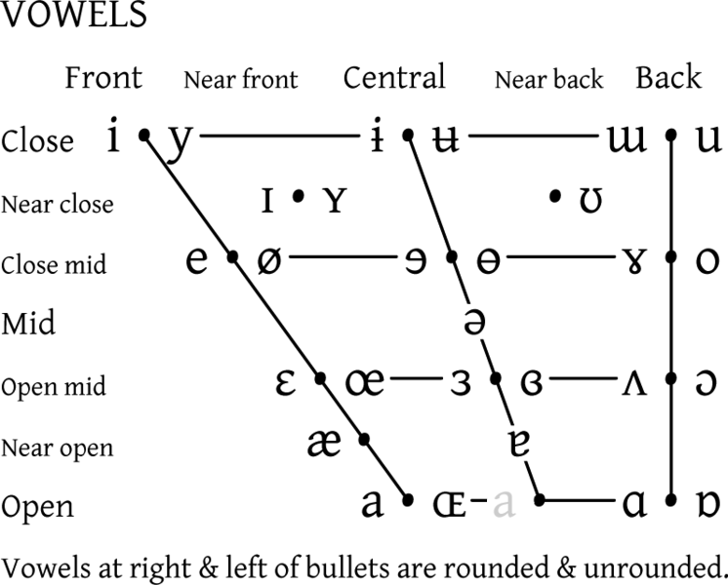
IPA vowels – vocalic quadrilateral

Slide 12
Standard lexical sets
Devised by J C Wells (Accents of English, 1982) for easier reference to English vowels.
They are written in capital letters (e.g. FLEECE).
“[t]he keywords have been chosen in such a way that clarity is maximized: whatever accent of English they are spoken in, they can hardly be mistaken for other words” (Wells 1982: 123).

Slide 13
Received Pronunciation RP
Prestige accent in England (possibly Wales as well).
‘received’ means acceptable in polite society (not received in public schooling)
Supposedly a non-localisable accent?
Closely linked with public boarding schools (e.g. Eton, Harrow, Rugby)
The exclusive link between RP and high education gradually disappeared during the 20th C.
Contrary to popular belief, RP originated in the (upper) middle class (not the upper class itself) through immense pressure on upward social mobility.

Slide 14
Received Pronunciation - RP
Varieties of RP:
  Trad-RP (Upton), U-RP (Wells), Refined RP (Cruttenden), marked RP (Honey), Conservative RP (Gimson);
  RP (Upton), mainstream RP (Wells), unmarked RP (Honey), General RP (Gimson and Cruttenden);
  Near-RP (Wells), Regional RP (Cruttenden), Advanced RP (Gimson);
  Adoptive RP (Wells), Constructed v. Native RP (Fabricius) ;
  General British (GB), Conspicuous GB, Regional GB (Cruttenden 2014);
  Non-regional pronunciation (NRP, Collins and Mees 2003).
  ----------------------------------------------------------------------------------------
  and, of course, the BBC accent, Oxford English, the Queen’s English…
  Standard English= a dialect spoken in any accent!

Slide 15
General American - GenAm
Term coined by George Philip Krapp in 1925.
The accent employed by educated speakers in formal settings but still permitting variability in particular US regions; i.e. it is not a purely non-localisable (supra-regional) accent like RP (used to be?).
The accent is ‘what is left over after speakers suppress the regional and social features that have risen to salience and become noticeable’ (Kretzchmar et Schneider 2004).

Slide 16
RP and GenAm vowels
Monophthongs (steady vowels)
  long v. short
  Short vowels preceding voiceless consonants are shorter than those preceding voiced consonants (e.g. dock v. dog).
Diphthongs
  glides from one vowel to another within one syllable
    fronting [eɪ] v. backing [aʊ];
    closing [aɪ] v. opening [ɪɐ];
    centring [ɪə]

Slide 17
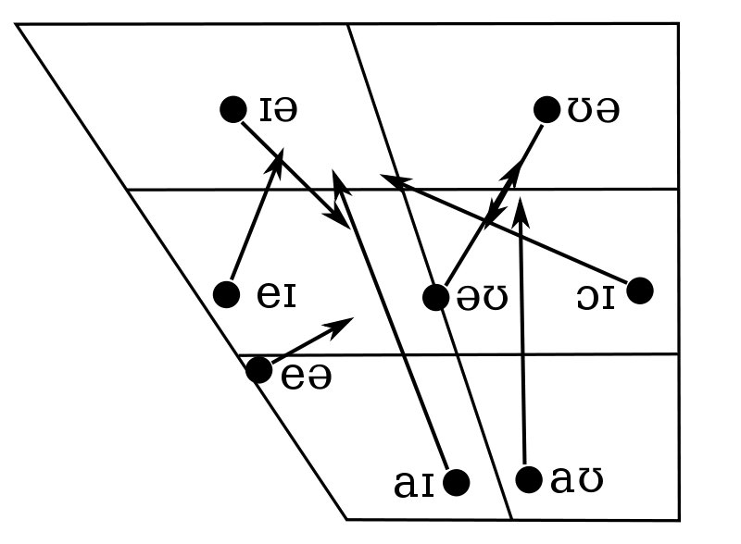
RP diphthongs
Source: Wikipedia: RP vowel charts (diphthongs)

Slide 18
RP and GenAm vowels
Each vowel is treated separately
Differences between the traditional model (Daniel Jones, A C Gimson, J C Wells, Alan Cruttenden) and an updated model (Clive Upton, Alan Cruttenden) are highlighted.

Slide 19
Upton’s model of RP
Devised in the 1980’s (how modern is that?) by Clive Upton.
Used in all Oxford University Press publications for the native market since the 1990’s.
Need to update the model because RP had ‘undeniably come to be associated with older middle- and upper-class speakers in the south-east of England’ (Upton 2000: 76).
Therefore, it is desirable ‘to objectively consider the notion of RP and to ensure the description of a late twentieth-century version of the accent […] looks forward to the new millenium rather than back at increasingly outmoded forms’ (Upton 2001: 352).
Upton’s model includes sounds ‘heard to be used by educated, non-regionally marked speakers rather than those “allowed” by a preconceived model’ (Upton 2000: 78).

Slide 20
Upton’s model of RP
Aim: ‘a larger group of people can lay claim to possession of an RP accent than has hitherto been acknowledged’ (Upton 2008: 78).
Why the model has failed to appear in the ELT world:
  ELT world is extremely conservative;
  phonetics is given less attention than grammar, syntax or semantics;
  it would be vastly expensive to re-edit all the ELT teaching materials.

Slide 21
Upton’s model of RP
Wells v. Upton- how to approach language change?
Wells: keep the symbols (for the sake of clarity), redefine the sounds they represent.
Upton: change the symbols to reflect the phonetic reality.
Some of the changes are mere transcriptional preferences, others have far-reaching impact.
Vowels: see the overview (Vowels of RP and trad-RP) uploaded in the IS (folder Jezek).

Slide 22
KIT vowel
[ɪ] in RP
[ɪ] in GenAm
fairly front and fairly close unrounded vowel
In word-final position frequently undergoes happY tensing (see below).

Slide 23
DRESS vowel
[e] in RP (Upton [ɛ])
[ɛ] in GenAm
front open mid unrounded vowel
Wells insists on [e] because of general familiarity with the symbol.

Slide 24
TRAP vowel
[æ] in RP (Upton and also Cruttenden 2014 [a]; lowered TRAP)
[æ] in GenAm (often considerably longer)
open front unrounded vowel in RP; in GenAm near open front unrounded vowel
It is also called the “ash” (aesc) vowel.
The correct symbol is rather controversial.

Slide 25
TRAP vowel - audio sample
Seaside resorts are enormous and, you know, the Royals used to take their holidays at the seaside and things like that and so a lot of money got, well, they just had a lot of money coming into all the time so they built these almost palatial flats along the seafront and things like that, like five storey mansions sort of holiday homes for people...
(Sample 14, Ježek 2017)

Slide 26
LOT vowel
[ɒ] in RP
[ɑ] in GenAm (often considerably longer)
open rounded back vowel in RP; in GenAm it is unrounded.

Slide 27
STRUT vowel
[ʌ] in RP
[ʌ] in GenAm
In both RP and GenAm this vowel is hard to pin down with great precision.
open-mid to central back unrounded vowel
raised STRUT [ʊ] a salient feature of the North-South divide in England
[ɤ] also a possible realisation; it is called a fudge.

Slide 28
STRUT vowel – audio sample
Ehm, I freelanced for a couple of years covering football matches which is the best job I’ve ever had cause I’d get to hold a microphone in front of people, ehm, but people of real status, you know, Arsene Wenger and Jose Mourinho and people, so that was, that was just sexy, it was, it was lovely. And of course you get to hear the sound of your own voice as well which kind of, after a while, ehm, isn’t, isn’t quite as horrifying as it, as it might otherwise ordinarily be, you know, to the uninitiated. So that was, that was kind of a great ego trip and if….unfortunately, didn’t fit in very well with having a young family because young family is gonna go to school.
(Sample 10, Ježek 2017)

Slide 29
FOOT vowel
[ʊ] in RP
[ʊ] in GenAm
fairly back and fairly close vowel with weak rounding
FOOT fronting a recent innovation in RP: fronting and unrounding of [ʊ], thus [ʉ].
no FOOT/STRUT opposition in northern accents in England

Slide 30
BATH vowel
[ɑ: ~ a] in RP
[æ] in GenAm
in RP a long back open unrounded vowel (Wells, Cruttenden) as well as a short front open unrounded one (Upton); in GenAm near open front unrounded vowel
the other major North-South divide feature
unlike raised STRUT, short BATH not stigmatised, hence the need to accept it in RP=> northern and southern RP
cf. shoda in Czech (Mathesius 1940)

Slide 31
BATH vowel – audio sample
And make the players realise they’re professional athletes. For the last, well, last season we had, I’d say there were three, no I think I could say there were four outstanding players in the team last season. Ehm, one was Fletcher, striker, he’s only just come back from injury, played the second half of the last game and he’s, he was very good last season until he got injured.
(Sample 7, Ježek 2017)

Slide 32
CLOTH vowel
[ɒ] in RP
[ɔ] in GenAm (frequently long [ɔ:])
in RP a short open rounded vowel; in GenAm open-mid back rounded vowel
Older RP variant [ɔ:] is now obsolete and humorous.

Slide 33
NURSE vowel
[ɜ:] (Wells, Cruttenden) and [ə:] (Upton) in RP
[ɜɹ] in GenAm
in GenAm rhotic
It is difficult to locate precisely.
Wells v. Upton: transcriptional preferences
  Wells criticises Upton’s choice on two grounds:
    1/ schwa is used in unstressed syllables only;
    2/ all the other long-short pairs use distinct symbols as well as the length symbol.

Slide 34
FLEECE vowel
[i:] in RP
[i:] in GenAm
In RP and GenAm it is a long close front unrounded vowel.
Subject to frequent diphthongisation [ɪi] in RP; if the starting-point is lower and retracted [əi], it is not RP.

Slide 35
FACE vowel
[eɪ] in RP
[eɪ] in GenAm
In RP and GenAm it is a closing diphthong with the starting-point between [e] and [ɛ].
If the starting-point is lower than [ɛ] (i.e. [æ] or even [a]), then redolent of Cockney.

Slide 36
PALM vowel
[ɑ:] in RP
[ɑ:] in GenAm
In both RP and GenAm it is a long open back unrounded vowel.

Slide 37
THOUGHT vowel
[ɔ:] in RP
[ɑ] in GenAm
In RP it is a long mid-open back rounded vowel.
In GenAm the vowel is short, fully open and there is no lip-rounding.

Slide 38
GOAT vowel
[əʊ] in RP (older people may have the starting-point close to [o])
[oʊ] in GenAm
For both RP and GenAm this is a diphthong. The starting-point for RP is central unrounded vowel (thus it is a backing diphthong), while it is retracted for GenAm with considerable lip-rounding.
The closing-point in RP may be fronted -> [əʉ].

Slide 39
GOOSE vowel
[u:] in RP
[u] in GenAm
In both RP and GenAm it is a back close rounded vowel; in RP it is usually long, while in GenAm typically short.
In RP it may be shortened and/or fronted -> GOOSE fronting [ʉ].

Slide 40
PRICE vowel
[aɪ] (Wells and Cruttenden) and [ʌɪ] (Upton) in RP
[aɪ] in GenAm
In both RP and GenAm it is a fronting diphthong; the starting-point in RP is front/central/back.
Absence of lip-rounding; if present, then regional (London).

Slide 41
CHOICE vowel
[ɔɪ] in RP
[ɔɪ] in GenAm
In both RP and GenAm it is a fronting diphthong; the starting-point is a back mid-close rounded vowel.

Slide 42
MOUTH vowel
[aʊ] in RP
[aʊ] in GenAm
In both RP and GenAm it is a backing diphthong; the starting-point in RP may be rather retracted to central or even back.

Slide 43
NEAR vowel
[ɪə] in RP
[ɪɹ] in GenAm
In GenAm rhotic, thus a fairly close and fairly front vowel followed by /r/.
In RP it is a centring diphthong; the closing-point is central, not lower.

Slide 44
SQUARE vowel
[ɛə] (Wells) and [ɛ:] (Upton, Cruttenden 2014) in RP
[ɛɹ] in GenAm
In GenAm rhotic, thus an open-mid front vowel followed by /r/.
In RP it is a centring diphthong or a monophthong with or without a glide (SQUARE monophthongisation).

Slide 45
START vowel
[ɑ:] in RP
[ɑɹ] in GenAm
in GenAm rhotic
In both RP and GenAm it is a back open unrounded vowel; in RP long.

Slide 46
NORTH vowel
[ɔ:] in RP
[ɔɹ] in GenAm
in GenAm rhotic
In both RP and GenAm it is a back open-mid rounded vowel; in RP long.

Slide 47
FORCE vowel
[ɔ:] in RP
[ɔɹ] in GenAm
in GenAm rhotic
In both RP and GenAm it is a back open-mid rounded vowel; in RP long.
The reason why FORCE and NORTH are given separate entries is that they used to be different: FORCE used to be diphthongal [ɔə] in RP.

Slide 48
CURE vowel
[ʊə ~ ɔ:] in RP
[ʊɹ] in GenAm
In GenAm rhotic, so a fairly back and a fairly close vowel followed by /r/.
In RP it is a centring diphthong or a back open-mid rounded long monophthong.
RP [ʊə] changed to [ɔ:] (CURE monophthongisation) as follows: the starting point was lowered to [ɔə] and then monophthongised to [ɔ:], like FORCE before.
[ʊə] still exists in less common words (e.g. gourd) or where minimal pairs need to be maintained dour v. door; cruel v. crawl.

Slide 49
happY vowel
[i] in RP
[i] in GenAm
In both RP and GenAm it is a close front unrounded vowel.
Short FLEECE vowel [i] has universally replaced older KIT vowel [ɪ] = happY tensing.
Cf. happy [-i] v. happier [-ɪə(ɹ)].

Slide 50
lettER vowel
[ə] in RP
[əɹ] in GenAm
In GenAm rhotic, thus central unrounded vowel followed by /r/.
In RP it is a central unrounded vowel. If lowered to [ɐ], then regional.

Slide 51
commA vowel
[ə] in RP
[ə] in GenAm
In both RP and GenAm it is a central unrounded vowel.
In RP intrusive /r/ is often employed to enable liasion between vowels.

Slide 52
unstressed KIT and FOOT vowel
Traditionally, [ɪ] and [ʊ] are employed here.
However, schwa [ə] is often used instead. Thus executive used to be [ɪgˈzekjʊtɪv], but now could be transcribed as [əgˈzekjətəv].
Upton uses composite symbols [ɨ] and [ʉ] to indicate that both [i] and [ə] or [ʊ] and [ə] can appear in the given position.
  E.g. happily is transcribed as [hapɨli] to indicate the second vowel may either be [i] or [ə].

Slide 53
Pronouncing dictionaries: ODP (2003), LPD (2008), CEPD (2011) - vowels
See the overview (Vowels of RP in three pronouncing dictionaries) uploaded in the IS (folder Jezek).

Slide 54
References
Collins, Beverley and Inger Mees. 2013. Practical Phonetics and Phonology, 3rd ed. London: Routledge.
Cruttenden, Alan. 2014. Gimson’s Pronunciation of English, 8th ed. London: Routledge.
Fabricius, Anne. 2000. T-glottaling between stigma and prestige: a sociolinguistic study of modern RP. Unpublished PhD thesis, Copenhagen Business School.
Gimson, A.C. 1980. Pronunciation of English, 3rd ed. London: Arnold.
Kortmann, Bernd and Edgar W. Schneider, eds. 2004. A Handbook of Varieties of English. Berlin/New York: Mouton de Gruyter.
Mathesius, Vilém. 1940. ‘Výslovnost jako faktor sociální a funkční’ [Pronunciation as a Social and Functional Factor]. Program D 41, 3: 71-74.
Upton, Clive. 2000a. ‘Maintaining the Standard’. In Robert Penhallurick (ed.) Debating Dialect: Essays on the Philosophy of Dialect Study. Cardiff: University of Wales Press, pp. 66-83.
Upton, Clive. 2001. ‘Revisiting RP’. In Malcolm Jones (ed) Essays in Lore and Language: Presented to John Widdowson on the Occasion of His Retirement. Sheffield: National Centre for English, pp. 351-68.

Slide 55
References
Upton, Clive. 2001. ‘Revisiting RP’. In Malcolm Jones (ed) Essays in Lore and Language: Presented to John Widdowson on the Occasion of His Retirement. Sheffield: National Centre for English, pp. 351-68.
Upton, Clive. 2008. ‘Received Pronunciation’. In Clive Upton and Bernd Kortmann (eds.) Varieties of English: The British Isles. New York: Mouton de Gruyter, pp. 237-52.
Upton, Clive, William A. Kretzschmar Jr and Rafal Konopka. 2017. The Routledge Dictionary of Pronunciation for Current English, 2nd ed. Oxford: Oxford University Press.
Wells, J. C. 1982. Accents of English, 3 vols. Cambridge: Cambridge University Press.
Wells, J. C. 2008. Longman Pronunciation Dictionary, 3rd ed. London: Pearson Longman.

Slide 56
References- dictionaries
Roach, Peter, Jane Setter, and John Esling (eds.) [Daniel Jones]. 2011. Cambridge English Pronouncing Dictionary, 18th ed. Cambridge: Cambridge University Press.
Upton, Clive, William A. Kretzschmar Jr and Rafal Konopka. 2003. The Oxford Dictionary of Pronunciation for Current English. Oxford: Oxford University Press.
Wells, J. C. 2008. Longman Pronunciation Dictionary, 3rd ed. London: Pearson Longman.

