Slide 1
Acting in an Accent
Barbora Husáriková
441809

Slide 2
General Introduction
"For actors, the chief delight and most solemn duty is to "disappear" inside their character‘s story, and to take on the character‘s behaviors, value system, fears, and dreams. By this act of mimesis, actors hope to penetrate a truth not their own, and to reveal that to an audience. A hard job!" (Meier 9)
Naturally, in order for this mimesis to work, actors frequently have to adopt accents different to their natural ones for their film roles...and some are better at achieving it than others
I have decided to look at Cockney accent to represent the UK and General American to represent the US, since it is impossible to cover all of „actors acting in an accent“ in one presentation

Slide 3
Cockney
The working class dialect of London, contrasting sharply with the prestigious Received Pronunciation
https://www.youtube.com/watch?v=7_FtnOTLkSs
Prominent features:
/aɪ/ in the face lexical set: train, late, came, face, able
T-glottalisation: "Hyde Park" pronounced as "Hy'Par‘ "
H-dropping: omission of the [h] sound
Th-fronting: /θ/ pronounced as [f] , /ð/ as [v]
Glottal stops
Non-rhotic
/ing/ endings treated as [ɪn]: feeling, stopping, talking

Slide 4
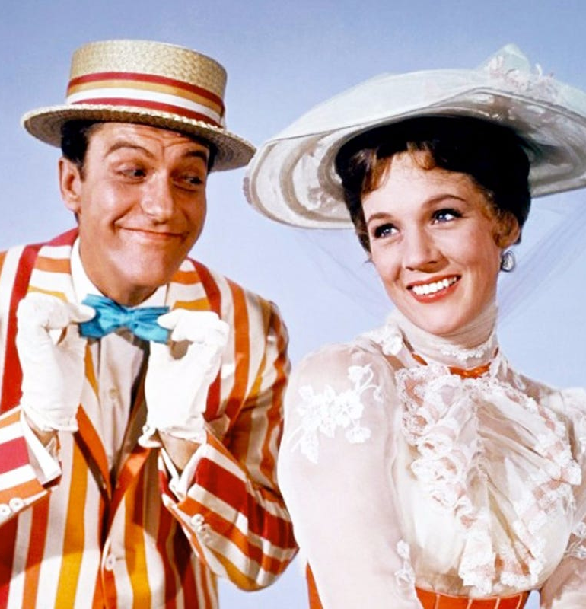
Cockney in Film
DICK VAN DYKE
Despite being a legend of the American cinema, his accent in Mary Poppins is widely considered „atrocious“. However, some claim to look back on the performance „with great fondness“ and say: „what Dick Van Dyke's performance lacks in authenticity he clearly makes up for with enthusiasm“
Van Dyke has since apologized for his attempts
https://www.youtube.com/watch?v=EjYjxL-ZtRY
https://www.youtube.com/watch?v=B_rVzBt20N0&pbjreload=10

Slide 5
Dick Van Dyke – Mary Poppins
Cockney is non-rhotic, but most of Van Dyke‘s /r/s are not only pronounced, they also sound American
I noticed probably only two cases of h-dropping, in happening and happen, but I would say even those were half-successful attempts
Th- fronting and glottal stops are similarly rare, so it is fair to say the accent is „all over the place“. In my opinion, it‘s his pronunciation of /r/ that reveals him undoubtedly as an American
Ultimately though, Mary Poppins is a film intended for children, so I think the target audience might be forgiving

Slide 6
General American
Regionally non-specific accent, does not have native speakers, perhaps apart from military brats
A good example is Stephen Colbert who practiced GenAm to avoid the Southern hillbilly stereotype (he is from South Carolina)
https://www.youtube.com/watch?v=OwsRI8or-c4
Prominent features:
Rhoticity, unlike Cockney
many Americans pronounce /t/ as [d]: litter, cattle, city
Yod-dropping: Americans would not say [tjun] but [tuː n]
“-ile endings” pronounced as [ɫ ], not [ɑ ɪ ɫ ]
Openness: GenAm does not employ a vowel /ɒ /, opting for /a:/ instead

Slide 7
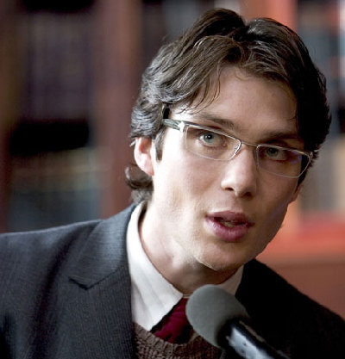
General American in Film
CILLIAN MURPHY
If Dick Van Dyke is the first example, than this Irish actor contrasts nicely with him. While Van Dyke is a legend, I consider Murphy underrated, and unfairly so. Morover, Van Dyke‘s bad accent was noticed by many, while Murphy‘s convincing one remains overshadowed by the accent of his colleague, Christian Bale. To compensate for this, I present Murphy‘s accent:
https://www.youtube.com/watch?v=E0GoKwlUPXo
https://www.youtube.com/watch?v=iqLDCIZ1DIs
https://www.youtube.com/watch?v=i-dJPoSlPfU

Slide 8
Cillian Murphy – Dark Knight Trilogy
I believe /r/s „make or break“ the accent, and Murphy‘s /r/ sound American
Openness in words such as that, sorry, mask, Batman
Murphy does not resort to using intrusive /r/s, as they are not a GenAm feature. When he says exile or death, there is simply a glottal stop between the first two words, not an intrusive /r/
No th-fronting; dental fricatives /θ/ and /ð/ are pronounced correctly
Unlike Mary Poppins, Nolan‘s trilogy is not intended for children and adults would likely be either disturbed by an inaxplicable non-American accent in Gotham, or at least aware of it. So props to Murphy for doing a good job, even if his character was a minor one!

Slide 9
A Few Suggestions
My goal was to cover accents done by actors not playing the main roles, I also wanted to give an example of a job done well and, in Van Dyke‘s own words, job done „atrociously“
However, there are plenty of other examples of actors adopting different accents!
In my bachelor thesis, I focused on Christian Bale, Renee Zellweger and their accents for The Dark Knight and Bridget Jones franchises
Bale used GenAm, Zellweger used Estuary English
His accent was more consistent throughout the franchise, since fewer years have passed between his portrayals of Batman

Slide 10
A Few Suggestions – cont.
TV shows are also worth mentioning
Hugh Laurie (British) in House, MD. (GenAm)
Idris Elba (British) in The Wire (Baltimore accent)
Simon Baker (Australian) and Owain Yeoman (Welsh) in The Mentalist (GenAm)
Ed Westwick (British) in Gossip Girl (New York)
I highly recommend a WIRED video series focusing on this topic:
https://www.youtube.com/watch?v=NvDvESEXcgE
https://www.youtube.com/watch?v=ZXyWwirLfcg
https://www.youtube.com/watch?v=_6ohUUzh9kk
It is necessary to admit that focusing on film accents has ruined certain films for me (I don‘t think I can ever watch One Day and Anne Hathaway‘s attempts at Yorkshire accent...just like Van Dyke, she has apologized for her accent)

Slide 11
Something to think about
Is a bad accent entirely the actor‘s fault?
A dialect coach Eric Singer claims that very often the issue of a bad accent would be fixed by the actor having more time to practice
Before Texas-born Renee Zellweger played Bridget Jones, the famous British singleton, she went undercover in a London publishing house to practice her Estuary English. Should this be a common practice for actors? I believe this woud help immensely!
Should actors even attempt to act in a different accent?
Casting Zellweger as the quintessential British heroine caused an uproar. Jane Austen and Margaret Thatcher were also played by American actresses (Anne Hathaway and Meryl Streep). On the other hand, Welsh-born Christian Bale has portrayed a famous American superhero. Should this be done at all? I have to admit that sometimes, the choices of producers and casting directors surprise me, I would not think of Hathaway when trying to cast a Jane Austen film.
Are there any actors whose natural accents surprised you?
Personally, I spent years in the mistaken belief that Christian Bale was American due to him mostly playing American characters (I think Nolan‘s Prestige is the only exception I can think of)!

Slide 12
Sources
https://www.theguardian.com/film/2017/jul/21/dick-van-dyke-sorry-for-cockney-accent-mary-poppins-disney
https://www.theguardian.com/film/2001/apr/04/fiction.features
https://www.telegraph.co.uk/news/2019/04/20/anne-hathaway-apologises-yorkshire-accent-gets-ready-offend/
MEIER, Paul. Accents and dialects for stage and screen : an instruction manual for 24 accents and dialects commonly used by English-speaking actors. Lawrence, Kan.: Paul Meier Dialect Services, 2010.

