Slide 1
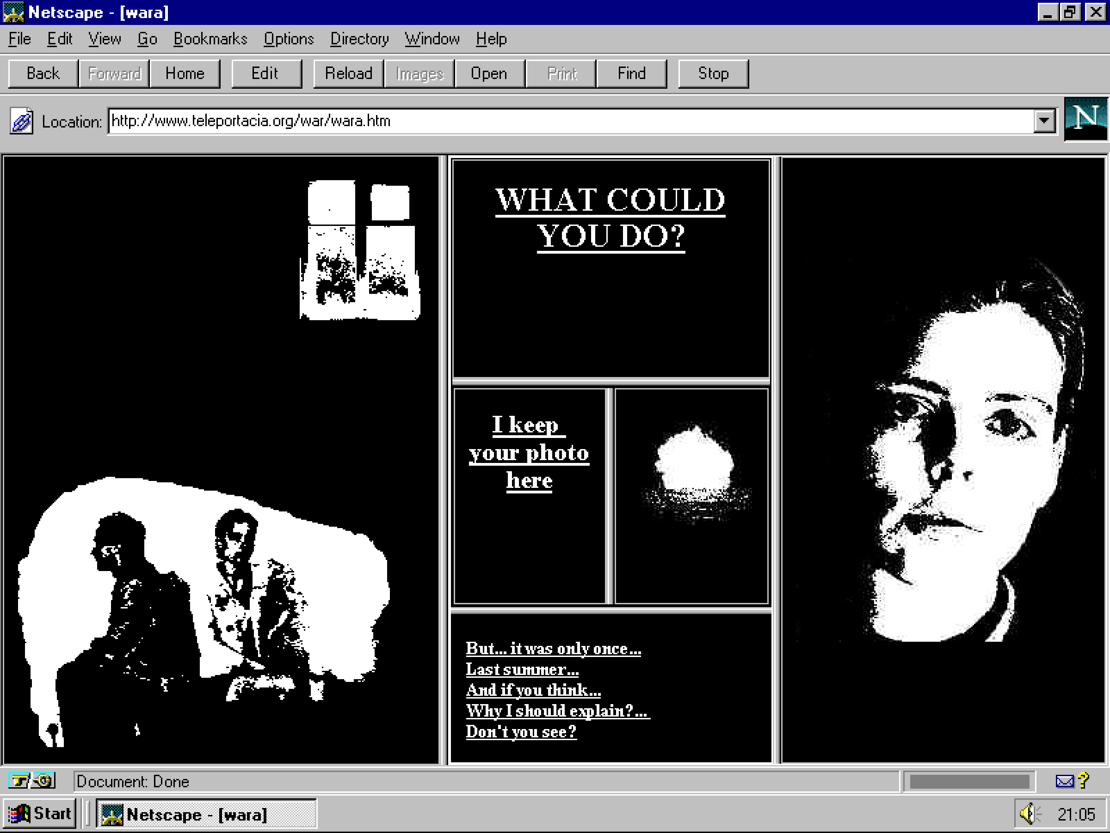
Net art

Slide 2
Historie a teorie Net Artu
Zdroje:
Rachel Green. Web Work: History of Internet Art. Artforum, květen 2000.
Eliška Kapounová. Net Art - očima české netartové královny. Earch.cz, 2003.
Marie Meixnerová (ed.). #mm net art – internetové umění ve virtuálním a fyzickém prostoru prezentace. Olomouc: Pastiche Filmz, 2014.
Adam Zbiejczuk. Net art. Bakalářská diplomová práce. Brno: Fakulta sociálních studií Masarykovy university, 2003.

Slide 3
Olia Lialina - My Boyfriend Came Back From the War (1996)
https://anthology.rhizome.org/my-boyfriend-came-back-from-the-war
https://sites.rhizome.org/anthology/lialina.html

Slide 4
Mark Amerika - GRAMMATRON (1995)
http://markamerika.com/artworks/grammatron-by-mark-amerika
http://www.grammatron.com/index2.html

Slide 5
Joan Heemskerk a Dirk Paesman JODI.org (1995)
http://wwwwwwwww.jodi.org/
http://message.sk/text/netart/netart53.html

Slide 6
Ben Benjamin: Superbad (1997)
https://www.superbad.com/
http://message.sk/text/netart/netart52.html

Slide 7
Mark Napier :Digital Landfill (1998)
http://www.potatoland.org/landfill/
https://www.marknapier.com/articles/Rhizome_datatrash_1998/Rhizome_DataTrash.htm

Slide 8
Miltos Manetas - SuperMario Sleeping (1998)
http://www.supermariosleeping.com/
https://www.gamescenes.org/2010/07/interview-miltos-manetas-the-first-machinimamaker.html

Slide 9
Vuk Cosic Ascii Art : ACSII History of Moving Images
http://www.ljudmila.org/~vuk/ascii/film/
http://bturn.com/8131/vuk-cosic-the-origins-of-net-art

Slide 10
Golan Levin: Audiovisual Environment Suite 1998
https://www.youtube.com/watch?v=ucVFa7re6xI
http://www.flong.com/projects/aves/

Slide 11
HEATH BUNTING: A Visitor's Guide to London Heath Bunting (1995)
http://www.irational.org/heath/london/front.html
http://sarahtage-research.blogspot.com/2009/10/visitors-guide-to-london.html

Slide 12
0100101110101101.ORG: Hybrids: Online Net Art collages
https://0100101110101101.org/hybrids/

