Slide 1
CV + formality + wordformation
ISKM09 - week 2 - 27th Feb

Slide 2
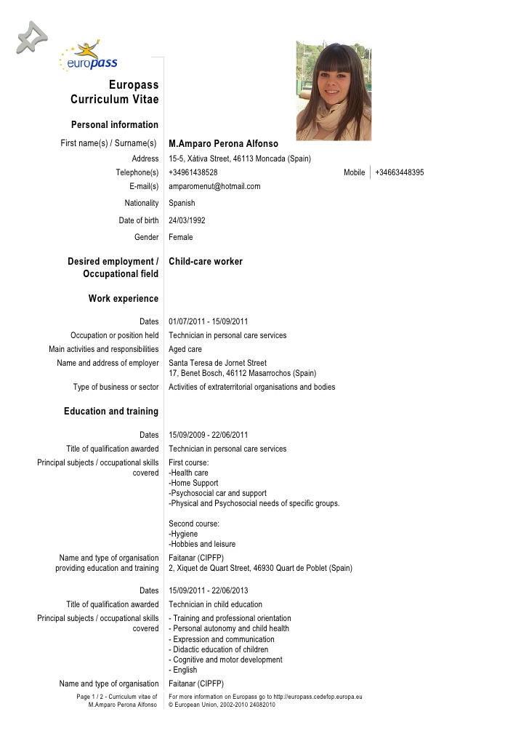
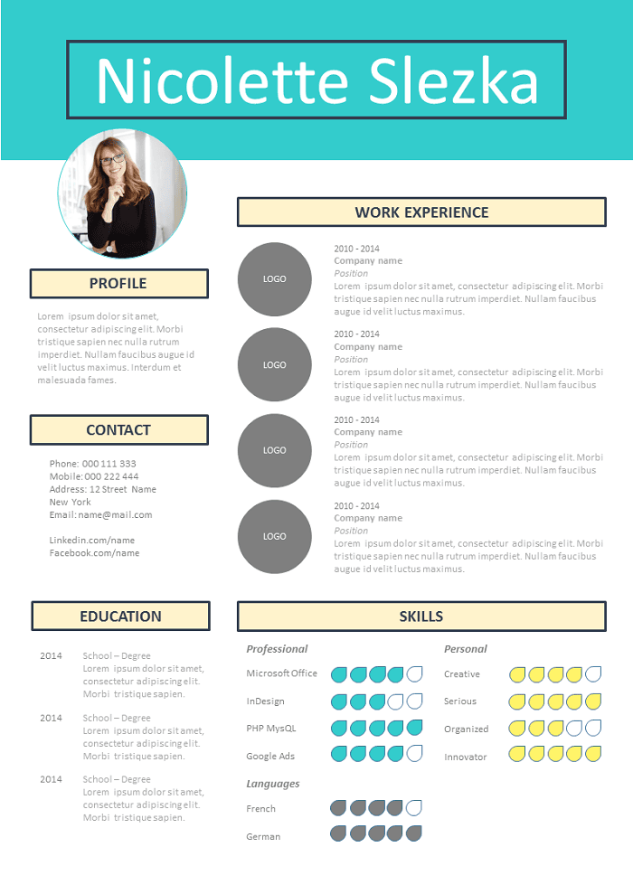
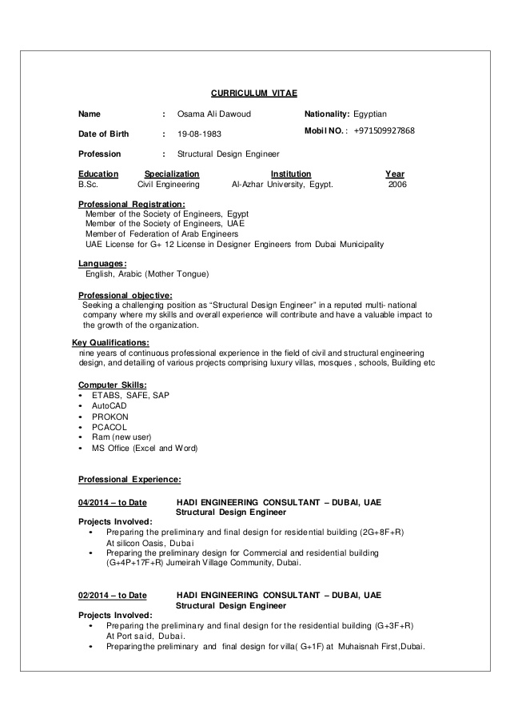
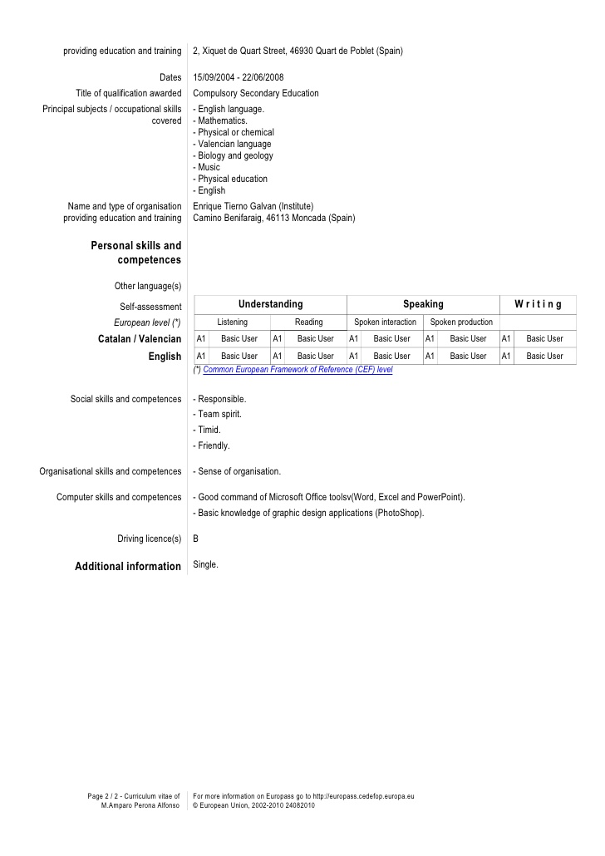
CV
From https://www.slideshare.net/osamaali48/osama-structure-eng-cv
From https://es.slideshare.net/1gsitamparoperona/europass-cv120530perona-alfonso-13135795?nomobile=true
From https://cv.guru/resume-template/resume-262-simple-structure/

Slide 3
FROZEN literally “frozen” in time and form
FORMAL impersonal, complete sentences, no slang, may use technical or academic vocabulary, used for scientific publishing
CONSULTATIVE used when consulting an expert such, formal register in conversation
CASUAL conversational tone, among and between friends; general words, rather than technical; may include slang and colloquialisms
INTIMATE private conversations, restricted to families, bedrooms etc.
Sarah Elaine Eaton: Language Register and Why It Matters (Or: Why You Can’t Write An Academic Paper in Gangsta Slang). Retreived from https://drsaraheaton.wordpress.com/2012/05/22/language-register-and-why-it-matters-or-why-you-cant-write-an-academic-paper-in-gangsta-slang/

Slide 4
register
Oh man, this sucks. I have this running nose and keep like sniffling and sneezing! I have this like allergy. And the doc is a real weirdo. He´s nuts! I Hate spring. It´s only March now! Weeks to go. Oh man...
❔
When daffodils begin to peer,
With heigh! the doxy, over the dale,
Why, then comes in the sweet o’ the year;
For the red blood reigns in the winter’s pale.
Hey Bunny, you are my little Easter baby...
Spring is beautiful, but it's also a key time of year for seasonal allergies. As plants release pollen, millions of people with hay fever start to sniffle and sneeze. There's no cure but you can take steps to curb springtime allergies, from medication to household habits.
The spring season associated with the vernal equinox, called astronomical spring, takes place around March 20 in the Northern Hemisphere, however meteorologists recognize March 1 as the first day of meteorological spring, which is based on annual temperature cycles and the Gregorian calendar. Leap years and the elliptical shape of that orbit around the sun affect when the astronomical seasons, or summer/winter solstices and vernal/autumnal equinoxes, occur.
❔

Slide 5
register
Oh man, this sucks. I have this running nose and keep like sniffling and sneezing! I have this like allergy. And the doc is a real weirdo. He´s nuts! I Hate spring. It´s only March now! Weeks to go. Oh man...
INTIMATE FROZEN CASUAL CONSULTATIVE FORMAL
When daffodils begin to peer,
With heigh! the doxy, over the dale,
Why, then comes in the sweet o’ the year;
For the red blood reigns in the winter’s pale.
Hey Bunny, you are my little Easter baby...
Spring is beautiful, but it's also a key time of year for seasonal allergies. As plants release pollen, millions of people with hay fever start to sniffle and sneeze. There's no cure but you can take steps to curb springtime allergies, from medication to household habits.
The spring season associated with the vernal equinox, called astronomical spring, takes place around March 20 in the Northern Hemisphere, however meteorologists recognize March 1 as the first day of meteorological spring, which is based on annual temperature cycles and the Gregorian calendar. Leap years and the elliptical shape of that orbit around the sun affect when the astronomical seasons, or summer/winter solstices and vernal/autumnal equinoxes, occur.
❔

Slide 6
FROZEN literally “frozen” in time and form
FORMAL impersonal, complete sentences, no slang, may use technical or academic vocabulary, used for scientific publishing
CONSULTATIVE used when consulting an expert such, formal register in conversation
CASUAL conversational tone, among and between friends; general words, rather than technical; may include slang and colloquialisms
INTIMATE private conversations, restricted to families, bedrooms etc.
Write two tweets in two different registers.
Sarah Elaine Eaton: Language Register and Why It Matters (Or: Why You Can’t Write An Academic Paper in Gangsta Slang). Retreived from https://drsaraheaton.wordpress.com/2012/05/22/language-register-and-why-it-matters-or-why-you-cant-write-an-academic-paper-in-gangsta-slang/

Slide 7
Select the best option and use it in the correct form:
assist • clarify • converse • extract • incline • sustain
1. The lecturer tried to explain her point more clearly by using another example more familiar to her students.
2. By the age of three, most children are able to talk with an adult in a limited fashion.
3. Because of unhappy childhood experiences, he is likely to believe that most people are basically very selfish.
4. During examinations, students are not allowed to talk to or to help other students in any way.
5. Students should not read every page of a book but instead identify and then take out only those ideas which are relevant.
6. Some students will stay up all night to finish their work, but it is impossible to keep this for very long and so it is not recommended.

Slide 8
Select the best option and use it in the correct form:
assist • clarify • converse • extract • incline • sustain
1. The lecturer tried to clarify her point by using another example more familiar to her students.
2. By the age of three, most children are able to converse with an adult in a limited fashion.
3. Because of unhappy childhood experiences, he is inclined to believe that most people are basically very selfish.
4. During examinations, students are not allowed to talk to or to assist other students in any way.
5. Students should not read every page of a book but instead identify and then extract only those ideas which are relevant.
6. Some students will stay up all night to finish their work, but it is impossible to sustain this for very long and so it is not recommended.

Slide 9
Clark Kent writing…

