Slide 1
paraphrasing
ISKM09 week 4 - 13th March 2020

Slide 2
paraphrasing - what and why
using use your own words to express something that was written or said by someone else
your own context and words make the message more relevant to your audience, give it a greater impact and possibly clarifies the message from your perspective
to support your argument with evidence of someone else
used in reports, presentations, reviews, speeches…
has to be referenced but not with quotation marks
paraphrased text should keep the length of the original text (approximately)
you can also pick a single point from a longer text
Adapted from mindtools.com

Slide 3
online tools
https://plagiarismdetector.net/
https://quillbot.com/
https://www.paraphrase-online.com/
These are some examples of tools that help you with paraphrasing or rather with checking plagiarism… Have a look how they work and how you could use them in writing.

Slide 4
paraphrasing on different levels
words (synonyms, antonyms…)
phrases (nouns into verbs, adjectives into nouns…)
structures (verb forms, nominalising…)
sentences (word order, information order…)

Slide 5
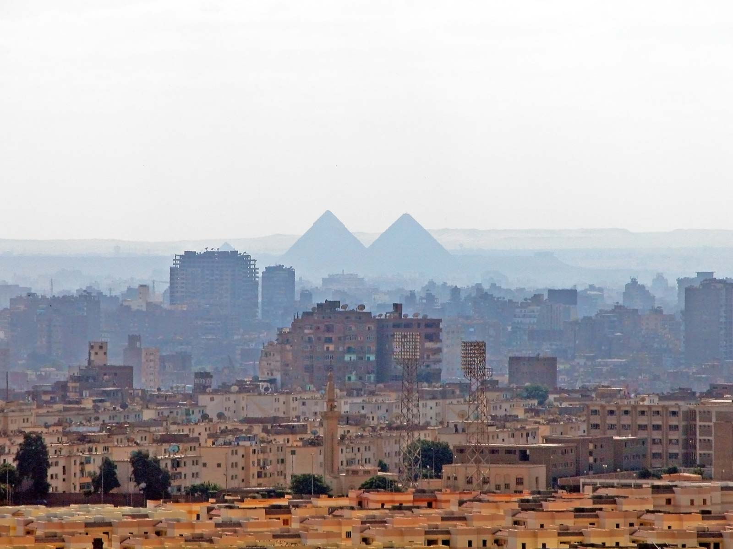
paraphrase this sentence (in a discussion forum too!)
Although Cairo has been the world's most heavily populated city for many years, the precise population was not known until four weeks ago.

Slide 6
paraphrazing
Read and understand the text.
Make a list of the main ideas.
Find the important ideas/words/phrases. In some way mark them – write them down, underline or highlight them.
Find alternative words/synonyms for these words/phrases - do not change specialised vocabulary or common words.
Change the structure of the text.
Identify the meaning relationships between the words/ideas - e.g. cause/effect, generalisation, contrast.
Express these relationships in a different way.
Change the grammar of the text: nouns to verbs, adjectives to adverbs, etc., break up long sentences, combine short sentences.
Rewrite the main ideas in complete sentences. Combine your notes into a piece of continuous writing.
Check your work.
Make sure the meaning and length are the same.
Make sure the style is your own.
Remember to acknowledge other people's work.

Slide 7
paraphrasing - examples
Look for a literature review in a topic you are interested in. Read the review and find one of the source texts the author of the review uses. Compare the original / source with the paraphrase...

Slide 8
paraphrazing - practice
A culture is the totally socially acquired life-way or life-style of a group of people. It consists of the patterned, repetitive ways of thinking, feeling and acting that are characteristic of the members of a particular society or segment of society.
Since differences in the anatomy and physiology of human males and females are so obvious it is easy to be misled into believing that sex-linked roles and statuses are primarily biological rather than cultural phenomena.

